Slide 1
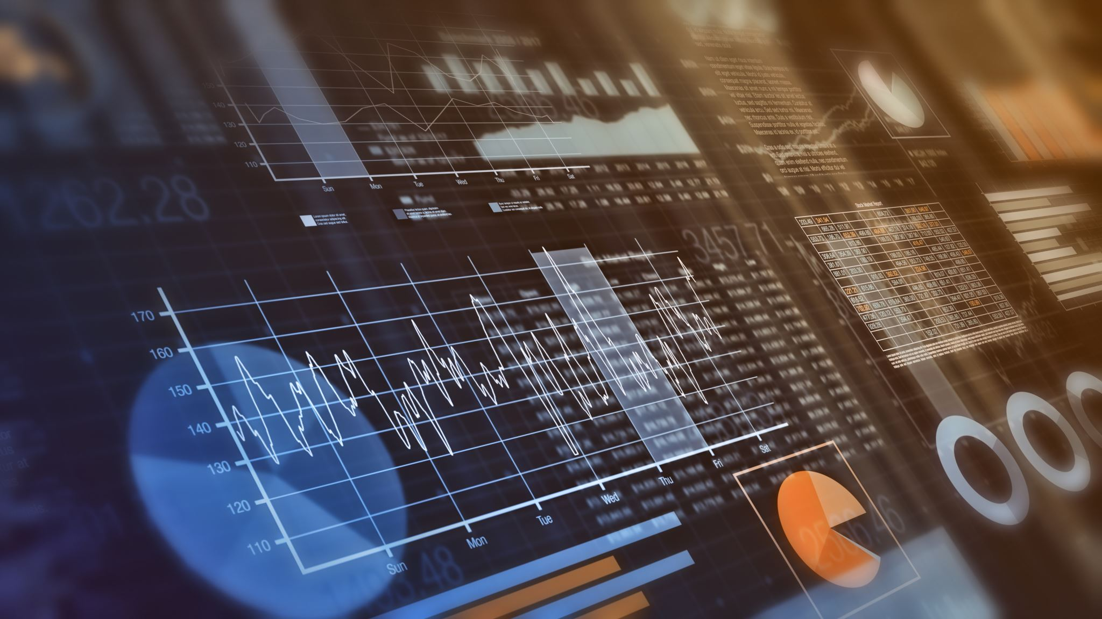
Real-Time Multi-Modal Monitoring System for Assisted Living
CS699B_FA25 – Article Presentation
- Pavan Kumar Pekala

Slide 2
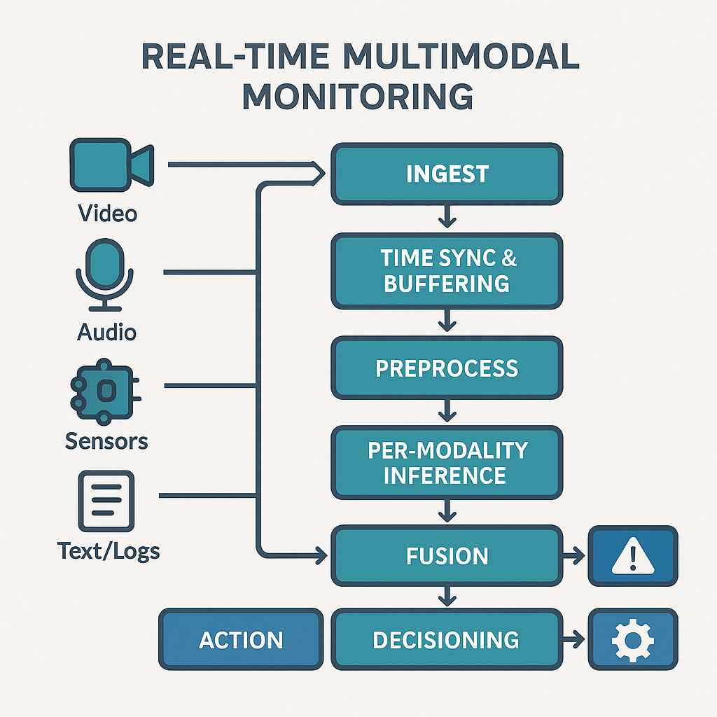
What is Real-Time Multi-Modal Monitoring System?
It is a method that helps in processing multiple types of data that helps in early detection of physiological disturbances.
The data can be analyzed or processed by using Unimodal models.
Late-fusion and Meta Learner can be used for multiple types of data.
Notes:
Key is to provide faster care and accurate results.
Inertial Measurement unit (IMU) is a device that measures body’s specific force and orientation in 3D space
Likewise, depth/millimeterWave(mmWave)/thermal, ambient IoT, audio, and vitals combining all of these makes a multi modal
The benefit of a multi modal is fewer false alarms than single sensor systems.
Unimodal and Late fusion can be sufficed for simpler tasks but early fusion shines in tasks requiring deep modality interactions such as emotion recognition.

Slide 3
Abstract
The main concerns of the assisted living are Falls, wandering, and undetected physiological deterioration.
We are proposing a RTMMS to give best results in high accuracy and precision to the sub-second detection.
The data can be collected from wearables, ambient IoT applications & depth/mmWave sensors.
The target is to protect the privacy of EHRs of patients.
Creating a dashboard to track the vitals, reviewing live making it interactive and actionable.
Notes:
The major problems in assisted living are falls, wandering and undetected physiological deterioration.
Developing a system to provide rapid detection that delivers clear and actionable alerts to medical staff
Sub Second detection - critical for real-time alerts
Feeding the data of Electronic Health Record (EHR) through Substitutable Medical Applications Reusable Technologies (SMART) on Fast Healthcare Interoperability Resources (FHIR) as a bridge to preserve the Protected Health Information (PHI) and ensures that no message is passed but it results in auditability and clinical handoff.

Slide 4
Motivation
The elderly in assisted homes continue to be victims of falls they can avoid, stumbling and fall hurts, coupled with unproven cases of poor health conditions.
The existing systems are fragile and very loud and so tend to make a multitude of alerts that individuals have long since learning to ignore and result in the fatigue of being alerted.
ML based solutions make it more accurate, reduces the cases of false alarms, and causes the caregivers to feel confident with the alerts that it indicates.
Notes:
Alarm fatigue is real sometimes the response time is slow and maybe short staff.
Fusion plus calibrations can raise precision without losing recall.
Using ML can provide better results and can reduce the cases of false alarms and improve the quality of life.

Slide 5
Problem Statement
My project is a design and evaluation of a privacy preserving real-time monitoring system.
I came to understand that seniors in the assisted care facilities are indeed at risk of falling, becoming disoriented, and experiencing health complications that cannot be noticed.
I am developing a multi-model machine learning system capable of identifying things regularly, responding swiftly and giving precise and actionable feedback to reduce false alarms.
Feeding the EHR through SMART ensures that no message is passed but the results are not disturbed.
Notes:
Detect high-risk events quickly with very low false alarms.
This is already an implemented model but privacy preserving fusion and bathroom safe privacy preserving fall systems are still being developed.

Slide 6
Relation to the Project
The proposed project will directly solve the given issue where wearable, environmental, and physiological signals will be installed and merged into one real-time stream per second.
It is not only about fall detection, but also includes wandering, distress communications, and abnormal vital condition, which seems more comprehensive and clinically applicable.
Notes:
The events to detect are falls, wandering and distress and abnormal vital condition.
The system builds a Unified pipeline that captures → fuse → score → alert → EHR.
Example: A fall is detected (video + accelerometer), scored at 0.97, alerted to staff, logged in EHR, and reviewed/labeled for accuracy, with all steps audited

Slide 7
Use Cases
Fall detection
Wandering
Distress call
Vitals anomaly detection
ADL monitoring (mobility, sleep, hygiene)
Environmental hazards
Alarm fatigue reduction
Device/Sensor health
Outcome tracking
Prolonged inactivity/unresponsive resident

Slide 8
Advantages & Disadvantages
Higher detection accuracy | System Complexity
Fewer false alarms | Data labeling scarcity
Privacy by design | Network reliability
Care quality metrics | Up-Front costs
Scalability | Alarm governance needed
End-to-End latency | User Adaption and Trust

Slide 9
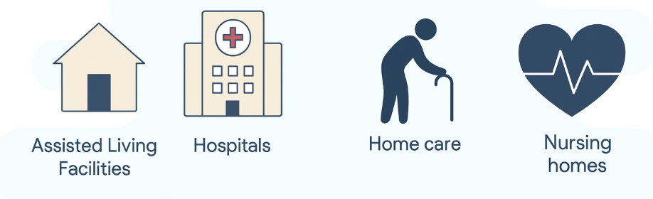
Where It Can Be Used ?

Slide 10
Technologies Used
ML/DL: PyTorch / TensorFlow (IMU CNN, MobileNetV3, fusion MLP)
Serving: NVIDIA Triton (GPU) or ONNX Runtime/TFLite (edge)
Streaming: Redpanda/Kafka topics (inference.events, alerts.raised)
APIs/UI: FastAPI (REST + SSE), React/Next.js (dashboard)
VS Code
EHR: SMART on FHIR bridge (Observations, Detected Issues)

Slide 11
Difference from References
The UP-Fall is all about falls , we are also considering the wandering and staying active and some vitals booster.
The Wandering CNN object tries to predict directions and integrate multiple modalities thereof in the aim of making it robust.
We integrate vitals anomaly scores into a fusion pipeline.

Slide 12
Possible Improvements
We ought to increase the number of datasets through performing multi-population checks.
Federated learning can be applied to personalize and maintain privacy.
Standardize clinician dashboards which have explainability capabilities.
Extend multimodal inputs (radar + ambient + wearables).
Predictive analytics are used to make proactive interventions.
Notes:
Using Federated learning can improve the detection or improve treatment plans without sharing the patient's health records.
Predictive analysis uses statistical models and ML Algorithms to enhance the actions before they occur.

Slide 13
Why does it matter to older adults?
Rapid fall detection lessens the severity and the complications of injuries.
It is immensely beneficial because wandering alerts avoid the opportunity of people to abandon hazardous areas and run off.
The identification of hazards in sensitive rooms like bathrooms and kitchen.
Vital anomalies can also be monitored, and we can get interventions by detecting the problems at the initial stage and this is life-saving.
Reduction in alarm burden enhances the attention of caregivers and dignity of residents.
Peace of mind for families and administrators.
Notes:
Faster response → fewer complications after falls.
Prevents unsafe elopement with discrete alerts.
Reduces caregiver alarm fatigue families gain peace of mind.

Slide 14
Implementation
Preprocessing the data for feature extraction.
Training the Multiple data with different Machine Learning models.
Pushing the data to perform late fusion to make the decisions.
Integrating with EHR by providing the bridge for SMART through FHIR.
Creating UI/UX design or a dashboard to provide better insights to the care givers.

Slide 15
Results and Challenges
Up-Fall: Random forest outperformed every other ML Algorithm
Wandering CNN: High precision scores but low on recall.
Class Imbalance, Domain Shift, Network drops and Privacy compliance are the main challenges.
The goal is to improve the privacy first multimodal fusion with late to early fusion to provide better results.
Calibrating with >0.85 of AUPRC and false alarms <0.20 per resident day can provide better results for the deployed system.
Notes:
Area under the Precision recall curve.
The targets for our system is AUPRC > 0.85 and false alarms < 0.20 per resident. Tuning the system to to achieve these targets can help in enhancing the systems performance.
Across many studies wearables needs to be tested more rigorously to see better results and reduce the false alarms.

Slide 16
Conclusion
This project entails the development of a multi-modal and the ML-based and real-time monitoring system, which is superior to the one used in fall detection technology at present.
We are incorporating wearables, environment sensors, glove cameras that are privacy friendly and vital signs tracking to provide all-day care to seniors.
With sensor fusion, edge computing and the connection to electronic health records, quicker response, fewer false alerts, and improved overall experience of care in assisted living and hospitals are realized.
Notes:
RTMMS provides privacy-first, real-time safety with measurable SLAs. (Service level Agreements)
Fusion + calibration reduce alarm burden while preserving recall.
EHR integration enables auditability and clinical handoff.
By maintaining the PHI as a bridge to protect the EHR can guarantee the privacy.

Slide 17
References
UP-Fall Detection Dataset: A Multimodal Approach by Lourdes Martínez-Villasenor, Hiram Ponce, Jorge Brieva, Ernesto Moya-Albor, Jose Nunez-Martínez and Carlos Peñafort-Asturiano. https://www.mdpi.com/1424-8220/19/9/1988
Wandering Detection: CNN for Elderly Wandering Prediction in Indoor Scenarios by Rafael Oliveira, Rafael Feres, Fabio Barreto and Raphael Abreu. https://pmc.ncbi.nlm.nih.gov/articles/PMC9019803/#Sec12
Undetected physiological deterioration: The impact of wearable continuous vital sign monitoring on deterioration detection and clinical outcomes in hospitalized patients by Carlos Areia, Christopher Biggs, Mauro Santos, Neal Thurley, Stephen Gerry, Lionel Tarassenko, Peter Watkinson and Sarah Vollam. https://ccforum.biomedcentral.com/articles/10.1186/s13054-021-03766-4

