Slide 1
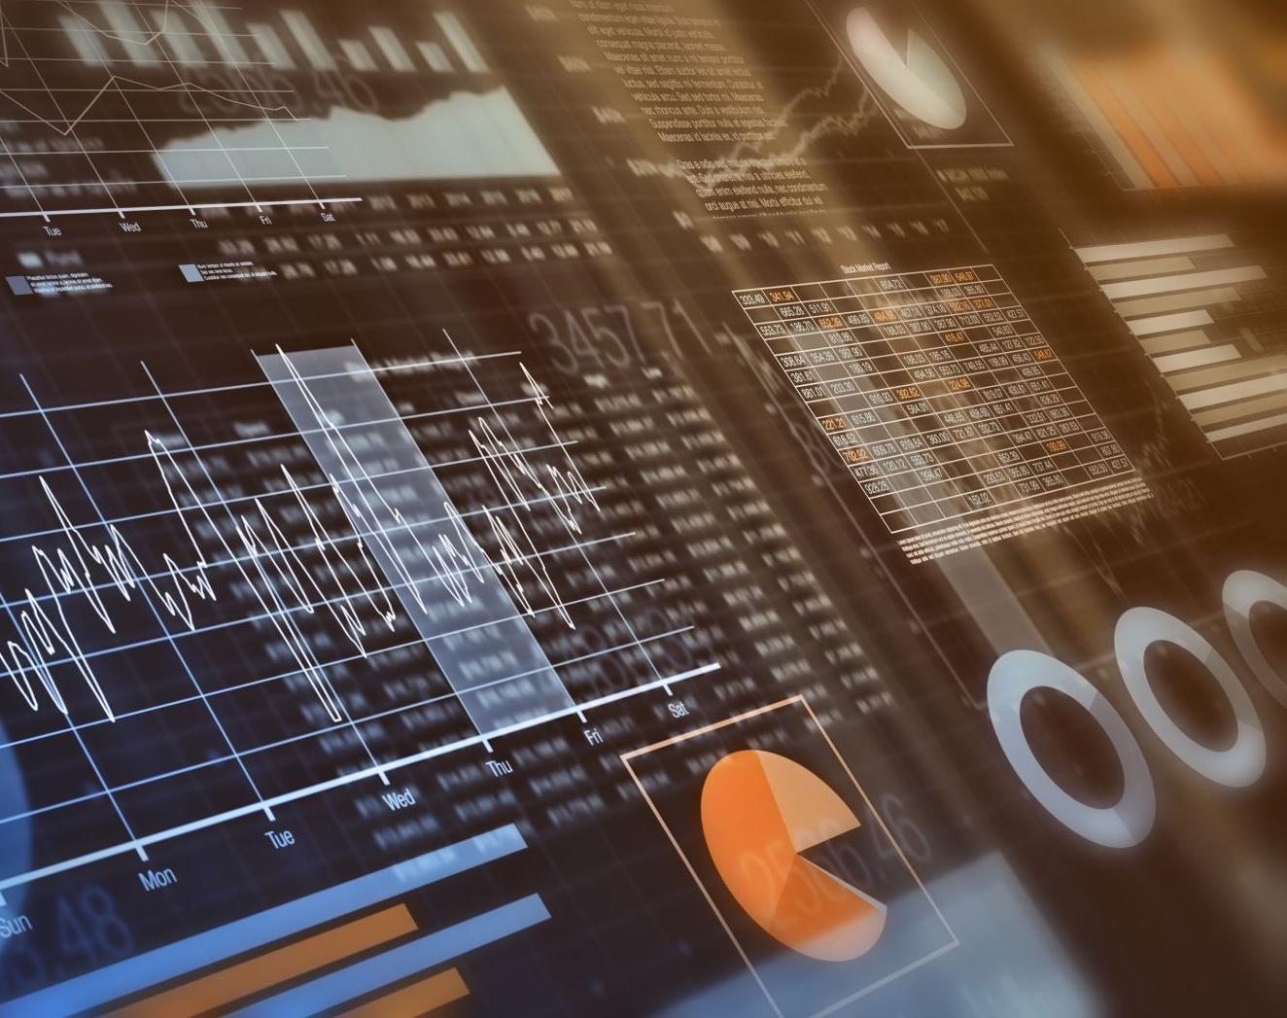
Real-Time Multi-Modal Monitoring System for Assisted Living
CS699B_FA25 Final Presentation
- Pavan Kumar Pekala

Slide 2
Abstract
Falls, Wandering & Deterioration
Main concerns in assisted living.
Real-Time Multi-Modal Monitoring System for sub-second detection.
Sensor Integration
Data from wearables, ambient IoT, depth/mmWave sensors.
Privacy Protection
Ensuring secure handling of patient EHRs.
Interactive Dashboard
Tracks vitals, reviews live data, and enables quick action.

Slide 3
Problem Statement
Project Focus
Design and evaluation of a privacy-preserving real-time monitoring system.
Problem Context
Seniors in assisted care are prone to falls, confusion, and unnoticed health issues.
System Capability
Multi-modal ML system for continuous detection and rapid, precise responses.
False Alarm Reduction
Delivers accurate, actionable insights to minimize false triggers.
Secure EHR Integration
Uses SMART to preserve EHR privacy while ensuring reliable outcomes.

Slide 4
Motivation
The elderly in assisted homes continue to be victims of falls they can avoid, stumbling and fall hurts, coupled with unproven cases of poor health conditions.
The existing systems are fragile and very loud and so tend to make a multitude of alerts that individuals have long since learning to ignore and result in the fatigue of being alerted.
ML based solutions make it more accurate, reduces the cases of false alarms, and causes the caregivers to feel confident with the alerts that it indicates.
Notes:
Alarm fatigue is real sometimes the response time is slow and maybe short staff.
Fusion plus calibrations can raise precision without losing recall.
Using ML can provide better results and can reduce the cases of false alarms and improve the quality of life.

Slide 5
Use Cases
Fall detection
Wandering
Distress call
Vitals anomaly detection
ADL monitoring (mobility, sleep, hygiene)
Environmental hazards
Alarm fatigue reduction
Device/Sensor health
Outcome tracking
Prolonged inactivity/unresponsive resident

Slide 6
Technologies Used
ML/DL, Numpy/Pandas,
Serving: NVIDIA Triton (GPU) or ONNX Runtime/TFLite (edge)
Streaming: Streamlit & GitHub
APIs/UI: FastAPI (REST + SSE), React/Next.js (dashboard)
EHR: SMART on FHIR bridge (Observations, Detected Issues)
Virtual Studio Code

Slide 7
Actor | Role
System Administrator | Manages overall system configuration, user accounts, and ensures data privacy and security.
Care Team (Doctors/Nurses) | Monitors patient vitals, receives alerts (e.g., fall detection, abnormal vitals), and acknowledges or responds to incidents.
Patient | Wears sensor devices (IMU, SpO₂, heart rate monitor), views their vitals on the dashboard, and can request help using the “I Need Help” button.
Edge Device / Gateway | Collects multi-modal data from sensors, preprocesses it locally, and sends it securely to the cloud for analysis.
Machine Learning Engine | Processes incoming sensor data, performs fusion analysis, detects abnormal events, and triggers alerts based on model inference.
Database Server | Stores historical alerts, vitals, and incident logs for reporting and further analysis.
EHR / Hospital System | Receives anonymized health data and alerts through the SMART on FHIR interface for medical record integration.
Functional specification

Slide 8
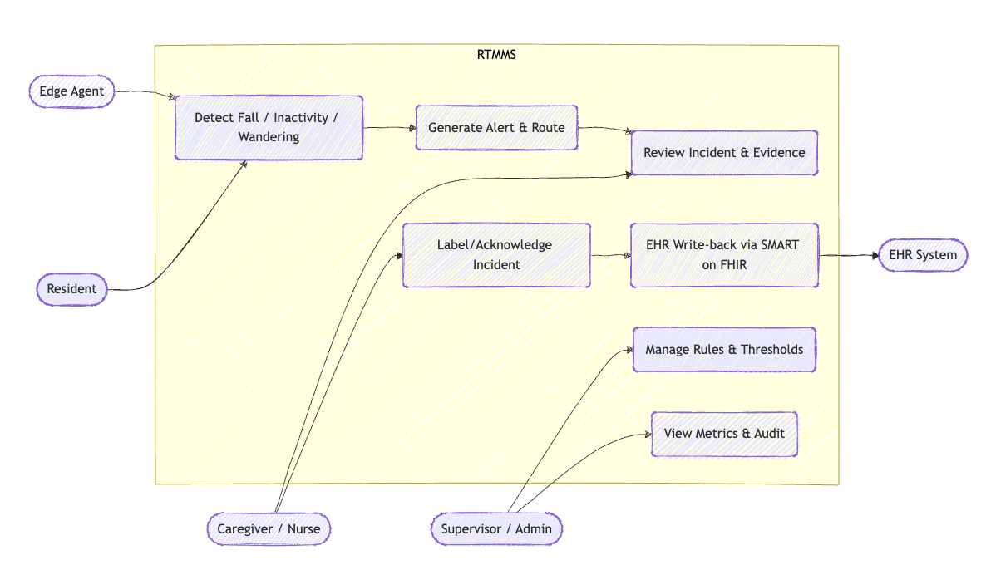
Use Case Diagram

Slide 9
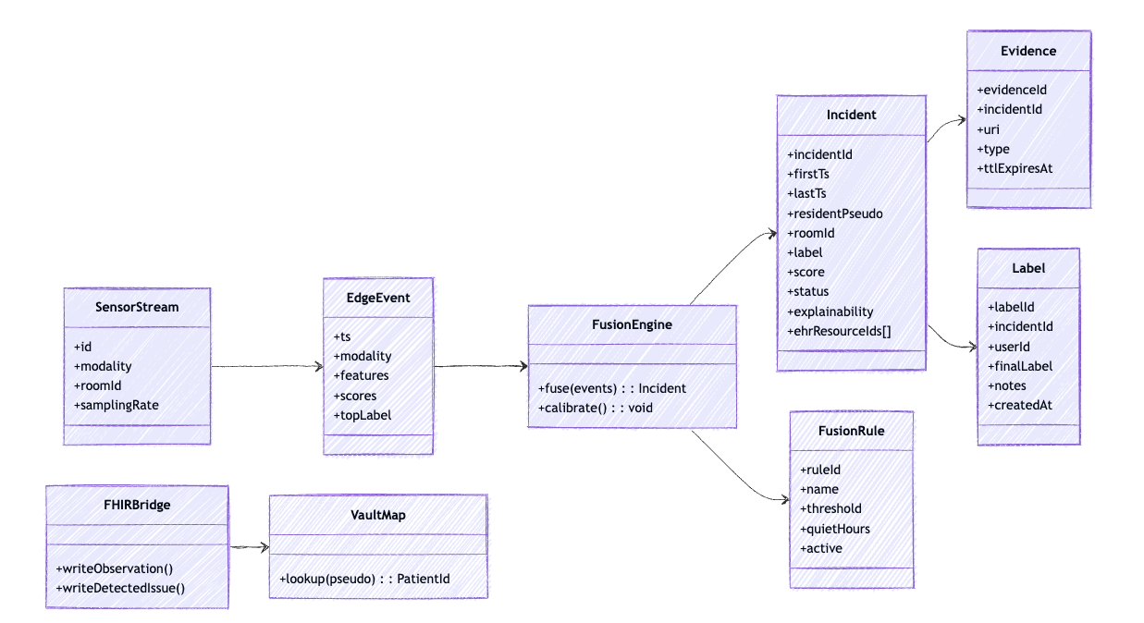
Class Diagram

Slide 10
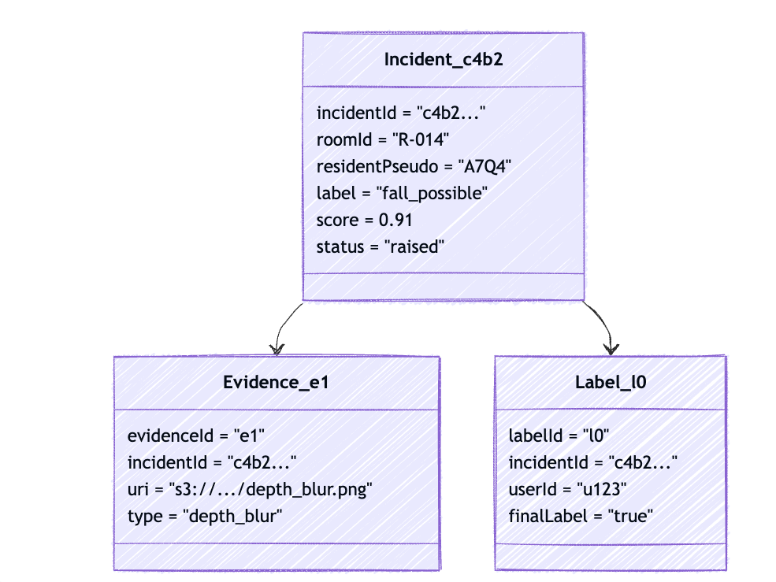
Object Diagram

Slide 11
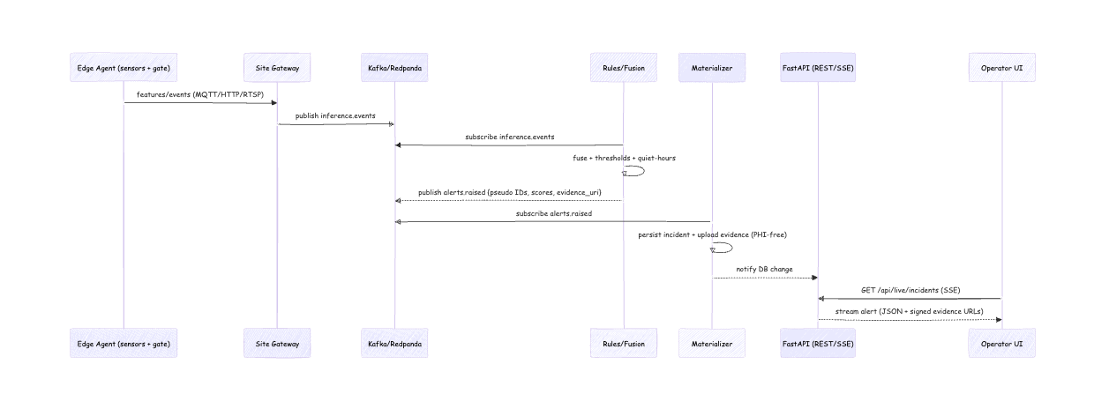
Sequence Diagram

Slide 12
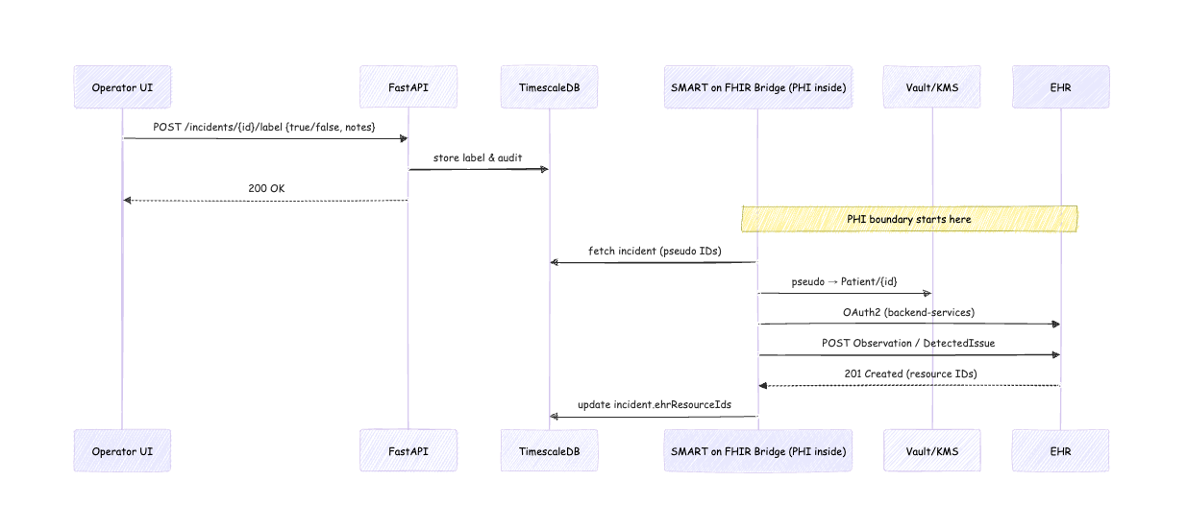
Sequence Diagram – Label & EHR Write Back

Slide 13
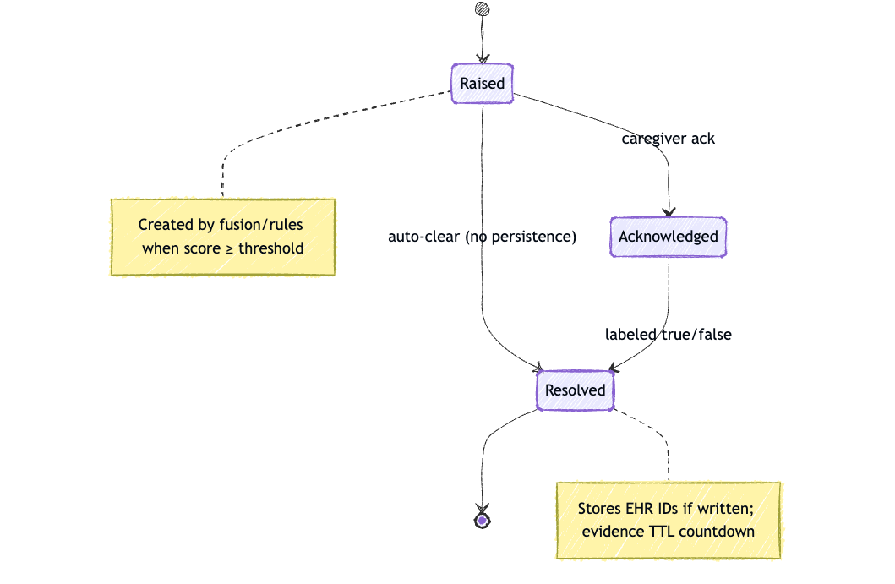
State Chart Diagram

Slide 14
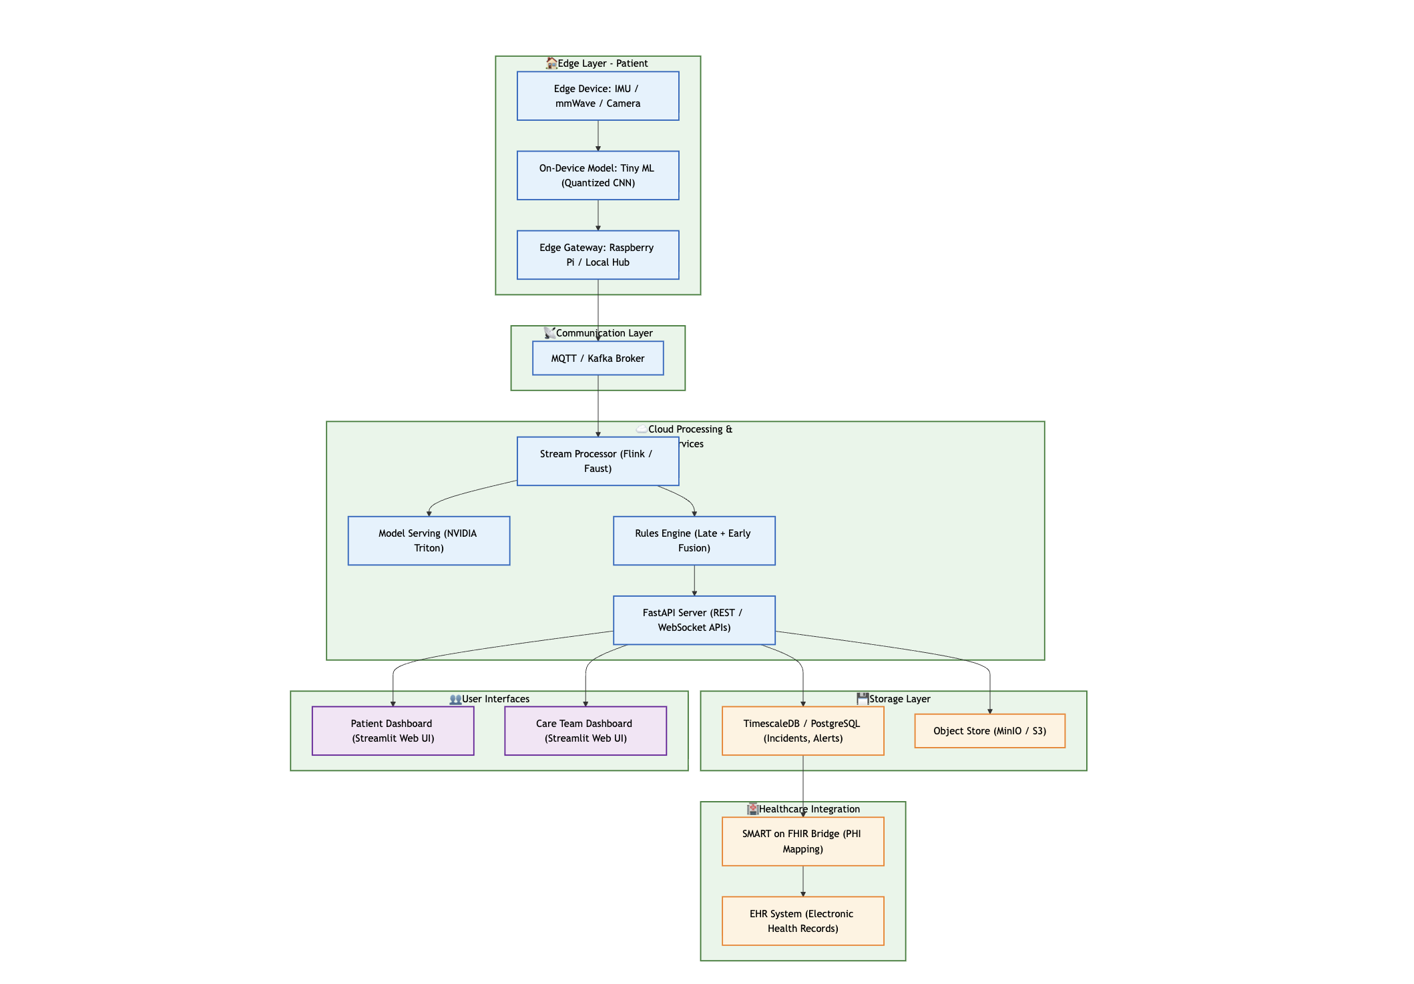
Deployment Diagram

Slide 15
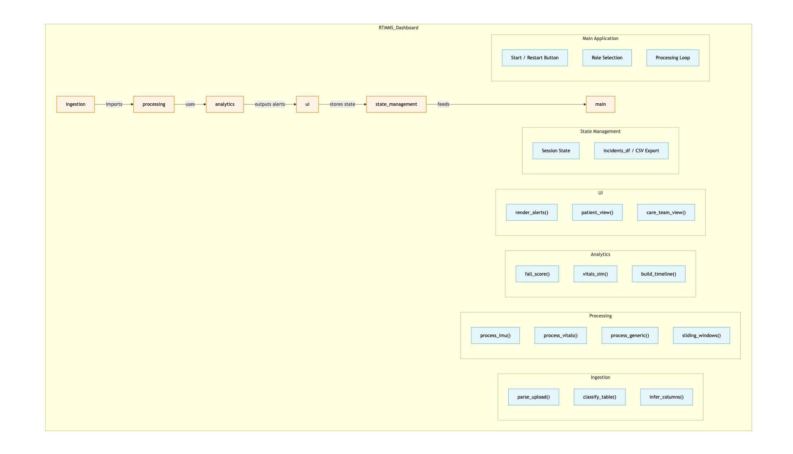
Package Diagram

Slide 16
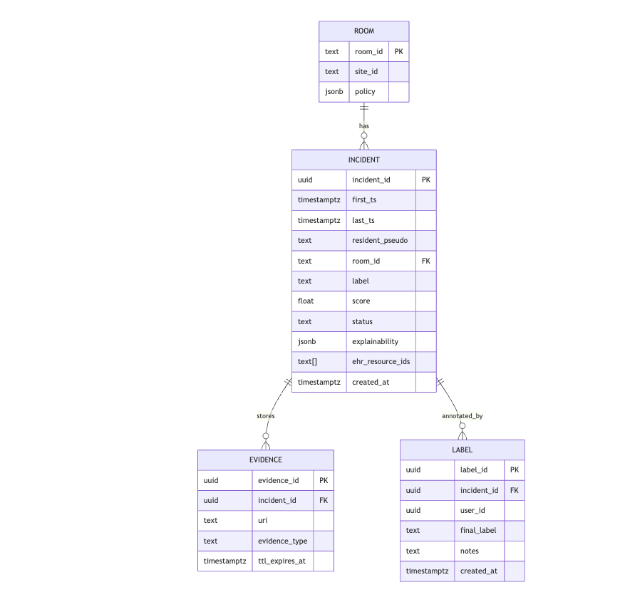
Entity Relationship diagram

Slide 17
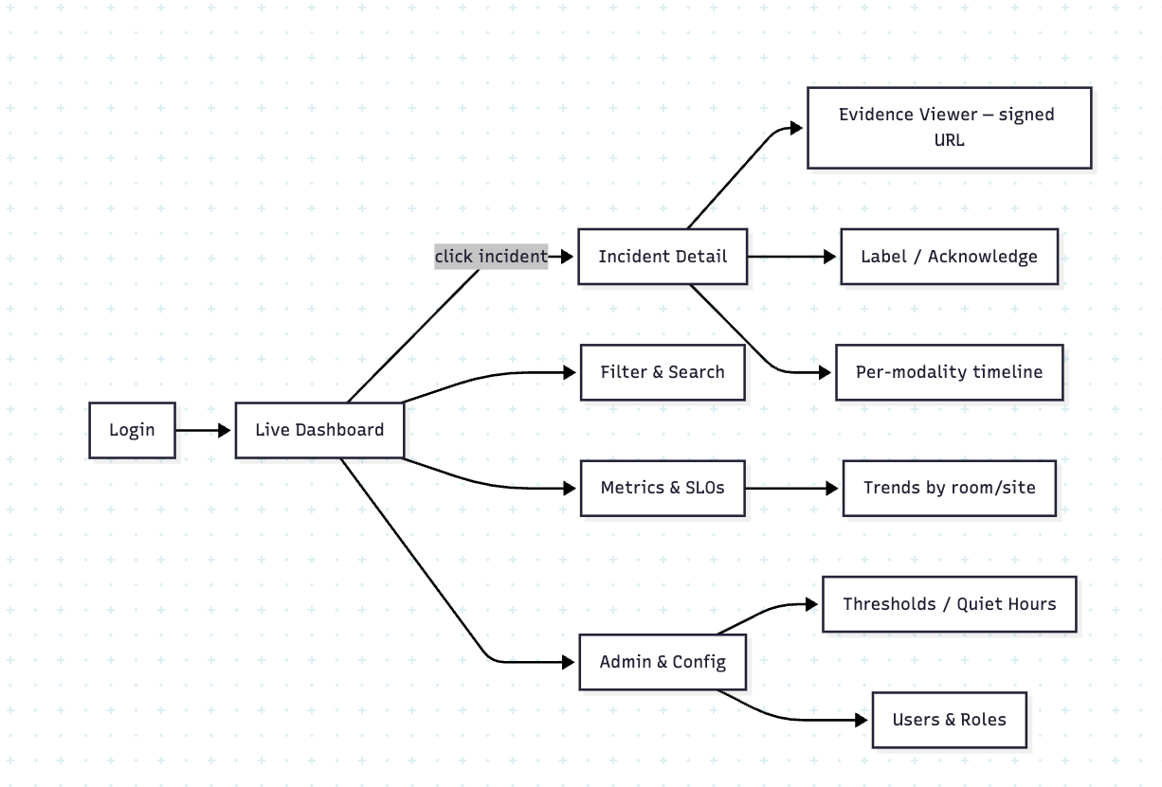
Navigation Diagram

Slide 18
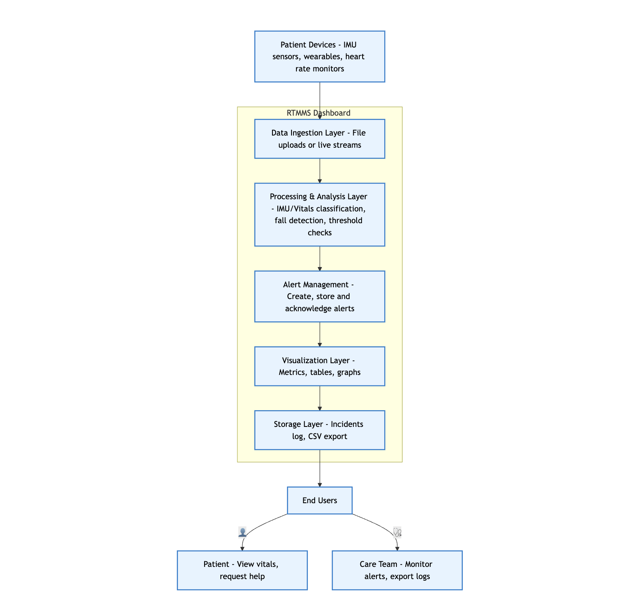
System Design Diagram

Slide 19
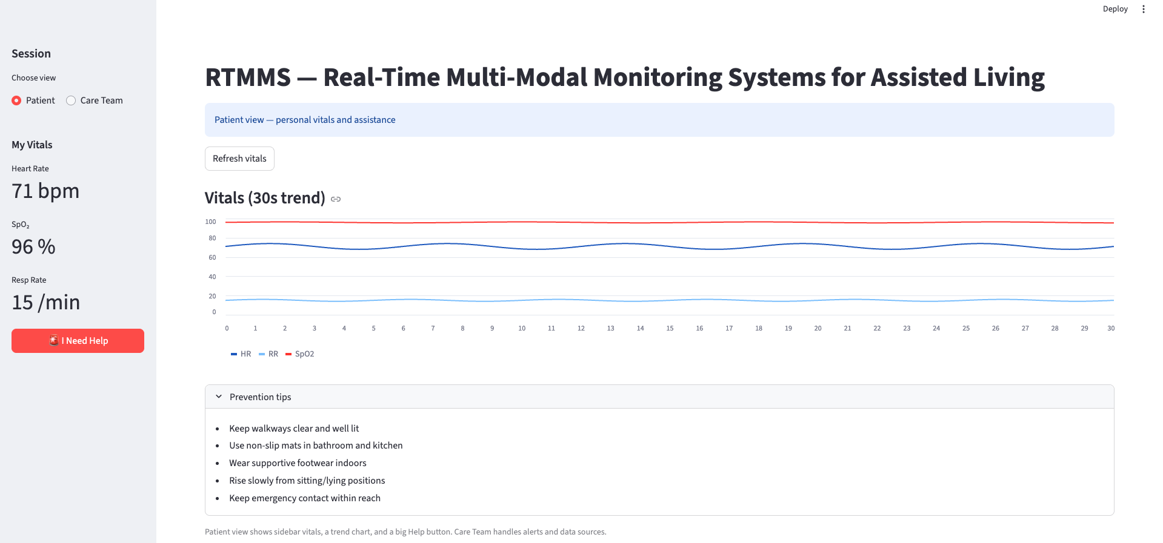
Patient side Dashboard

Slide 20
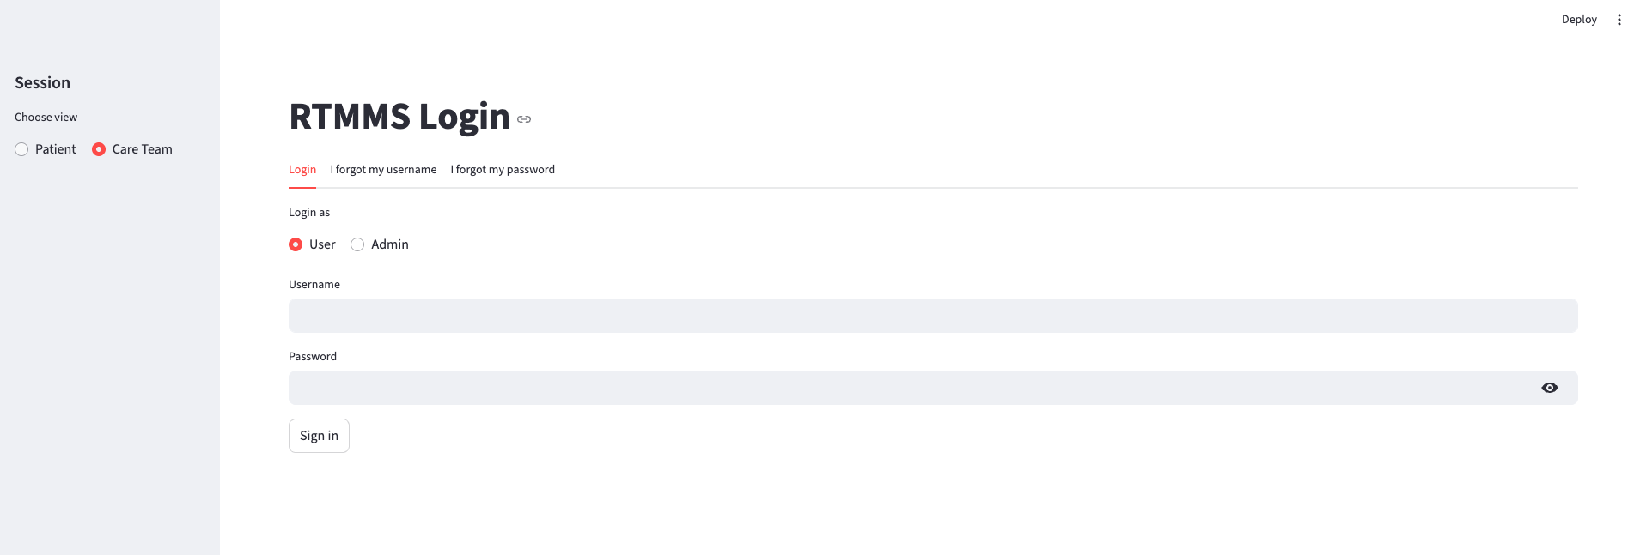
LOGIN PAGE

Slide 21
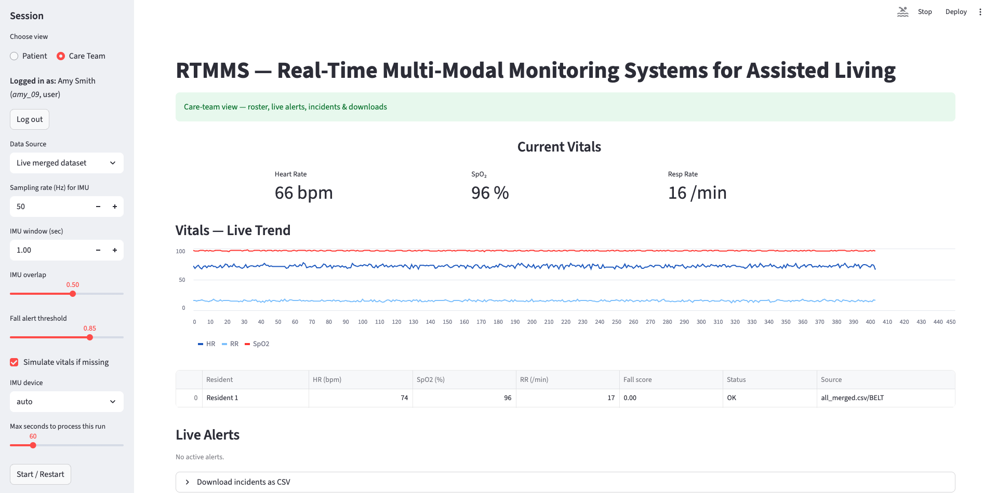
Care Team side Dashboard

Slide 22
Implementation
Streamlit Dashboard
Caretaker portal
Fast API summary endpoint
Modules for environment configuration and user login are enabled.

Slide 23
Possible Future Issues
Data Privacy & Security
Protecting EHRs, API vulnerabilities, and compliance with HIPAA/GDPR.
Sensor Reliability
Signal interference, calibration drift, and false alerts.
Model Bias & Generalization
Overfitting to specific environments and demographic bias.
System Integration
Challenges syncing SMART/FHIR with legacy EHR systems.
Real-Time Constraints
Maintaining sub-second detection under network latency.
User Adoption
Resistance from elderly users and need for intuitive interfaces.
Scalability & Maintenance
Growing data loads require retraining and system upkeep.

Slide 24
FUTURE WORK & IMPROVEMENTS
Improve fusion strategies to further reduce false alarms.
Clear explainability on clinical dashboards.
Improve the design and features on the Webpage/Dashboard
Focus on richer data integration, evaluation and deployment for real world.
Develop metrics and evaluation models in line with care of SLO’s (Service level objective).

Slide 25
Conclusion
This project entails the development of a multi-modal and the ML-based and real-time monitoring system, which is superior to the one used in fall detection technology at present.
We are incorporating wearables, environment sensors, glove cameras that are privacy friendly and vital signs tracking to provide all-day care to seniors.
With sensor fusion, edge computing and the connection to electronic health records, quicker response, fewer false alerts, and improved overall experience of care in assisted living and hospitals are realized.
Notes:
RTMMS provides privacy-first, real-time safety with measurable SLAs. (Service level Agreements)
Fusion + calibration reduce alarm burden while preserving recall.
EHR integration enables auditability and clinical handoff.
By maintaining the PHI as a bridge to protect the EHR can guarantee the privacy.

Slide 26
References
UP-Fall Detection Dataset: A Multimodal Approach by Lourdes Martínez-Villasenor, Hiram Ponce, Jorge Brieva, Ernesto Moya-Albor, Jose Nunez-Martínez and Carlos Peñafort-Asturiano. https://www.mdpi.com/1424-8220/19/9/1988
Wandering Detection: CNN for Elderly Wandering Prediction in Indoor Scenarios by Rafael Oliveira, Rafael Feres, Fabio Barreto and Raphael Abreu. https://pmc.ncbi.nlm.nih.gov/articles/PMC9019803/#Sec12
Undetected physiological deterioration: The impact of wearable continuous vital sign monitoring on deterioration detection and clinical outcomes in hospitalized patients by Carlos Areia, Christopher Biggs, Mauro Santos, Neal Thurley, Stephen Gerry, Lionel Tarassenko, Peter Watkinson and Sarah Vollam. https://ccforum.biomedcentral.com/articles/10.1186/s13054-021-03766-4

Slide 27


