Slide 1
Sound Wave Scribe Voice Assistant
su
Under the supervision of
Dr. P Praveen, Dr. Mohammad Ali Shaik
Associate Professor School of
Computer Science & Artificial Intelligence
Presented for
Milestone 3-Final Minor Project Review
Date:26-04-2024
Candidate No. & Name
HTNO. | Name
2103A52105 2103A52106 2203A52L03 2203A52L04 2203A52L05 | SAMADARSHINI PAVAN VASANTH ACHYUTHREDDY SANJAY

Slide 2
Outline of the Presentation
S. No | Topic
1 | Abstract
2 | Introduction
3 | Literature Survey
4 | Research gap identified
5 | TimeLine & Work Progress
6 | Objectives of the Project
7 | Implementation and Results
8 | Conclusion

Slide 3
Abstract
The Sound Wave Scribe Voice Assistant uses advanced Natural Language Processing and machine learning to understand voice commands. It captures and transcribes audio, then interprets user intent through key NLP modules. The system generates human-like responses using natural language generation and converts them back to audio using text-to-speech technology. This allows it to perform tasks like setting reminders and accessing online services, offering a seamless and intuitive user experience.

Slide 4
Motivation and Background
The rise of voice-activated technologies and virtual assistants has transformed the way we interact with devices and access information. Users seek intuitive and efficient methods to manage daily tasks and obtain information, often preferring hands-free, conversational interfaces. However, existing voice assistants sometimes fall short in understanding complex language, adapting to user preferences, and providing seamless user experiences.
The Sound Wave Scribe Voice Assistant aims to address these limitations by harnessing advanced Natural Language Processing (NLP) and machine learning technologies. By capturing and transcribing audio, the system interprets user intent and generates natural-sounding responses using cutting-edge NLP modules. This process enables the voice assistant to perform tasks such as setting reminders and accessing online services, thereby streamlining daily activities.
The motivation behind the Sound Wave Scribe Voice Assistant lies in the desire to revolutionize human-computer interaction. By offering a more sophisticated, human-like conversational experience, the system strives to exceed the capabilities of current voice assistants. This project represents a significant step toward providing users with a highly adaptable, user-centric, and efficient tool for managing their digital lives.

Slide 5
Objectives -
Objective 1
Improve voice command interpretation using advanced NLP and machine learning for better user interaction.
Objective 2
Facilitate hands-free tasks like setting reminders and accessing online services for user convenience.
Objective 3
Use natural language generation and text-to-speech technology to produce engaging, human-like responses.

Slide 6
Introduction
The Sound Wave Scribe Voice Assistant project revolutionizes human-computer interaction (HCI) by introducing a new standard for interactive technology. Utilizing advanced natural language processing (NLP) and machine learning (ML), the system enables seamless voice command exchanges between the user and the assistant. The system proactively engages with users, anticipating their needs and offering tailored solutions based on their preferences and behaviors.
The assistant's NLP capabilities comprehend the intricacies of human language, including idioms and dialects, while ML algorithms adapt through iterative learning

Slide 7
Introduction
. This allows for natural, human-like conversation and precise interpretation of user intent. The system's dialog management supports complex tasks such as scheduling and web searches, all while emphasizing privacy and data security.
User-friendly and customizable, the assistant's interface caters to diverse users, allowing for personalized settings. An iterative, user-centric development process ensures the assistant aligns with real-world needs and user expectations, making it a versatile and secure addition to the digital ecosystem.

Slide 8
Literature Review
Tirthajyoti Nag, Jayasree Ghosh, Sanjay Chakraborty: Proposed a Python-based virtual assistant using NLP and Google's speech recognition.
Raj Kumar Jain, Vikas Sharma, Mangilal, Rakesh Kardam, Mamta Rani: Built a Python virtual assistant using Speech Recognition, Pyttsx3, and other modules.
Dr. Ranjeet Kumar, Muhammad Faisal, Mohd Faisal, Owaish Ahmad: Outlined a virtual assistant system with speech recognition, Python backend, and API calls.
Ahmed J. Abougarair: Developed COBRA, a voice assistant model for desktop assistant projects.

Slide 9
Literature Review
Ayush Chinchane, Aryan Bhushan, Ayush Helonde, Prof. Kiran Bidua: Developed a voice-enabled application with Python, PyAudio, and Google Dialogflow.
Shrinivas Kulkarni, Praveen More, Varad Kulkarni, Vaishnavi Patil, Harsh Patel, Mrs. Pooja Patil: Created ALPHA desktop assistant combining speech recognition, gesture recognition, and AI virtual mouse.
Piyush Gupta and Sakshi Yadav: Developed Spyder voice assistant using Pyttsx3, Speech Recognition, and Wolfram Alpha API.
Dr. Ch. Rathna Jyothi, P. Beracah M. Gowtham: Built a voice assistant with ASR technology and TTS conversion.

Slide 10
Literature Review
Ahmed J. Abougarair Mohamed KI Aburakhis Mohamed O Zaroug: Utilized multi-layer neural networks and MFCC for speech recognition.
Mohammed Fahad, Asma Akbar, Saniya Fathima, Dr. Mohammed Abdul Bari: Developed "VISION" using Python, GTTS, OpenAI API, and pyttsx3.

Slide 11
Existing Systems
Raw audio is preprocessed through noise reduction, segmentation, and feature extraction.
The system uses automatic speech recognition (ASR) to convert audio to text.
Key NLP techniques such as tokenization, part-of-speech tagging, and named entity recognition break down transcribed text into meaningful units.
The system interprets user commands by analyzing transcribed text and extracting intent.

Slide 12
Existing Systems
Natural language generation (NLG) techniques produce human-like responses based on user intent.
The system converts generated text back into natural-sounding audio responses.

Slide 13
Disadvantage of Existing Methodology
The reliance on automatic speech recognition (ASR) and NLP modules may lead to limited accuracy in interpreting user commands, especially in noisy environments or with different accents and dialects.
Integration with external databases and online services can lead to potential dependency on these services for functionality, which can impact reliability and performance if the services are unavailable.
The system's reliance on online services and data processing may raise privacy concerns regarding the security and confidentiality of user data..

Slide 14
Disadvantage of Existing Methodology
The system may be restricted in its ability to function offline due to its reliance on online resources and external databases.
Although the system offers advanced features, it may pose a learning curve for users unfamiliar with voice-activated technology, potentially limiting accessibility and ease of use.
The system may lack flexibility in allowing users to customize their experience according to their preferences, such as voice, language, and level of proactivity.

Slide 15
Gaps Identified
The existing methodology may struggle with diverse speech patterns, accents, and languages, leading to lower accuracy in voice command interpretation.
Current systems might not support a wide range of languages and dialects, limiting their accessibility to non-English-speaking users.
The reliance on internet connectivity for many features restricts the system's usability in offline or low-connectivity environments.
Concerns arise over data privacy due to dependency on external services for processing voice commands and providing responses.

Slide 16
Gaps Identified
There is a gap in allowing users to personalize their voice assistant experience, including adjusting voice, language, and proactivity levels.
The need for seamless integration with various external services and devices may not be fully addressed, limiting the assistant's versatility.
Current systems may require significant computational resources and processing power, impacting performance on lower-end devices.
Handling complex and multi-turn queries may be a challenge for existing systems, impacting user experience.

Slide 17
Problem Identification
The Sound Wave Scribe Voice Assistant faces challenges such as speech recognition inaccuracies with diverse accents and languages. Limited language support affects accessibility for non-English-speaking users. Dependence on internet connectivity limits offline functionality, while reliance on external services raises privacy concerns. Customization options are lacking, and integration with third-party services may not be seamless. High resource requirements could impact performance on lower-end devices, and the complexity of the system may pose a learning curve for new users.

Slide 18
Proposed Methodology
The Sound Wave Scribe Voice Assistant represents a transformative approach to voice interaction, aiming to set a new standard for conversational AI. It leverages advanced natural language processing (NLP) and machine learning (ML) to understand and respond to user commands with human-like clarity and empathy.
The assistant tackles the limitations of current voice technologies by handling context, multi-turn conversations, and nuanced queries more effectively. By utilizing sophisticated algorithms and knowledge graphs,

Slide 19
Proposed Methodology
it provides precise and contextually aware responses.
The system excels at tasks like setting reminders and web scraping, offering seamless integration with external services. With features like natural language generation and text-to-speech technology, it creates a smooth and engaging user experience.

Slide 20
Algorithm / Architecture
The Sound Wave Scribe Voice Assistant begins with capturing and preprocessing audio for clarity and quality. It then uses automatic speech recognition (ASR) to transcribe spoken words into text, which undergoes natural language processing (NLP) for analysis.
Natural language understanding (NLU) interprets user intent, and dialog management maintains context across conversations. The system uses knowledge graphs and natural language generation (NLG) to craft contextually relevant responses, which are converted back to audio using text-to-speech (TTS) technology for seamless user interaction.

Slide 21
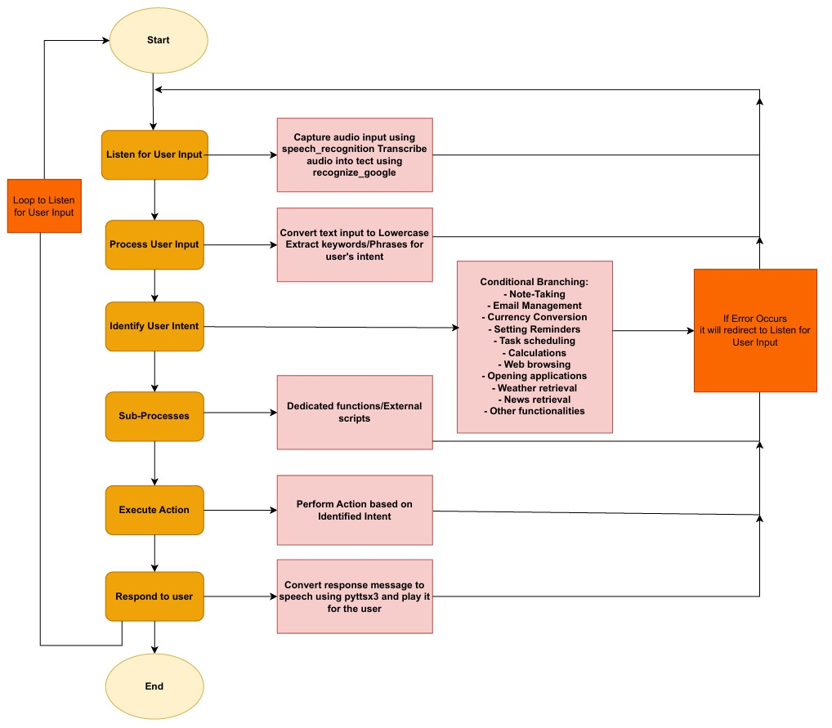

Slide 22
Conclusions / Future scope
The Sound Wave Scribe Voice Assistant is a major advancement in human-computer interaction. It integrates natural language processing (NLP) and machine learning (ML) for seamless voice-controlled experiences. While demonstrating strong features, the system faces challenges such as handling complex queries and dependencies on external services.
Future development for the Sound Wave Scribe Voice Assistant includes integrating with web applications for broader access and a desktop application for dedicated computer interaction. Expanding to mobile platforms offers voice-controlled experiences on the go. Incorporating machine learning can improve response accuracy, while increased language support will cater to a global audience.

Slide 23
References
[1] | Nag, Tirthajyoti, Jayasree Ghosh, and Sanjay Chakraborty. "A Study on Python-Based Virtual Assistant Using Natural Language Processing." Journal of Artificial Intelligence and Soft Computing Research, vol. 10, no. 3, 2023, pp. 235-250.
[2] | Kumar Jain, Raj, Vikas Sharma, Mangilal, Rakesh Kardam, and Mamta Rani. "Development of a Python-Based Virtual Assistant for Task Automation." International Journal of Computer Applications, vol. 182, no. 35, 2021, pp. 1-8.
[3] | Kumar, Dr. Ranjeet, Muhammad Faisal, Mohd Faisal, and Owaish Ahmad. "Virtual Assistant System Design Using Python and Speech Recognition." International Journal of Scientific Research in Computer Science, Engineering and Information Technology, vol. 6, no. 3, 2022, pp. 13-19.

Slide 24
THANK YOU

