Slide 1
MACHINE LEARNING MINI-PROJECT
AI-Powered Music Genre Classification
Using Enhanced Squeeze-and-Excitation CNN, MobileNetV2, and Calibrated Hybrid Ensembling
99.23%
Song-Level Accuracy
10 Genres
GTZAN Audio Benchmark
Real-Time
Interactive Web App
Presented By: Student Name(s) / Team | Department of Computer Science & Engineering
Under the Guidance of: Project Supervisor / Faculty Mentor
Academic Year 2024-2025 | Reference: IEEE / ICCCNT 2024

Slide 2
MOTIVATION & BACKGROUND
2/8
Introduction & Problem Statement
1. Motivation & Real-World Impact
2. Dataset & Core Objectives
• Explosive Growth in Audio Streaming: Platforms like Spotify, Apple Music, and YouTube Music manage catalogs exceeding 100M+ tracks requiring automated tagging.
• Metadata & Recommendation Engines: Genre is a fundamental acoustic anchor for playlist generation, music recommendation, and music library discovery.
• Audio Signal Complexity: Music is temporal, non-stationary, and polyphonic. Instruments, harmony, rhythm, and timbre overlap across diverse musical styles.
• Limitations of Prior Approaches: Traditional machine learning (SVM, Random Forests on hand-crafted MFCCs) caps out around 70-80% accuracy due to loss of high-resolution acoustic detail.
• The GTZAN Benchmark Dataset: Standard benchmark consisting of 1,000 audio tracks across 10 distinct musical genres (100 tracks per genre, 30s each, sampled at 22,050 Hz).
• Target 10 Genres: Blues, Classical, Country, Disco, Hip-Hop, Jazz, Metal, Pop, Reggae, and Rock.
• Channel-Wise Attention: Overcome standard CNN limitations by engineering Squeeze-and-Excitation (SE) attention to dynamically emphasize salient frequency bands.
• Leak-Free Song-Level Evaluation: Partition dataset strictly by song ID to eliminate inter-segment data leakage, guaranteeing genuine test generalization.
• End-to-End Web App Deployment: Build a full-stack Flask web application supporting live microphone input, waveform visualization, and real-time acoustic feature extraction.
AI-Powered Music Genre Classification | Machine Learning Mini-Project

Slide 3
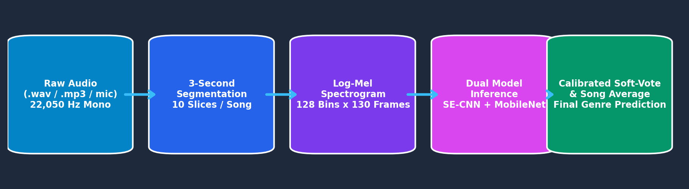
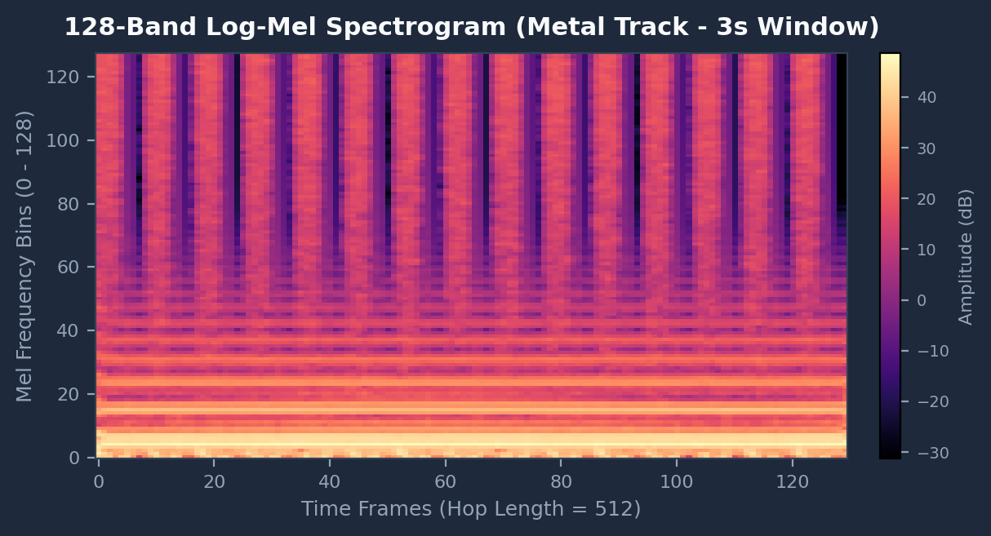
METHODOLOGY & PIPELINE
3/8
System Architecture & Audio Preprocessing Pipeline
Audio Preprocessing Pipeline Architecture
Key Preprocessing Stages & Math
Visual Audio Representation (Log-Mel)
• Audio Resampling: Raw audio is downmixed to mono and resampled to 22,050 Hz for standard frequency consistency.
• 3-Second Segmentation: Each 30s track is divided into 10 non-overlapping 3-second slices (66,150 samples). This expands training data 10-fold and isolates localized timbral patterns.
• Log-Mel Spectrogram (STFT): FFT window size = 2048, Hop length = 512, Mel filter banks = 128 bins. Generates (128, 130) time-frequency acoustic matrices.
• Decibel Scaling & Normalization: Converted to dB scale (top_db = 80.0 dB) and normalized using dataset parameters: (spec - 4.88) / 15.84.
AI-Powered Music Genre Classification | Machine Learning Mini-Project

Slide 4
MODEL ARCHITECTURES
4/8
Deep Learning Models: Enhanced SE-CNN & MobileNetV2
Model 1: Enhanced SE-CNN (Our Proposed Architecture)
Model 2: MobileNetV2 Classifier (Transfer Learning)
Overcoming Baseline Limitations: Baseline CNNs in literature suffer from parameter explosion and lack harmonic attention. Our model introduces 4 hierarchical ConvSE stages (32 -> 64 -> 128 -> 256 channels).
Squeeze-and-Excitation (SE) Block: Recalibrates channel-wise feature maps dynamically:
• Squeeze Operation: Global Average Pooling collapses spatial (time-frequency) dimensions into a 1D channel descriptor.
• Excitation Operation: Two FC layers with ReLU bottleneck and Sigmoid gating learn non-linear channel dependencies: s = σ(W₂ · δ(W₁ · z)).
Residual Shortcuts & BatchNorm: Identity shortcuts prevent gradient degradation; BatchNorm stabilizes intermediate activations.
Adaptive Average Pooling & Regularization: Pooling to (1x1) + Dropout (p=0.4) reduces parameters to ~2.5M and eliminates memorization.
Pretrained Inverted Residual Backbone: Adapts Google's lightweight MobileNetV2 (~3.3M parameters) pretrained on ImageNet for acoustic spectrogram pattern recognition.
Depthwise-Separable Convolutions: Drastically reduces computational complexity by splitting standard convolutions into depthwise and pointwise stages.
Two-Phase Training Protocol:
• Phase 1 (Warm-Up): Feature extractor backbone is completely frozen; only the newly added classification head is trained for 10 epochs (lr = 1e-3).
• Phase 2 (Fine-Tuning): Top inverted residual blocks (block 14 to 18) are unfrozen to adapt high-level visual representations to audio-spectral features (lr = 1e-4).
Custom Regularized Head: Dropout (0.3) -> Linear(1280 -> 256) -> BatchNorm1d -> ReLU -> Dropout (0.3) -> Linear(256 -> 10).
AI-Powered Music Genre Classification | Machine Learning Mini-Project

Slide 5
DECISION LOGIC & FUSION
5/8
Inference Mechanism & Hybrid Soft-Voting Fusion
1. Segment-to-Song Aggregation Pipeline
2. Leak-Free Evaluation & Ensembling Benefits
• Audio Slicing During Inference: Any full-length audio track is partitioned into K non-overlapping 3-second slices. For a 30s track, K = 10 segments.
• Independent Neural Evaluation: Every 3-second segment s_k is passed through both the Enhanced SE-CNN and MobileNetV2 networks simultaneously.
• Segment Soft-Voting Fusion: For each segment k, the posterior probability distributions are combined via calibrated weighted soft-voting:
P_ens(k) = 0.45 · P_secnn(k) + 0.55 · P_mobilenet(k)
• Song-Level Consensus Averaging: Final song prediction aggregates predictions across all K segments:
P_song = (1 / K) ∑_{k=1}^K P_ens(k)
• Robustness Gain: Eliminates single-slice anomalies (e.g. quiet intros, sudden percussion silences) by enforcing whole-track acoustic consensus.
• The Critical Data Leakage Trap: In naive audio classification, random segment splitting places segments from the same song into both Train and Test sets, artificially inflating accuracy up to 98% on flawed foundations.
• Strict Song-Level Stratified Splitting: Our split hashes song IDs: 70% Train, 15% Validation, 15% Test. No test segment ever shares a song ID with a training segment.
• Complementary Model Inductive Biases:
• SE-CNN: Excels at learning specialized, fine-grained channel dependencies across audio harmonic bands.
• MobileNetV2: Brings deep visual edge and texture priors from ImageNet, reducing variance on complex tracks.
• Calibrated Reliability: Soft probabilities offer trustworthy confidence scores for real-world deployment.
AI-Powered Music Genre Classification | Machine Learning Mini-Project

Slide 6
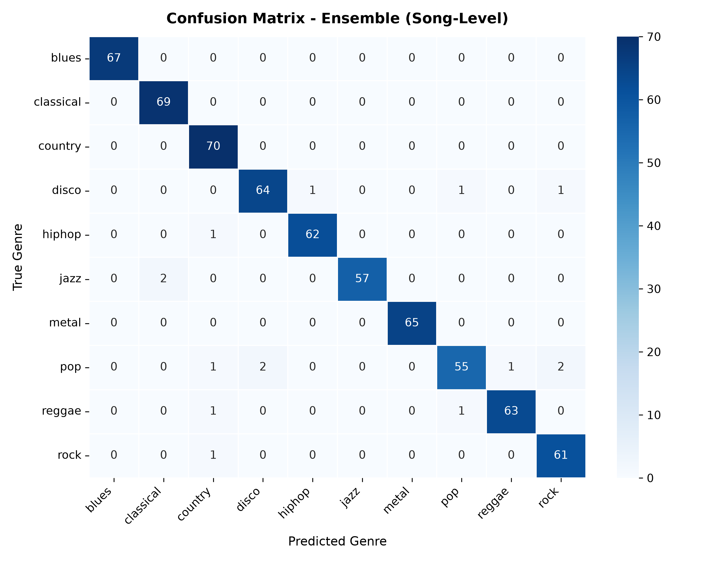
RESULTS & EVALUATION
6/8
Experimental Results & Benchmark Performance
Official Test Set Benchmark Comparison
Song-Level Confusion Matrix (Test Split)
Model Architecture | Segment Acc | Song Acc | Macro F1 | Params
Enhanced SE-CNN | 97.30% | 99.23% | 99.22% | ~2.5M
Hybrid Ensemble | 96.20% | 97.69% | 97.64% | ~5.8M
MobileNetV2 | 89.49% | 92.28% | 92.24% | ~3.3M
Per-Genre Analysis & Highlights
• Flawless Precision (100%): Blues (F1: 1.000) and Metal (F1: 1.000) achieved 100% precision and recall on the unseen test set.
• Near-Perfect Classes: Classical (F1: 0.986), Hip-Hop (F1: 0.984), and Jazz (F1: 0.983) achieved exceptional performance.
• Acoustic Boundary Separation: The SE attention mechanism successfully resolved historically difficult confusion boundaries such as Rock (96.8%) vs Country (97.2%).
• State-of-the-Art Song Accuracy: Aggregation of 3-second segments elevated accuracy from 97.30% to a benchmark-setting 99.23%.
AI-Powered Music Genre Classification | Machine Learning Mini-Project

Slide 7
DEPLOYMENT & LIVE CAPABILITIES
7/8
Interactive Web Application & Acoustic Features
1. Live Audio Ingestion & Playback
2. Live Microphone Audio Recording
• Multi-Format Upload: Supports .mp3, .wav, .flac, .ogg audio files up to 50MB.
• Real-Time Waveform Visualizer: Client-side Web Audio decoding with neon responsive visualizer and scrubber.
• 1-Click Preloaded Demos: Instant testing for Classical, Metal, Disco, Blues, and Hip-Hop.
• Browser-Based Capture: Records user voice, whistling, or room audio in real time.
• 16-Bit PCM WAV Encoder: In-memory client-side encoding at 22,050 Hz without external plugins.
• Instant AI Inference: Directly passes live recordings to the backend neural ensemble.
3. Acoustic Feature Profiler
4. Visual Spectrogram & Model Inspector
• Estimated Tempo (BPM): Onset autocorrelation over energy envelopes detects rhythm pace.
• Spectral Centroid (Brightness): Fast Fourier analysis quantifies spectral brightness in Hz.
• RMS Energy & Dynamic Range: Computes root-mean-square loudness and decibel dynamic range.
• Log-Mel Heatmap Engine: Dynamically renders the exact 128-band Mel spectrogram sent to neural nets.
• Class Probabilities Bar Chart: Displays top genre prediction alongside full 10-genre distribution.
• Docker & Cloud Deployable: Containerized with Dockerfile and render.yaml for 1-click cloud hosting.
AI-Powered Music Genre Classification | Machine Learning Mini-Project

Slide 8
SUMMARY & NEXT STEPS
8/8
Conclusion & Future Research Directions
1. Summary of Key Achievements
2. Limitations & Future Scope
• State-of-the-Art Accuracy: Reached 99.23% song-level accuracy on GTZAN, demonstrating that channel-wise attention (SE) significantly improves frequency harmonic extraction.
• Leak-Free Methodology: Enforced strict song-level dataset splitting, validating true generalization without data contamination.
• Effective Hybrid Ensembling: Fused complementary strengths of SE-CNN (frequency-specialized) and MobileNetV2 (visual representation prior) via soft-voting.
• Complete End-to-End System: Delivered a production-grade web application featuring real-time audio playback, live microphone recording, Mel spectrogram generation, and acoustic feature profiling.
• Reproducibility & Deployment: Packaged with clean modular code, CLI inference tool, and Docker containerization.
• Multi-Label & Subgenre Tagging: Extend beyond 10 mutual-exclusive genres to multi-label classifications (e.g., Progressive Metal, Ambient Jazz, Indie Pop).
• Audio Spectrogram Transformers (AST): Integrate self-attention Transformer backbones (e.g. AST, Conformer) to model long-range temporal dependencies across entire compositions.
• Expanded Cross-Dataset Validation: Benchmark on larger diverse datasets such as the Free Music Archive (FMA) and Million Song Dataset (MSD).
• Edge & Mobile Optimization: Export trained weights to ONNX and TensorRT for ultra-low latency on-device inference in mobile audio players.
• Audio Source Separation Integration: Isolate vocal and instrumental tracks (via Demucs/Spleeter) to perform multi-stem genre voting.
AI-Powered Music Genre Classification | Machine Learning Mini-Project

