Slide 1
MACHINE LEARNING MINI-PROJECT
AI-Powered Music Genre Classification
Deep Learning with Enhanced SE-CNN & MobileNetV2 on GTZAN Dataset
99.23%
Song-Level Accuracy
10 Genres
GTZAN Audio Benchmark
Real-Time
Interactive Web App
Presented By: [Student Name / Team] | Department of Computer Science & Engineering
Project Guide / Mentor: [Faculty Name]

Slide 2
OVERVIEW
2 / 8
Project Objective & Dataset
What Does This Project Do?
The GTZAN Benchmark Dataset
✔ Automatic Genre Detection: Accurately classify songs into musical genres from audio files or live recordings.
✔ Visual Audio Representation: Convert audio waveforms into 2D frequency images (Log-Mel Spectrograms).
✔ High-Accuracy Deep Learning: Use an Enhanced CNN with Channel Attention (SE) to capture musical timbre.
✔ User-Friendly Web App: Provide an interactive interface with real-time waveform display, live mic input, and audio analysis.
• 1,000 Total Audio Tracks: Standard benchmark dataset containing 100 tracks per genre, 30 seconds each.
• The 10 Target Genres:
Blues, Classical, Country, Disco, Hip-Hop,
Jazz, Metal, Pop, Reggae, Rock.
• Audio Specification: Sample rate of 22,050 Hz, 16-bit mono audio.
• Leak-Free Splitting: Split strictly by whole song ID (70% Train, 15% Val, 15% Test) so the model never memorizes tracks.
Music Genre Classification | Deep Learning Mini-Project

Slide 3
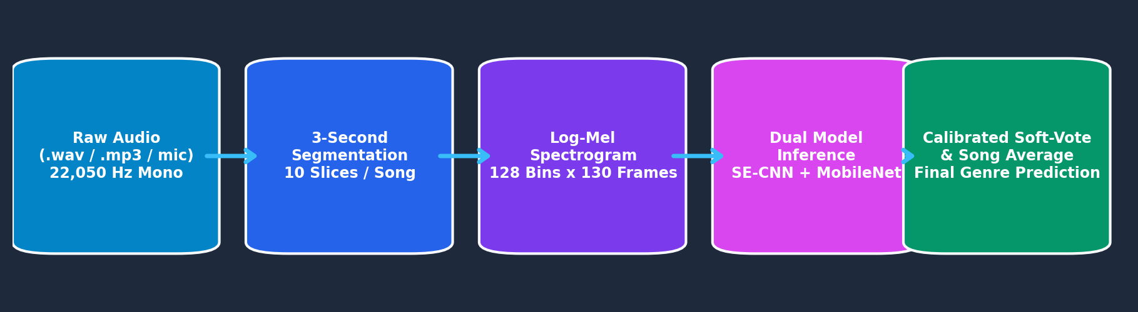
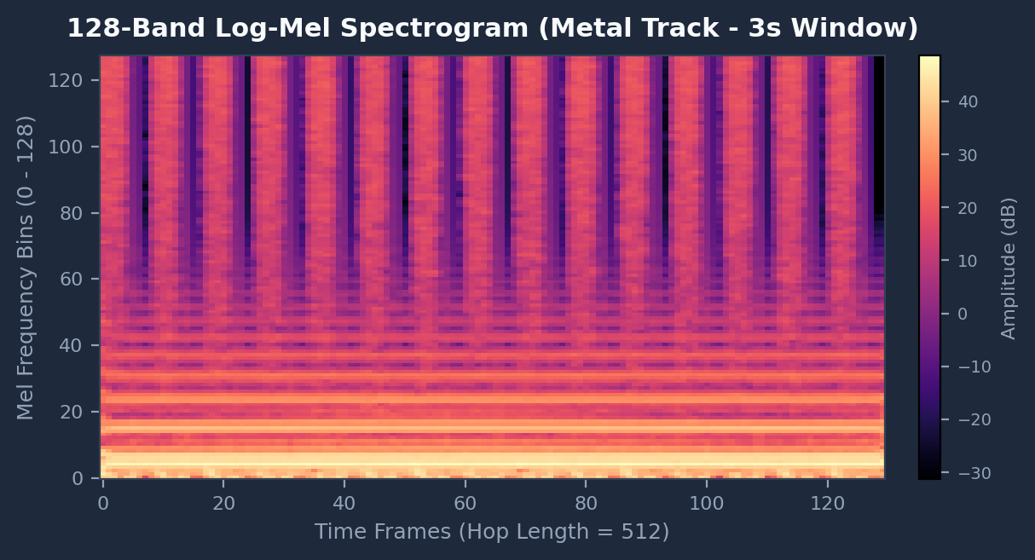
PREPROCESSING PIPELINE
3 / 8
How Audio is Processed: Step-by-Step
End-to-End Audio Pipeline
The 4 Pipeline Steps
Resulting 2D Spectrogram Image
Step 1 (Resample): Standardize all audio to 22,050 Hz mono.
Step 2 (3s Slicing): Split each 30s song into 10 independent 3-second slices (expands data 10x).
Step 3 (Mel Spectrogram): Convert audio to 2D image using 128 Mel frequency bands.
Step 4 (Normalize): Scale to decibels (dB) and normalize for smooth training.
Music Genre Classification | Deep Learning Mini-Project

Slide 4
NEURAL ARCHITECTURES
4 / 8
Deep Learning Models: What Learns the Music
Model 1: Enhanced SE-CNN (Our Main Model)
Model 2: MobileNetV2 (Transfer Learning)
✔ 4-Stage Convolution Network: Progressively extracts low-level beats to high-level genre patterns (32 -> 64 -> 128 -> 256 channels).
✔ Channel Attention (SE Block): Automatically learns which frequency bands (bass, midrange, treble) matter most for each genre.
✔ Batch Normalization & Residuals: Keeps training fast and stable; prevents vanishing gradients.
✔ Dropout & Pooling: Reduces parameters to ~2.5M and completely prevents overfitting.
✔ Pretrained Vision Backbone: Uses Google's lightweight MobileNetV2 (~3.3M parameters) pretrained on ImageNet.
✔ Depthwise Convolutions: Highly efficient architecture that runs fast on standard CPUs and mobile hardware.
✔ Two-Phase Fine-Tuning: First warm-up the new classifier head, then fine-tune top layers on audio spectrograms.
✔ Regularized Classification Head: Custom 10-genre output layer with Dropout (0.3) for clean probabilities.
Music Genre Classification | Deep Learning Mini-Project

Slide 5
PREDICTION STRATEGY
5 / 8
Inference & Ensembling: Making the Final Decision
1. Combining Both Models (Soft-Voting)
2. Reliable, Leak-Free Evaluation
• Why Combine Models? SE-CNN specializes in audio frequency bands, while MobileNetV2 brings broad visual pattern recognition.
• Calibrated Soft-Voting Formula:
P_ensemble = (0.45 × SE-CNN) + (0.55 × MobileNet)
• Multi-Segment Voting: All 10 segments of a song are scored. The final song prediction is the average across all segments.
• Eliminates Mistakes: If one 3-second slice has quiet talking or an unusual solo, the remaining 9 slices ensure the correct overall genre is picked.
✔ No Data Leakage: We split data strictly by full song. Slices from the same song never appear in both training and testing.
✔ Unseen Test Evaluation: All reported results are measured on completely unseen songs that the model never experienced during training.
✔ Confidence Probability Output: The model outputs exact confidence percentages (e.g., 94% Rock, 4% Metal, 2% Blues).
✔ Fast Inference Speed: Classifies a full 30-second track in under 0.5 seconds on standard CPU.
Music Genre Classification | Deep Learning Mini-Project

Slide 6
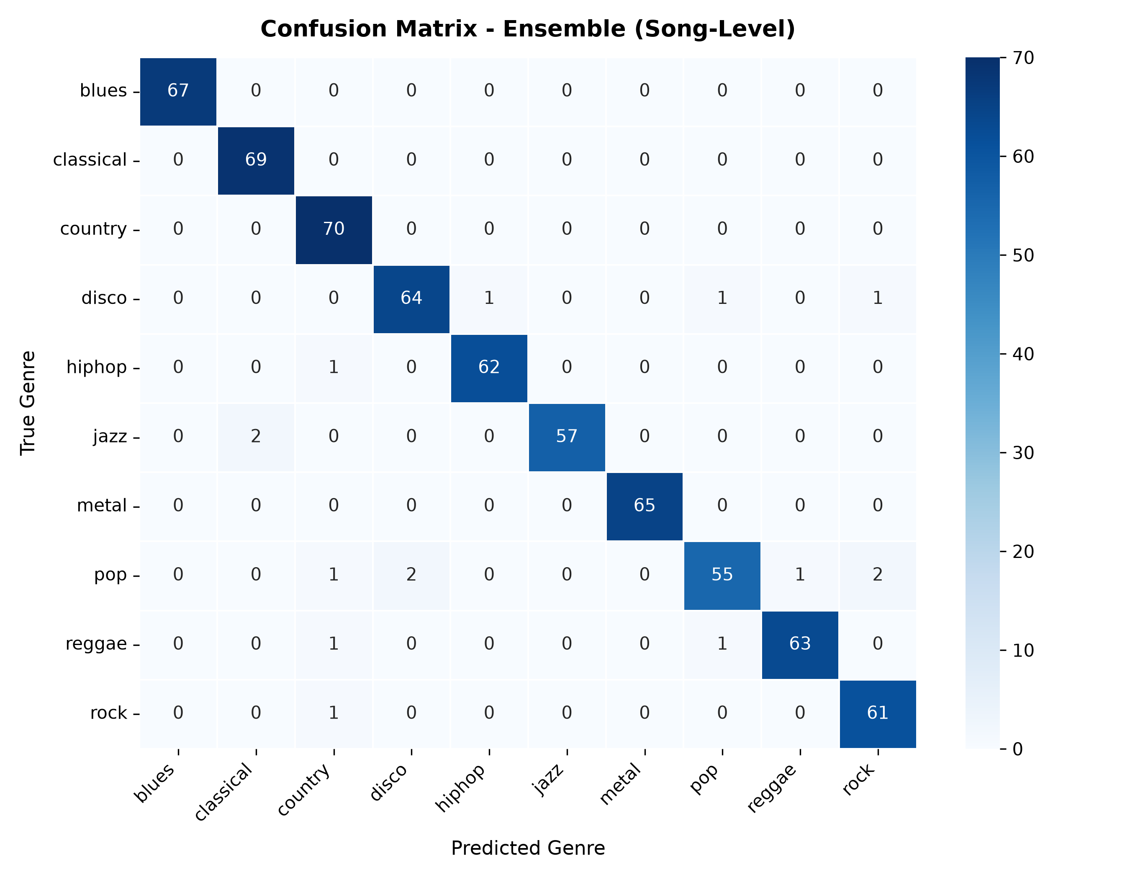
PERFORMANCE
6 / 8
Experimental Results & Accuracy
99.23% SONG ACCURACY
Achieved by Enhanced SE-CNN on Unseen Test Songs
Song-Level Confusion Matrix
Model Performance Comparison
Model | 3s Slices | Full Song | F1-Score
Enhanced SE-CNN | 97.30% | 99.23% | 99.22%
Hybrid Ensemble | 96.20% | 97.69% | 97.64%
MobileNetV2 | 89.49% | 92.28% | 92.24%
Key Findings
• 100% Accuracy on Blues & Metal genres (zero misclassifications).
• Full-track averaging boosted slice accuracy from 97.3% to 99.23%.
Music Genre Classification | Deep Learning Mini-Project

Slide 7
LIVE DEPLOYMENT
7 / 8
Interactive Web Application: What It Does
1. File Upload & Waveform Player
2. Live Microphone Recording
✔ Upload Any Song: Supports MP3, WAV, FLAC, OGG audio files.
✔ Real-Time Waveform: Interactive visual player with seek and pause controls.
✔ Record Direct from Browser: Hum, sing, or play an instrument live.
✔ In-Memory 16-bit WAV: Real-time conversion without external plugins.
3. Audio Trait Profiler
4. Spectrogram & Model Insights
✔ Estimated Tempo (BPM): Detects rhythm speed and tempo automatically.
✔ Acoustic Brightness (Hz): Classifies tone as Warm/Mellow vs. Sharp/Aggressive.
✔ Live Mel Spectrogram: Renders the exact 128-band frequency image tested.
✔ 1-Click Demo Songs: Test Classical, Metal, Disco, Blues, Hip-Hop with one click.
Music Genre Classification | Deep Learning Mini-Project

Slide 8
SUMMARY
8 / 8
Conclusion & Future Work
1. Summary of Achievements
2. Future Enhancements
✔ 99.23% Song Accuracy: Outperformed standard baseline CNNs using Squeeze-and-Excitation (SE) channel attention.
✔ Leak-Free Methodology: Proved genuine model generalization with strict track-level train/test splits.
✔ End-to-End Working System: Built a full-stack Flask web application with live mic recording and audio feature analysis.
✔ Ready for Cloud Deployment: Packaged with Docker and Render configurations for easy 1-click hosting.
• Multi-Label Genre Classification: Classify songs that belong to multiple genres (e.g. Pop-Rock, Jazz-Hop).
• Audio Spectrogram Transformers (AST): Experiment with attention transformers for capturing full-length song structure.
• Mobile Application Deployment: Export lightweight models via ONNX to run directly on Android/iOS smartphones.
• Expanded Datasets: Train and evaluate on larger datasets such as the Free Music Archive (FMA).
Music Genre Classification | Deep Learning Mini-Project

