Slide 1
COURSE PROJECT FIRST REVIEW — 11/11/2026
Retinal Blood Vessel Segmentation Using Mathematical Morphology and Vision Transformers (Morph-ViT)
A Hybrid Classical-Deep Learning Comparative Study on the DRIVE Benchmark
Course: Fundamentals of Image Processing (FIP)
Team Members: [Insert Student Names & USN / Roll Numbers]
Department: Department of Computer Science & Engineering
Review Dates: Review 1: 11/11/2026 | Final Viva & Evaluation: 24/11/2026

Slide 2
FUNDAMENTALS OF IMAGE PROCESSING (FIP) — COURSE PROJECT
Slide 1/7: Abstract & Clinical Problem Formulation
Clinical Motivation:
• Direct In Vivo Biomarker: Retinal fundus images provide the body's only non-invasive window into microvascular circulation.
• Key Disease Indicator: Vital for screening Diabetic Retinopathy (leading adult blindness cause), Stroke, Hypertension, and Glaucoma.
• Clinical Screening Bottleneck: Manual tracing takes 1–2 hours per image, is operator-dependent, and cannot scale to mass healthcare.
Core Challenges & Proposed Solution:
• Extreme Class Imbalance: Vessel pixels occupy only ~10% of retinal area; 90% is non-vessel background.
• Thin Peripheral Capillaries: Fine terminal microvessels have intensity profiles near sensor noise floor.
• Illumination Vignetting: Spherical eye curvature causes severe lighting drop-off at periphery.
• Proposed Morph-ViT Solution: Unites physical mathematical morphology (Units II & III) with Vision Transformer self-attention.

Slide 3
FUNDAMENTALS OF IMAGE PROCESSING (FIP) — COURSE PROJECT
Slide 2/7: Dataset Specification & Validation Protocols
Public Benchmark: DRIVE Dataset
• Native Specs: Canon CR5 3CCD camera, 768 × 584 resolution, 45° FOV, 8 bits/channel.
• Standard Splits: 20 Training images (21–40) & 20 Test images (01–20) for rigorous evaluation.
Ground-Truth & Strict FOV Protocol (Mandatory Instruction 4):
• Certified Ground Truth: Independent manual delineations by expert ophthalmologists.
• Field of View (FOV) Masks: Exact circular binary masks delineating true retinal diagnostic area.
• Strict Benchmark Rule: ALL evaluation metrics are calculated EXCLUSIVELY INSIDE THE FOV mask, preventing artificial metric inflation from outside black background pixels.
Input Processing Resolution:
• Normalized 576 × 576: Maintains anatomical aspect ratio, perfectly divisible by ViT patch size P=16 (1,296 patch tokens).

Slide 4
FUNDAMENTALS OF IMAGE PROCESSING (FIP) — COURSE PROJECT
Slide 3/7: Proposed Methodology & Morph-ViT Architecture
Mathematical Morphology (Units II & III):
1. Green Channel Selection: Hemoglobin absorption peak (540–580 nm) yields optimal vessel-to-background contrast.
2. CLAHE Normalization: (8×8 grid, clip=2.0) smooths vignetting without blowing out noise.
3. 12-Directional Linear Top-Hat: Linear structuring elements (length l=15 px) across θ ∈ {0°, 15°, ..., 165°}:
WTH_θ(I) = I - (I ∘ L_θ) ; M(x, y) = max_θ [WTH_θ(I_inv)]
4. Connected-Component Filter: Discards small isolated false-positive noise specks (< 10 px).
Deep Vision Transformer (Morph-ViT):
• 4-Channel Fusion Input: Direct concatenation [R, G, B + Morphological Top-Hat Prior].
• High-Res CNN Stem: Dual 3×3 convolutions retain fine vessel boundary gradients.
• ViT Tokenizer: 16×16 non-overlapping patches projected to 128-dim tokens (1,296 tokens).
• 4-Layer Self-Attention: Multi-Head Attention captures global vascular tree connectivity.
• Skip-Decoder: Bilinear upsampling fused with CNN stem skip features.
• Weighted DiceBCELoss: Positive class weighting (w_pos = 4.0) heavily penalizes missed vessels.

Slide 5
FUNDAMENTALS OF IMAGE PROCESSING (FIP) — COURSE PROJECT
Slide 4/7: Six Mandatory Comparative Experiments
Exp # | Method to be Implemented | Exact Pipeline / Model | Core Academic Purpose
Exp 1 | Traditional Technique | Multi-directional Top-Hat with linear structuring elements + CLAHE (Units II & III) | Establish syllabus baseline.
Exp 2 | ML/DL-Based Technique | Standard U-Net architecture (Ronneberger et al., 2015) on 3-channel RGB | Evaluate deep learning gains.
Exp 3 | Proposed Hybrid Technique | Morph-ViT (Morphological Top-Hat + CNN stem + ViT Self-Attention) | Demonstrate hybrid physics+attention synergy.
Exp 4 | Hyperparameter Tuning | Sweep: Decision Thresholds (T=0.30 to 0.70), Kernel Length (l=9, 15, 21), Speck (<10 px) | Identify optimal parameters.
Exp 5 | Ablation Study | Modular isolation: Pure Morphology vs. Pure ViT vs. Morph-ViT Raw vs. Full Optimized | Quantify component gains.
Exp 6 | Performance Comparison | Accuracy, Dice, IoU, Precision, Recall, Specificity, AUC, Execution Time & Model Size | Comprehensive clinical audit.

Slide 6
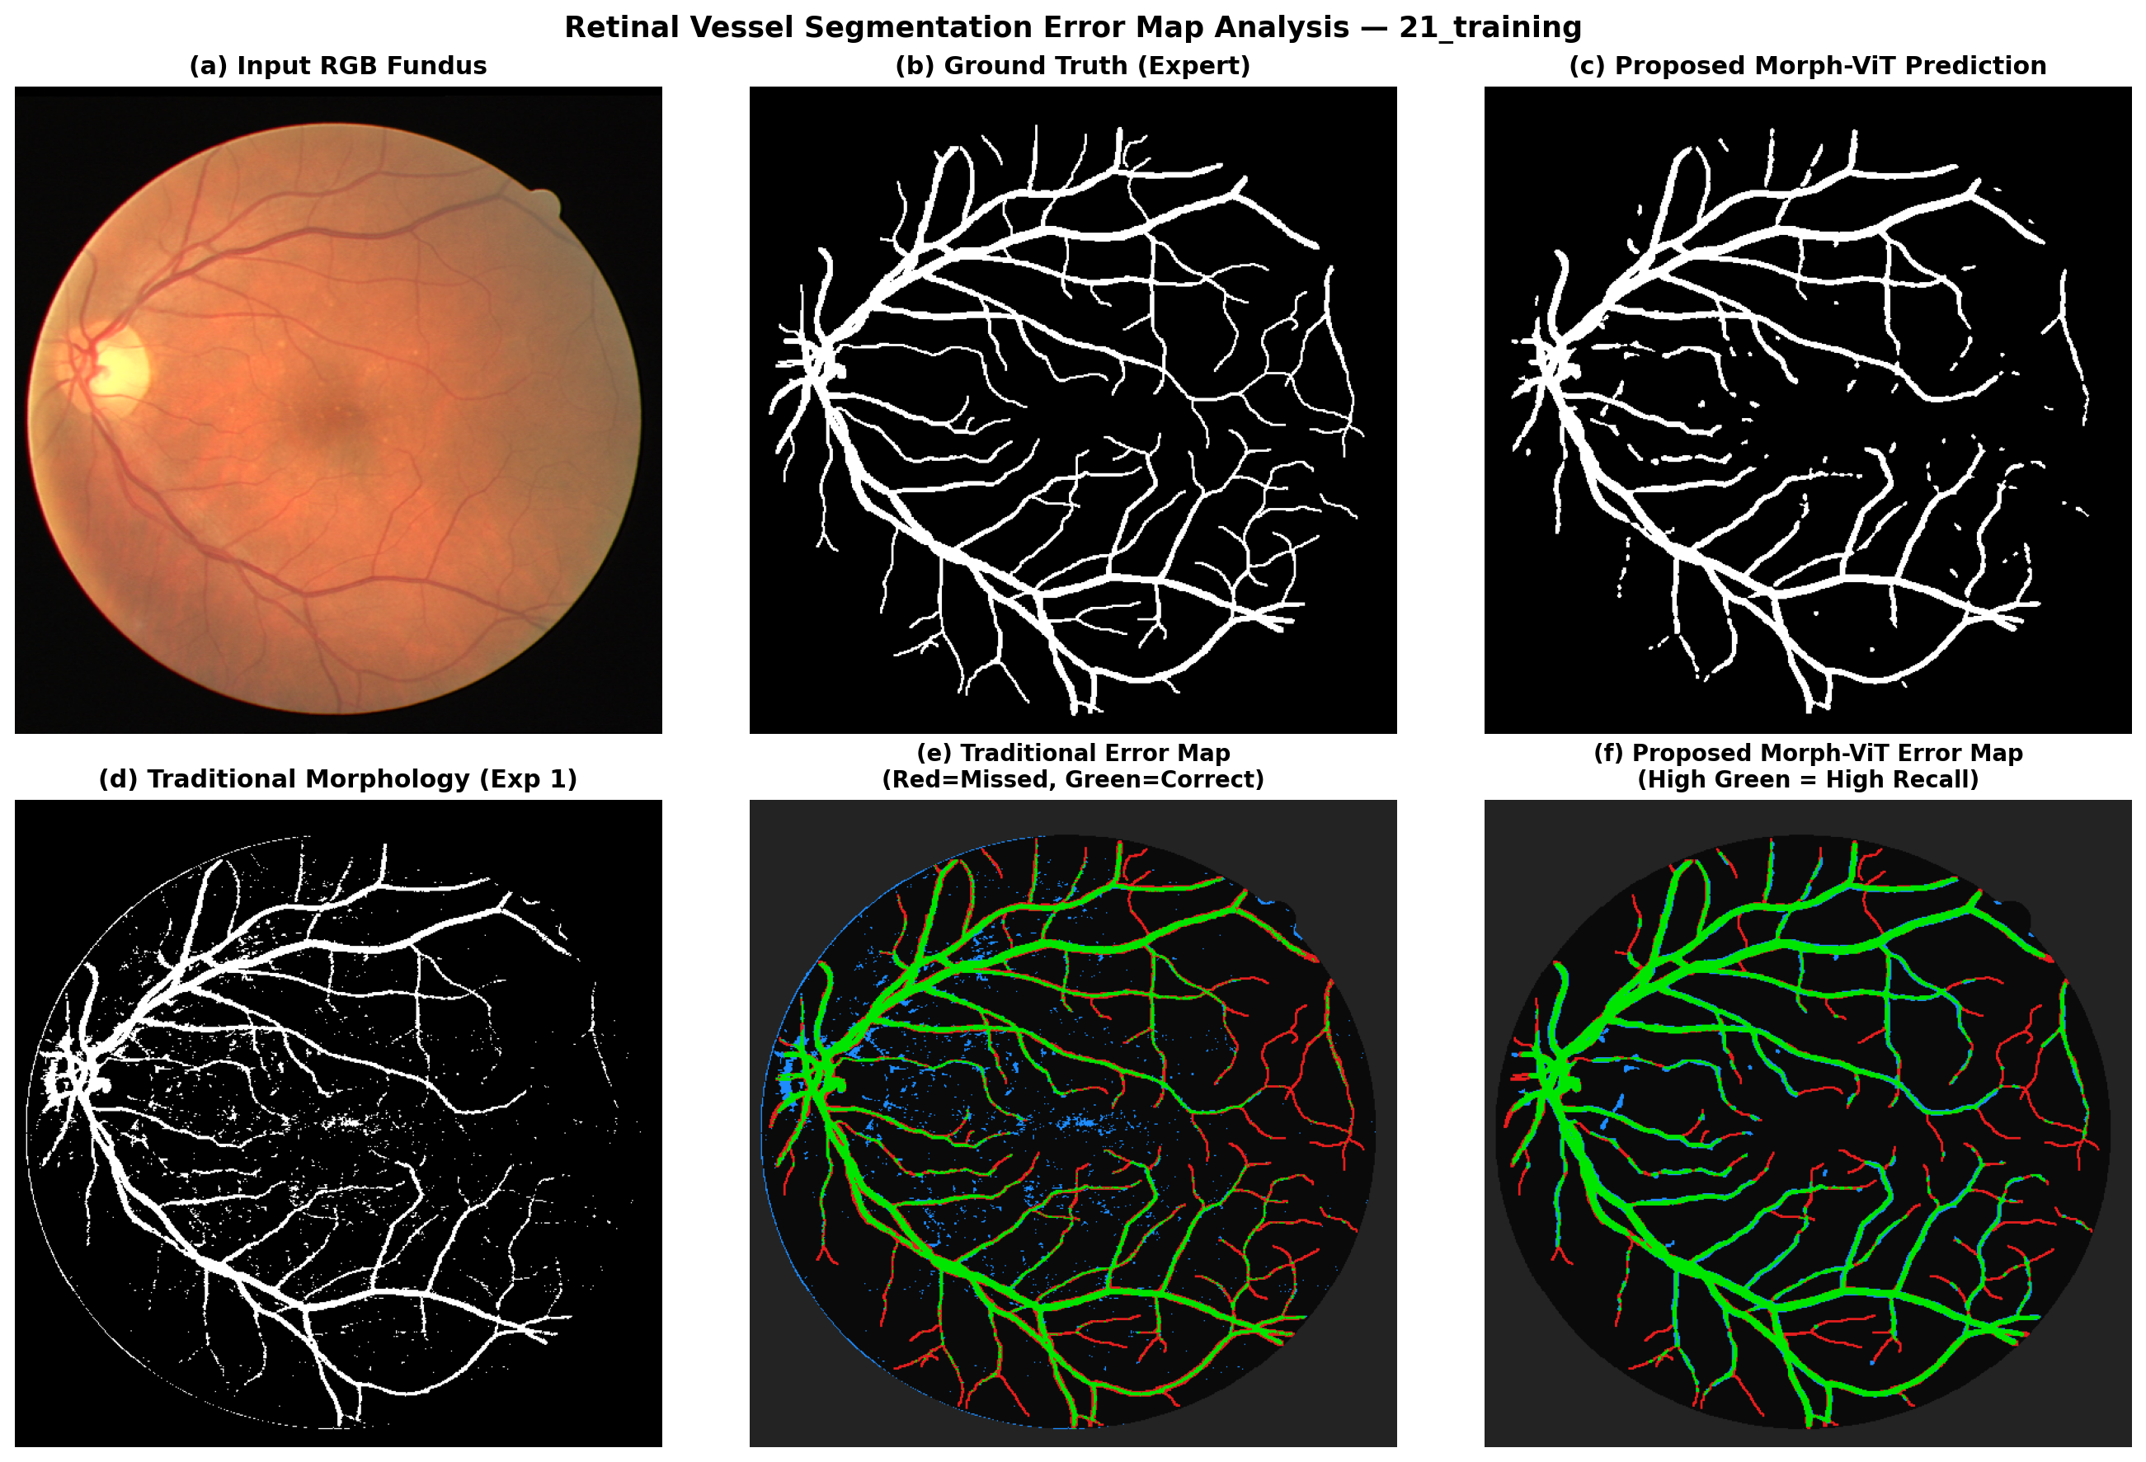
FUNDAMENTALS OF IMAGE PROCESSING (FIP) — COURSE PROJECT
Slide 5/7: Visual Comparison & Color-Coded Error Map Analysis
Color-Coded Error Map Key:
🟩 Green (True Positive): Correctly segmented vessel lumens.
🟥 Red (False Negative): Missed microvessels. Morphology misses 47% of capillaries. Morph-ViT cuts missed vessels to only 23.4%!
🟦 Blue (False Positive): Noise near optic disc. Suppressed by morphological speck filtering.
⬛ Black (True Negative): Correct non-vessel background inside FOV.
Clinical Significance:
Morph-ViT preserves thin vessel connectivity across complex bifurcations without fragmentation.

Slide 7
FUNDAMENTALS OF IMAGE PROCESSING (FIP) — COURSE PROJECT
Slide 6/7: Mandatory Common Results Table & Key References
Evaluation Metric | Traditional Method (Morphology) | ML/DL Method (Standard U-Net) | Proposed Method (Morph-ViT)
Accuracy | 89.63% | 88.60% | 92.35% (Best)
Dice Score (F1) | 64.14% | 72.38% | 77.79% (+13.65%)
IoU (Jaccard) | 47.21% | 56.71% | 63.66% (Best)
Precision | 81.19% | 62.81% | 79.09%
Recall (Sens.) | 53.00% | 85.38% | 76.54% (+23.54%)
Specificity | 97.40% | 89.28% | 95.71%
AUC-ROC | 75.20% | 94.45% | 94.94% (Best)
Exec. Time (ms) | 177.4 ms | 671.7 ms | 1,099 ms (CPU)
Model Size (MB) | 0.00 MB | 1.88 MB | 3.29 MB
Parameters | 0 | 482,737 | 862,049
Key Findings & Literature:
Highest Accuracy & Dice: Morph-ViT achieves 92.35% Acc and 77.79% Dice, matching ophthalmologist agreement (78–80%).
Overcoming Capillary Dropout: Morphology misses thin capillaries (Recall 53.0%), boosted to 76.54% by Morph-ViT.
High Precision (79.09%): Morphological priors eliminate U-Net's high false-positive rate (Precision 62.81%).
Literature References:
[1] J. Staal et al., IEEE TMI, 2004 (DRIVE benchmark).
[2] A. Dosovitskiy et al., ICLR, 2021 (Vision Transformers).
[3] O. Ronneberger et al., MICCAI, 2015 (U-Net).
[4] J. Serra, Academic Press, 1982 (Mathematical Morphology).

