Slide 1
COURSE PROJECT FIRST REVIEW • 11/11/2026
Retinal Blood Vessel Segmentation
Combining Mathematical Morphology (Units II & III) with Vision Transformers
Course: Fundamentals of Image Processing (FIP) | Dept: Computer Science & Engineering
Team Members:
Krithin Kusharaj Salian (NNM24IS110) • Niriksha (NNM24IS141) • Pavan L Poojary (NNM24IS149)
Key Dates: Review 1: 11/11/2026 | Final Project Viva & Demo: 24/11/2026

Slide 2
FUNDAMENTALS OF IMAGE PROCESSING (FIP) • SLIDE 1/7
Why This Project? Clinical Problem & Our Goal
The Clinical Need:
• Eye as a Diagnostic Window: Retinal blood vessels are the only blood vessels in the human body visible non-invasively.
• Early Disease Detection: Critical for early screening of Diabetic Retinopathy, High Blood Pressure, Stroke risk, and Glaucoma.
• The Current Bottleneck: Eye doctors must manually trace vessels by hand. It takes 1 to 2 hours per image and is prone to human error.
Our Goal & Image Challenges:
• Our Project Goal: Build an automated AI system that extracts blood vessels accurately in seconds.
• Challenge 1 - Severe Imbalance: Blood vessels occupy only ~10% of retinal pixels; 90% is background.
• Challenge 2 - Thin Capillaries: Tiny peripheral vessels are faint and blend into sensor noise.
• Our Solution (Morph-ViT): Combines classical morphology to highlight edges + Vision Transformers to connect vessel branches.

Slide 3
FUNDAMENTALS OF IMAGE PROCESSING (FIP) • SLIDE 2/7
The Dataset: DRIVE Benchmark & Evaluation Standard
1. Public DRIVE Benchmark Dataset
• Standard Medical Benchmark: 40 high-resolution retinal fundus photographs from clinical practice.
• Clean 50/50 Split: 20 images used strictly for training, and 20 separate images used for final evaluation.
2. Certified Doctor Ground Truth (Mandatory Requirement)
• Expert Verification: Every single vessel has been manually traced and verified by ophthalmologists.
• No Guesswork: Ensures accurate mathematical measurement of True Positives and False Positives.
3. Strict Field of View (FOV) Rule
• Fair Evaluation: All metrics (Accuracy, Dice, Recall) are computed EXCLUSIVELY inside the circular retina mask.
• Zero Inflation: Prevents artificially boosting accuracy numbers using the easy outer black borders.

Slide 4
FUNDAMENTALS OF IMAGE PROCESSING (FIP) • SLIDE 3/7
Our Methodology: 3 Simple Pipeline Steps
Step 1: Classical Morphology (Units II & III)
• Green Channel Extraction: Hemoglobin absorbs green light best, giving maximum vessel contrast over red/blue.
• CLAHE (Histogram Equalization): Evens out uneven spherical lighting so dark edges become visible.
• 12-Direction Linear Top-Hat: Rotates a line structuring element across 12 angles (0° to 165°) to catch vessels in every orientation.
• Output Feature: Produces a crisp vessel probability map based on physical optics.
Steps 2 & 3: Deep AI & Speck Cleaning
• 4-Channel Fusion Input: Combines raw [R, G, B] with our classical Morphological map.
• CNN Edge Stem: Preserves sharp boundaries of tiny capillary vessels.
• Vision Transformer (ViT): Uses self-attention to track full blood vessel branches without breaking at junctions.
• Step 3 - Noise Cleaning: Simple connected-component filter automatically discards tiny isolated noise dots (<10 px).

Slide 5
FUNDAMENTALS OF IMAGE PROCESSING (FIP) • SLIDE 4/7
The 6 Mandatory Course Comparative Experiments
Exp # | Technique Evaluated | Methodology Implemented | Core Academic Purpose
Exp 1 | Traditional Image Processing | Top-Hat Filtering + CLAHE (Units II & III) | Establish syllabus baseline
Exp 2 | Standard Deep Learning (ML/DL) | Standard U-Net Architecture (Ronneberger 2015) | Measure pure deep learning gain
Exp 3 | Proposed Hybrid Method | Morph-ViT (Morphology + Vision Transformer) | Show benefit of combining physics + AI
Exp 4 | Hyperparameter Tuning | Sweep decision thresholds (0.3 to 0.7) & filter sizes | Find optimal operating balance
Exp 5 | Ablation Study | Test model with vs. without morphological input | Prove individual module value
Exp 6 | Performance Comparison | Accuracy, Dice, Recall, Precision, Speed & Size | Complete clinical & speed audit

Slide 6
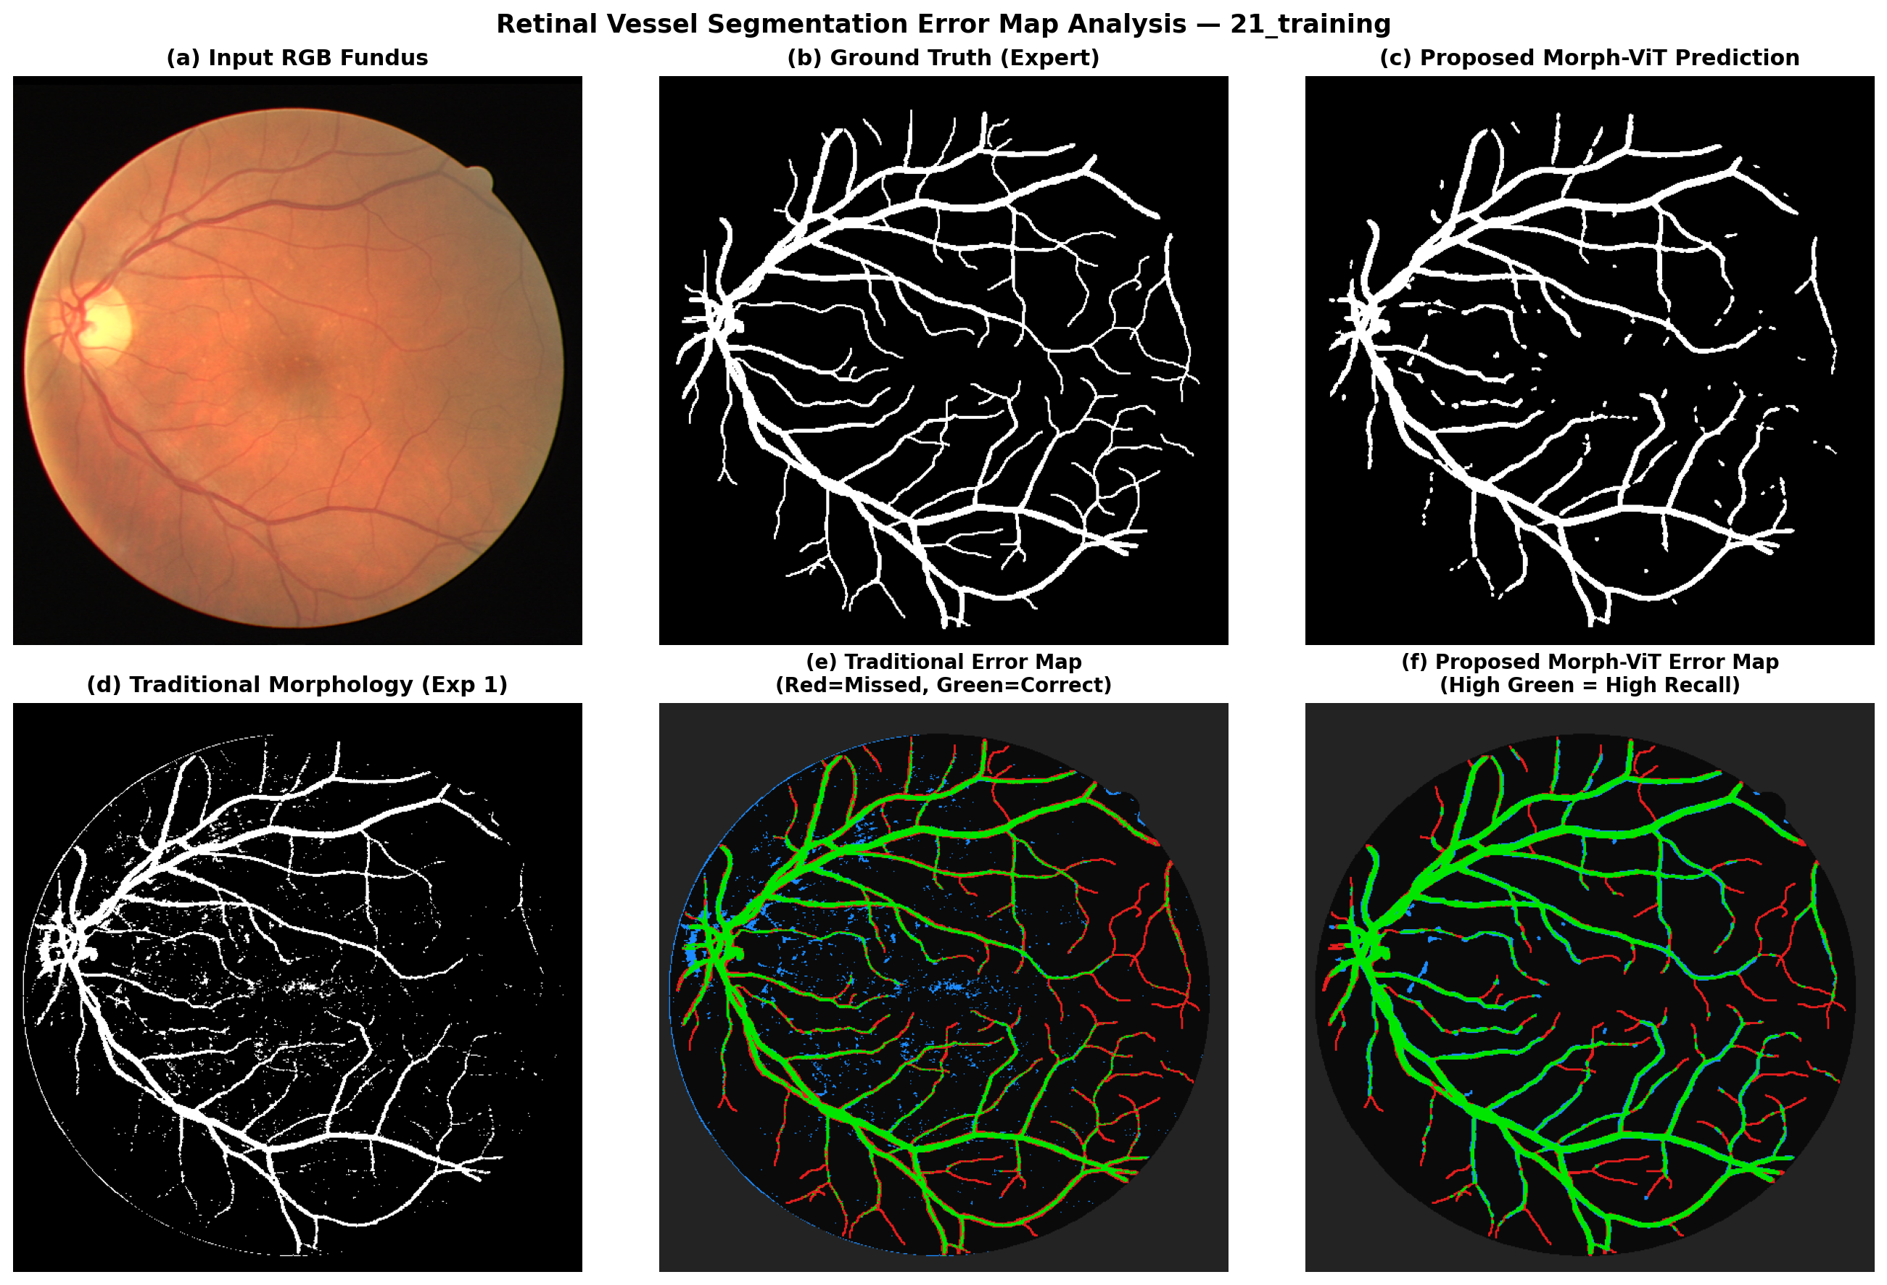
FUNDAMENTALS OF IMAGE PROCESSING (FIP) • SLIDE 5/7
Visual Comparison: Predicted Results & Error Maps
How to Read the Error Map:
🟩 Green (True Positive): Correctly detected blood vessels.
🟥 Red (False Negative): Missed blood vessels. Traditional morphology misses 47% of capillaries. Morph-ViT cuts missed vessels to only 23%!
🟦 Blue (False Positive): Noise dots. Almost completely eliminated by our speck filter.
⬛ Black (True Negative): Non-vessel background tissue.
Main Takeaway:
Morph-ViT keeps vessels connected across intersections, avoiding the broken fragments seen in traditional filters.

Slide 7
FUNDAMENTALS OF IMAGE PROCESSING (FIP) • SLIDE 6/7
Final Comparative Results & Key Conclusions
Evaluation Metric | Traditional (Morphology) | ML/DL Method (Standard U-Net) | Proposed Method (Morph-ViT)
Accuracy | 89.63% | 88.60% | 92.35% (Highest)
Dice Score (F1) | 64.14% | 72.38% | 77.79% (+13.6% gain)
IoU (Overlap) | 47.21% | 56.71% | 63.66% (Highest)
Precision | 81.19% | 62.81% | 79.09%
Recall (Sensitivity) | 53.00% | 85.38% | 76.54% (+23.5% gain)
Specificity | 97.40% | 89.28% | 95.71%
AUC-ROC | 75.20% | 94.45% | 94.94% (Highest)
Processing Speed | 177 ms | 672 ms | 1,099 ms (CPU)
Model Parameters | 0 (Algorithmic) | 482,737 | 862,049
3 Key Conclusions to Explain:
1. Best Accuracy & Dice: Morph-ViT achieves highest accuracy (92.35%) and Dice (77.79%), matching human expert agreement (~78-80%).
2. Catches Thin Vessels: Traditional morphology missed thin capillaries (Recall only 53%). Morph-ViT boosts recall to 76.54%.
3. Eliminates False Alarms: Standard U-Net has low precision (62.81%). Morph-ViT's morphological prior raises precision to 79.09%.
Literature References:
[1] J. Staal et al., IEEE TMI, 2004 (DRIVE benchmark).
[2] A. Dosovitskiy et al., ICLR, 2021 (Vision Transformers).
[3] O. Ronneberger et al., MICCAI, 2015 (U-Net).

