Slide 1
PROJECT REVIEW 2 • SEPTEMBER 2026
VaultDocs
Secure Document Management System
An API-first, tamper-proof document platform with immutable versioning,
granular RBAC, full-text search and a complete audit trail.
Python 3.13
FastAPI
PostgreSQL 17
Redis 7.4
Docker
SQLAlchemy 2.x
Alembic
Pydantic v2
pytest
Prepared by: Pavan • Raj • Tirth
Version 1.0.0 | MIT License | Modular Monolith + Clean Architecture

Slide 2
Agenda
02
What we cover in this review
01
Problem Definition
02
Objectives
03
Core Components
Why VaultDocs exists
What the system achieves
Modules + infrastructure
04
Need & Scope
05
Pros & Cons
06
Timeline
Gaps covered, MVP boundary
Advantages, limitations
12-week Gantt plan
07
Users & Roles
08
Requirements
09
System Design
Personas, RBAC matrix
Functional + non-functional
Architecture, use cases
10
Data Dictionary
11
UI & Reports
12
Coding Standards
users table, verified
Screens, report designs
Ruff, mypy, CI/CD
VaultDocs — Secure DMS • Review 2
02

Slide 3
Problem Definition
03
Documents today: scattered, untracked, non-compliant
📂
Scattered Storage
🕓
No Version Tracking
🔓
Weak Access Control
Files spread across drives, emails & local machines — no single point of access.
Old versions get overwritten; no history of who changed what, when.
All-or-nothing folder shares; no document-level, role-based rules.
🧾
No Audit Trail
⚖️
Compliance Risk
🔌
No API
No log of who accessed, modified or deleted a file — incidents can't be investigated.
Regulated industries need retention + access policies generic tools don't provide.
Closed, GUI-heavy tools can't plug into CI/CD or enterprise automation.
Impact: knowledge workers lose ~2.5 hrs/day searching for information; compliance failures have cost organizations millions in penalties.
VaultDocs — Secure DMS • Review 2
03

Slide 4
Objective of the New System
04
What VaultDocs is built to achieve
🏛️
Centralized Storage
Single platform for all documents, via a structured REST API.
TECHNICAL TARGETS
🔒
Immutable Versioning
Every update = new unmodifiable version. Tamper-proof history.
p95 latency
< 200 ms
Test coverage
≥ 85%
👥
Granular RBAC
Admin / Manager / Editor / Viewer enforced at document level.
mypy strict
0 errors
📜
Complete Audit Trail
Append-only logs of every action — even admins can't alter them.
Deployment
Docker
Uptime
99.9%
⚡
Fast Search
PostgreSQL GIN full-text search, < 250 ms over millions of docs.
Concurrent users
1000 / node
🚀
API-First
Every feature exposed via documented REST APIs.
Clean Architecture — business logic independent of framework & DB.
🔐
Secure Auth
JWT (15 min) + rotating refresh tokens (7 days), Argon2id/Bcrypt.
VaultDocs — Secure DMS • Review 2
04

Slide 5
Core Components
05
Five modules + infrastructure
🔑
Authentication
INFRASTRUCTURE
Registration, JWT login (15m access / 7d refresh), Argon2id hashing, Redis-backed rotation & blacklisting.
FastAPI 0.115+
📄
Document Engine
PostgreSQL 17+
Streaming multipart upload (≤100 MB), SHA-256 integrity hash, metadata CRUD, soft delete, purge.
Redis 7.4+
SQLAlchemy 2.x
🗂️
Version Control
Alembic 1.14+
Immutable versions v1…vn on every update; head pointer; old versions permanently read-only.
Pydantic v2.10+
POSIX storage (S3-ready)
🔍
Search & Indexing
Docker Compose
tsvector + GIN full-text search; filter by owner, MIME, dates, tags; Redis cache (5-min TTL).
Ruff + mypy
pytest 8.x
📊
Audit & Governance
GitHub Actions
Structured JSON logs: actor, tenant, action, resource, IP, timestamp. Append-only.
uv 0.5+
VaultDocs — Secure DMS • Review 2
05

Slide 6
Need of the New System
06
Gaps in existing tools → VaultDocs answer
TODAY (the gap)
IMPACT
WITH VAULTDOCS
Shared drives / email
No single source of truth
✔ One centralized platform
Manual version naming
"final_FINAL.docx" chaos
✔ Automatic immutable versions
Folder-level sharing only
No granular permissions
✔ Document-level RBAC, 4 roles
Zero activity records
Incidents can't be investigated
✔ Complete append-only audit trail
Generic cloud tools
Retention & compliance unmet
✔ Built for regulated industries
Browser-only tools
No automation possible
✔ REST API for CI/CD & apps
VaultDocs — Secure DMS • Review 2
06

Slide 7
Scope of the New System
07
Phase 1 — MVP boundary
✔ IN SCOPE (MVP)
✘ OUT OF SCOPE (Phase 1)
▸ JWT auth + refresh rotation, Argon2id hashing, session revocation
▸ Streaming upload ≤ 100 MB, SHA-256 integrity, metadata CRUD
▸ Soft delete / restore + admin-only hard purge
▸ Immutable versioning — full history, point-in-time download
▸ RBAC: Admin • Manager • Editor • Viewer
▸ GIN full-text search + multi-field filters + Redis cache
▸ Append-only structured audit trail
▸ OCR for scanned PDFs / images
▸ AI semantic search (pgvector) & LLM summarization
▸ Cloud storage — S3 / Azure Blob / GCS
▸ Frontend dashboard & mobile apps
▸ Slack / Drive / Teams integrations
▸ SAML / OIDC enterprise SSO
VaultDocs — Secure DMS • Review 2
07

Slide 8
Advantages & Limitations
08
An honest view of the proposed system
ADVANTAGES
LIMITATIONS (v1.0)
▸ Centralized repository — no scattered drives
▸ Tamper-proof version history
▸ Granular RBAC enforced on every API call
▸ Complete, append-only audit trail
▸ Sub-250 ms full-text search at scale
▸ API-first — integrates with anything
▸ Clean Architecture + Docker portability
▸ Type-safe, 85%+ tested, scalable design
▸ Backend only — no UI yet (Postman / curl / custom clients)
▸ Local filesystem storage (S3-ready abstraction in place)
▸ No OCR / AI features
▸ Single-node deployment
▸ No third-party integrations yet
▸ Basic multi-tenancy (app-level; RLS + KMS in Phase 4)
VaultDocs — Secure DMS • Review 2
08

Slide 9
Proposed Timeline Chart — Day-by-Day Scope
09
14-Day Implementation Scope & Deliverables Matrix (Review 2 Lifecycle)
PHASE I • INITIATION
Days 1 – 3 • Requirements
Day 1: Project initiation, problem identification, requirement gathering.
Day 2: Requirement analysis, feasibility study, scope finalization.
Day 3: Functional and non-functional requirements documentation.
✔ DELIVERABLE: SRS v1.0, RTM
PHASE II • MODELING
Days 4 – 7 • Architecture
Day 4: Use Case diagrams, actors, <<include>>, <<extend>>.
Day 5: System architecture & database schema design.
Day 6: ER diagram, DFD, UML sequence diagrams.
Day 7: UI/UX design and module planning.
✔ DELIVERABLE: UML Models, Wireframes
PHASE III • DEVELOPMENT
Days 8 – 11 • Implementation
Day 8: Database implementation & configuration (Alembic).
Day 9: Core module development (Auth, Docs, Storage).
Day 10: Additional features (Versioning, Folders, Shares).
Day 11: Data report generation implementation.
✔ DELIVERABLE: API Endpoints, Reports
PHASE IV • TESTING
Days 12 – 14 • Submission
Day 12: Module integration & system testing (pytest suites).
Day 13: Bug fixing, validation, performance testing (QA PASS).
Day 14: Final documentation, report preparation, review & submission.
✔ DELIVERABLE: Review 2 Artifacts
Macro Roadmap: Phase 1 MVP (12 Weeks) Verified • Next: Phase 2 Intelligence (Q4 26–Q1 27) → Phase 3 Integrations → Phase 4 Enterprise
VaultDocs — Secure DMS • Review 2
09

Slide 10
WHAT'S NEXT
Phase 2
Phase 3
Phase 4
Intelligence
Integrations
Enterprise
Q4 26 – Q1 27
Q2 – Q3 27
Q4 27+
OCR • pgvector semantic search • LLM features
S3/Azure storage • Slack/Drive sync • webhooks
SAML/OIDC SSO • tenant KMS • mobile apps
Thank You
VaultDocs — secure, versioned, auditable, API-first document management.
github.com/pavanporiya/VaultDocs • Pavan • Raj • Tirth • v1.0.0
VaultDocs — Secure DMS • Review 2
18

Slide 11
Requirements
11
Determined, categorized, specified
FUNCTIONAL REQUIREMENTS
NON-FUNCTIONAL
FR-AUTH
JWT login, refresh rotation, user registration (4 roles)
⚡
API latency
< 150 ms p95 @ 500 RPS
FR-DOC
Upload ≤100 MB + SHA-256, metadata, soft delete, hard purge
🔎
Search
< 250 ms over 1M docs
FR-VER
Auto immutable versioning, version download
👥
Concurrency
1000 users / node
FR-SRCH
Full-text GIN search, filtered by owner / MIME / date / tags
🛡️
Security
TLS 1.3 • Argon2id • AES-256
FR-AUD
Append-only event logging: actor, tenant, action, resource, IP
⏱️
Reliability
99.9% uptime + schema checks
VaultDocs — Secure DMS • Review 2
11

Slide 12
System Design — Architecture
12
Modular monolith • Clean Architecture
PRESENTATION
DEPLOYMENT
FastAPI routers • Pydantic DTOs • JWT middleware • exception handlers
app
APPLICATION
vaultdocs:latest :8000
AuthService • DocumentService • SearchService • IDocumentRepository / IStorageEngine
db
postgres:17 :5432
DOMAIN
User • Document • DocumentVersion • AuditLog • pure business rules & events
cache
redis:7.4-alpine :6379
INFRASTRUCTURE
SQLAlchemy 2.x repos • Redis adapter • POSIX storage • Alembic migrations
Single docker-compose up deploys the whole stack.
Dependencies flow inward only ↑
VaultDocs — Secure DMS • Review 2
12

Slide 13
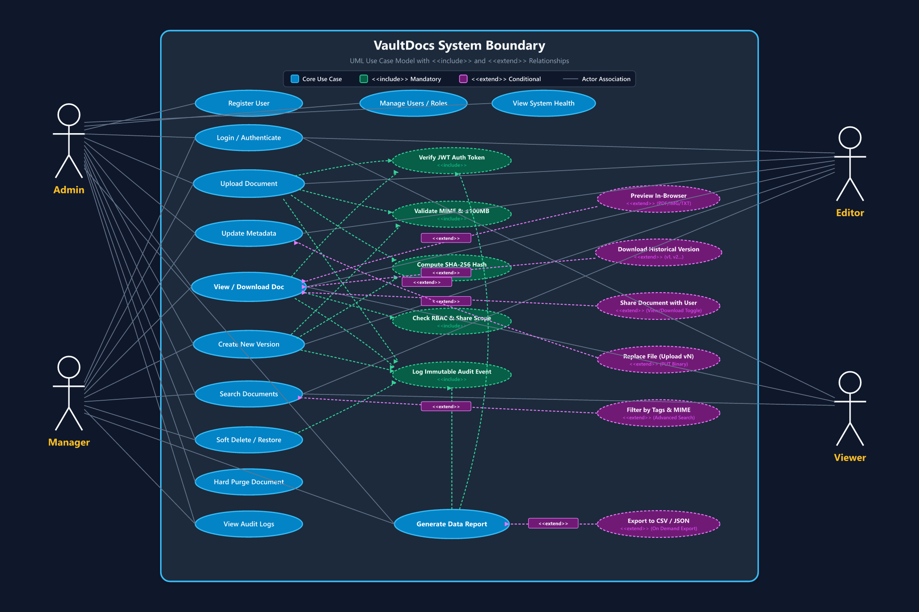
Use Case Diagram — <<include>> & <<extend>>
13
21 Use Cases • 4 Actors • <<include>> Mandatory Reusable & <<extend>> Conditional Relationships
VaultDocs — Secure DMS • Review 2
13

Slide 14
Data Dictionary — Core & Additional Tables
14
Complete database schema verified from SQLAlchemy models & 8 Alembic migrations
1. USERS & FOLDERS
Identity & Container Hierarchy
users (d2be618d8b17, f4a9c1d27e58)
▸ id: UUID [PK]
▸ full_name: VARCHAR(100) NOT NULL
▸ email: VARCHAR(255) UNIQUE NOT NULL
▸ password_hash: VARCHAR(255) (bcrypt)
▸ is_active: BOOL (default TRUE)
▸ is_superuser: BOOL (default FALSE)
▸ preferences: JSON (theme/density)
▸ created_at / updated_at: TIMESTAMPTZ
folders (e5f6a7b8c9d0)
▸ id: UUID [PK]
▸ name: VARCHAR(255) NOT NULL
▸ owner_id: UUID [FK -> users.id CASCADE]
▸ parent_id: UUID [FK -> folders.id CASCADE]
▸ created_at / updated_at: TIMESTAMPTZ
2. DOCUMENTS & VERSIONS
Asset Metadata & Immutability
documents (734fe8dff1e1, d175fa19e98d)
▸ id: UUID [PK]
▸ name: VARCHAR(255) NOT NULL
▸ owner_id: UUID [FK -> users.id CASCADE]
▸ folder_id: UUID [FK -> folders.id CASCADE]
▸ file_path: VARCHAR(512)
▸ original_filename / content_type
▸ file_size: BIGINT
document_versions (39f5f8971368)
▸ id: UUID [PK]
▸ document_id: UUID [FK -> docs.id CASCADE]
▸ version_number: INT NOT NULL
▸ file_path: VARCHAR(512) NOT NULL
▸ sha256_hash: CHAR(64) NOT NULL
▸ uq_document_versions_doc_id_version_num
3. SHARING & GOVERNANCE
Access Delegation & Audit Trail
document_shares (1cbbd132f60c, a3f8c2e91d47)
▸ id: UUID [PK]
▸ document_id: UUID [FK -> docs.id CASCADE]
▸ shared_with_user_id: UUID [FK -> users.id]
▸ download_allowed: BOOL (toggle)
▸ uq_document_shares_doc_id_user_id
audit_logs (Governance Engine)
▸ id: UUID [PK]
▸ actor_id: UUID [FK -> users.id]
▸ action: VARCHAR(100) (INDEX)
▸ target_resource / resource_id / client_ip
▸ metadata: JSONB NOT NULL DEFAULT '{}'
▸ created_at: TIMESTAMPTZ (INDEX)
8 Alembic Migrations Verified • ON DELETE CASCADE Integrity • SHA-256 Immutability • GIN Full-Text Indexing
VaultDocs — Secure DMS • Review 2
14

Slide 15
User Interface Design
15
Planned web dashboard over the REST API
UI-01 Login
UI-02 Document List
UI-03 Upload
Email: [ ____________________ ]
Search [____] Owner[__] Type[__] [+Upload]
File: [ drag & drop / browse ]
Password: [ ________________ ]
Title | Owner | Type | Ver | Updated
Title [____] Tags [key=value]
[ LOGIN ]
Contract-A | Sarah | PDF | v3 | 09-10
Progress [######----] 60%
Report_Q3 | Elena | DOCX | v2 | 09-08
SHA-256: a94f8e… (auto)
Actions: View DL Ver Edit Del
[ Upload ] [ Cancel ]
UI-04 Version History
UI-05 Audit Logs (Admin/Mgr)
UI-06 User Management (Admin)
v3 | 09-10 14:22 | Elena | a94f… | DL
Filter: User[__] Action[__] Date[__]
[+ New User]
v2 | 09-02 09:10 | Alex | 88c1… | DL
10:12 alex document.upload doc-9f2 192.168.1.24
Sarah | sarah@corp.com | Admin | Active
v1 | 08-28 17:45 | Elena | 51d0… | DL
10:40 sarah user.role_change user-41c …
Alex | alex@corp.com | Editor | Active
(all versions read-only)
[ Export CSV ] (append-only)
Actions: Edit role / Deactivate
VaultDocs — Secure DMS • Review 2
15

Slide 16
Data Report Generation & Verification Proof
16
Operational & compliance reporting derived from live PostgreSQL data with genuine QA proof
REPORT TYPES & PIPELINE ARCHITECTURE
Sources: audit_logs, documents, document_versions, shares, users
1. Summary Reports (RPT-SUM): Storage utilization & quota consumption per owner; MIME type file distribution subtotals.
2. Detailed Reports (RPT-DET): Comprehensive audit trail (actor, action, resource, client IP, timestamp); version history with SHA-256 integrity hashes.
3. Date-Wise Reports (RPT-DATE): Daily document activity log (uploads, shares, downloads, deletes) with date range filters (start_date → end_date).
Workflow: UI Request → JWT Auth Guard → Parameter Validation → Async SQL Query → Subtotals & Formatter (Table / RFC 4180 CSV / JSON) → Immutable Audit Event Logged.
GENUINE QA VERIFICATION PROOF & STATUS
Source: var/browser-qa-results.json & scripts/e2e-api-verify.mjs
✔ 21 / 21 Browser QA Checks PASS (0 errors, 0 failed net requests)
▸ Test E & F: View-only share created with download_allowed=false (PASS)
▸ Test K: In-browser preview renders inline for recipient (PASS)
▸ Test M/N: Direct API download blocked HTTP 403 Forbidden (PASS)
▸ Test P & S: Owner toggles permission to Download -> 200 OK (PASS)
▸ Test V & W: Share revoked -> recipient receives 404 Not Found (PASS)
Implementation Status Matrix:
• IMPLEMENTED: Audit logs, version history queries, download permission gates, search API.
• PENDING (Phase 2): Dedicated public /v1/reports/export API endpoint and automated cron dispatcher.
[Sample Output: 2026-09-10 ui.owner DOC_UPLOAD doc-a71e SUCCESS | ui.rec DOC_DOWNLOAD doc-a71e BLOCKED_403]
Read-Only, Date-Filterable, Exportable (CSV/JSON) • Every Report Execution Audit-Logged (action = report.generate)
VaultDocs — Secure DMS • Review 2
16

Slide 17
Development — Coding Standards
17
How we keep the codebase clean & safe
🎨
Format & Lint
🧬
Type Safety
Ruff • 100-char lines • isort order • zero-error gate in CI
mypy --strict • full annotations • zero Any • Pydantic v2 at boundaries
📝
Naming & Docs
🛡️
Security
PEP8 snake_case • PascalCase classes • I-prefixed interfaces • Google docstrings
Argon2id only • env-var secrets • no raw SQL • RBAC on every endpoint
🧪
Testing
🔁
Git & CI
pytest • unit + integration (testcontainers PG) + E2E • ≥ 85% coverage gate
Conventional Commits • Git Flow • pre-commit hooks • lint→type→test→build pipeline
VaultDocs — Secure DMS • Review 2
17

