Slide 1
Introduction to financial markets and derivatives

Slide 2
What is a Derivative?
A derivative is an instrument whose value depends on, or is derived from, the value of another asset.
Examples: futures, forwards, swaps, options, exotics…

Slide 3
Why Derivatives Are Important
Derivatives play a key role in transferring risks in the economy
The underlying assets include stocks, currencies, interest rates, commodities, debt instruments, electricity prices, insurance payouts, the weather, etc
Many financial transactions have embedded derivatives
The real options approach to assessing capital investment decisions has become widely accepted

Slide 4
How Derivatives Are Traded
On exchanges such as the Chicago Board Options Exchange (CBOE)
In the over-the-counter (OTC) market where traders working for banks, fund managers and corporate treasurers contact each other directly

Slide 5
The OTC Market Prior to 2008
Largely unregulated
Banks acted as market makers quoting bids and offers
Master agreements usually defined how transactions between two parties would be handled
But some transactions were cleared through central counterparties (CCPs). A CCP stands between the two sides to a transaction in the same way that an exchange does

Slide 6
The Lehman Bankruptcy
Lehman’s filed for bankruptcy on September 15, 2008. This was the biggest bankruptcy in US history
Lehman was an active participant in the OTC derivatives markets and got into financial difficulties because it took high risks and found it was unable to roll over its short-term funding
It had hundreds of thousands of transactions outstanding with about 8,000 counterparties
Unwinding these transactions has been challenging for both the Lehman liquidators and their counterparties

Slide 7
Since 2008…
OTC market has become regulated. Objectives:
Reduce systemic risk (see Business Snapshot 1.2, page 5)
Increase transparency
In the U.S and some other countries, standardized OTC products must be traded on swap execution facilities (SEFs) which are electronic platforms similar to exchanges
Central Counterparties (CCPs) must be used to clear standardized transactions between financial institutions in most countries
All trades must be reported to a central repository

Slide 8
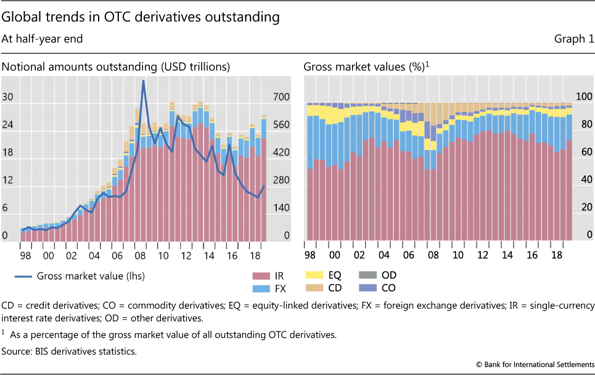
Size of OTC Derivatives Markets
Source: Bank for International Settlements.

Slide 9
How Derivatives are Used
To hedge risks
To speculate (take a view on the future direction of the market)
To lock in an arbitrage profit
To change the nature of a liability
To change the nature of an investment without incurring the costs of selling one portfolio and buying another
Notes:
4

Slide 10
Main types of derivatives
Forward contracts
Futures contracts
Swaps
Options

Slide 11
Forward Contract
A forward contract is an agreement to purchase an asset at a time in the future at an agreed price.
The forward price is the delivery price that would be applicable to the contract if were negotiated today
The forward price may be different for contracts of different maturities – see example on next slide
Notes:
11

Slide 12
Foreign Exchange Quotes for GBP, May 3, 2016 (See page 6)
 | Bid | Offer
Spot | 1.4542 | 1.4546
1-month forward | 1.4544 | 1.4548
3-month forward | 1.4547 | 1.4551
6-month forward | 1.4556 | 1.4561

Slide 13
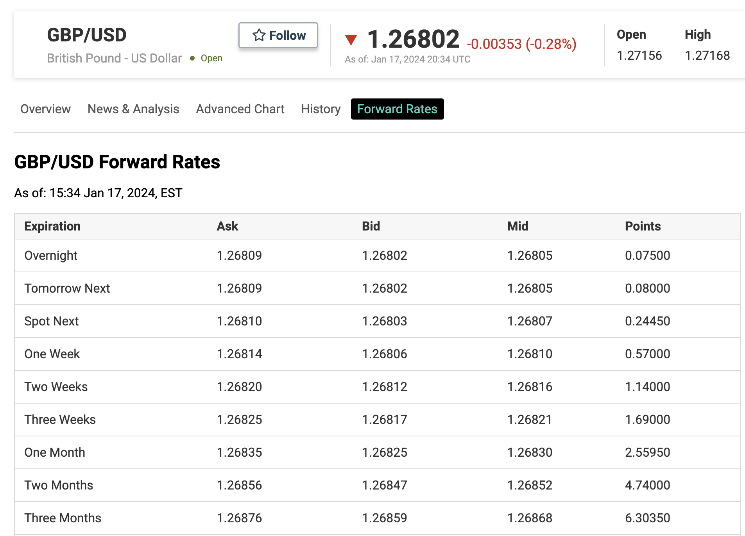
GBP/USD quotes today

Slide 14
Terminology
The party that has agreed to buy has a long position
The party that has agreed to sell has a short position
Notes:
10

Slide 15
Example (pages 6-7)
On May 3, 2016, the treasurer of a corporation enters into a long forward contract to buy £1 million in six months at an exchange rate of 1.4561
This obligates the corporation to pay $1,456,100 for £1 million on November 3, 2016
What are the possible outcomes?

Slide 16
Profit from a Long Forward Position (K= delivery price=forward price at time contract is entered into)
Profit
Price of Underlying at Maturity, S_{T}
K
Notes:
14

Slide 17
Profit from a Short Forward Position (K= delivery price=forward price at time contract is entered into)
Profit
Price of Underlying
at Maturity, S_{T}
K
Notes:
15

Slide 18
Futures Contracts (page 8)
Agreement to buy or sell an asset for a certain price at a certain time
Similar to a forward contract
Whereas a forward contract is traded OTC, a futures contract is traded on an exchange
Daily margined

Slide 19
Exchanges Trading Futures
CME Group (formed when Chicago Mercantile Exchange and Chicago Board of Trade merged) https://www.cmegroup.com/
InterContinental Exchange(ICE) https://www.theice.com
BM&F (Sao Paulo, Brazil)
TIFFE (Tokyo)
…

Slide 20
Examples of Futures Contracts
Agreement to:
Buy 100 oz. of gold @ US$1300/oz. in December
Sell £62,500 @ 1.4500 US$/£ in March
Sell 1,000 bbl. of oil @ US$50/bbl. in April
Notes:
9

Slide 21
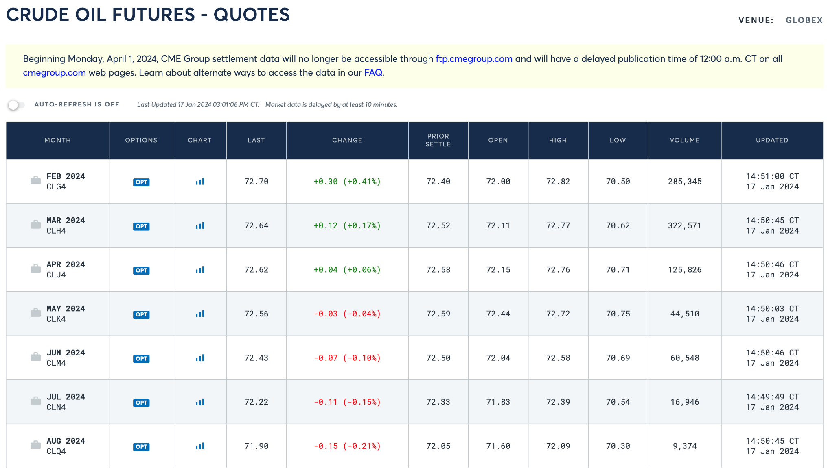

Slide 22
Options
A call option is an option to buy a certain asset by a certain date for a certain price (the strike price)
A put option is an option to sell a certain asset by a certain date for a certain price (the strike price)

Slide 23
American vs European Options
An American option can be exercised at any time during its life
A European option can be exercised only at maturity

Slide 24
Google Call Option Prices from CBOE (May 3, 2016; Stock Price is bid 695.86, offer 696.25); See Table 1.2 page 9
Strike Price | Jun 2016 Bid | Jun 2016 Offer | Sep 2016 Bid | Sep 2016 Offer | Dec 2016 Bid | Dec 2016 Offer
660 | 43.40 | 45.10 | 60.80 | 62.70 | 72.70 | 76.70
680 | 29.20 | 30.60 | 47.70 | 50.70 | 60.90 | 64.70
700 | 18.30 | 18.90 | 37.00 | 39.20 | 49.70 | 52.50
720 | 9.90 | 10.50 | 27.50 | 29.50 | 40.10 | 42.80
740 | 4.70 | 5.20 | 19.80 | 21.60 | 31.40 | 34.40

Slide 25
Google Put Option Prices from CBOE (May 3, 2016; Stock Price is bid 695.86, offer 696.25); See Table 1.3 page 9
Strike Price | Jun 2016 Bid | Jun 2016 Offer | Sep 2016 Bid | Sep 2016 Offer | Dec 2016 Bid | Dec 2016 Offer
660 | 7.50 | 8.20 | 24.20 | 26.20 | 35.60 | 38.10
680 | 13.30 | 14.00 | 31.90 | 33.80 | 43.40 | 46.00
700 | 21.70 | 23.00 | 40.80 | 42.70 | 52.40 | 55.20
720 | 33.10 | 34.80 | 51.10 | 53.20 | 62.60 | 65.20
740 | 47.70 | 49.60 | 63.10 | 65.20 | 74.10 | 76.70

Slide 26
Options vs Futures/Forwards
A futures/forward contract gives the holder the obligation to buy or sell at a certain price
An option gives the holder the right to buy or sell at a certain price

Slide 27
Types of Derivatives Traders
Hedgers
Speculators
Arbitrageurs
Notes:
15

Slide 28
Hedging Examples (pages 11-13)
A US company will pay £10 million for imports from Britain in 3 months and decides to hedge using a long position in a forward contract
An investor owns 1,000 Microsoft shares currently worth $28 per share. A two-month put with a strike price of $27.50 costs $1. The investor decides to hedge by buying 10 contracts
Notes:
16

Slide 29
Value of Microsoft Shares with and without Hedging (Fig 1.4, page 13)

Slide 30
Speculation Example
An investor with $2,000 to invest feels that a stock price will increase over the next 2 months. The current stock price is $20 and the price of a 2-month call option with a strike of 22.50 is $1
What are the alternative strategies?
Notes:
17

Slide 31
Arbitrage with forward contracts
Today’s spot price of gold is $1,950.
Interest rates are 5%
We are offered a forward contract on gold with maturity 1 year, for $2,055.
Long position: on 17-Jan-25 we must pay $2,055 and receive 1 oz of gold
Short position: on 17-Jan-25 we must deliver 1 oz of gold and receive $2,055.

Slide 32
Arbitrage with forwards
Take a short position in the forward contract.
Borrow $1,950 from the bank and purchase 1 oz gold.
After 1Y, we owe the bank $1,950 + interest = $2,047.50
Deliver the gold (we have the short side of the forward contract) and receive $2,055
Pay the bank $2,047.50
Net profit = $2.50
Conclusion: there is a “fair” forward price, which should not lead to arbitrage. More about this in lecture 4.

