Slide 1
Interest Rates and Fixed Income

Slide 2
What are interest rates?
Time value of money: how much is worth today one dollar paid in the future?
Debt is the life blood of the modern economy
Governments, companies and consumers borrow money.
Interest rates are a major determinant of the value of these liabilities

Slide 3
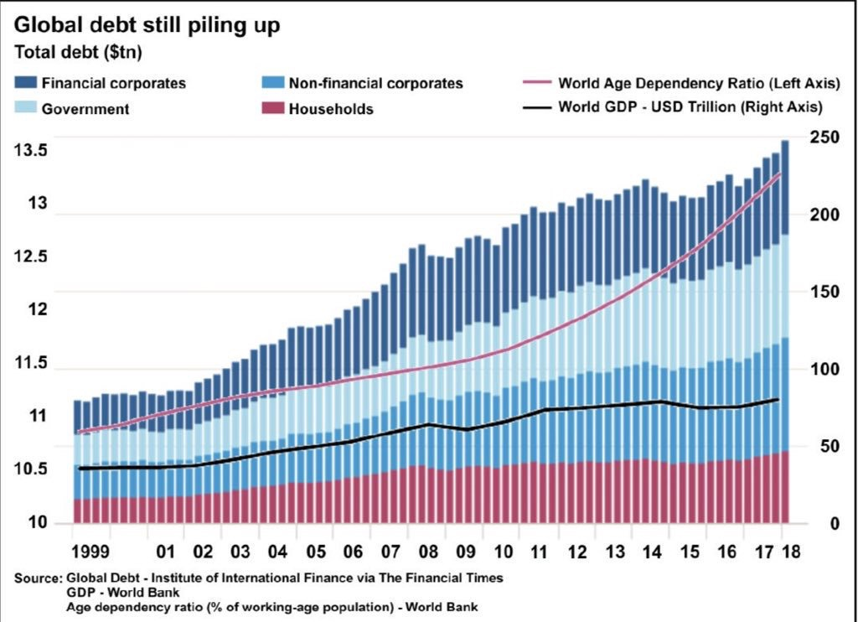

Slide 4
Interest compounding
Savings institutions (banks, money market funds) pay interest income on deposits
An initial deposit grows in time by interest compounding
Interest is accrued periodically (daily, monthly, yearly). An interest rate must be quoted together with its accrual frequency.

Slide 5
Outline of class
Types of interest rates
Measuring interest rates: discrete and continuous compounding
Yield curve: a snapshot of today’s interest rates. Determining the yield curve from data
Bonds and their valuation and risk: duration and convexity

Slide 6
Types of Rates
A wide variety of interest rates:
Zero rates
LIBOR, now SOFR
Swap rates
Treasury rates
Fed funds rate
Repo rates
…

Slide 7
Zero Rates
The zero rate (or spot rate) R(T), for maturity T is the rate of interest earned on an investment that provides a payoff only at time T
Defined in terms of the discount factor D(T) – the value today of a dollar paid at time T - as
D(T) = exp(-R(T) T)

Slide 8
Quoting Interest Rates
The compounding frequency used for an interest rate is important
The difference between quarterly and annual compounding is analogous to the difference between miles and kilometers

Slide 9
Impact of Compounding
When we compound m times per year at rate R an amount A grows to A(1+R/m)^{m} in one year
Compounding frequency | Value of $100 in one year at 10%
Annual (m=1) | 110.000
Semiannual (m=2) | 110.250
Quarterly (m=4) | 110.381
Monthly (m=12) | 110.471
Weekly (m=52) | 110.506
Daily (m=365) | 110.515
Continuous (m→∞) | 110.517

Slide 10
Continuous Compounding (Page 82-83)
In the limit as we compound more and more frequently we obtain continuously compounded interest rates
$100 grows to $100e^{RT} when invested at a continuously compounded rate R for time T
$100 received at time T discounts to $100e^{-RT} at time zero when the continuously compounded discount rate is R

Slide 11
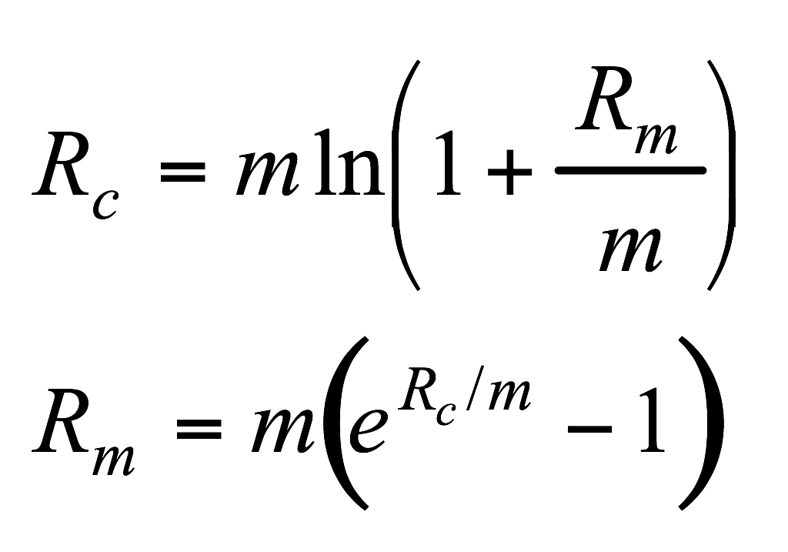
Conversion Formulas (Page 83)
Define
R_{c} : continuously compounded rate
R_{m}: same rate with compounding m times per year

Slide 12
Examples
10% with semi-annual compounding is equivalent to 2ln(1.05)=9.758% with continuous compounding
8% with continuous compounding is equivalent to 4(e^{0.08/4} -1)=8.08% with quarterly compounding
Rates used in option pricing are nearly always expressed with continuous compounding

Slide 13
LIBOR
LIBOR used to be the benchmark for interbank borrowing rates (until June 2023).
This was the rate of interest at which a AA-rated bank could borrow money on an unsecured basis from another bank
LIBOR was open to manipulation, and became controversial after several manipulation attempts were uncovered.
For this reason it was phased out over the past 5 years. It ceased being published in June 2023.

Slide 14
The new reference rates
US dollar: SOFR (secured overnight funding rate)
GBP: SONIA (sterling overnight index average
EU: ESTR (euro short-term rate), co-exists with EURIBOR
Switzerland: SARON (Swiss average overnight rate)
Japan: TONAR (Tokyo average overnight rate)

Slide 15
Repo rate
Repurchase agreement is a type of short-term borrowing where a financial institution that owns securities agrees to sell them for X and buy them back in the future (usually the next day) for a slightly higher price, Y
The financial institution obtains a loan.
The rate of interest is calculated from the difference between X and Y and is known as the repo rate

Slide 16
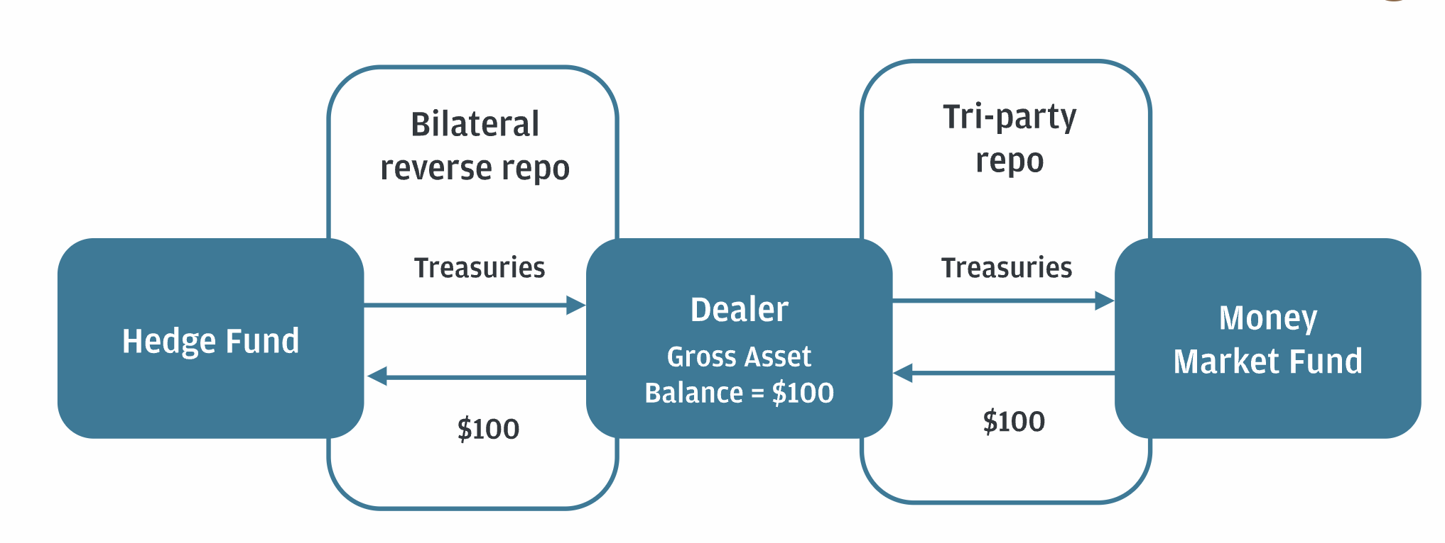
Tri-party repo
Example: hedge fund borrows cash from a money market fund using a financial institution (dealer) as intermediary

Slide 17
SOFR
The repo market is the lifeblood of Wall Street
The gross size of this market is about $5.1 trillion
The SOFR rate is calculated daily by the Federal Reserve from repo rates:
Secured
Overnight rate (1-day)
Funding rate

Slide 18
Treasury Rate
Rate on instruments issued by a government in its own currency
In the US, the US Treasury issues debt instruments:
Treasury Bills (1m, 3m, 6m, 1y)
Treasury Notes (2Y, 5Y, 7Y)
Treasury Bonds (10Y,30Y) 100Y?
https://home.treasury.gov

Slide 19
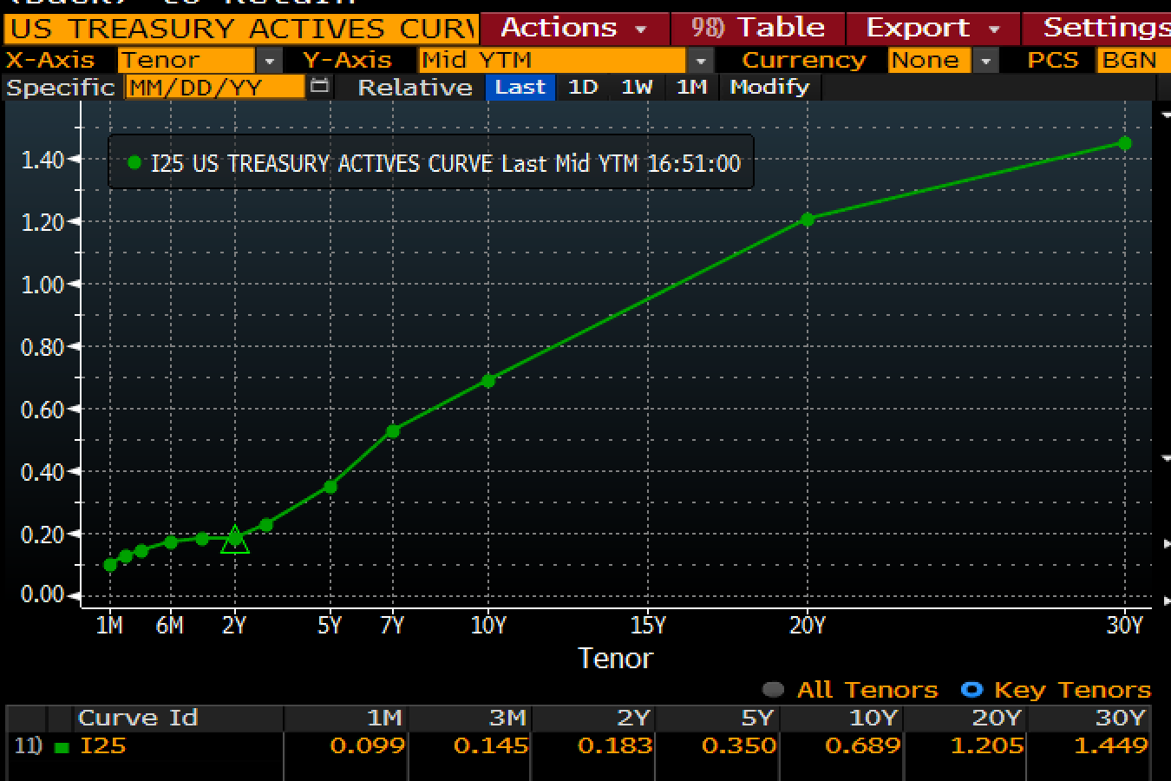
Normal shape of the Treasury curve
Published daily at https://www.treasury.gov/resource-center/data-chart-center/

Slide 20
Yield Curve Properties/Assumptions
Zero rates should be positive
Yield curve should be increasing(?)
Normal vs. Inverted yield curves
Bond investors expect to be paid more for long-term bonds than for short-term bonds.
Once in a while, short-term rates rise above long-term rates. This is called an inverted yield curve, and it is considered to anticipate a recession.

Slide 21
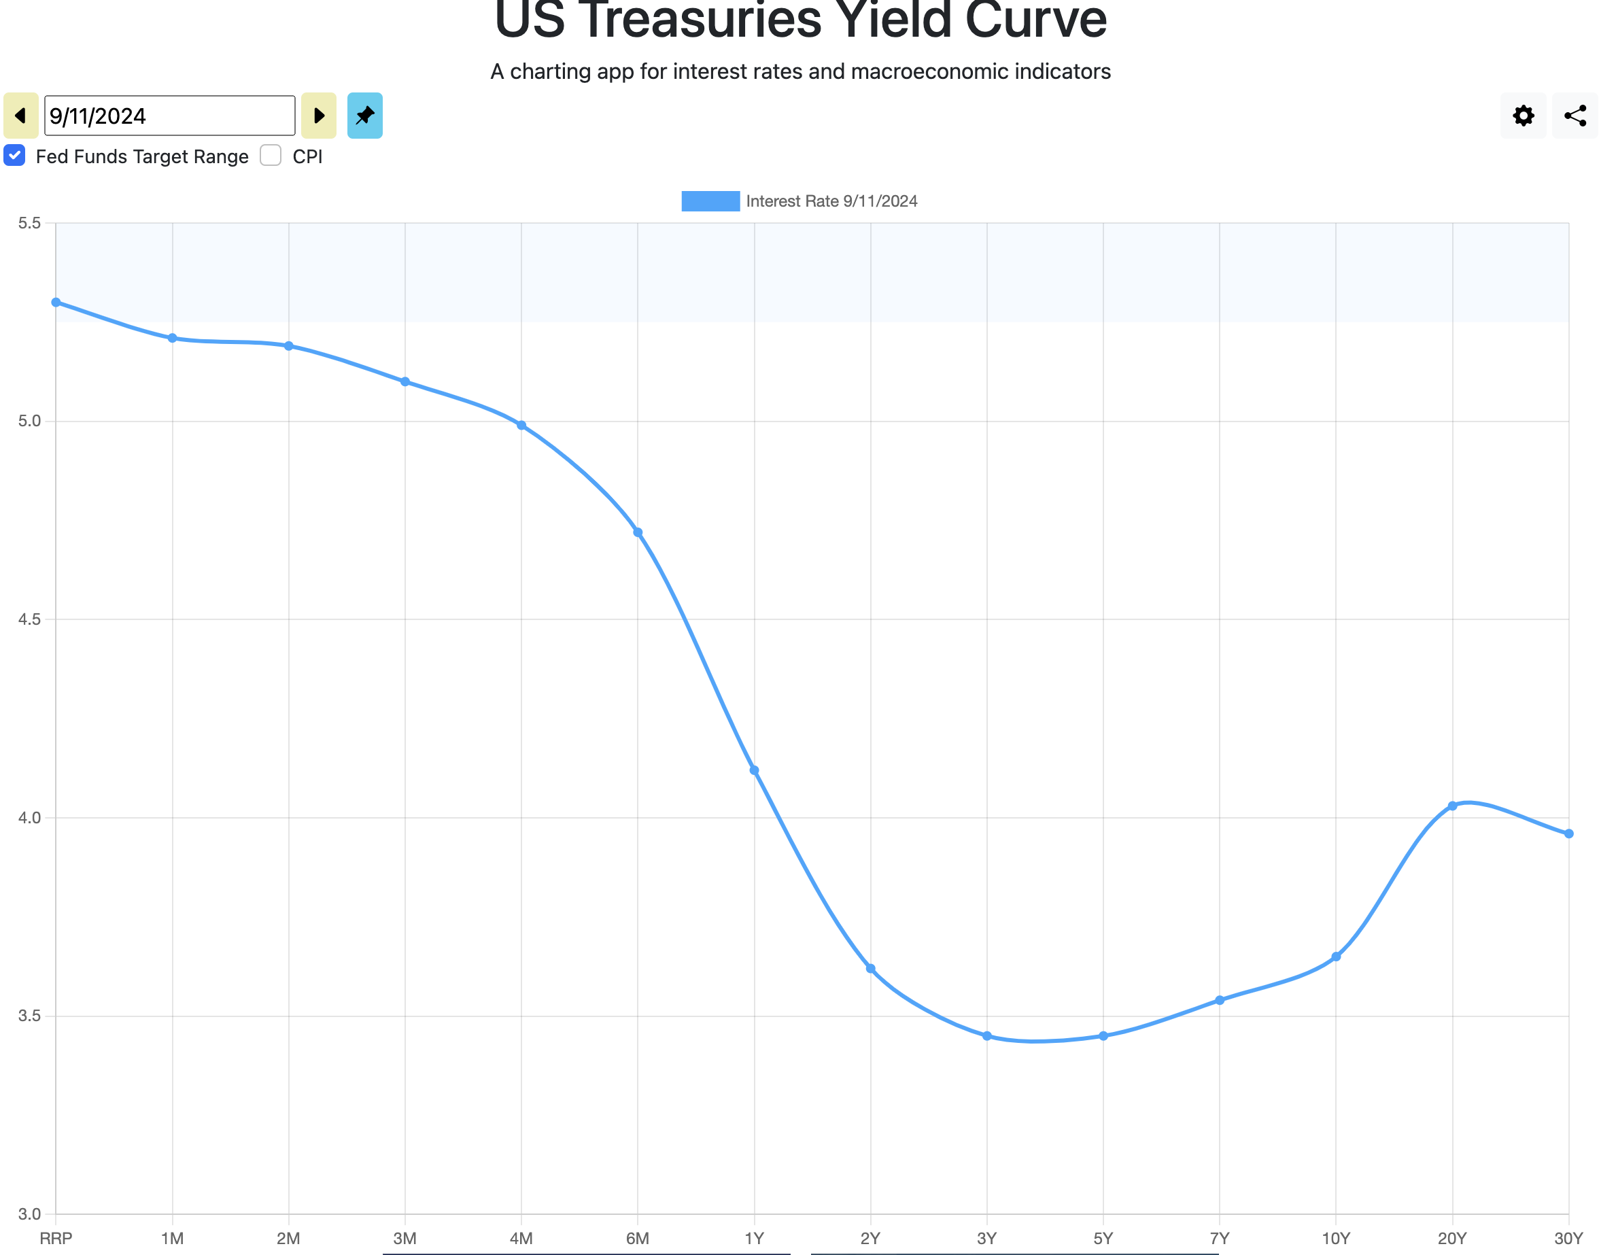
Recent Treasury yield curve
From https://www.ustreasuryyieldcurve.com/

Slide 22
The U.S. Fed Funds Rate
Unsecured interbank overnight rate of interest
Allows banks to adjust the cash (i.e., reserves) on deposit with the Federal Reserve at the end of each day
The effective fed funds rate is the average rate on brokered transactions
The central bank may intervene with its own transactions to raise or lower the rate
Similar arrangements in other countries

Slide 23
Bonds
Simplest debt instrument: issued by governments, municipalities or corporations
Pays coupons (fixed or floating, linked to a reference rate)
Can be non-callable or callable
May be converted to shares of the issuing company (convertible bonds)

Slide 24
Bond Pricing
To calculate the cash price of a bond we discount each cash flow at the appropriate zero rate
[For this lecture:] Assume bond issuer will never default

Slide 25
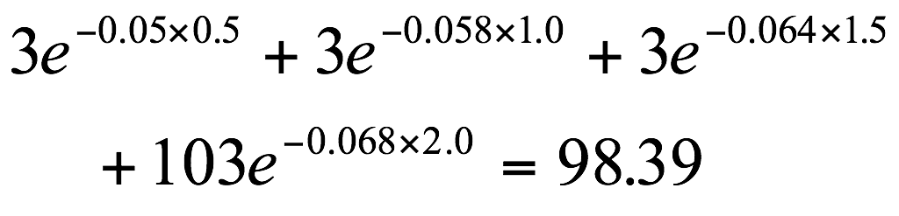
Example (Table 4.2, page 84)
Maturity (years) | Zero rate (cont. comp.)
0.5 | 5.0
1.0 | 5.8
1.5 | 6.4
2.0 | 6.8
Example: the theoretical price of a two-year bond providing a 6% coupon semiannually is

Slide 26
Bond Yield
The bond yield is the discount rate that makes the present value of the cash flows on the bond equal to the market price of the bond
Suppose that the market price of the bond in our example equals its theoretical price of 98.39
The bond yield (continuously compounded) is given by solving
to get y=0.0676 or 6.76%.

Slide 27
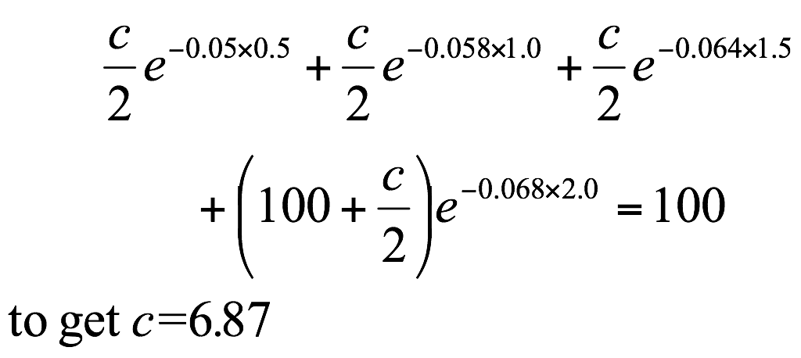
Par Yield
The par yield for a certain maturity is the coupon rate that causes the bond price to equal its face value.
In our example we solve

Slide 28
Determining the yield curve
The yield curve is the graphical representation of the zero rate R(T) plotted as a function of maturity
The yield curve can be determined from prices of bonds with several maturities, using a method called bootstrapping

Slide 29
Example: Data to Determine Zero Curve (Table 4.3, page 86)
Bond Principal | Time to Maturity (yrs) | Coupon per year ($)* | Bond price ($)
100 | 0.25 | 0 | 99.6
100 | 0.50 | 0 | 99.0
100 | 1.00 | 0 | 97.8
100 | 1.50 | 4 | 102.5
100 | 2.00 | 5 | 105.0
* Half the stated coupon is paid each year

Slide 30
The Bootstrap Method
An amount 0.4 can be earned on 99.6 during 3 months.
Because 100=99.4e^{0.01603×0.25} the 3-month rate is 1.603% with continuous compounding
Similarly the 6 month and 1 year rates are 2.010% and 2.225% with continuous compounding

Slide 31
The Bootstrap Method continued
To calculate the 1.5 year rate we solve
to get R = 0.02284 or 2.284%
Similarly the two-year rate is 2.416%

Slide 32
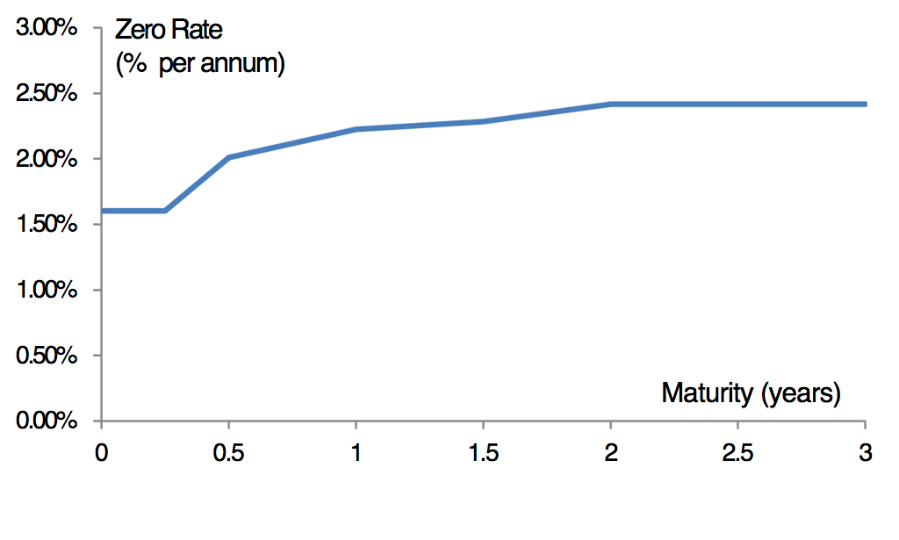
Zero Curve Calculated from the Data (Figure 4.1, page 87)

Slide 33
Forward Rates
Definition: The forward rate is the future zero rate implied by today’s term structure of interest rates

Slide 34
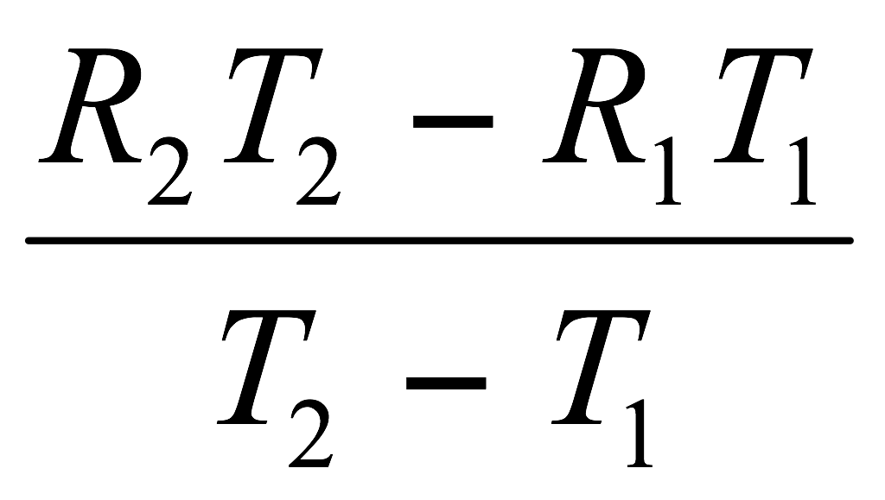
Formula for Forward Rates
Suppose that the zero rates for time periods T₁ and T₂ are R₁ and R₂ with both rates continuously compounded.
The forward rate for the period between times T₁ and T₂ is
This formula is only approximately true when rates are not expressed with continuous compounding

Slide 35
Application of the Formula
Year (n) | Zero rate for n-year investment (% per annum) | Forward rate for nth year (% per annum)
1 | 3.0
2 | 4.0 | 5.0
3 | 4.6 | 5.8
4 | 5.0 | 6.2
5 | 5.5 | 6.5

Slide 36
Bonds: Duration and convexity
The sensitivity of the bond price to changes in the yield curve is measured by duration and convexity
Duration: the slope of the price vs shift of yield curve
Convexity: the curvature of the price vs shift of yield curve

Slide 37
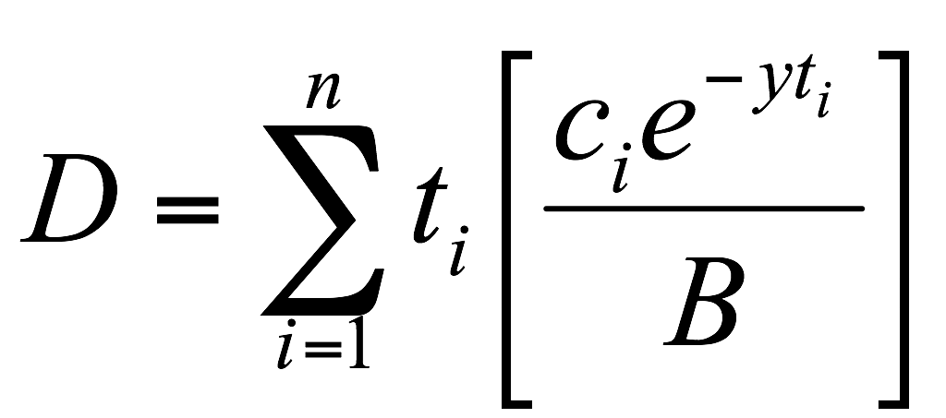
Duration (page 94-97)
Duration of a bond that provides cash flow c_{i} at time t_{i} is
where B is its price and y is its yield (continuously compounded)

Slide 38

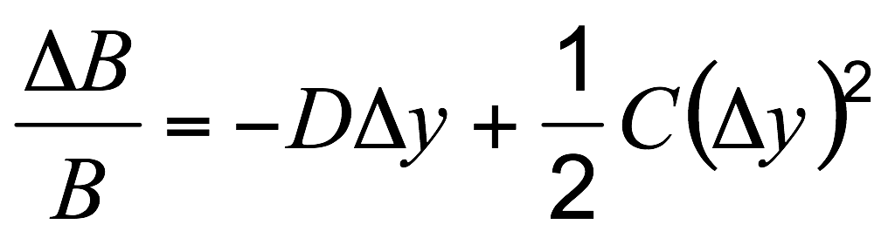
Convexity
The convexity, C, of a bond is defined as
This leads to a more accurate relationship
When used for bond portfolios it allows larger shifts in the yield curve to be considered, but the shifts still have to be parallel

Slide 39
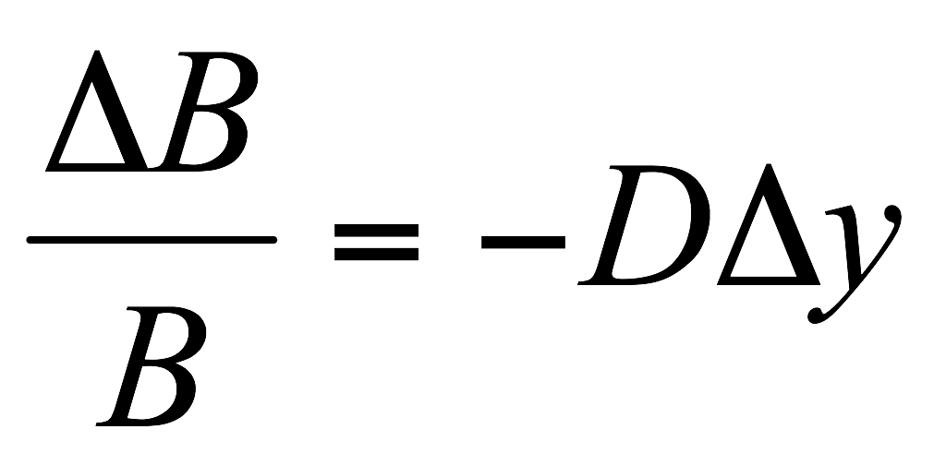
Duration and Bond Price change
Duration offers a simple (approximate) formula for the change in the price of the bond for a given change in yield.
Under this approximation, bond price changes are linear in yield changes

Slide 40
Bond Portfolios
The duration for a bond portfolio is the weighted average duration of the bonds in the portfolio with weights proportional to prices
The key duration relationship for a bond portfolio describes the effect of small parallel shifts in the yield curve
What exposures remain if duration of a portfolio of assets equals the duration of a portfolio of liabilities?

Slide 41
Forward Rate Agreement
A forward rate agreement (FRA) is an OTC agreement that a certain rate will apply to a certain principal during a certain future time period - Simplest IR derivative
R(T1,T2)
Receive R(T1,T2)
t=0 (today)
T1
T2
Pay fixed rate K

Slide 42
Forward Rate Agreement: Key Results
An FRA is equivalent to an agreement where interest at a predetermined rate, R_{K} is exchanged for interest at the market rate
An FRA can be valued by assuming that the forward interest rate, R_{F} , is certain to be realized
This means that the value of an FRA is the present value of the difference between the interest that would be paid at interest at rate R_{F} and the interest that would be paid at rate R_{K}

