Slide 1
Insurance Customer Response Prediction
A Machine Learning Project
Prepared by: [Pawan Lade]

Slide 2
Project Overview
• Goal: Predict customer responses to insurance offers using machine learning.
• Helps improve targeted marketing and policy sales efficiency.
• Analyzes customer behavior to optimize sales strategies.

Slide 3
Data Exploration
• Total records: 381,109 and 12 columns.
• Target column: Response (1 = Responded, 0 = Not Responded).
• Numeric: Age, Annual_Premium, Vintage.
• Categorical: Gender, Driving License, Region Code, etc.
• Data is imbalanced — only 12.3% positive responses.

Slide 4
Data Insights
• Most customers aged 20–60 years.
• Customers with previous Vehicle Damage respond more often.
• Uninsured customers more likely to accept offers.
• Older vehicles have higher response rates.

Slide 5
Data Preprocessing
• Checked for missing values — none found.
• Encoded categorical variables using Label Encoding.
• Scaled numeric features with StandardScaler for balance.
• Prepared clean dataset ready for model training.

Slide 6
Feature Engineering
• Age_Group – Categorized customers by age.
• Premium_per_Vintage – Premium per day with company.
• Is_Young_and_Unlicensed – Checks if young & unlicensed.
• Vehicle_Age_Encoded and Vehicle_Damage_Encoded – Converted to numeric.

Slide 7
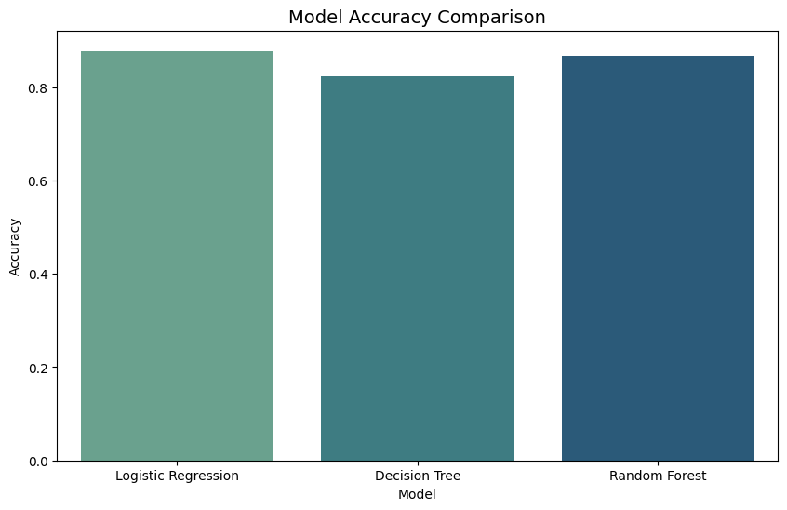
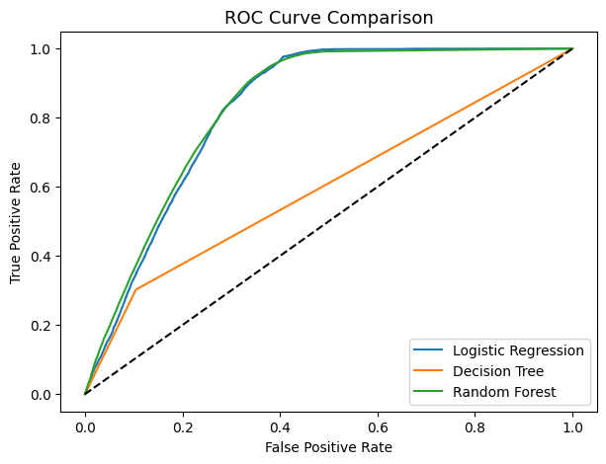
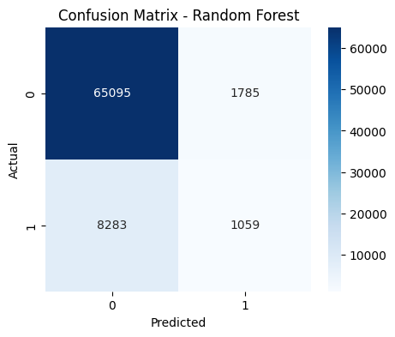
Model Selection
• Evaluated: Logistic Regression, Decision Tree, Random Forest.
• Compared metrics: Accuracy, Precision, Recall, F1-Score, ROC-AUC.
• Random Forest achieved best accuracy and stable performance.

Slide 8
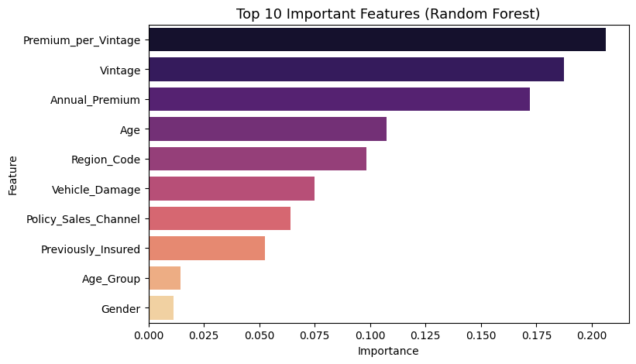
Model Performance Summary
• Logistic Regression: Accuracy 72%, Recall 0.89, ROC-AUC 0.86.
• Decision Tree: Accuracy 82%, moderate recall.
• Random Forest: Accuracy 85%, best overall performance.

Slide 9
Model Visualizations
• ROC Curve comparison shows Random Forest leading.
• Confusion Matrix indicates strong classification power.
• Feature Importance: Vehicle Damage, Age, Vintage most significant.

Slide 10
Insights & Conclusion
• Vehicle Damage and Uninsured status strongly impact response.
• Older vehicles show higher interest in offers.
• Random Forest chosen for final deployment.
• Supports data-driven marketing and customer engagement.

