Slide 1
Northeastern University: A Comprehensive Overview
Exploring the History, Programs, and Achievements of a Top-Tier University

Slide 2
Northeastern University: A Comprehensive Overview
Exploring the History, Programs, and Achievements of a Top-Tier University

Slide 3
Introduction
Northeastern University: Its History and Impact
Renowned Programs and Academic Achievements
Student Life and Campus Resources
Co-op Education and Career Opportunities
Notable Alumni and Their Contributions

Slide 4
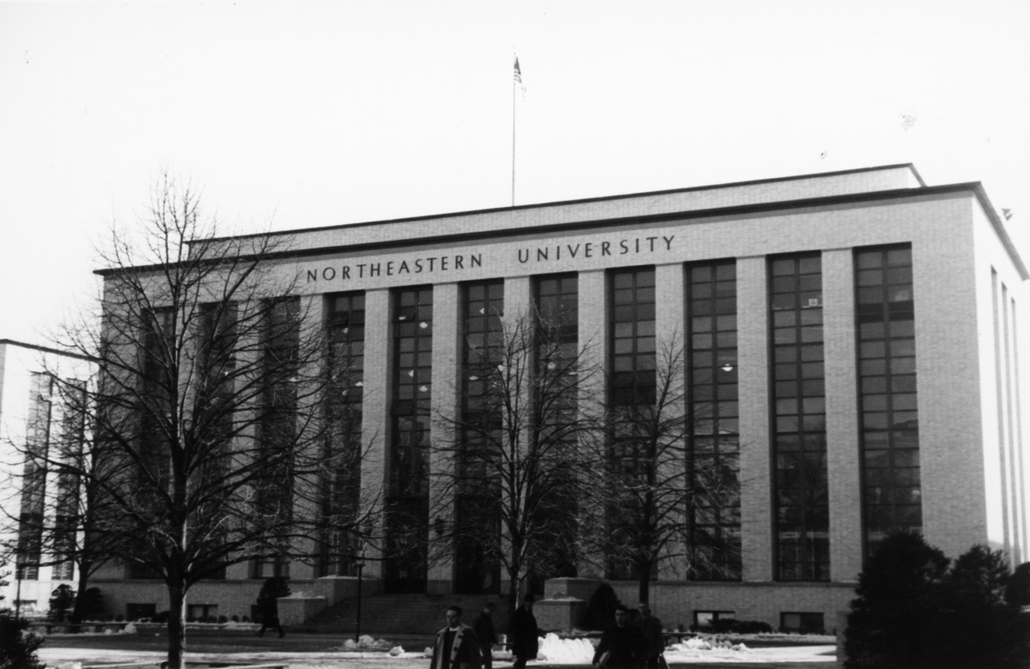
A Rich History
Founding, Growth, and Innovation
Founded in 1898 in Boston, Massachusetts
Originally established as a evening school for working class men and women
Transitioned to coeducational institution in 1943
Transformed into a research university in the 1970s and 1980s
Today, a globally recognized institution with over 27,000 students

Slide 5

Academic Excellence
Ranked #40 in National Universities by U.S. News & World Report (2023)
Distinguished programs in:
Engineering
Business
Computer Science
Health Sciences
Over $246 million in annual research expenditures
2,000+ faculty members engaged in research

Slide 6
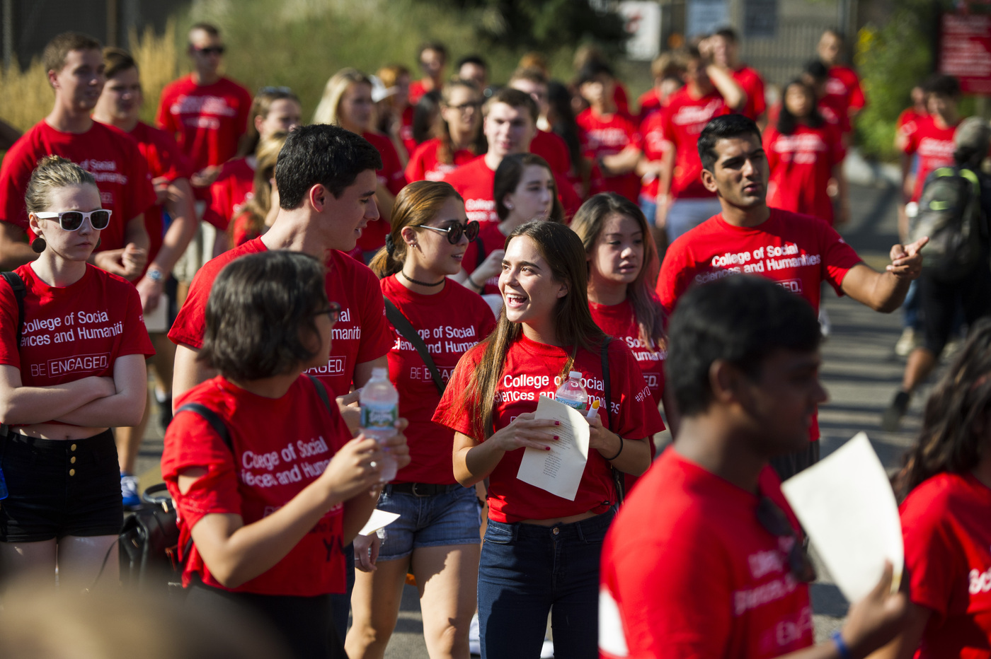
Student Life
Campus Resources and Opportunities
200+ student organizations
30+ fraternities and sororities
33 NCAA Division I athletic teams
State-of-the-art facilities:
Curry Student Center
Marino Recreation Center
Snell Library
Study abroad and experiential learning programs

Slide 7
Cooperative Education
Over 3,100 employer partners in 140+ countries
70% of students participate in co-ops
Average starting salary for co-op students: $20/hour
Career services:
Career fairs and workshops
Employer information sessions
Personalized career counseling

Slide 8

Alumni Success Stories
Impacting the World
Notable alumni:
Doug Flutie (Football Hall of Famer)
Renée Richards (Tennis Player and Transgender Pioneer)
Paula Johnson (First Female President of Wellesley College)
Shaquille O'Neal (NBA Hall of Famer and Businessman)
Alumni contributions in:
Business
Sports
Science and Technology
Healthcare
Education

Slide 9
Key Takeaways
Northeastern University's rich history and impact
Renowned programs and academic achievements
Engaging student life and campus resources
Preparation for careers through co-op education
Successful alumni contributing to various fields

