Slide 1
Domain-Specific LLM Adaptation: Transformer Pipeline for Medical Question Answering
A Case Study on Fine-Tuning FLAN-T5 for Medical Question Answering
By: Sai Pavan Reddy Doddam Reddy

Slide 2
Motivation & Research Questions
Why Medical QA?
Increasing demand for AI in clinical and biomedical applications.
Generic LLMs struggle with factual consistency in specialized domains.
Research Questions:
Can FLAN-T5 be adapted for accurate medical QA?
How does fine-tuning aﬀect factuality, accuracy, and semantic relevance?

Slide 3
Related Work
BioBERT, SciBERT – pre-trained biomedical LMs.
PubMedGPT, Galactica – large-scale medical/citation-based models.
FLAN-T5 – instruction-tuned but not domain-specific.

Slide 4
Methodology –Model Overview
Model Used:
FLAN-T5 Base (pretrained, instruction-tuned).
Fine-tuned separately.
PubMedQA (generative QA).
MedMCQA (multiple-choice QA).

Slide 5
Methodology –Datasets
Datasets:
PubMedQA: 1,000+ biomedical research Q&A with abstracts and long-form answers.
MedMCQA: 194k+ questions from medical exams (NEET PG, AIIMS), MCQ format.
Preprocessing:
Tokenization, truncation, format standardization.

Slide 6
Methodology –Training Approach
Used Hugging Face Transformers & PyTorch.
Batch size: 4, Learning rate: 3e-4, Epochs: 2.
Evaluation on test set after each epoch.
GPU: Google Colab (T4).

Slide 7
Evaluation Metrics
Generative QA (PubMedQA):
ROUGE-1, ROUGE-2, ROUGE-L.
BLEU.
F1 Score.
BERTScore.
USEScore.
Exact Match (EM).
Multiple Choice QA (MedMCQA):
Accuracy

Slide 8
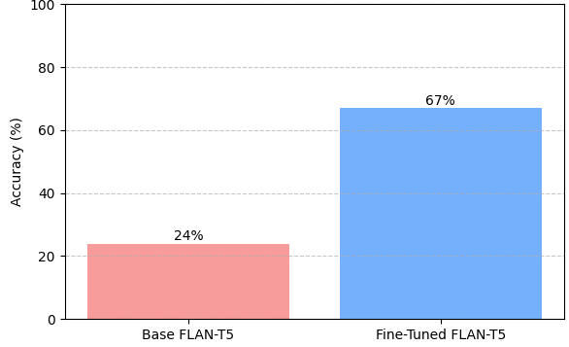
Results – MedMCQA Accuracy
Model | Accuracy
Base FLAN-T5 | 24%
Fine-tuned | 67%

Slide 9
Results – PubMedQA Metrics
Metric | Base | Fine-Tuned
ROUGE-1 | 17.53% | 26.21%
ROUGE-2 | 6.45% | 9.43%
ROUGE-L | 14.37% | 20.21%
BLEU | 0.44% | 2.32%
F1 SCORE | 0.1380 | 0.2048
Exact Match (EM) | 0.00 | 0.00
BERT SCORE F1 | 0.8462 | 0.8783
USE SCORE | 0.3191 | 0.4421

Slide 10
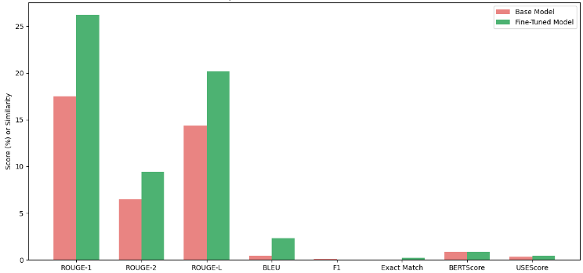
Results – PubMedQA Metrics

Slide 11
Qualitative Analysis
PubMedQA Predictions:
Q: Does vitamin D supplementation reduce the risk of respiratory infections?
Context: Vitamin D is known for immune support and may affect respiratory health.
Predicted Answer: Vitamin D is an important component of a healthy immune system and may be a factor in the prevention of respiratory infections.
Q: What are the long-term effects of chemotherapy on cognitive function?
Context: Chemotherapy is a common cancer treatment that may have side effects.
Predicted Answer: Alzheimer's disease is a common side effect of chemotherapy.
Q: Is there a link between gut microbiota and autoimmune diseases?
Context: Gut microbiota influences many aspects of human health and immune function.
Predicted Answer: Gut microbiota plays an important role in the development of autoimmune diseases.

Slide 12
Qualitative Analysis
MedMCQA Predictions:
Q: Which vitamin deficiency causes scurvy?
Options: ['Vitamin A', 'Vitamin C', 'Vitamin D', 'Vitamin B12']
Predicted Answer: Vitamin A
Q: The primary function of the sinoatrial node in the heart is to:
Options: ['Pump blood to the lungs', 'Initiate the heartbeat', 'Regulate blood pressure', 'Filter blood']
Predicted Answer: Regulate blood pressure
Q: Which antibiotic is effective against Gram-positive bacteria?
Options: ['Ciprofloxacin', 'Penicillin', 'Metronidazole', 'Amphotericin B']
Predicted Answer: Amphotericin B

Slide 13
Challenges & Limitations
Challenges:
Limited compute and memory.
Domain complexity.
Noisy labels in training data.
Limitations:
Lack of factual grounding.
Small fine-tuning set size.
No external medical knowledge integration.

Slide 14
Future Work
Incorporate retrieval-augmented generation (RAG).
Explore instruction tuning with clinical prompts.
Multi-modal inputs: images, patient charts.
Larger medical LLMs (e.g., GatorTron, MedPaLM.

Slide 15
Conclusion
Fine-tuning FLAN-T5 improves accuracy and semantic quality for domain-specific QA.
Results highlight the value of task-specific adaptation.
Substantial gains on both datasets using relatively small fine-tuning setups.

Slide 16
Thank You

