Slide 1

Fruit Recognition & Classification System
An intelligent, automated solution powered by Computer Vision and Deep Learning — transforming how fruits are identified, sorted, and managed across agriculture, food processing, and retail.
COMPUTER VISION
DEEP LEARNING
CNN ARCHITECTURE

Slide 2
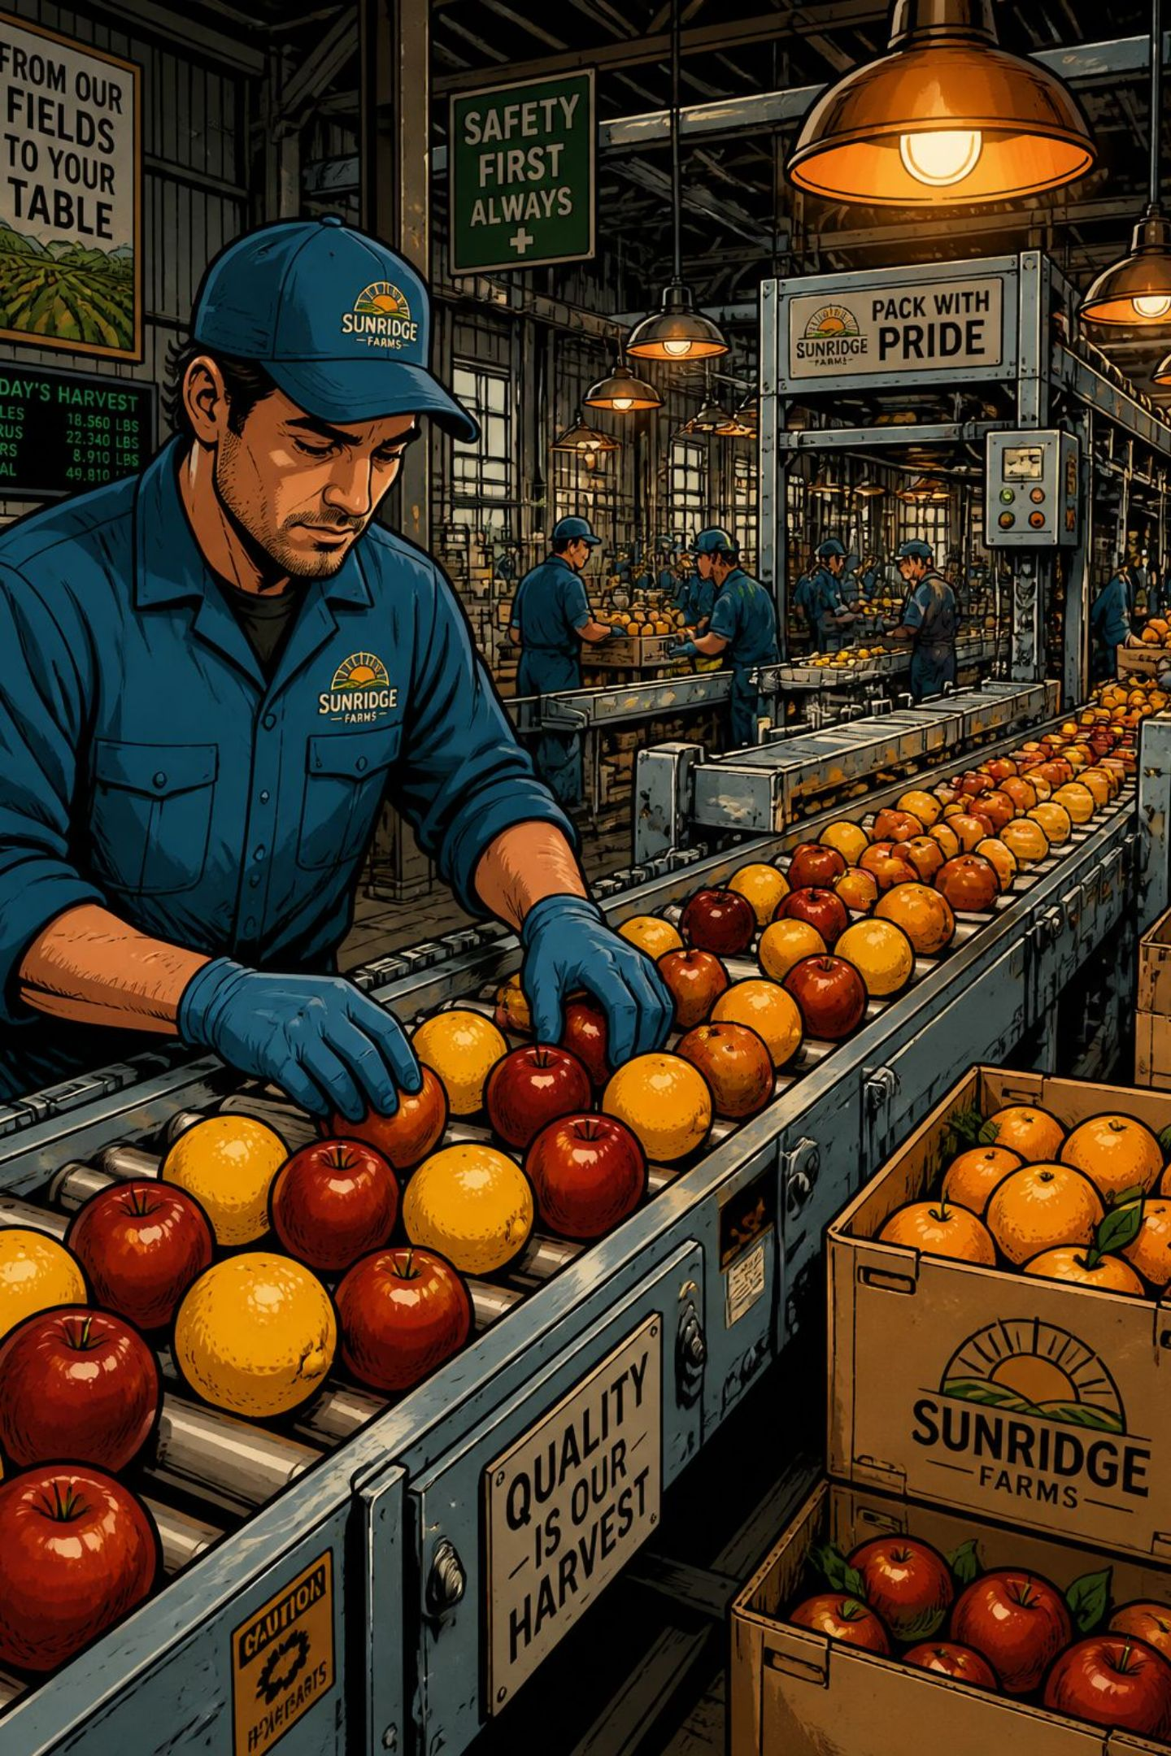
The Challenge: Manual Classification Is Broken
Human-based fruit identification is slow, inconsistent, and error-prone — especially at scale.
🌈 Visual Variability
Fruits vary widely in size, shape, color, texture, and ripeness — even within the same species.
💡 Lighting Conditions
Ambient light, shadows, and reflections distort appearance, reducing human and machine accuracy.
⏱️ Speed & Scale
High-volume sorting lines demand sub-second decisions that manual inspection simply cannot deliver.
📉 Inconsistency
Subjective judgment leads to misclassification, waste, and financial loss across the supply chain.

Slide 3
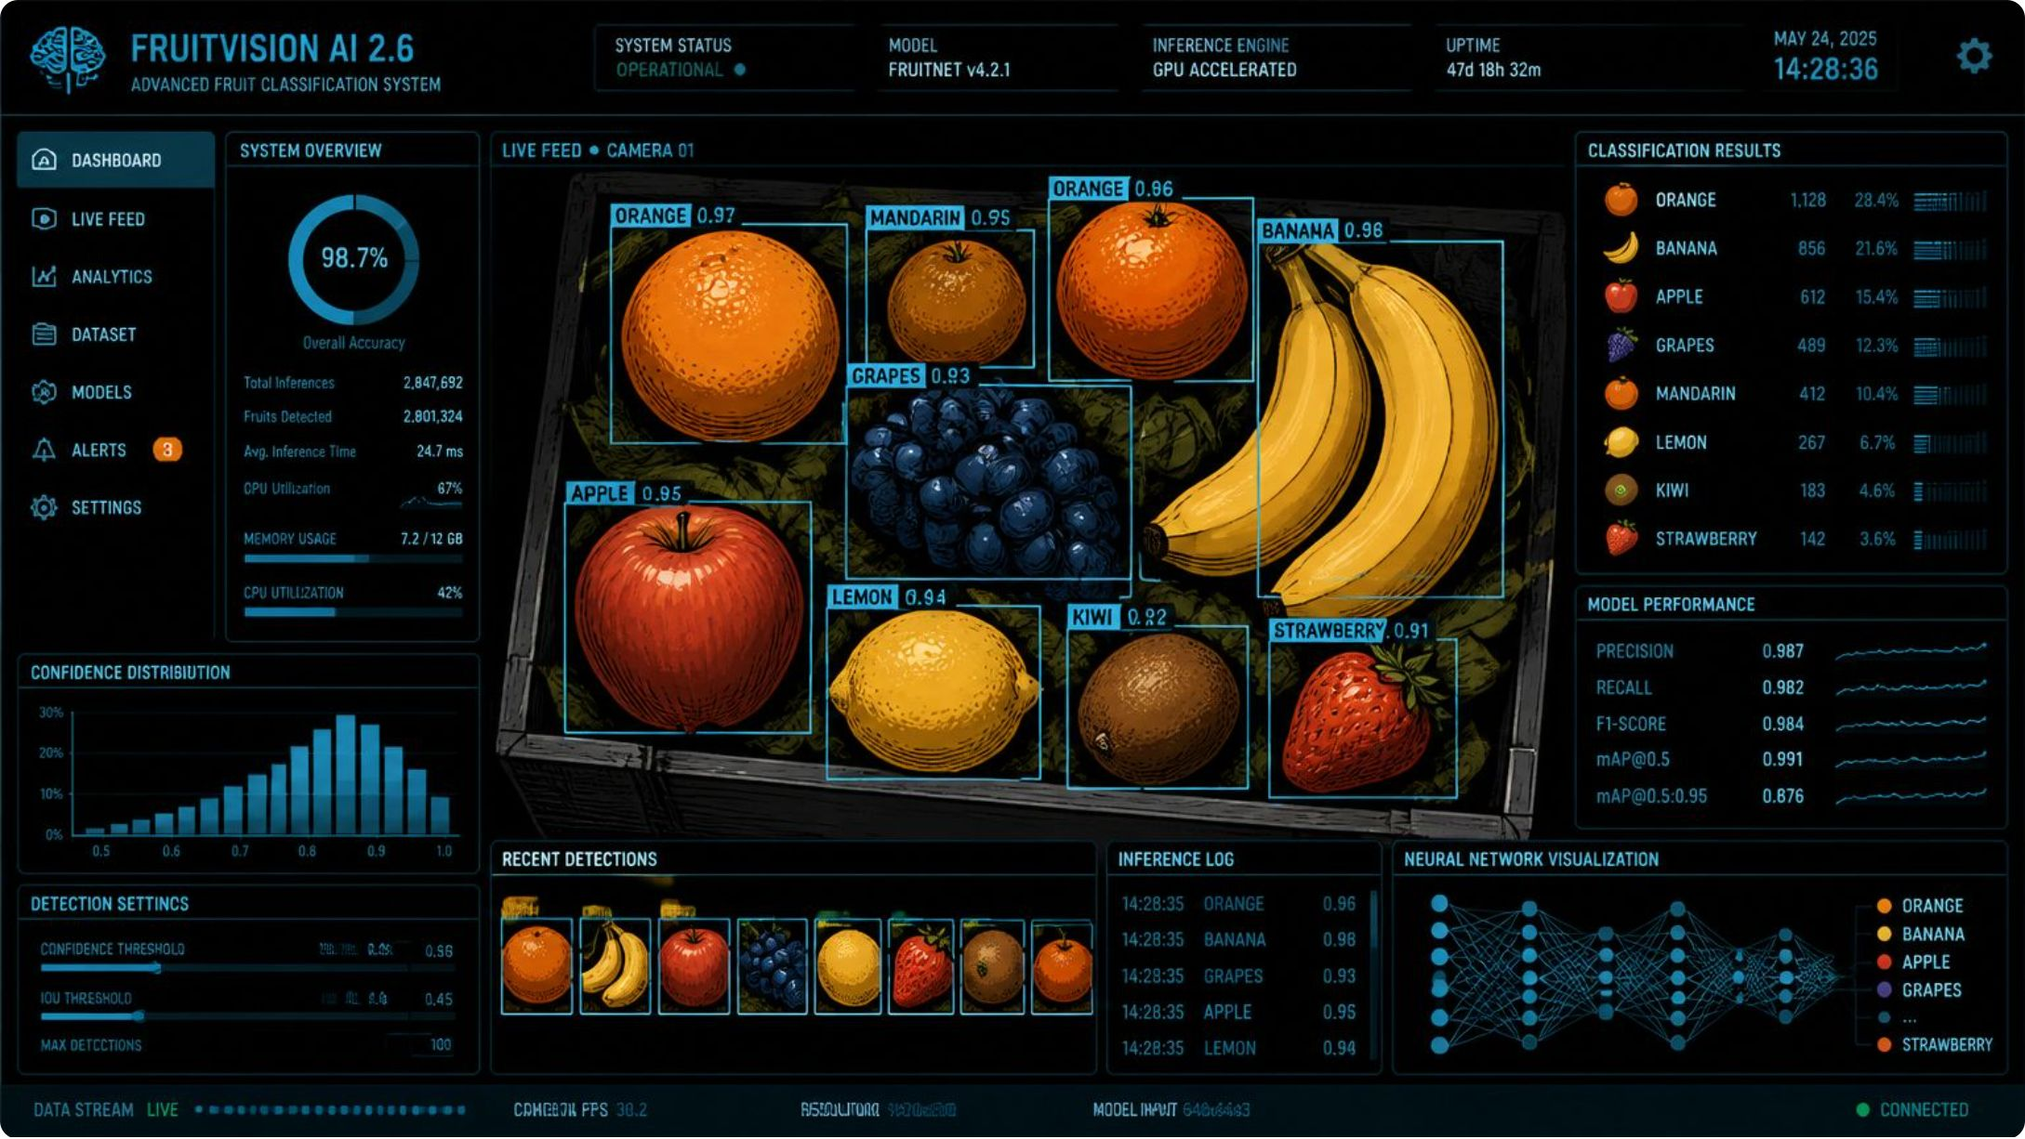

The Proposed Solution
Automated Image-Based Recognition
The system accepts an uploaded fruit image and returns an instant, accurate classification — complete with a confidence score and visual result overlay.
Upload a fruit image via web or API interface
Process the image through a trained CNN pipeline
Receive a classified label with confidence metrics in real time

Slide 4

Complete System Workflow
Acquire Images
Preprocess
Augment Data
Extract Features
Each stage is optimized to maximize accuracy and minimize false classifications — from raw image capture through final confidence-scored output.

Slide 5
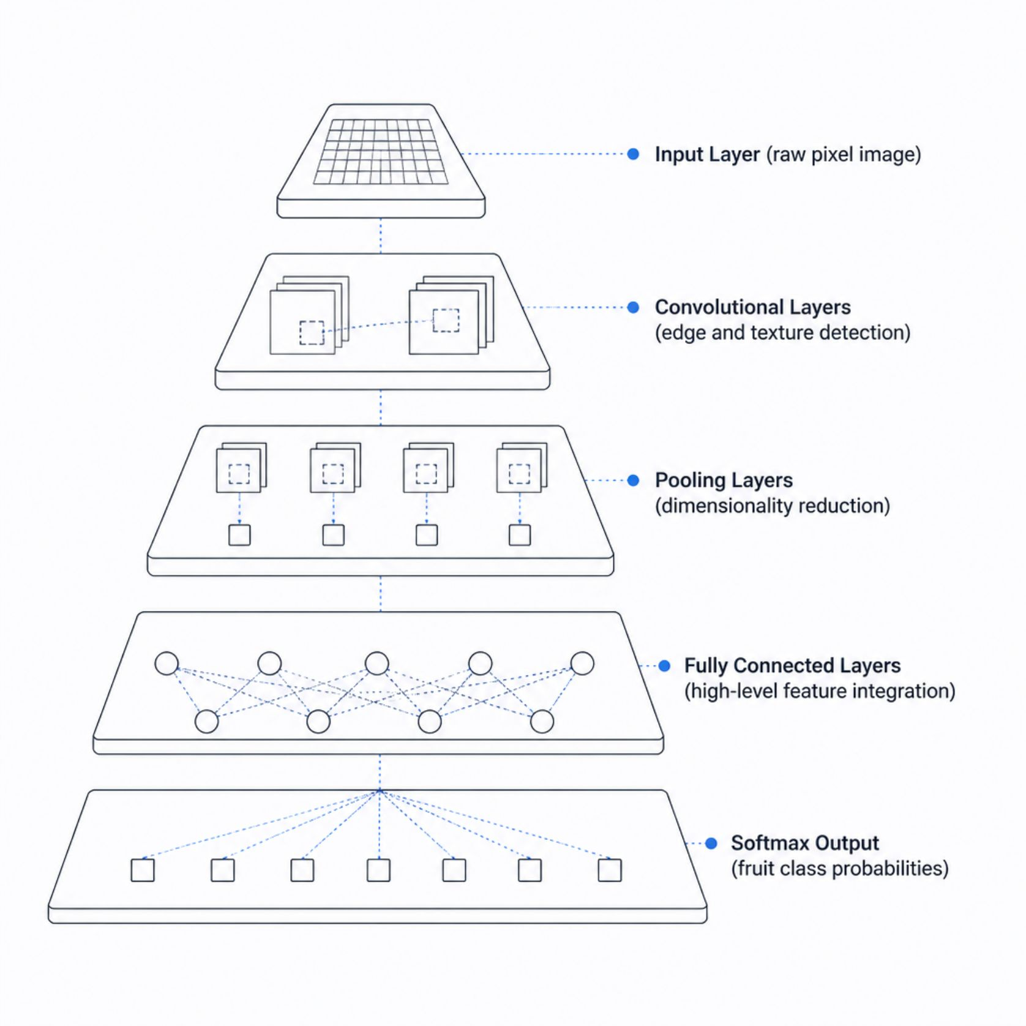

Why CNNs? The Engine Behind Recognition
Convolutional Neural Networks
CNNs excel at image tasks because they automatically learn spatial hierarchies of features — edges, textures, shapes, and color patterns — directly from pixel data.
Spatial Awareness
Parameter Efficiency
Transfer Learning Ready
Preserves positional relationships between pixels, critical for shape-based fruit ID.
Weight sharing reduces overfitting and computational cost vs. fully connected networks.
Pre-trained models (ResNet, VGG, EfficientNet) accelerate training with limited data.

Slide 6
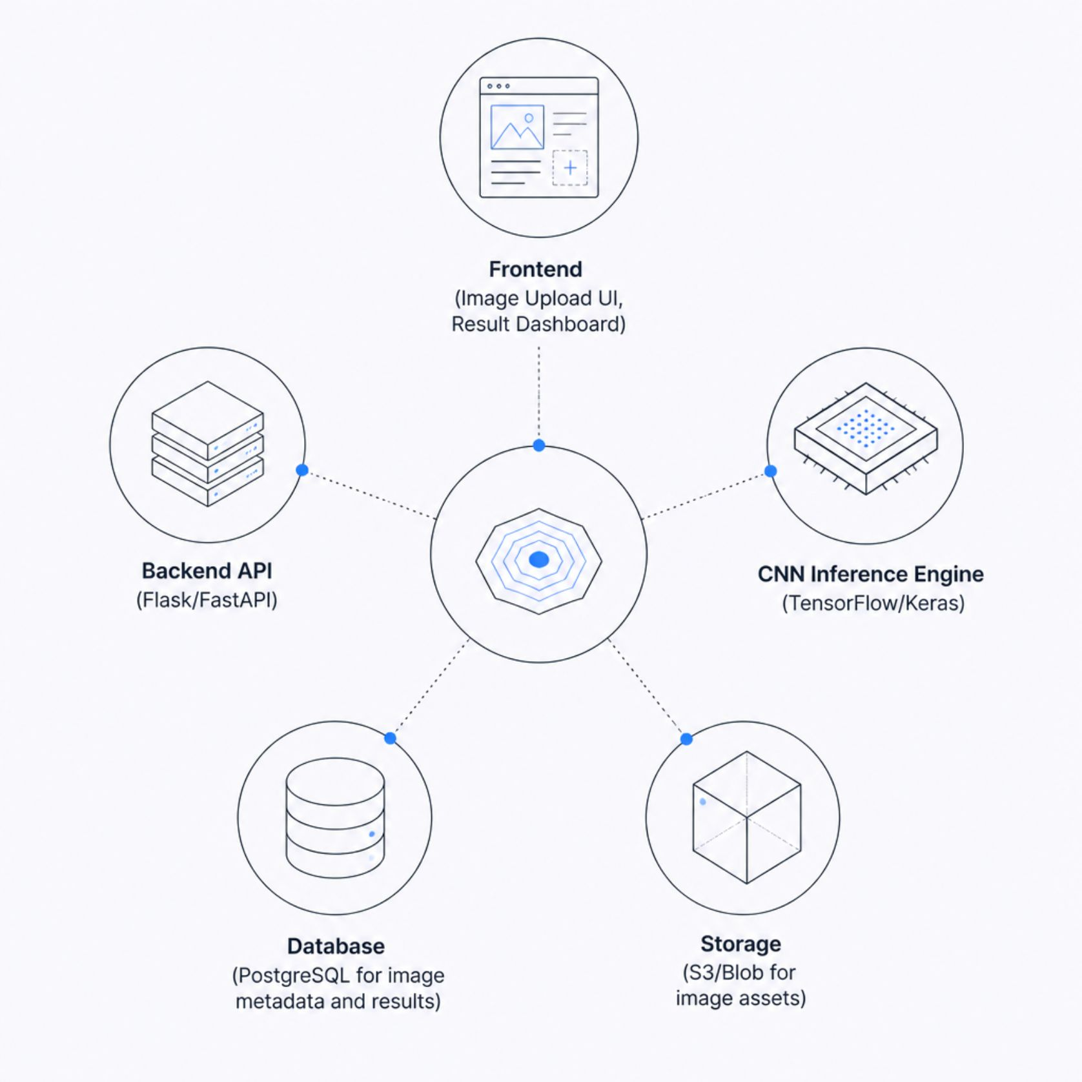
System Architecture & Technology Stack
Core Technologies
🐍 Python
🧠 TensorFlow / Keras
Primary language for ML pipelines and backend services
Model architecture, training, and inference deployment
🖼️ OpenCV
☁️ Flask / FastAPI
Image preprocessing, augmentation, and real-time capture
RESTful API layer connecting frontend to inference engine

Slide 7

Dataset, Training & Evaluation
01
Dataset Collection
Curated image datasets (e.g., Fruit-360, custom field photos) with diverse lighting, angles, and ripeness stages.
02
Annotation & Preprocessing
Images labeled by class, resized, normalized, and augmented (rotation, flip, zoom) to expand training diversity.
03
Training & Validation Split
80/20 train-validation split; k-fold cross-validation ensures robust generalization across unseen data.
04
Performance Evaluation
Metrics computed on held-out test set: Accuracy, Precision, Recall, F1-Score, and Confusion Matrix.

Slide 8
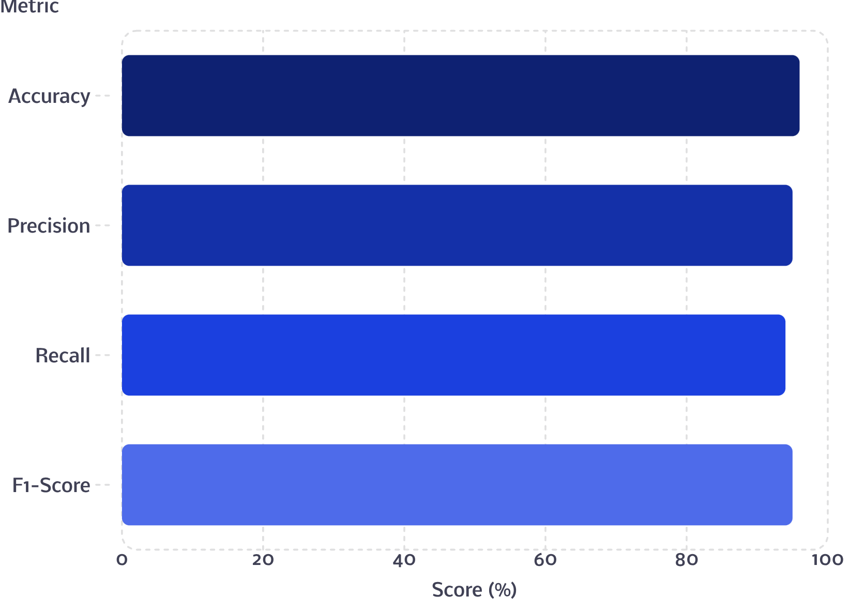

Performance Metrics at a Glance
What Each Metric Tells Us
Accuracy
Precision
Overall correctness across all fruit classes.
Of predictions for a class, how many were correct? Minimizes false positives.
Recall
F1-Score
Of actual instances of a class, how many were found? Minimizes false negatives.
Harmonic mean of Precision and Recall — a balanced single-number performance indicator.
Illustrative benchmark values — actual scores depend on dataset size, model architecture, and training configuration.

Slide 9




Key Features & Real-World Applications
System Capabilities
Where It's Deployed
Real-Time Prediction
🌾 Agriculture
🏭 Food Processing
Sub-second classification on standard hardware or edge devices.
Harvest sorting, quality grading, yield estimation
Automated conveyor sorting, defect detection
Flexible Upload Interface
Web UI, REST API, or mobile camera integration.
🛒 Supermarkets
🎓 Research & Education
Self-checkout identification, inventory management
Confidence Scoring
Botanical studies, ML training datasets, academic research
Every prediction includes a probability score for decision transparency.
Classification Reports
Detailed per-class metrics and confusion matrices for auditing.

Slide 10







Scalability, Security & the Road Ahead
Scalability
Cloud-native deployment supports thousands of concurrent requests; new fruit classes added via incremental retraining.
Security & Reliability
Encrypted data pipelines, role-based access control, and model versioning ensure production-grade robustness.
Mobile & Edge
TensorFlow Lite enables on-device inference for field use — no internet connection required.
Future Enhancements
Ripeness grading, disease detection, multi-fruit scene recognition, and integration with robotic sorting arms.
Bottom Line: This system eliminates manual classification bottlenecks, achieves >95% accuracy across diverse fruit categories, and delivers measurable operational efficiency gains across agriculture and retail.

