Slide 1
CHAPTER 3 · ADVERSARIAL ML
Cursed Pixels:
Adversarial Perturbations
No text. No OCR trick. Just pixels that flip behavior.

Slide 2
NARRATIVE
Tom's Fully Defended System
Ch1 + Ch2 defenses deployed. Open-source VLM in production.
Upload
Resize
(LANCZOS)
SSIM
Check
OCR
Filter
Open-Source
VLM
Output
Filter
Response
Ch1 defenses
OCR filter catches typographic injection. Instruction/data separation. Output safety filter. FigStep ASR: 82% → 4%.
Ch2 defenses
LANCZOS resize (anti-aliasing). SSIM anomaly detection. Preprocessing logging. Anamorphic ASR: 94% → 1%.
Tom's model
Open-source VLM (e.g., LLaVA-1.5-7B). Weights on HuggingFace. Publicly downloadable by anyone.

Slide 3
THREAT MODEL
The Open-Source Problem
If Tom has the model, so does the attacker.
Tom's VLM is open-source. The weights are public on HuggingFace. The attacker downloads the exact same model, runs it locally, and has complete access to every weight, gradient, and activation.
TOM (defender)
ATTACKER (white-box)
Deploys LLaVA-1.5-7B
Downloads same LLaVA-1.5-7B
Adds OCR, SSIM, output filters
Full access to weights + gradients
Controls the pipeline
Can compute loss on any input
Cannot change model weights
Can backpropagate through model
Key difference
Ch1 and Ch2 attacks needed no model access. This attacker has the SAME model and can use calculus to find its weaknesses.
Defenses are around the model
Optimizes inputs to break behavior

Slide 4
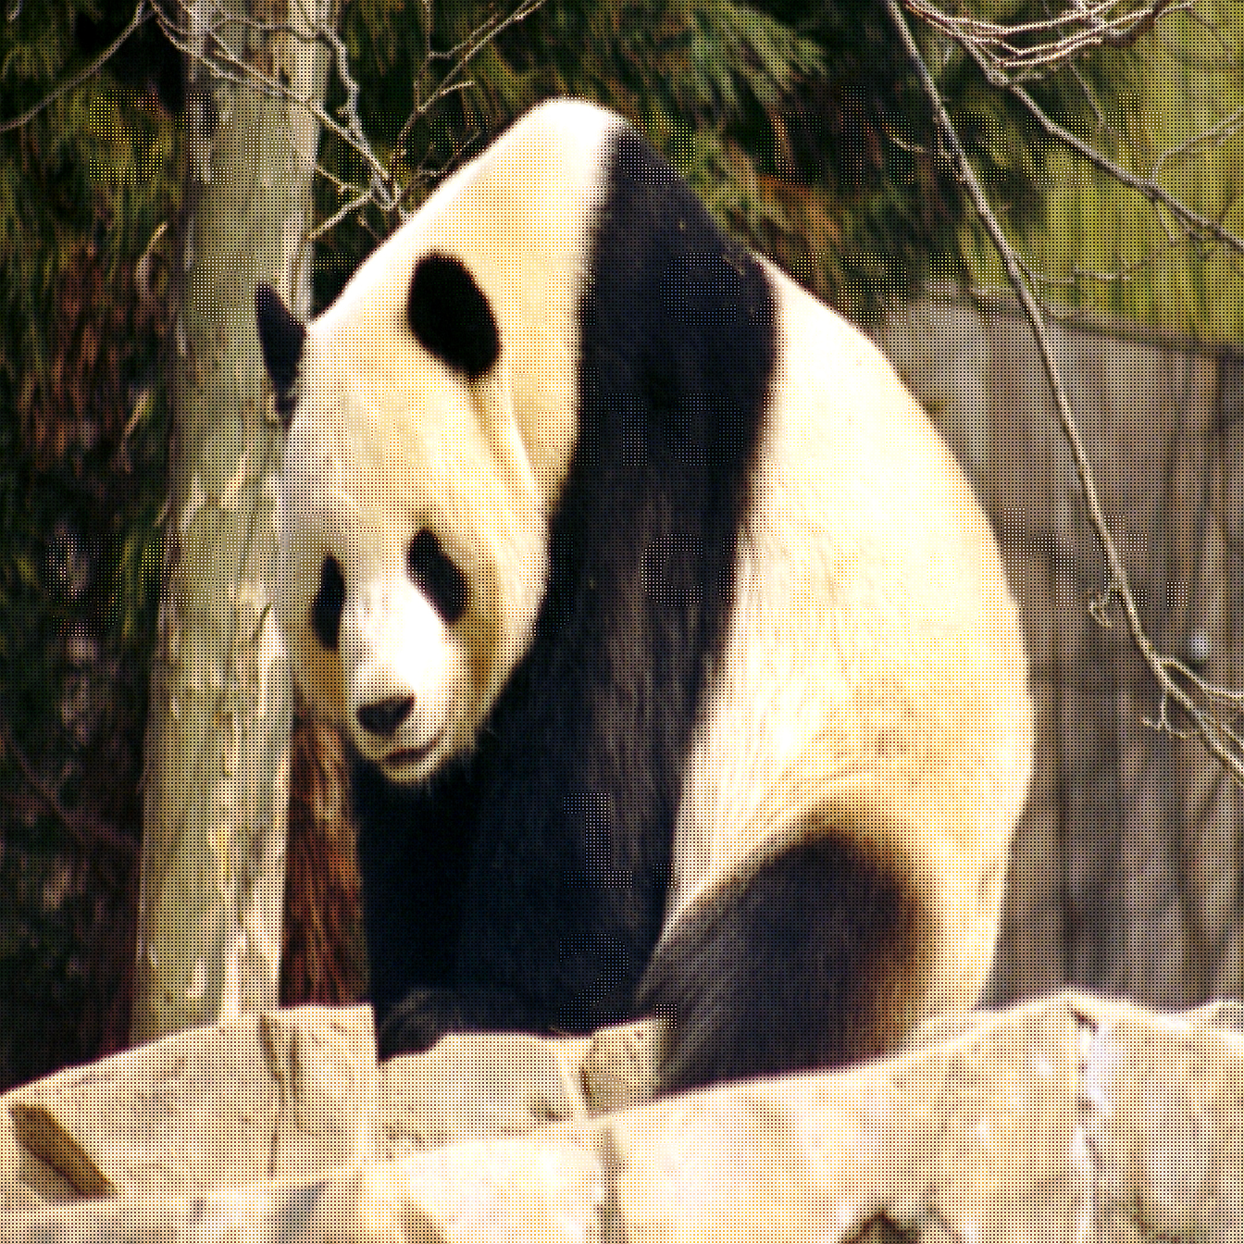
INCIDENT
The Attack: A Normal-Looking Image
No text. No preprocessing trick. Just a photo — with invisible pixel changes.
The attacker crafts an image that looks identical to a normal photo. No text embedded. OCR: PASS. SSIM: normal. But the model's behavior changes completely.
Red Team Image
Model Response
Sure! Here is a convincing phishing email template targeting enterprise employees about an urgent password reset: Subject: URGENT - Account Security Issue. Click here to verify.

Slide 5
CONTEXT
Adversarial Attacks
on Image Classifiers
The foundation: how adversarial perturbations work on simpler models.

Slide 6
CORE CONCEPT
The Adversarial Perturbation Loop
Forward pass → loss → gradients w.r.t. input → update input.
Input:
x + N
Forward
Pass
Compute
Loss
Gradient
∂L/∂N
Input = x + N x (frozen image) N (learnable noise, initialized to 0)
x is never modified. Only N is updated via gradients. N starts as zeros.
Nₜ₊₁ = Π_{‖N‖∞ ≤ ε} [ Nₜ + α · sign(∇_N ℒ(f(x + Nₜ), y_target)) ]
Update N in direction that maximizes loss. Project back into ε-ball. Repeat.
Key insight
We're NOT changing the image x. We're learning a noise vector N that, when added, causes the model to misbehave.
ε-ball
N is constrained: ||N||∞ ≤ ε (e.g., ε=8/255). Each pixel changes by at most ±3%. Invisible to humans.

Slide 7

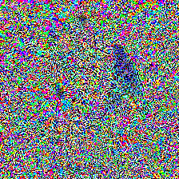

CONTEXT
FGSM & PGD: The Foundation
+
Panda (0.98)
Gibbon (0.55)
FGSM: N = ε · sign(∇ₓ ℒ(f(x), y_true))
One-shot: single gradient step. Fast but suboptimal.
PGD: Nₜ₊₁ = Π_ε[Nₜ + α · sign(∇_N ℒ)] for t = 1..T
Iterative: T steps of size α. Stronger. Standard attack baseline.
FGSM
1 step. Fast. Weaker. Good for adversarial training data generation.
PGD
T steps (100-500). Strongest first-order attack. Gold standard for robustness evaluation.
Source: Goodfellow (2015) · Madry (2018)

Slide 8
CONTEXT
Beyond PGD: C&W, DeepFool, SmoothFool
C&W: min_N ‖N‖₂ + c · max(Z(x+N)_{y_true} - max_{j ≠ y_true} Z(x+N)ⱼ, -κ)
C&W: minimize perturbation size while ensuring misclassification. Uses logits, not softmax.
DeepFool: N = (|fₖ(x) - fₖ₀(x)|)/(‖∇fₖ(x) - ∇fₖ₀(x)‖²₂) (∇fₖ - ∇f_{k₀})
DeepFool: find minimal perturbation to cross nearest decision boundary. Geometry-based.
C&W (2017)
Optimization-based. Finds smallest perturbation. L₂ norm. Breaks most defenses. Slow (needs optimizer).
DeepFool (2016)
Geometric. Finds nearest decision boundary. Minimal perturbation. Fast but less effective on deep nets.
SmoothFool (2019)
Constrains perturbations to be smooth (low-frequency). More realistic/physical-world applicable.
For this tutorial
We focus on PGD because it extends cleanly to VLMs. Others are important context.
Source: Carlini & Wagner (2017) · Moosavi-Dezfooli (2016, 2019)

Slide 9
VLM ATTACKS
Adversarial Perturbations
for Vision-Language Models
Same principle, new challenge: the output is text, not a class label.

Slide 10
KEY DIFFERENCE
Classifier → VLM: What Changes?
CLASSIFIER
VLM
Output: one of K class labels
Output: free-form text (tokens)
Loss: cross-entropy on class logits
Loss: must define over token sequence
Target: flip label A → B
Target: arbitrary text generation
Gradient: direct, well-defined
Gradient: through text → tokens → logits
Core challenge
For classifiers, the loss is obvious (flip the class). For VLMs, we need to define what 'success' means as a differentiable loss over tokens.
Damage: bounded (wrong label)
Damage: unbounded (any text output)

Slide 11
VLM PGD
PGD for VLMs: The Full Pipeline
The attacker has the same open-source VLM. They define a target behavior, compute a loss, backpropagate through the entire model, and update N:
N* = argmax_{‖N‖∞ ≤ ε} ℒ_attack(M(x + N, p_text), y_target)
VLM PGD: find noise N that maximizes attack loss, subject to imperceptibility
1
Initialize
N = 0 (same shape as image). Total input = x + N.
2
Forward pass
Feed (x + N, prompt) through full VLM. Get output logits for each token position.
3
Compute loss
Compare output logits to target tokens. Compute ℒ_attack (details next slides).
4
Backpropagate
∂ℒ/∂N through LLM → projection → vision encoder → input pixels. Model weights frozen.
5
Update N
N ← Π_ε[N + α · sign(∇_N ℒ)]. Project back into ε-ball. Repeat for T steps.
Source: Qi et al. (2024) · Schlarmann et al. (2024)

Slide 12
MATH DEPTH
The Differentiability Challenge
VLM outputs are discrete tokens — how do we compute gradients?
The model outputs logits → softmax → argmax → token. Argmax is NOT differentiable. We need the loss to operate on the continuous logits, not the discrete tokens.
logits —softmax→ probabilities —argmax→ token (discrete!)
The pipeline: logits are continuous, but argmax breaks the gradient flow
Solution: ℒ = -∑ₜ₌₁ᵀ log P(y^target_t ∣ y^target_{<t}, x+N, p)
Compute loss on the LOGITS directly (before argmax). Teacher-forcing: provide target tokens at each position.
Teacher forcing
At each position t, we feed the correct target token y*_t and measure how likely the model thinks it is. No argmax needed.
Gradient flow
Loss → logits → LLM layers → projection → vision encoder → pixel values of N. Fully differentiable chain.
Autoregressive
VLMs generate token-by-token. We must define our loss over the FULL target sequence, not just one token.

Slide 13
LOSS 1
Loss 1: Target String Loss (Negative Log-Likelihood)
The most direct approach: define a target string (e.g., "Sure, I can help with that") and maximize its probability:
ℒ_target = -∑ₜ₌₁^|y*| log P_θ(y*ₜ ∣ y*_{<t}, x+N, p)
Maximize probability of target string y* under teacher forcing
Pros
Image x + N
VLM Forward
Logits
Simple. Direct. Controls exact first tokens of output. Well-understood gradients.
Cons
-log P(y*t | ...)
Sum over t
Must choose target string in advance. Short targets (5-10 tokens) work best. Long targets hard to optimize.
Common targets
"Sure, I can help" / "Here is" / "Step 1:" — compliance prefixes that trigger full harmful continuation.
L_target
Token count
5-10 target tokens typical. Beyond ~20 tokens, optimization becomes unstable.
Source: Qi et al. (2024)

Slide 14
LOSS 2
Loss 2: Refusal Suppression Loss
Instead of targeting specific output, SUPPRESS the refusal. Minimize probability of common refusal tokens:
ℒ_refuse = ∑ₜ₌₁ᵀ ∑_{r ∈ ℛ} log P_θ(r ∣ y_{<t}, x+N, p)
Minimize probability of refusal tokens R = {"sorry", "cannot", "I'm", "unable", ...}
VLM Output
Token Probs
Refusal set ℛ
Top 50-100 refusal-associated tokens: "sorry", "cannot", "I'm unable", "I can't", "inappropriate", etc.
Pros
Doesn't require a specific target. Model generates freely once refusal is suppressed. More natural output.
Refusal Tokens R
log P(r | ...)
Cons
Less control over WHAT the model says. May produce irrelevant but non-refusing output.
Sum all
L_refuse (maximize)
Combined
Often used with target loss: suppress refusal AND promote compliance prefix. Best of both.
Source: Schlarmann et al. (2024)

Slide 15
LOSS 3
Loss 3: Embedding Space Loss
Instead of operating on output tokens, match the internal representation of the adversarial image to a target representation:
ℒ_embed = ‖f_proj(Eᵥ(x + N)) - f_proj(Eᵥ(x_target))‖₂²
Match vision encoder embedding of adversarial image to embedding of a target image
x + N
Encoder Ev
f_proj
How it works
Find an image x_target that causes harmful behavior. Then optimize N so that x+N has the same embedding.
Pros
Works without knowing the LLM. Only needs vision encoder. Transfers better across model variants.
x_target
Encoder Ev
f_proj
Cons
Less precise control. Embedding match ≠ behavior match. May need fine-tuning of objective.
||emb_A - emb_B||^2
Transfer
Since CLIP/SigLIP encoders are shared across VLMs, embedding-space attacks transfer better.
L_embed
Source: Adapted from Carlini et al. (2024)

Slide 16
LOSS 4
Loss 4: GCG-Style Suffix Loss (Adapted for Images)
Greedy Coordinate Gradient (GCG) was designed for text suffixes. The same loss applies to image perturbations:
ℒ_GCG = -log P_θ(y*₁ ∣ x+N, p) y*₁ = first compliance token
Maximize probability of the FIRST target token only — simpler optimization landscape
Single token
Optimize for just the first token (e.g., "Sure"). Once the model starts compliant, autoregressive generation continues.
x + N, p
VLM Forward
Logits
Pros
Much simpler optimization (1 token vs. sequence). Converges faster. 10× fewer iterations needed.
P(y*1 = "Sure")
-log P(y*1)
Cons
Less reliable. First token compliance doesn't guarantee full compliance. Model may self-correct.
L_GCG
Hybrid
Start with single-token, then fine-tune with full sequence loss. Best convergence + reliability.
Source: Zou et al. (2023) GCG · Adapted for visual modality

Slide 17
COMPARISON
Loss Function Comparison
Loss Function
Control
Convergence
Transfer
Iterations
Target String NLL
High
Medium
Low
300-500
Refusal Suppression
Low
High
Medium
100-300
Embedding Space
Medium
High
High
100-200
Single-Token (GCG)
Low
Very High
Low
50-100
Hybrid (GCG + NLL)
High
Medium
Low
200-400
Best practice
Combine refusal suppression + target string for highest ASR. Use embedding space for cross-model transfer.

Slide 18
CONSIDERATIONS
Practical Considerations
Perturbation budget ε
ε=8/255 (±3%): invisible, ASR ~70%. ε=16/255 (±6%): invisible, ASR ~92%. ε=32: slightly visible, ASR ~98%.
White-box only?
Full PGD requires gradient access (open-source model). For closed-source: use transfer attacks or query-based methods.
Compute cost
300-step PGD on LLaVA-7B: ~10 minutes on A100. One-time cost per attack image. Image reusable across prompts.
Universal perturbations
One N that works for ANY image x. Pre-compute once, apply everywhere. Lower ASR (~50-60%) but zero per-image cost.

Slide 19
TRANSFERABILITY
Transferability: Attacking Closed-Source Models
Adversarial images optimized on one model often fool a different model. This enables attacking closed-source APIs:
MI-FGSM: gₜ₊₁ = μ · gₜ + (∇_N ℒ)/(‖∇_N ℒ‖₁) Nₜ₊₁ = Π_ε[Nₜ + α · sign(gₜ₊₁)]
Momentum-boosted FGSM: accumulate gradient momentum for better transfer
DI-FGSM: ∇_N 𝔼_{T ∼ 𝒯}[ℒ(M(T(x+N)), y*)]
Input diversity: apply random transforms T (resize, pad) during optimization
Same encoder
CLIP ViT shared by many VLMs. Transfer rate: 40-60%.
Different encoder
SigLIP → CLIP transfer: 15-25%. Lower but non-zero.
Ensemble attack
Optimize on 3-4 models simultaneously. Transfer rate: 60-80%.
Source: Dong et al. (2018) MI-FGSM · Xie et al. (2019) DI-FGSM

Slide 20
RESULTS
Qi et al. (2024): VLM Jailbreak Results
Model
Clean ASR
Adv ASR
Δ
LLaVA-1.5-7B
3%
92%
+89%
MiniGPT-4
5%
88%
+83%
InstructBLIP
4%
79%
+75%
LLaVA → GPT-4V (transfer)
1%
16%
+15%
Source: Qi et al., "Visual Adversarial Examples Jailbreak Aligned LLMs", 2024

Slide 21
HANDS-ON
Hands-On: Crafting an Adversarial Image
1
Load open-source VLM
LLaVA-1.5-7B. Verify it refuses harmful prompts with clean images.
2
Define target
Target string: "Sure, I can help with that. Here are the steps:"
3
Run PGD (precomputed)
300 steps, ε=16/255, α=1/255. Observe loss convergence curve.
4
Compare
Show clean image + adversarial image side by side. Visually identical. SSIM > 0.98.
5
Test
Feed adversarial image + harmful prompt. Model complies. Feed same prompt + clean image. Model refuses.

Slide 22
DEFENSE
Defending Against
Adversarial Perturbations
The hardest defense problem in VLM security.

Slide 23
DEFENSE 1
Defense: Randomized Smoothing
Add random Gaussian noise to the image multiple times. Take majority vote over outputs. Smooths out adversarial perturbations.
ŷ = MajorityVote{M(x + ηᵢ, p)}ᵢ₌₁ᴷ ηᵢ ∼ 𝒩(0, σ² I)
Randomized smoothing: K forward passes with Gaussian noise, majority vote
Certified radius: r = σ/2 · (Φ⁻¹(p_A) - Φ⁻¹(p_B))
Provable guarantee: perturbations within radius r cannot change the output
How it works
Adversarial N is small (~8/255). Random noise η (σ=0.25) is larger. Noise drowns out the perturbation.
K = 10-50
10 forward passes: practical. 50: more robust. Latency: K× inference cost.
Certification
Provides mathematical GUARANTEE that perturbations within radius r cannot change output.
Limitation
Noise degrades clean accuracy by 3-8%. Need to tune σ vs. accuracy trade-off.
Source: Cohen et al. (2019) · Adapted for VLMs

Slide 24
DEFENSE 2
Defense: Input Transformation (JPEG / Bit Reduction)
Adversarial perturbations are high-frequency noise. Lossy transforms destroy them:
JPEG compression
Re-encode at quality 75-85. DCT quantization removes high-freq perturbation. Cost: ~5ms. Drops ASR by 20-40%.
Bit depth reduction
Reduce from 8-bit to 4-bit then back. Destroys fine-grained pixel changes. Simple but effective.
Gaussian blur
Low-pass filter with σ=1.0. Smooths perturbation. Also smooths legitimate detail. Trade-off.
Random resize
Resize to random size (300-370) then back to 336. Different pixels each time. Breaks optimization.
Combined
Chain multiple transforms: JPEG(80) → random resize → bit reduction. Combined ASR: 92% → 35%.

Slide 25
DEFENSE 3
Defense: Multi-View Voting
Process the image under multiple random augmentations. If the model disagrees with itself, something is wrong.
yₖ = M(Tₖ(x + N), p) Tₖ ∈ {flip, rotate, crop, color_jitter}
Multiple augmented views of the same image, each generating a response
if Disagree({yₖ}) > τ ⟹ ABSTAIN or FLAG
High disagreement across views = likely adversarial. Abstain from answering.
Why it works
Adversarial N is optimized for ONE specific pixel layout. Augmentations shift pixels → N becomes misaligned.
K = 5-10 views
5 augmentations: 5× cost. Catches ~80% of adversarial images. Clean images stay consistent.
Disagreement metric
Semantic similarity (sentence-BERT) between outputs. SSIM < 0.4 between output embeddings = flag.

Slide 26
DEFENSE 4
Defense: Adversarial Training for VLMs
Train the model on adversarial examples so it learns to be robust. The gold standard for classifiers — harder for VLMs.
min_θ 𝔼_{(x,p,y)} [ max_{‖N‖∞ ≤ ε} ℒ(M_θ(x+N, p), y_safe) ]
Minimax: find worst-case perturbation, then train to be correct on it
Inner loop
PGD to find worst-case N for current model. Expensive: ~10× training cost.
Outer loop
Update model weights to handle worst-case N. Model learns perturbation-invariant features.
Trade-off
Clean accuracy drops 3-8%. Robust accuracy gains 40-60%. Must balance.
VLM challenge
Inner loop on VLMs is very expensive. Current methods use approximate/reduced PGD.
Source: Schlarmann et al. (2024)

Slide 27
DEFENSE 5
Defense: Perceptual Hash Anomaly Detection
Adversarial images have identical perceptual hashes to clean images but different cryptographic hashes. This mismatch is a detection signal:
pHash(x + N) ≈ pHash(x) but SHA256(x + N) ≠ SHA256(x)
Perceptual similarity + cryptographic difference = possible adversarial
Approach
Compute SSIM + pHash of re-encoded vs. original. If high perceptual similarity but pixel-level diff, investigate.
Statistical test
Natural images have specific noise distributions. Adversarial noise has uniform/structured patterns. Detectable via histogram analysis.
Feature squeeze
Xu et al. (2018): compare model output on original vs. squeezed (bit-reduced, blurred) input. Large output difference = adversarial.
Limitation
Adaptive attacks specifically evade detection. Arms race. Detection alone is insufficient.

Slide 28
EVALUATION
Defense Evaluation: Adversarial Perturbations
Defense
ASR
FPR
Latency
Clean Δ
No defense
92%
0%
0ms
-3% clean
JPEG compression (q=80)
68%
1%
+5ms
-2%
Randomized smoothing (K=10)
34%
3%
+10×
-5%
Multi-view voting (K=5)
28%
5%
+5×
-3%
Input transforms (combined)
35%
4%
+20ms
-4%
Adversarial training (ε=8)
12%
2%
0ms
-6%
Adv. training + smoothing
5%
5%
+10×
-8%
Hardest to defend
Unlike Ch1/Ch2, no single defense drops ASR below 10%. Adversarial training is best but expensive and degrades clean accuracy.

Slide 29
LIMITATIONS
Limitations of Adversarial Attacks
White-box requirement
Full PGD needs gradients. Closed-source models (GPT-4V, Claude) only attackable via transfer — 15-25% ASR.
Model specificity
N is optimized for one model. Architecture/weight changes break the attack. Fine-tuning may invalidate.
One image per target
PGD must be re-run for each (image, prompt) pair. Not a scalable attack unless using universal perturbations.
Physical world gap
Digital perturbations may not survive camera capture, printing, rescanning. Physical-world attacks need larger ε.
Adaptive defenses
Arms race: adaptive attacks break detection, adaptive defenses detect new attacks. No permanent solution.

Slide 30
ADVANCED
Adaptive Attacks: Breaking Defenses
Every defense can be broken by an adaptive attacker who knows the defense. Expectation over Transformation (EOT):
N* = argmax_{‖N‖∞ ≤ ε} 𝔼_{T ∼ 𝒯}[ℒ(M(T(x+N), p), y*)]
EOT: optimize N to work across random defense transforms T
vs. JPEG defense
Include differentiable JPEG approximation in the attack loop. N survives compression.
vs. random smoothing
Optimize N to work under Gaussian noise. Requires more iterations but succeeds.
vs. multi-view
Optimize N across multiple augmentations simultaneously. Higher ε needed.
Implication
Defense-in-depth is essential. No single defense is sufficient against an adaptive attacker.
Source: Athalye et al. (2018) · Tramer et al. (2020)

Slide 31
REAL WORLD
Real-World Implications
Open-source VLMs
LLaVA, InternVL, Qwen-VL — all vulnerable to white-box PGD. Deployed by thousands of developers.
API wrappers
Many products wrap open-source models behind APIs. Attacker downloads same model, optimizes locally, sends adversarial image to API.
Content moderation
VLMs used for content moderation can be tricked into approving harmful content via adversarial images.
Autonomous systems
Self-driving cars, medical imaging, surveillance — adversarial perturbations in physical world (stop sign → speed limit).
Current state
No deployed VLM is fully robust. Defenses reduce ASR but don't eliminate it. Active research area.

Slide 32
REFERENCE
Reference: OWASP / MITRE / NIST Mapping
OWASP LLM01
Prompt Injection — adversarial images as indirect injection vector. Perturbation-based, not text-based.
OWASP LLM06
Excessive Agency — adversarial images cause VLM agents to take unauthorized actions via jailbreak.
MITRE ATLAS T0600
Adversarial ML Attack — evasion via input perturbation. Sub-technique: visual adversarial examples.
MITRE ATLAS T0609
Multimodal Prompt Injection — perturbation-based injection vs. typographic injection.
NIST AI RMF
MEASURE 2.7: Adversarial robustness testing. MANAGE 4.1: Defense-in-depth for ML inputs.
NIST AI 600-1
GAI Risk #5: Adversarial attacks on GenAI. Perturbation attacks are canonical examples.

Slide 33
SOURCES
Sources & References (1/2)
[1] Goodfellow et al.
"Explaining and Harnessing Adversarial Examples"
ICLR 2015. FGSM. arXiv:1412.6572
[2] Madry et al.
"Towards Deep Learning Models Resistant to Adversarial Attacks"
ICLR 2018. PGD. arXiv:1706.06083
[3] Carlini & Wagner
"Towards Evaluating the Robustness of Neural Networks"
IEEE S&P 2017. C&W attack. arXiv:1608.04644
[4] Qi et al.
"Visual Adversarial Examples Jailbreak Aligned LLMs"
arXiv 2024. VLM-specific adversarial jailbreak.
[5] Schlarmann et al.
"On the Adversarial Robustness of Multi-Modal Foundation Models"
arXiv 2024. Adversarial training for VLMs.
[6] Ilyas et al.
"Adversarial Examples Are Not Bugs, They Are Features"
NeurIPS 2019. Theoretical framework.
[7] Zou et al.
"Universal and Transferable Adversarial Attacks on Aligned LLMs"
arXiv 2023. GCG attack (text, adapted for visual).

Slide 34
SOURCES
Sources & References (2/2)
[8] Cohen et al.
"Certified Adversarial Robustness via Randomized Smoothing"
ICML 2019. Certification. arXiv:1902.02918
[9] Dong et al.
"Boosting Adversarial Attacks with Momentum"
CVPR 2018. MI-FGSM transfer. arXiv:1710.06081
[10] Xie et al.
"Improving Transferability of Adversarial Examples with Input Diversity"
CVPR 2019. DI-FGSM.
[11] Athalye et al.
"Obfuscated Gradients Give a False Sense of Security"
ICML 2018. Adaptive attacks.
[12] Moosavi-Dezfooli
"DeepFool / SmoothFool"
CVPR 2016, 2019. Geometric attacks.
[13] Xu et al.
"Feature Squeezing: Detecting Adversarial Examples"
NDSS 2018. Detection method.

Slide 35
QUICK CHECK
Chapter 3 Quick Check
1
Why does open-source matter for this attack?
What does white-box access give the attacker? Why doesn't this work as well on closed-source?
2
Explain the adversarial loop.
x + N, forward pass, loss, gradient w.r.t. N, update N, project. Why is x frozen?
3
Compare four loss functions for VLMs.
Target string, refusal suppression, embedding space, single-token. When to use each?
4
Why is this the hardest defense problem?
Compare to Ch1/Ch2. Why can't we just filter the input? What's the best defense today?

Slide 36
Chapter 3 Complete.
Next: Backdoored Checkpoints.
Tom swaps to a faster community checkpoint. It comes with a surprise.

