Slide 1
Pavan Kulkarni
18 Apr 2024

Slide 2

Agenda of the session
Presenter’s Introduction - 10 Minutes
Audience Introduction – 15 Minutes
Flow of the whole program – 10 Minutes
Flow of each session – 5 Minutes
Today’s topic discussion – 10 Minutes
Q&A session – 10 Min

Slide 3
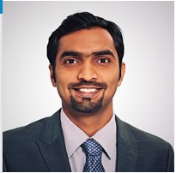
My Introduction
Name - Pavan Kulkarni
Educational Background – M.S in Computational Engg, B.E in Industrial & Production Engg.
Experience – 8 Yrs in Simulation Automation
Skills – Python, C++, C, TCL/TK, Data Structures & Algorithms, Software Architecture, Design Patterns, SOLID Principles, Open MP/MPI, Parallel programming, High performance.
Tools: Ansys Workbench, Abaqus CAE, BetaCAE Suite, Altair Suite, Matlab, nCode, modeFrontier and similar
Hobbies and interests: Trekking, Biking, Cooking

Slide 4
Flow of the whole program
Scheduled for 2 months
Sessions every alternate day.
Holidays are covered
Changes or extension will be notified during the process.
Program is divided in 2 categories and 3 stages
Training
Assignment
Stage 1
Stage 2
Stage 3
Basics
Advanced
Professional

Slide 5
Flow of the each session
Session duration - 1.5 Hours
Session timings – 10.00 Am – 11.30 Pm IST.
Session breakup
First 10 minutes – Revision
Next 1 hour - Actual session
Next 10 minutes - Q&A session
Revision of previous session
That day’s session content
Q & A

Slide 6
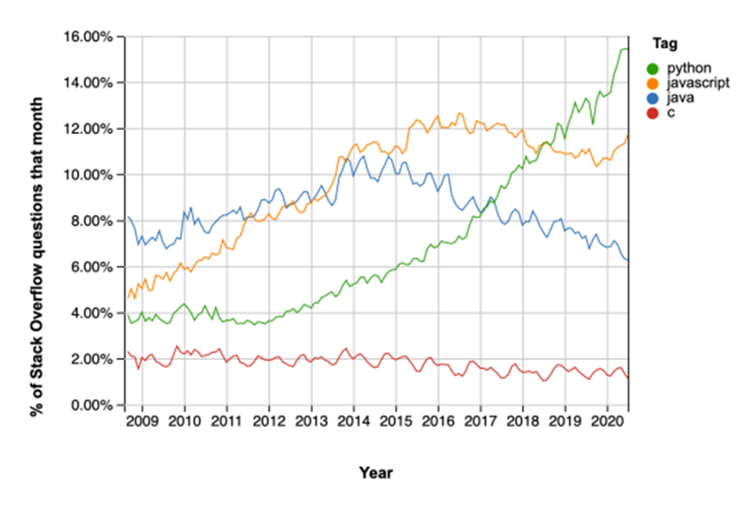
Today’s Session – 18/04/2024
Guido van Rossum in 1991
What is so special about python?
Python is a full-spectrum language:
Beginners, intermediates and experts
Access to large, well-packaged and powerful library resource
Fun
Popularity

Slide 7
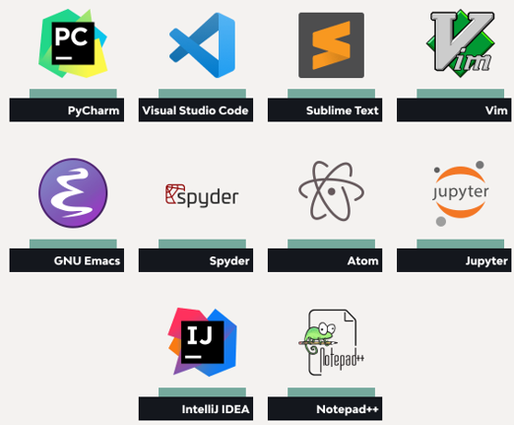
Today’s Session – 18/04/2024

Slide 8
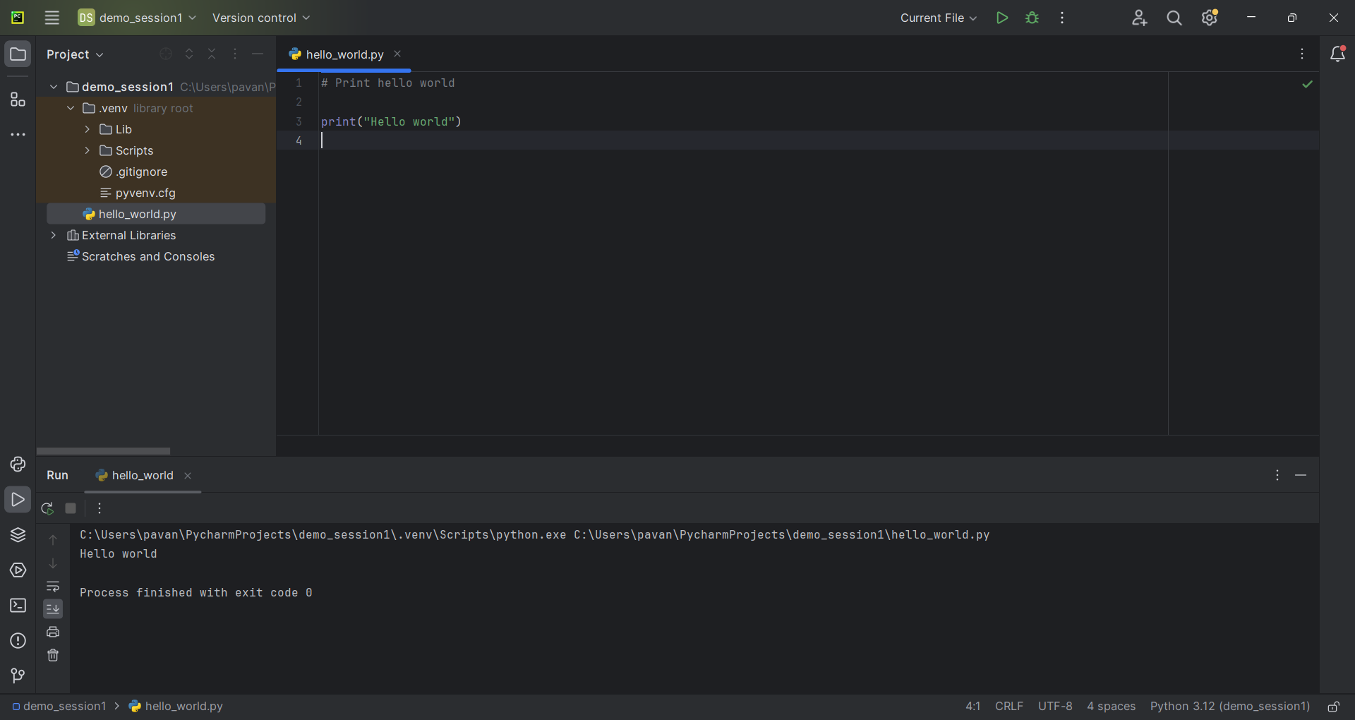
Today’s Session – 18/04/2024
Your first program printing “Hello World”

