Slide 1




Online car parts selling Platform
Group No: 16
Team Members:
Suresh Raju Nandimandalam
Bhanu Gadde
Sai praveen lokavarapu
Sai Pavan Sagi
Preetham Reddy Annavaram
Bhavani Navari

Slide 2


Contents
Project Description
ER Diagram
Technology Used
Home Page
Demo

Slide 3
Project Description
The "Car parts selling platform" is an online system that will successfully meet the demand for buyers and sellers in the car parts arena.
This web application smoothen the interaction of garage owners with customers in buying auto parts and garage owners in order to sell the auto parts, and also in the resolution of whatever service requests are brought forth by the clients.
The system provides strong database administration to update and arrange important data in support of the operational processes.
The system needs email and password to login into and buy the carParts as a user and administrator to manage the carParts

Slide 4
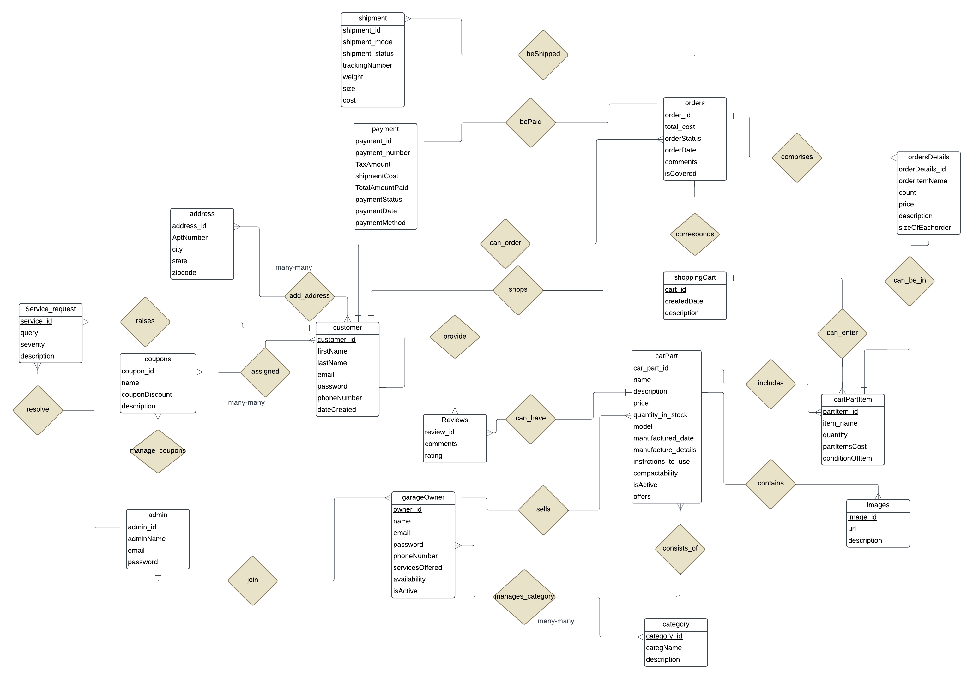
ER Diagram

Slide 5

Technology USEd
Technology and Language:
Node JS, Express JS
React, Java Script
Boot Strap for styling
MySQL to handle database
Tools and Utilities:
Visual Studio Code
MySQL work bench

Slide 6

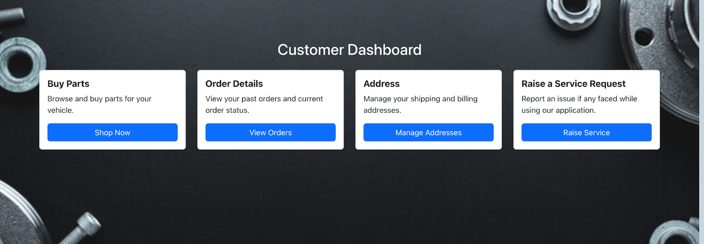
Customer dashboard

Slide 7
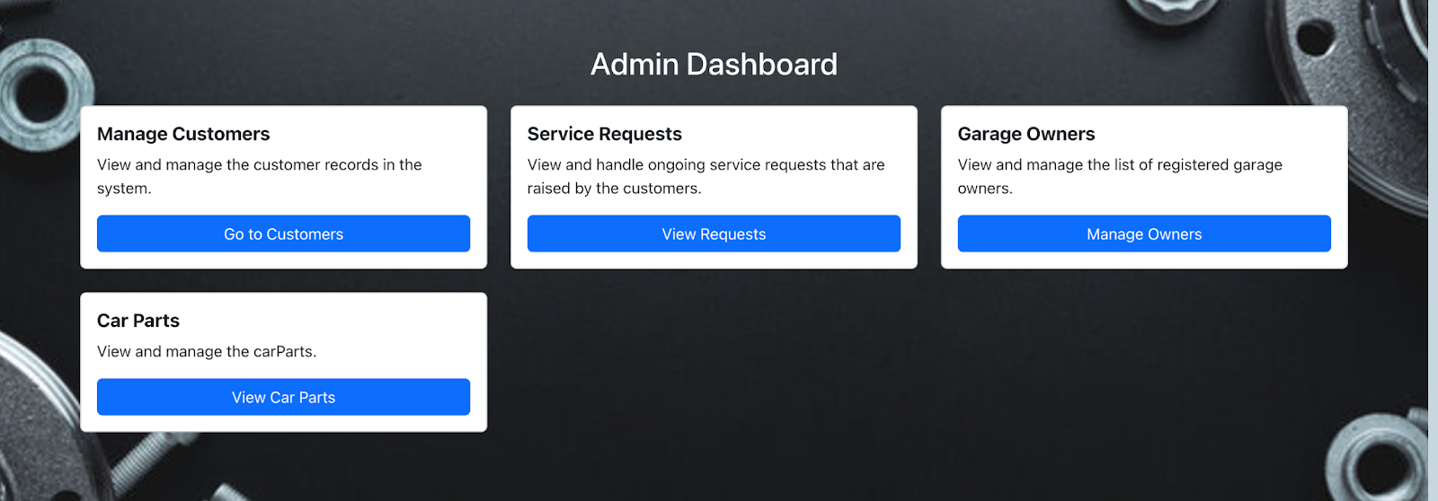
Admin Dashboard

Slide 8
DEMO

Slide 9
Thank you
Any Questions ?

