Slide 1
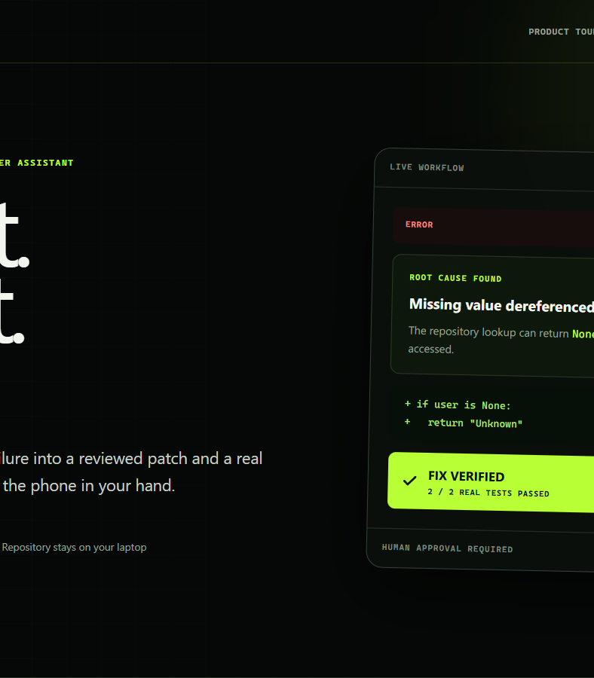

POCKETPILOT AI
PHONE CONTROL
DEVELOPER TOOLS
See it.
Say it.
Fix it.
A phone-first, local-first developer assistant that turns visible failures into human-approved, test-verified fixes.
iQOO Hackathon 2026 | Team Zero Day 404
Notes:
PocketPilot AI submission cover. Product-tour visual: https://pocketpilot-ai.sleek-pearl-0098.chatgpt.site

Slide 2
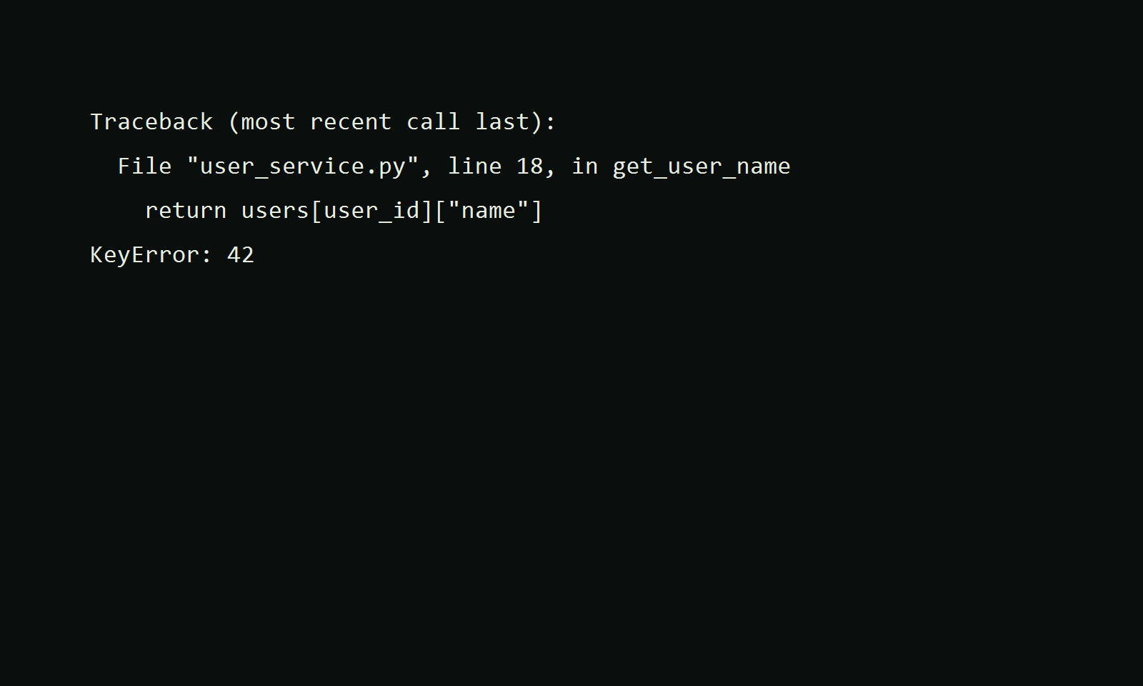
THE PROBLEM
02
Debugging breaks when the failure is outside the IDE
01
The error is visible
A terminal, another machine, or a borrowed device shows the failure.
02
Context is fragmented
Copying traces, finding files, and validating a repair becomes manual work.
03
Trust is the real bottleneck
Developers need evidence, a readable diff, explicit approval, and rollback.
PocketPilot keeps the developer in control while moving the workflow to the phone.
POCKETPILOT AI • ZERO DAY 404
Notes:
The terminal image is a repository demo fixture used for the verified Python scenario.

Slide 3
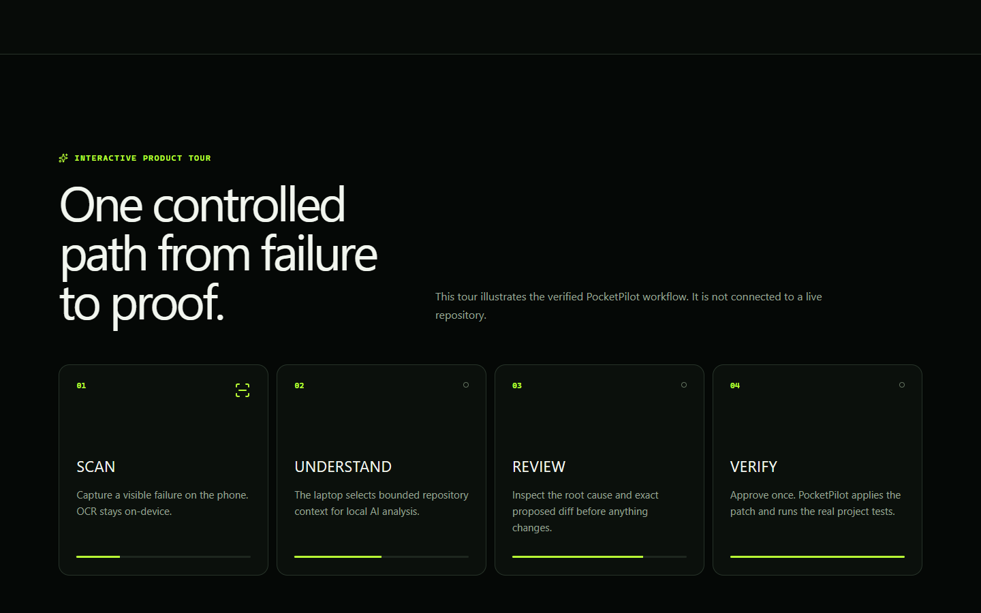
THE WORKFLOW
03
One loop from visible failure to verified outcome
SCAN
UNDERSTAND
REVIEW
VERIFY
Camera and OCR
Local model + repo
Root cause + diff
Tests + rollback
POCKETPILOT AI • ZERO DAY 404
Notes:
Illustrative product-tour sequence. Live tour: https://pocketpilot-ai.sleek-pearl-0098.chatgpt.site

Slide 4
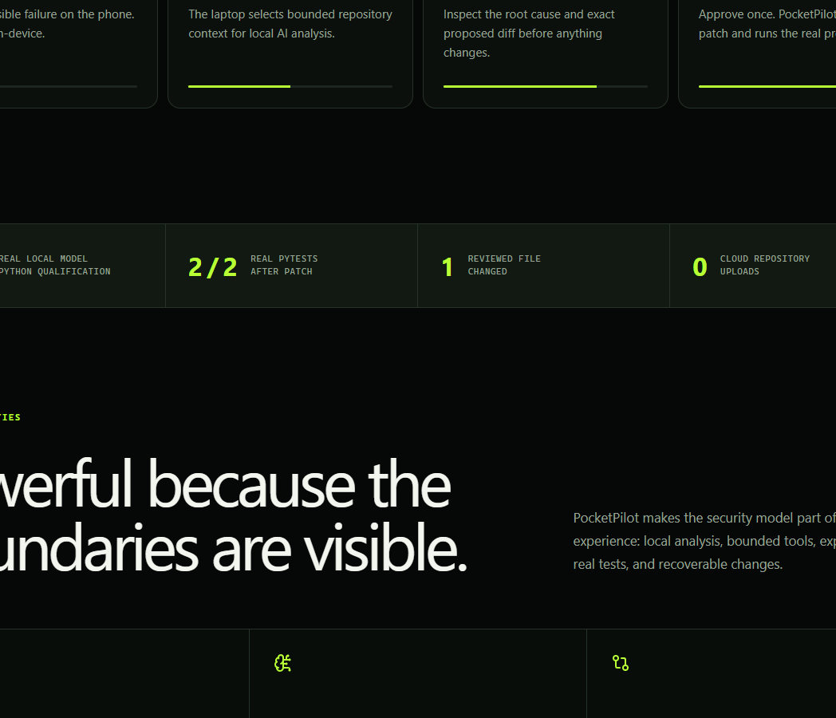
PHONE-FIRST EXPERIENCE
04
The phone becomes the safe control surface
CAPTURE
Camera scan and on-device OCR
COMMAND
Closed-vocabulary Android voice actions
REVIEW
Root cause, evidence, bounded source, and diff
CONTROL
Approve, reject, inspect, verify, and undo
FEEDBACK
Status, latency, speech, and progress animation
The phone never owns arbitrary project paths. It sends bounded intent to an authenticated laptop agent.
POCKETPILOT AI • ZERO DAY 404
Notes:
Capabilities listed here are implemented and covered by repository validation or physical iQOO device checks.

Slide 5
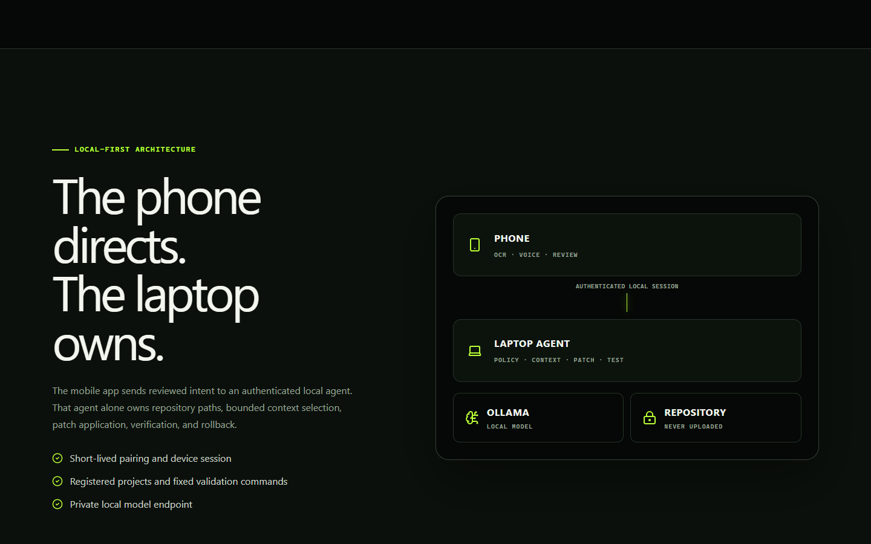
LOCAL-FIRST ARCHITECTURE
05
The phone directs. The laptop owns.
No source repository is uploaded to a cloud model. The selected workspace, validation command, and file boundaries remain laptop-owned.
POCKETPILOT AI • ZERO DAY 404
Notes:
Architecture reflects the implemented authenticated LAN bridge, local repository ownership, and local Ollama provider path.

Slide 6
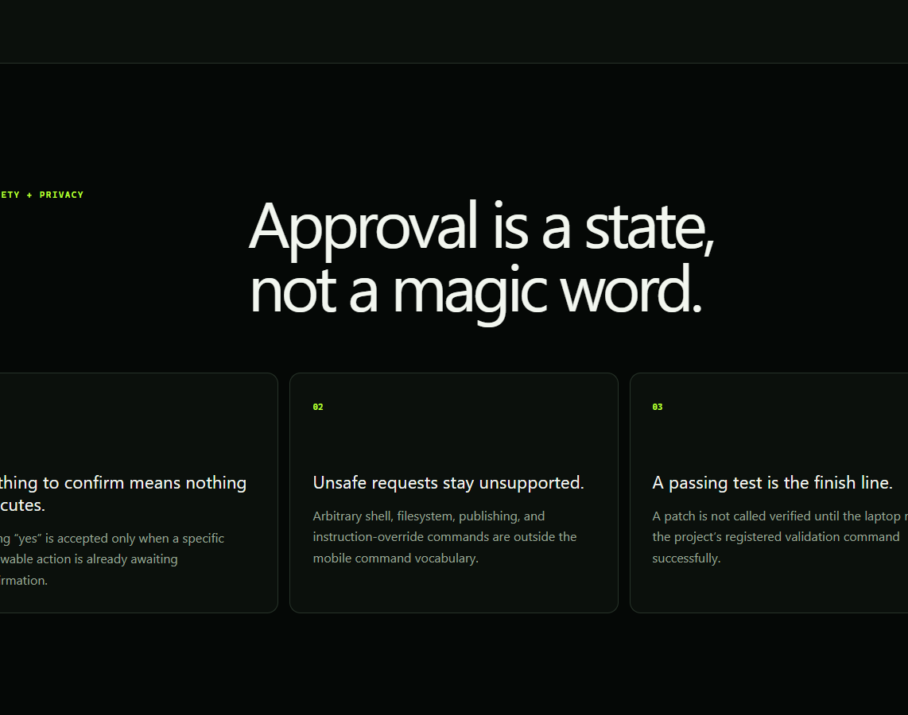
TRUST BY CONSTRUCTION
06
Approval is a state, not a magic word
SCHEMA
EVIDENCE
Only known action shapes are accepted
Claims must point to bounded source context
PATH
HASH
Edits cannot escape the registered workspace
Stale proposals fail before write
DIFF
VERIFY
The exact patch is visible before approval
Only allowlisted validation commands run
ROLLBACK
Applied changes can be restored
Human approval stays mandatory before any file changes.
POCKETPILOT AI • ZERO DAY 404
Notes:
Safety claims correspond to implemented protocol validation, workspace confinement, approval checks, and rollback behavior.

Slide 7
VERIFIED EVIDENCE
07
Evidence, not theatre
2 / 2
7 / 7
130
DEMO TESTS PASSED
REAL OLLAMA CYCLES
BACKEND TESTS PASSED
Python missing-user repair
Python scenarios
4 environment skips
149
21 / 21
1
JAVASCRIPT TESTS PASSED
EXPO DOCTOR CHECKS
PHYSICAL IQOO DEVICE
Desktop, mobile, shared
Native project health
Full apply, verify, undo
Also verified with WAN unavailable while the phone and laptop remained connected over the local network.
POCKETPILOT AI • ZERO DAY 404
Notes:
Counts are from the repository validation record and physical Android milestone checks completed before submission packaging.

Slide 8
TECHNICAL DEPTH
08
A real mobile, backend, protocol, and local-AI system
01
ANDROID APP
Camera, on-device OCR, speech service, review, approval, progress, undo
React Native + Expo
02
LAPTOP AGENT
Pairing, sessions, repository context, transactional patching, verification
FastAPI + SQLite
03
LOCAL MODEL
Root-cause analysis and structured repair proposals without cloud repo upload
Ollama + qwen3-coder:30b
04
TRUST PROTOCOL
Bounded commands, replay resistance, evidence checks, state-aware approval
Authenticated WebSocket
Registered demos cover Python, Java, and React/TypeScript scenarios.
POCKETPILOT AI • ZERO DAY 404
Notes:
Technology and scenario coverage are documented in the PocketPilot repository.

Slide 9
HACKATHON FIT
09
Built for usefulness, originality, execution, and presentation
30%
USEFULNESS
Shortens a fragmented debugging workflow while keeping the user in control.
25%
ORIGINALITY
A phone-first approval and evidence surface for local developer automation.
20%
EXECUTION
Working mobile app, authenticated bridge, local model, patching, tests, and rollback.
15%
PRESENTATION
A single clear story with visible proof at every stage.
10%
OFFICE KIT
Use the supplied kit for screen mirror, clipboard, file transfer, and remote control during the event.
Office Kit is used as an official cross-device productivity tool. No unsupported vendor API integration is claimed.
POCKETPILOT AI • ZERO DAY 404
Notes:
Rubric and Office Kit details follow the official iQOO Hackathon guide: https://iqoo.reskilll.com/guide

Slide 10
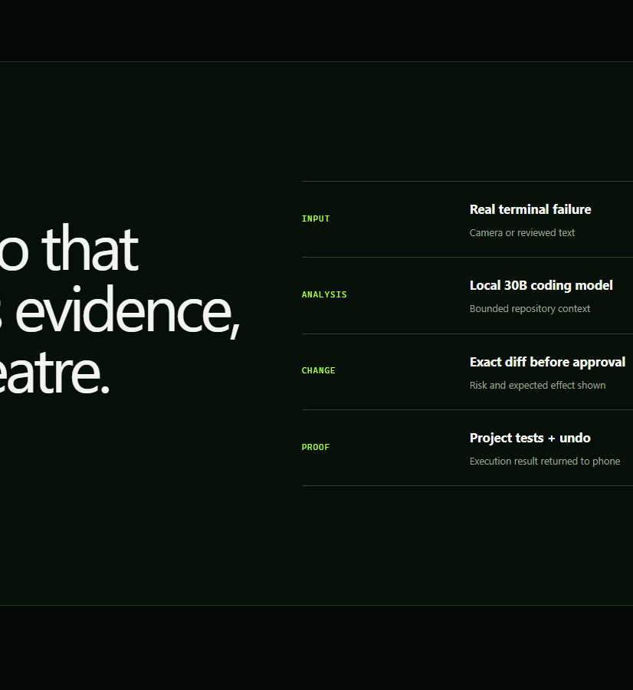
READY FOR PHASE 1
From visible failure
to verified outcome.
Scan the failure. Understand it locally. Review the exact change. Approve it deliberately. Verify it with real tests.
LIVE PRODUCT TOUR
pocketpilot-ai.sleek-pearl-0098.chatgpt.site
TEAM ZERO DAY 404 • IQOO HACKATHON 2026
Notes:
Live product tour: https://pocketpilot-ai.sleek-pearl-0098.chatgpt.site

