Slide 1
Secure Data-in-Transit and Data-at-Rest in Containers Using Istio, LUKS, and HashiCorp Vault
Balaga Pavan Sai 21114025
Kanuru Mohith Kumar Reddy 21114047
Priyanshu Behera 21114077

Slide 2

Problem Statement
Encrypt data-in-transit between containers
Encrypt data-at-rest inside container volumes
Use secure access management for encryption keys

Slide 3

Architecture Overview
TLS Encryption – Mutual TLS using Istio
Volume Encryption – LUKS for encrypted persistent volumes
Access Management – HashiCorp Vault for secure key handling

Slide 4
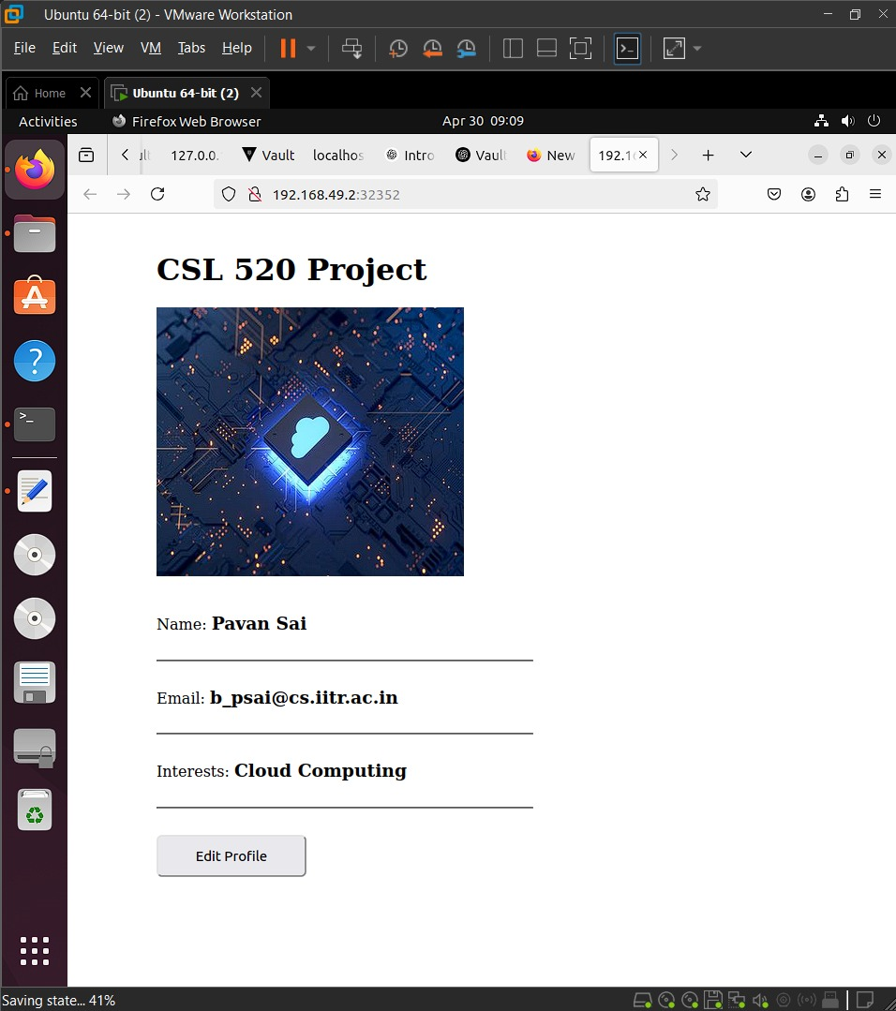
Usecase
Overview:
Deployment of a simple web application to store user information, including name, email, and interests.
Architecture:
Frontend: Developed using HTML, CSS, and Node.js, hosted in a dedicated pod.
Backend: Utilized MongoDB as the database, hosted in a separate pod.
Security:
Demonstrates secure data transmission and storage through pod-based architecture.

Slide 5
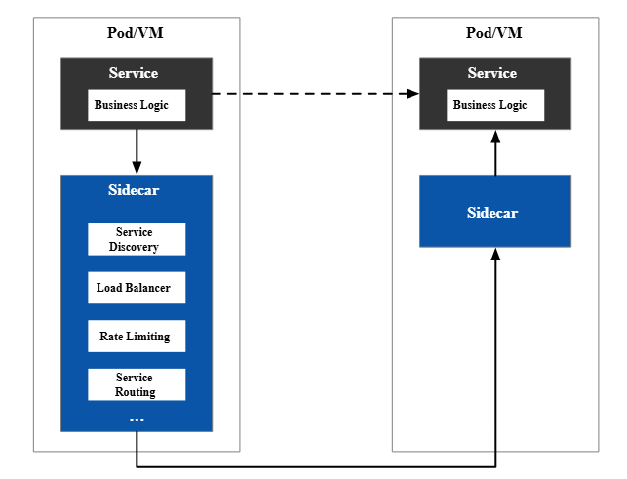
TLS Encryption using Istio
Mutual TLS (mTLS) secures all traffic between pods within the service mesh
Envoy sidecar proxies automatically inject TLS into each request
Istio handles certificate management and automates the TLS handshake
Uses TLS 1.2 or 1.3, with:
ECDHE for secure key exchange
AES-128-GCM or AES-256-GCM for data encryption

Slide 6
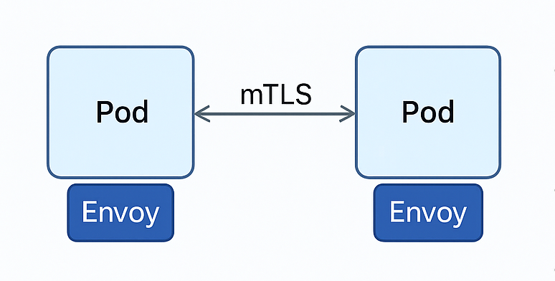
Istio + mTLS Setup
Enabled sidecar injection using label
Applied PeerAuthentication and DestinationRule for mTLS
Verified encrypted traffic via istioctl authn tls-check

Slide 7
Volume Encryption Using LUKS
Disk is encrypted with LUKS using cryptsetup luksFormat
InitContainer runs cryptsetup open to decrypt the volume at startup
Volume is mounted only after successful decryption
Applications access the volume via the decrypted mount path

Slide 8
Using InitContainer with LUKS
Encrypted a disk using cryptsetup luksFormat
Created an initContainer to run cryptsetup open
Volume was mounted using decrypted path

Slide 9
Secure Key Management with Vault
Passphrase stored in HashiCorp Vault
Pod retrieves it using Vault’s Kubernetes Auth method
Access is tightly controlled via Vault policies

Slide 10
Tech Stack
Istio for mTLS and service mesh
LUKS for volume encryption
HashiCorp Vault for secret management
Minikube for container orchestration (local Kubernetes)
MongoDB for database
Docker for containerization

Slide 11
Thank You

