Slide 1
OPERATING SYSTEMS · SYSTEMS PROGRAMMING
System Calls
Monitoring and
Analysis Tool
A BTech project presentation
TEAM
MEMBER 01
MEMBER 02
Team 16
P.Pavan Sai · 2520030417
U.Ankith · 2520030403
T.Akilesh · 2520030570

Slide 2
01 · THE BOUNDARY
System calls are the bridge to the OS
USER SPACE
KERNEL SPACE
Application code
Privileged resources
Runs the program and requests protected services.
Manages protected operating-system services.
Applications use system calls to request protected services from the operating system.
SYSTEM CALL
Monitoring reveals what a process asks for, how often, and with what result.
THE SYSTEM-CALL BOUNDARY CONNECTS THE TWO SPACES.
02

Slide 3
02 · THE GAP
Normal tools hide the behavior we need to study
Applications continuously request services from the kernel. Generic diagnostics do not make frequency, overhead, and error rates easy to inspect.
Students and developers need a transparent view of user-to-kernel transitions.
Our solution is a user-space C program running on Ubuntu, avoiding kernel modification and reducing development risk.
03

Slide 4
03 · THE ANALYSIS LENS
01
02
Four objectives turn tracing into analysis
Monitoring utility
Context-switch overhead
Log system calls made by target child processes.
Measure execution time and performance cost.
03
04
Kernel-invocation categories
Status and error codes
Group file management, process control, and information maintenance calls.
Record return values and diagnostic errors.
04

Slide 5
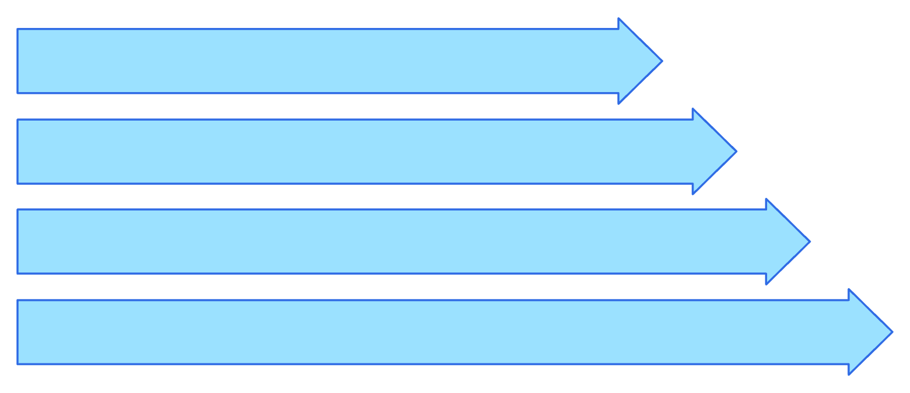
04 · THE TRACE LOOP
The tracer follows each user-to-kernel transition
Parent Forks
Parent, child, kernel boundary, interception loop, and report output stay connected.
Child Traces & Execs
Intercept Loop
Extract & Report
05

Slide 6
THE LINUX INTERFACE
fork() | Creates the child process to monitor.
execvp() | Loads and runs the selected target program.
ptrace() | Lets the parent trace and control the child.
waitpid() | Synchronizes the tracer with child stops.
PTRACE_GETREGS | Reads the traced process's CPU registers.
Five Linux APIs make the monitor possible
06

Slide 7

06 · INTERCEPTION
Interception turns execution into observable events
Parent Tracer
The parent observes boundaries without changing the kernel.
Child Target
Kernel Boundary
Kernel / Syscalls
07

Slide 8
REGISTER | DETAIL
user_regs_struct | Captures the traced process's register state.
orig_rax | Identifies the system-call number.
Other register values | Carry system-call arguments.
Return value | Shows the result or failure status.
07 · REGISTER STATE
CPU registers expose the call details
Registers give the tracer a low-level view without changing the kernel.
08

Slide 9
08 · EVIDENCE
EVIDENCE | ANALYSIS AND REPORT USE
Frequency · Call count | How often the call occurs · Compare activity
Duration · Execution time | Latency and overhead · Inspect cost
Status · Return value | Success or failure · Identify error codes
Category · Function group | File, process, or information work · Generate a structured terminal report
The report turns raw events into useful evidence
The output keeps the signals needed for analysis.
Illustrative example — final output depends on the target program.
09

Slide 10
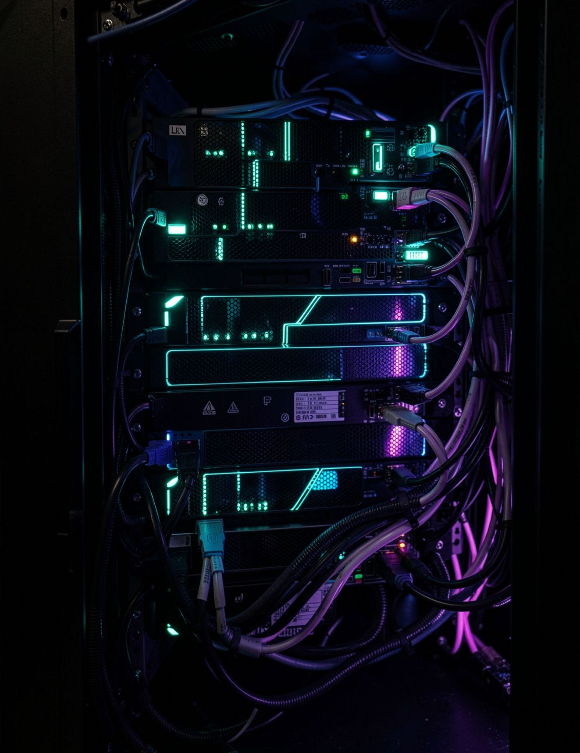
09 · THE BUILDING BLOCKS
The toolchain stays close to Linux
C / C++: Systems programming and low-level process logic.
Linux / Ubuntu: Development and testing environment.
VS Code: Source editing and project work.
GCC: Compile source into executable binaries.
GDB: Debug execution flow.
Make / Makefile, POSIX APIs, ptrace: Automate builds and access Linux process interfaces.
10

