Slide 1


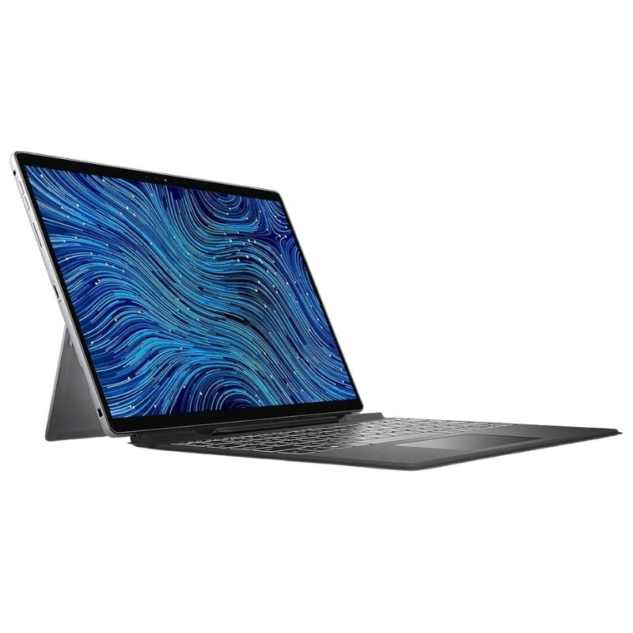
PROJECT ON
Laptop Market Analysis
PRESENTED BY :
B.SHRIYA
V.PAVAN SAI

Slide 2



OBJECTIVES
Collect laptop data from Flipkart using web scraping.
Extract key details such as price, specifications, discounts, and ratings.
Perform data cleaning and Exploratory Data Analysis (EDA).
Identify market trends and generate meaningful insights through visualizations.

Slide 3

Libraries Used

Slide 4
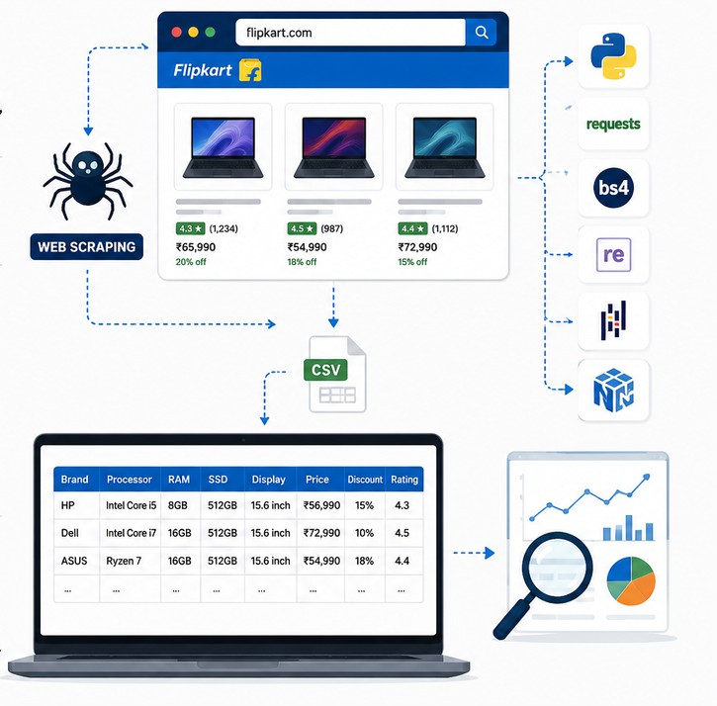
Problem Statements
Identify pricing trends across laptop brands.
Compare processors, RAM, and SSD configurations.
Analyze customer ratings and discounts.
Discover factors influencing laptop prices.
Identify the characteristics of premium laptops.

Slide 5
Process Involved
Scraped multiple Flipkart laptop listing pages.
Extracted product details such as Brand, Processor, RAM, SSD, Display, Price, Discount, and Rating.
Applied Regular Expressions (Regex) to identify and extract structured patterns from specification text (e.g., RAM, SSD size, processor).
Cleaned and transformed the data by handling missing values, removing duplicates, and standardizing formats.
Created a structured dataset and performed EDA to visualize trends and generate insights.

Slide 6

Data Overview
🌐 Data Source - Flipkart
📊 Dataset Size: 500+ Laptop Records
📋 Features:Brand, Price, Processor, RAM, SSD, Display, Discount, Rating
🧹 Data Cleaning
🗑 Removed Duplicates
🔧 Handled Missing Values
🔄 Standardized Data Types
💾 Converted SSD to GB
💯 Converted Discount to Numeric
🆕 New Features Created
🏷 Price Category
⭐ Rating Flag
🎁 Discount Category

Slide 7


General & Comparative Analysis

Slide 8
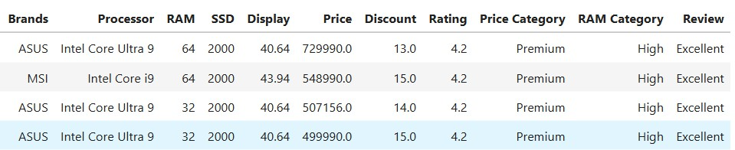
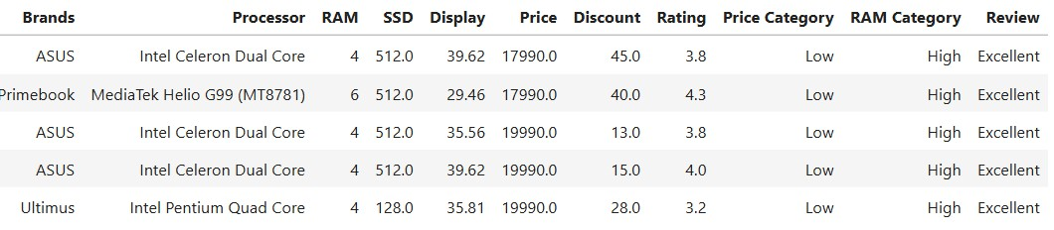

Top 5 Expensive vs Top 5 Cheapest Laptops
Top 5 Expensive Laptops::
Top 5 Cheapest Laptops:
pre e ncode d. png

Slide 9
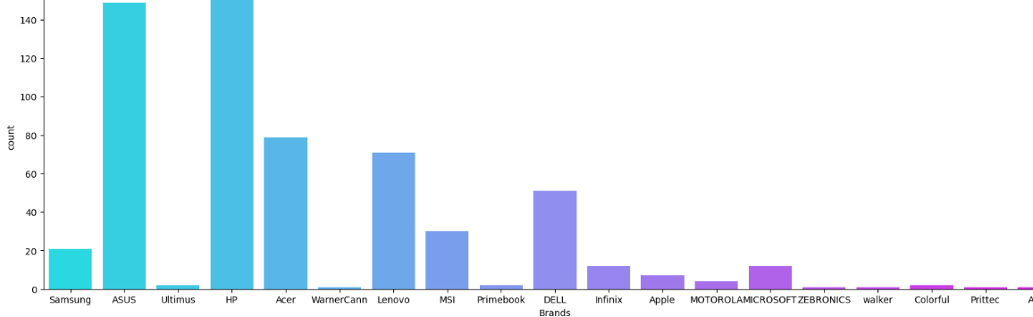
Brand Distribution(count plot)
This plot displays the number of laptop models available for each brand.
The brands like “HP”, “ASUS”, ACER”, LENOVO”, DELL, SAMSUNG” contains more number of models.

Slide 10

Trend Analyis over Specifications

Slide 11
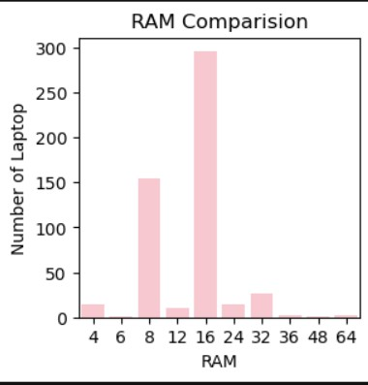
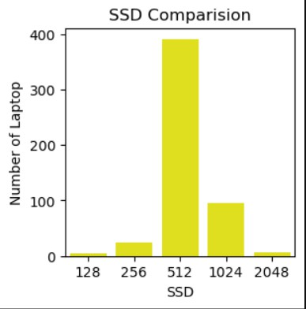
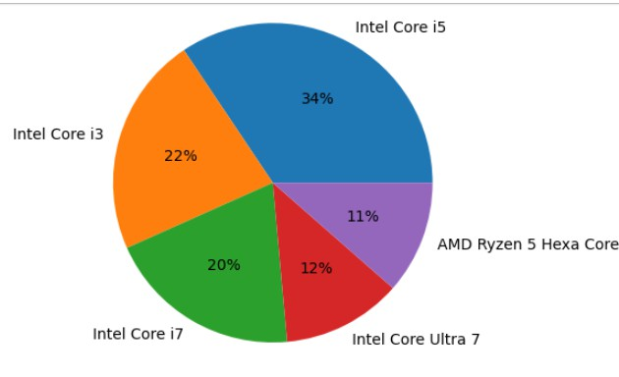
Hardware Analysis
Most laptops are equipped with 16 GB RAM, Making it the most common configuration.
512 SSD is most preferred storage capacity among the laptops analyzed.
Intel Core i5 processor dominate the market, followed by Intel Core i3 and Intel Core i7.

Slide 12
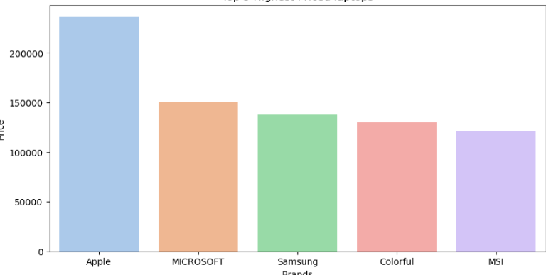
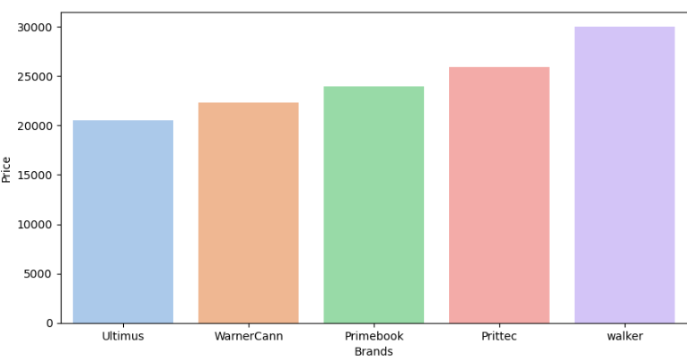
Laptop Market Analysis : Highest vs Lowest Average Priced Brands
Top 5 Highest Priced Laptops Top 5 Lowest Priced Laptops

Slide 13
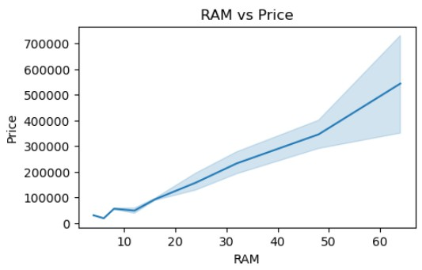
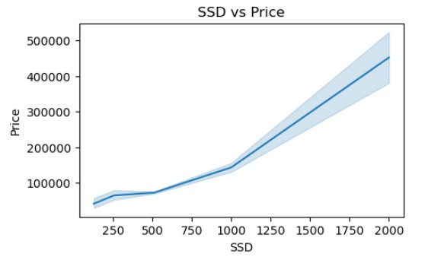
Both SSD and RAM have a positive correlation with laptop prices, meaning higher specifications generally lead to higher-priced laptops.

Slide 14
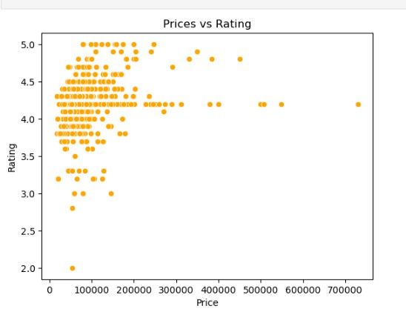
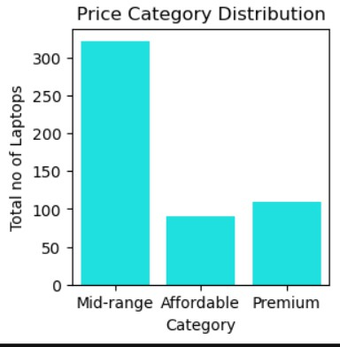


Pricing and Customer Analysis
Higher-Priced laptops do not always received higher ratings
pre e ncode d. png

Slide 15
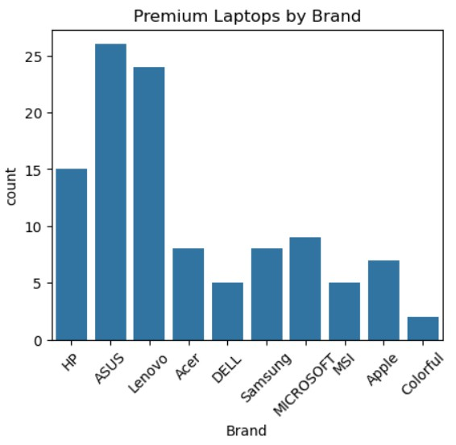
No.of premium Laptops by Brand

Slide 16
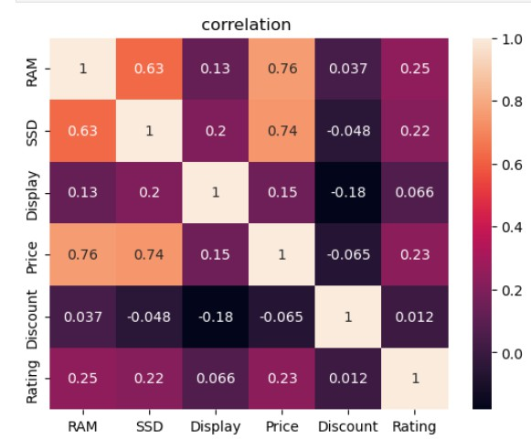
Correlation Heat Map
Prices shows positive correlation with RAM and SSD, indicating that laptops with better hardware tend to be more expensive
Discount has negative correlation with Price
The heat map helps to identify which features have the greatest influence on laptop prices.

Slide 17
Key Insights
Intel-Core-i5-is the most common processor
512 GB SSD is the most popular storage option.Power Backup and Lift availability increase rent by 10-15%.
HP, ASUS, Lenovo, Acer, and Dell have the largest product ranges.
Premium laptops mostly feature Intel Core 7 or i7 processors with 16–32 GB RAM.
Discounts vary significantly across brands and models.
Higher RAM and SSD capacities are generally associated with higher prices.
Higher-Priced laptops do not always receive higher ratings, showing that price does not determine customer statisfaction.
.
pre e ncode d. png

Slide 18

By applying web scraping, data preprocessing, and exploratory data analysis, this project transformed raw e-commerce data into meaningful insights. The analysis highlighted market trends, popular laptop configurations, and pricing patterns, making it useful for comparing products and understanding customer preferences.

Slide 20

THANK YOU

