Slide 1
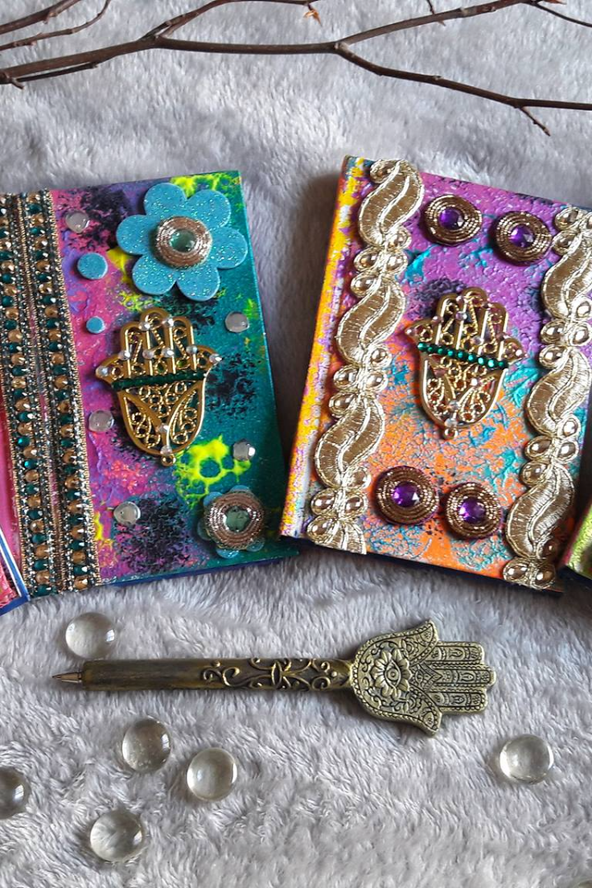

Empowering Artisans through E-commerce
Join us on a journey of discovery through the vibrant world of handmade crafts and unique goods from artisans across the globe.

Slide 2
Mission Statement
Empowerment
Cultural Preservation
Community Building
Our mission is to provide a sustainable marketplace that empowers artisans by making their unique products accessible to customers worldwide.
We believe in fostering connections and collaboration between artisans, customers, and communities to build a more equitable and just world.
We strive to preserve indigenous and traditional craft techniques by providing a platform for artisans to showcase their skills and share their stories.

Slide 3
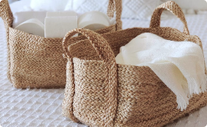



Artisan Partners and Their Crafts
Weaving
Ceramics
Wood Carving
Our weaving partners use traditional techniques passed down through generations to create unique and functional baskets, rugs, and textiles.
Our ceramic partners make beautiful, functional items that add a pop of color and personality to any home.
Our partners in wood carving create stunning works of art that blend traditional techniques with contemporary design.
Jewelry Making
Our jewelry partners use local materials and techniques to create unique and beautiful pieces that are both stylish and sustainable.

Slide 4
Product Categories
1
2
3
Home Decor
Apparel and Accessories
Kitchen and Dining
From colorful textiles and woven baskets to hand-carved furniture and ceramics, we have everything you need to add personality and character to your living space.
Discover a world of gourmet delights, from handmade tableware and cookware to artisanal spices, jams, and condiments.
Add some flair to your wardrobe with our unique jewelry, scarves, and other handmade accessories.

Slide 5
User Experience
Easy Navigation
Secure Checkout
Customer Reviews
Our website is easy to navigate and designed to help you find exactly what you're looking for, whether you're browsing by category or searching for a specific item.
Our secure checkout process ensures that your personal and payment information is always kept safe and confidential.
We value customer feedback and include detailed reviews and ratings from customers to help you make informed purchasing decisions.

Slide 6
Order Fulfillment and Shipping
1
Fast and Reliable
We work with top-rated shipping partners to ensure that your orders arrive quickly and safely, no matter where you are in the world.
Packaging
2
We use sustainable and eco-friendly packaging materials and methods to reduce waste and minimize our environmental impact.
3
Tracking and Support
We provide detailed tracking information and customer support to ensure that you always know the status of your orders.

Slide 7
Customer Service
24/7 Support
Ease of Returns
Custom Orders
Our customer service team is available 24/7 to help you with any questions or concerns you may have.
We offer easy returns and refunds for any items that don't meet your expectations.
We work with our artisans to fulfill custom orders and special requests, so let us know if you have a specific item or design in mind!

Slide 8



Marketing and Promotions
Seasonal Promotions
Social Media
Referral Program
Sign up for our newsletter to receive exclusive discounts, early access to sales, and information on new products!
Follow us on social media for daily inspiration, behind-the-scenes glimpses of our artisans at work, and exciting contests and giveaways!
Share your love for our products with your friends and family and receive discounts and rewards for each new customer you refer.

