Slide 1
STUDENT MANAGEMENT SYSTEM(SMS) LOGIN BY USING
FACE RECOGNITION
Guided by Mrs. N. Swathi
Asst. professor, RGUKT-Nuzvid

Slide 2
OUR TEAM
J.Pavan Sankar (N180109)
Ch.Sai (N180082)
K.Srinivasa Rao (N180083)
M.Thanuja (N180616)
J.Nandini (N180429)

Slide 3
ABSTRACT
The development of this project is aimed at automating tasks through face recognition. We have a password-protected login system for SMS at our university. However, despite being password-protected, students were able to discover the password through the exam files and use it to log into other accounts, access their results and details or change profiles to make fun of them. Here the student needs to manually enter username and password to log into SMS. So, we are going to give a face recognition-based login which takes the user image input through the webcam and compares it with the details of the database and if a match is found he will be logged into the SMS automatically. Here we used the face_recognition module for recognizing faces and the selenium library for browser automation. This model can apply to various websites for automatic login. Here we took images of all 2018 batch students(1191 students). With this, we successfully logged into the SMS ensuring security.
Keywords: face encodings, fernet encryption, browser automation

Slide 4
INTRODUCTION
As security is a major concern while logging into our account, it was preferable to choose other options of login. For enhanced security we took face recognition based login. Here we used face_recognition library which is the world’s simplest one, for face recognition. The face_recognition library of Python is a wrapper of Dlib which is a C++ library that performs tasks related to machine learning and computer vision. The overall process of face recognition and browser automation results in enhancing security while reducing human effort in the manual entry of details on the login page. So the combined version of face recognition and browser automation can be applicable in various works like automatically filling exam details or forms(of same structure) through face recognition. For our project, we collected photos of all 2018 batch students(of a total of 1191) using the requests module and took the passwords from exam files. In the end, we made a successful attempt to log users of RGUKT into SMS through face recognition.

Slide 5
RELATED WORKS
Exam form automation using facial recognition
In this[1] proposed model, the face_recognition module is used for face detection and recognition. Here at first, the detected face is encoded into 128 measurements and then comparing the measurement with already encoded faces of the database and finally recognizingthe face. Now after recognition of face, mark the attendance in a CSV file along with timestampand finally perform web automation to fill out personal information in an exam

Slide 6
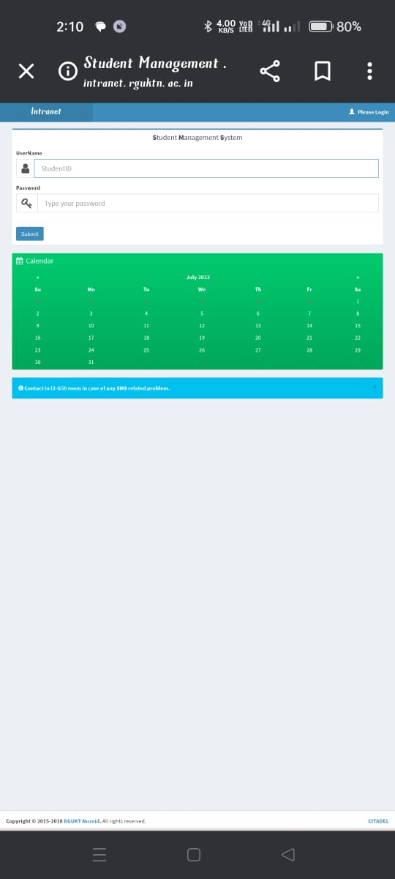
EXISTING WORKS
We have a password-protected login system for SMS at our
University. However, despite being password-protected, students
were able to discover the password through the exam
files and use it to log into other accounts, access their results
and details, or change profiles to make fun of them. Here the
student needs to manually enter username and password to log
into SMS.

Slide 7
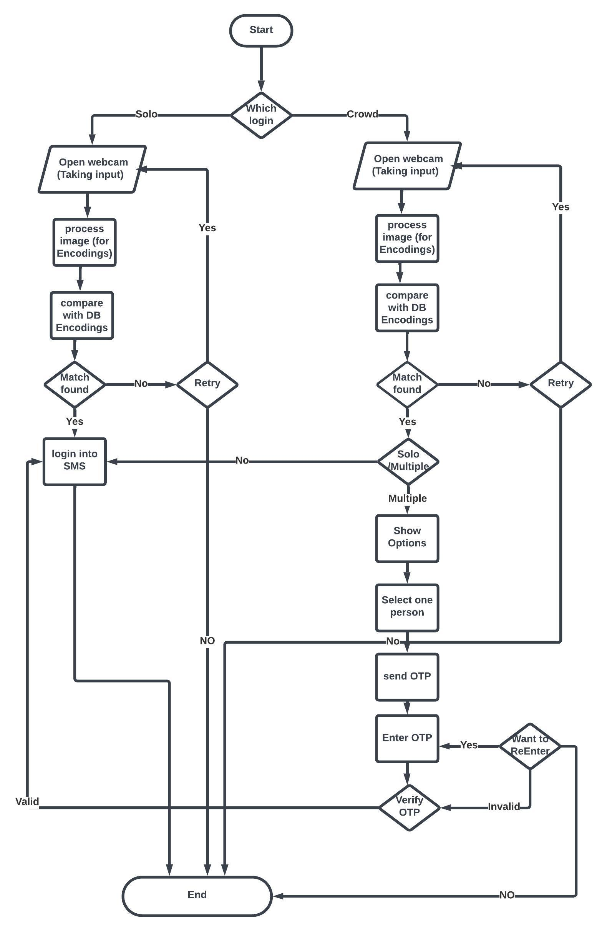
PROPOSED METHOD

Slide 8
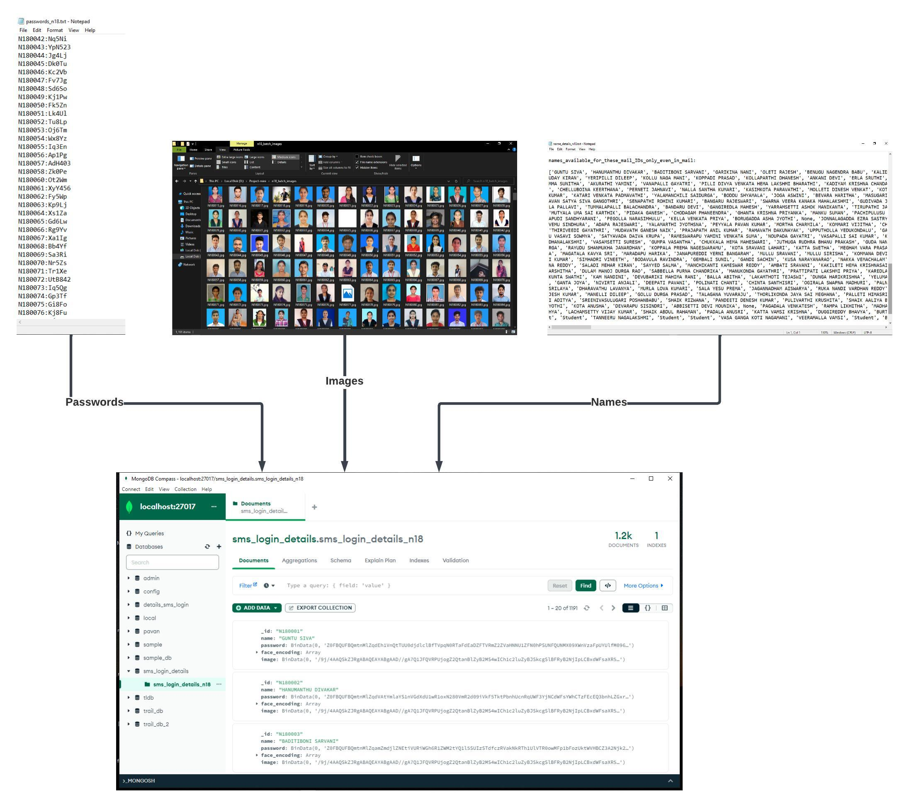
Dataset:
Images, passwords and names of all 2018 batch students

Slide 9
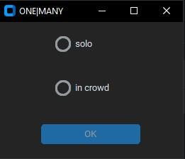
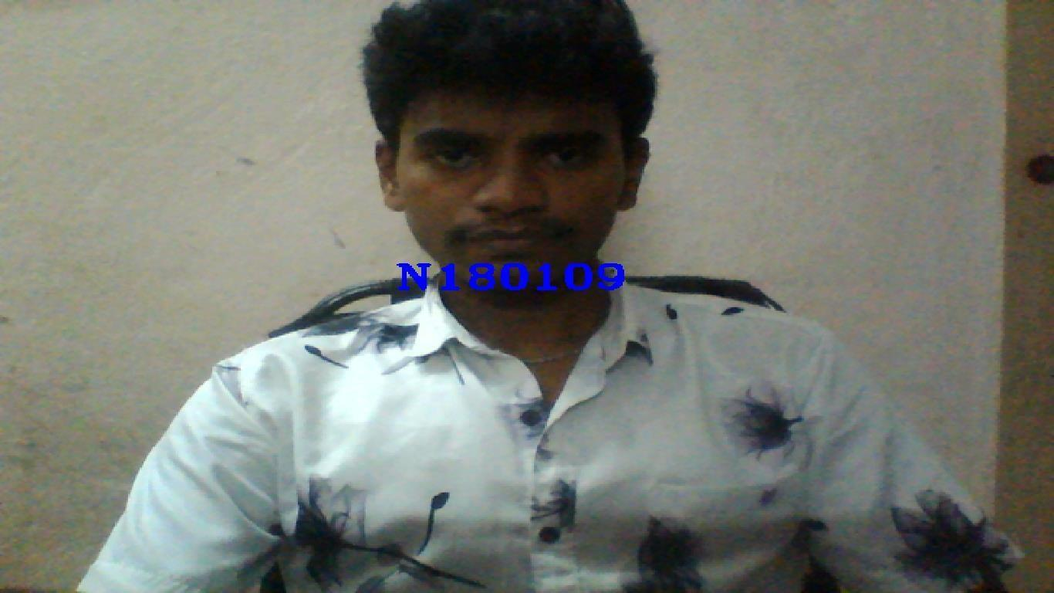
Case-1: Solo Login
CustomTkinter:
customtkinter - to create a GUI in python.
Choosing whether we are solo or in crowd.
OpenCV:
OpenCV is widely used for computer vision and image processing tasks.
OpenCV will provide access to the webcam.
Face_recognition module:
Simplifies face recognition tasks.
Utilizing pre-trained deep learning models in Dlib.

Slide 10
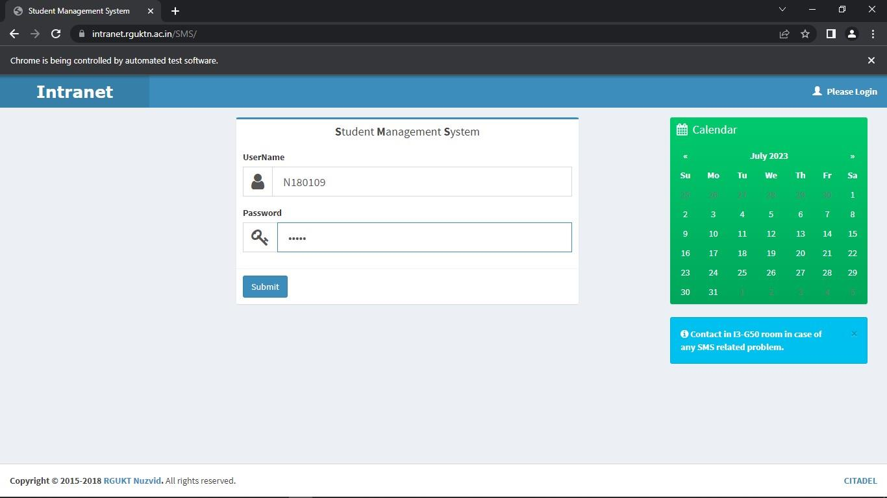
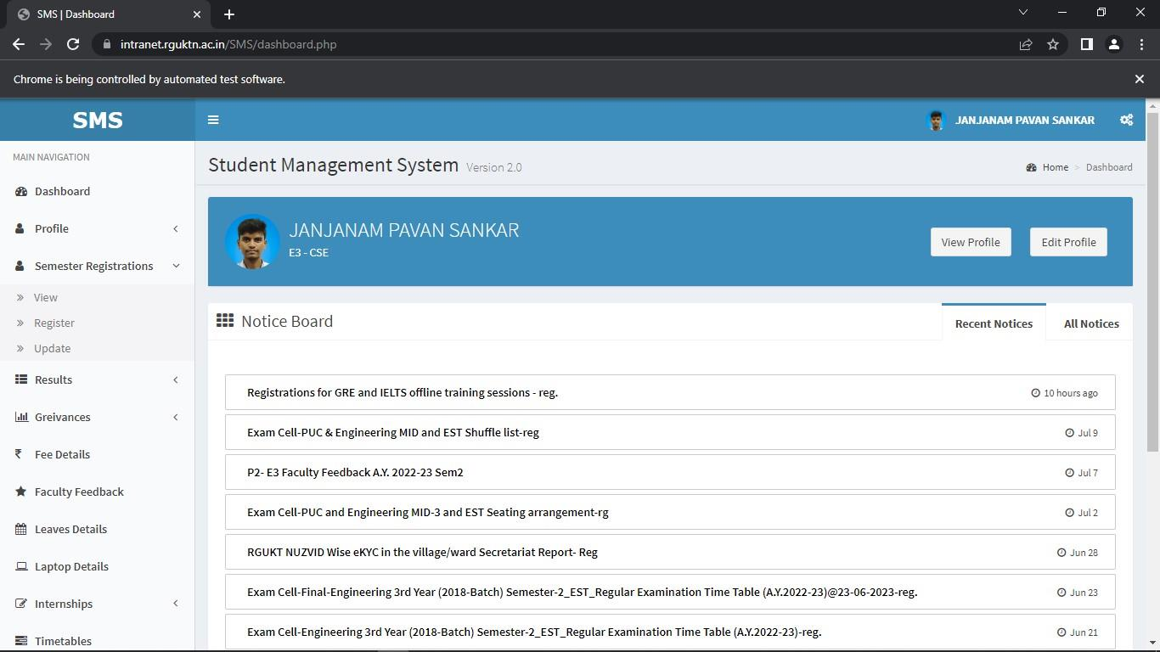
Selenium:
Selenium - to automate web browsers from python
It Supports: Chrome, Safari, Firefox, and Internet Explorer
Result:
Successfully logged into the Student Management System through face recognition.

Slide 11
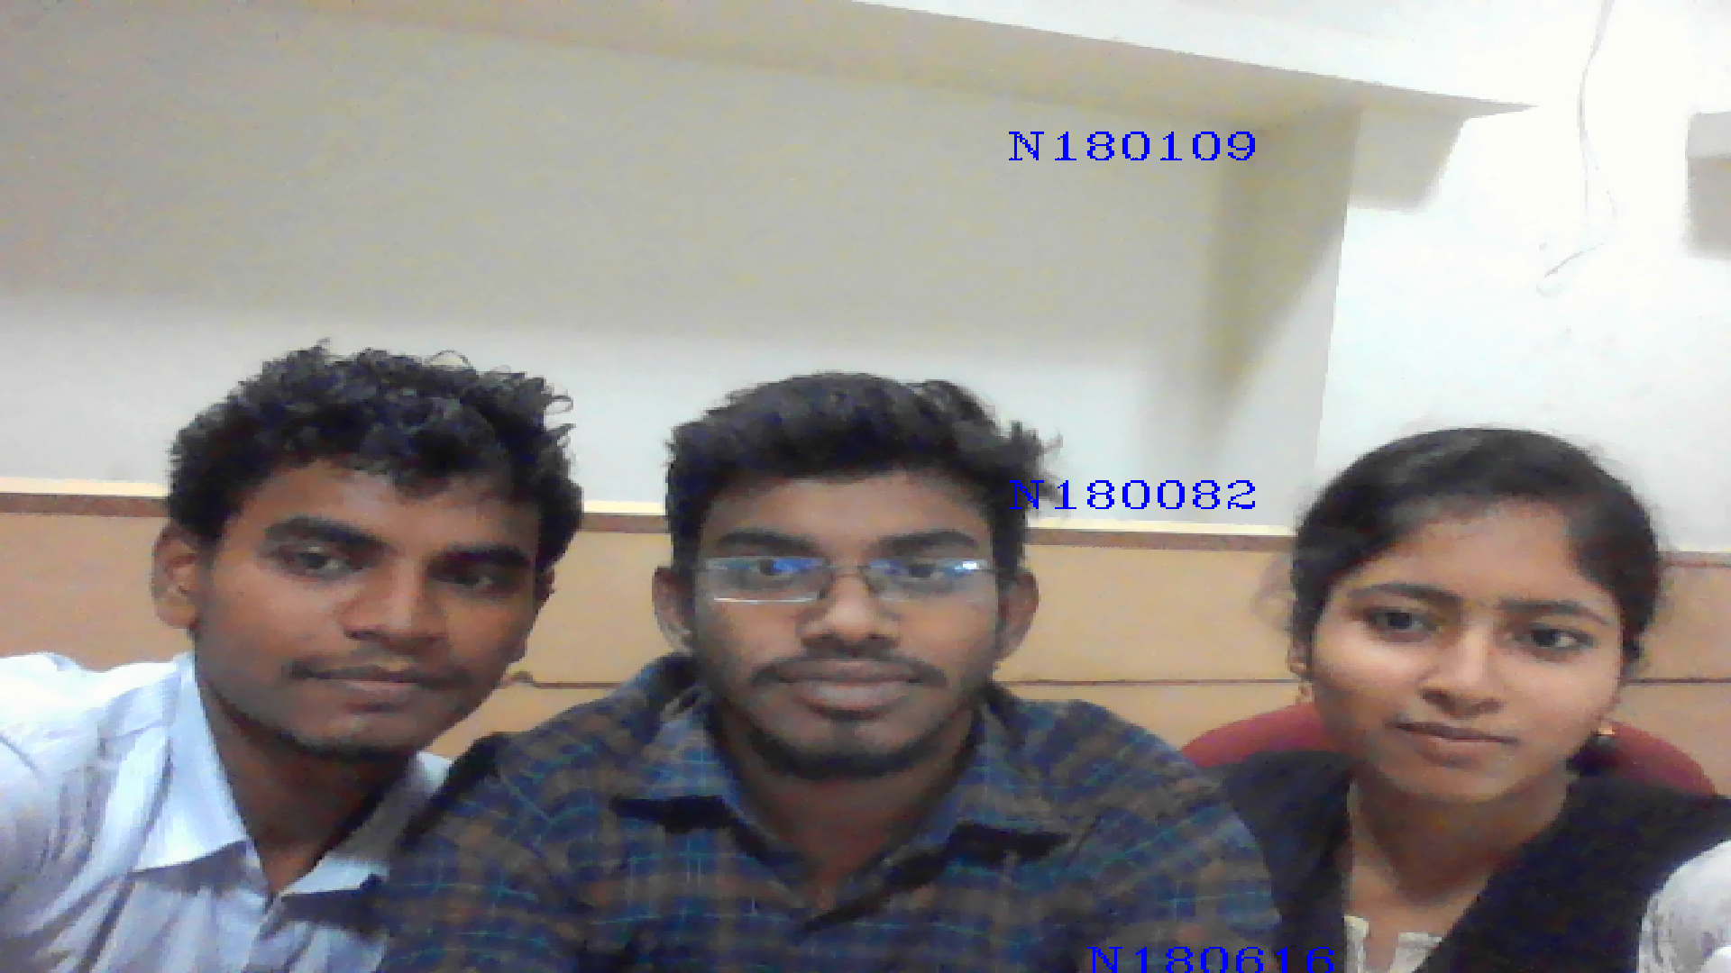
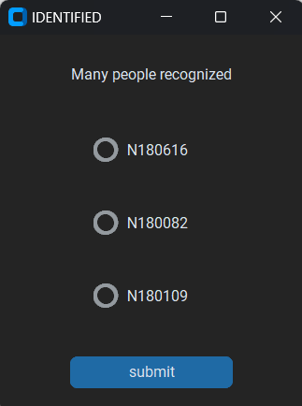
Case-2: In Crowd
Many persons were recognised.
It will show them as options with their respective IDs.

Slide 12
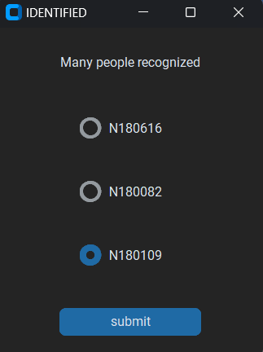
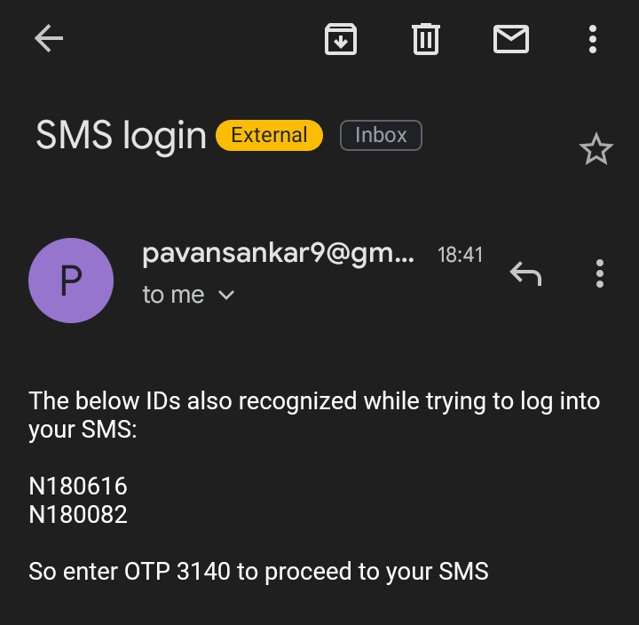
The user will choose one option from all
smtplib:
smtplib is a Python library that provides a simple way to send an email using SMTP

Slide 13
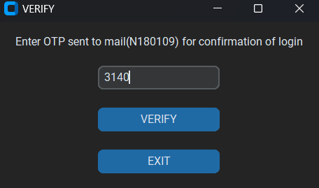
Entering OTP for reconfirmation
If entered OTP is valid then it will directly log into the SMS

Slide 14
Successfully logged into the SMS

Slide 15
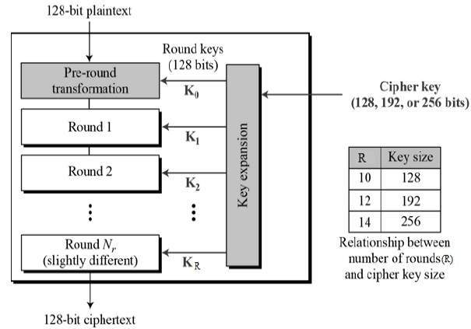
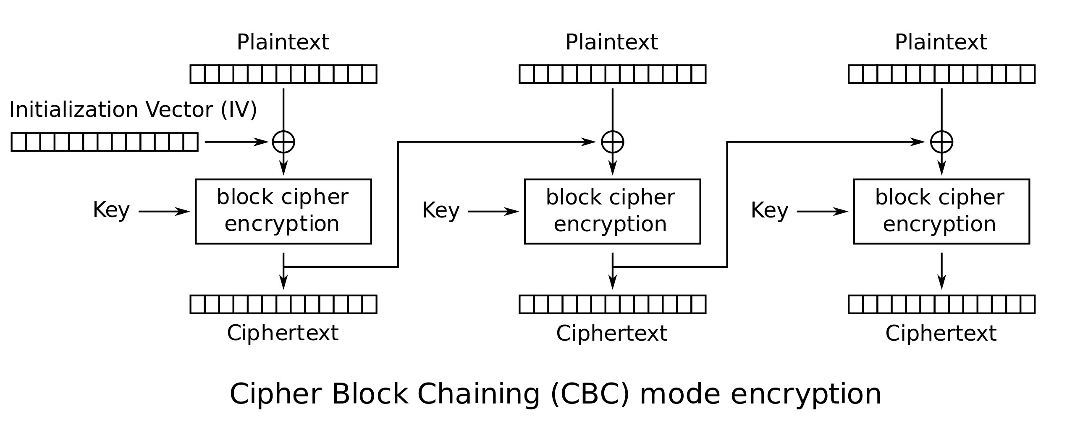
ALGORITHMS
Fernet Algorithm:
Fernet is a symmetric encryption AES algorithm in CBC mode.

Slide 16
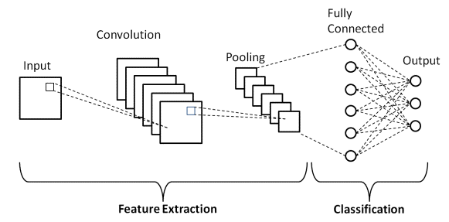
Face Encoding using Convolutional Neural Networks (CNN):
The face recognition module employs a deep neural network to compute the face encoding of each face.
Encodings-128 measurements

Slide 17
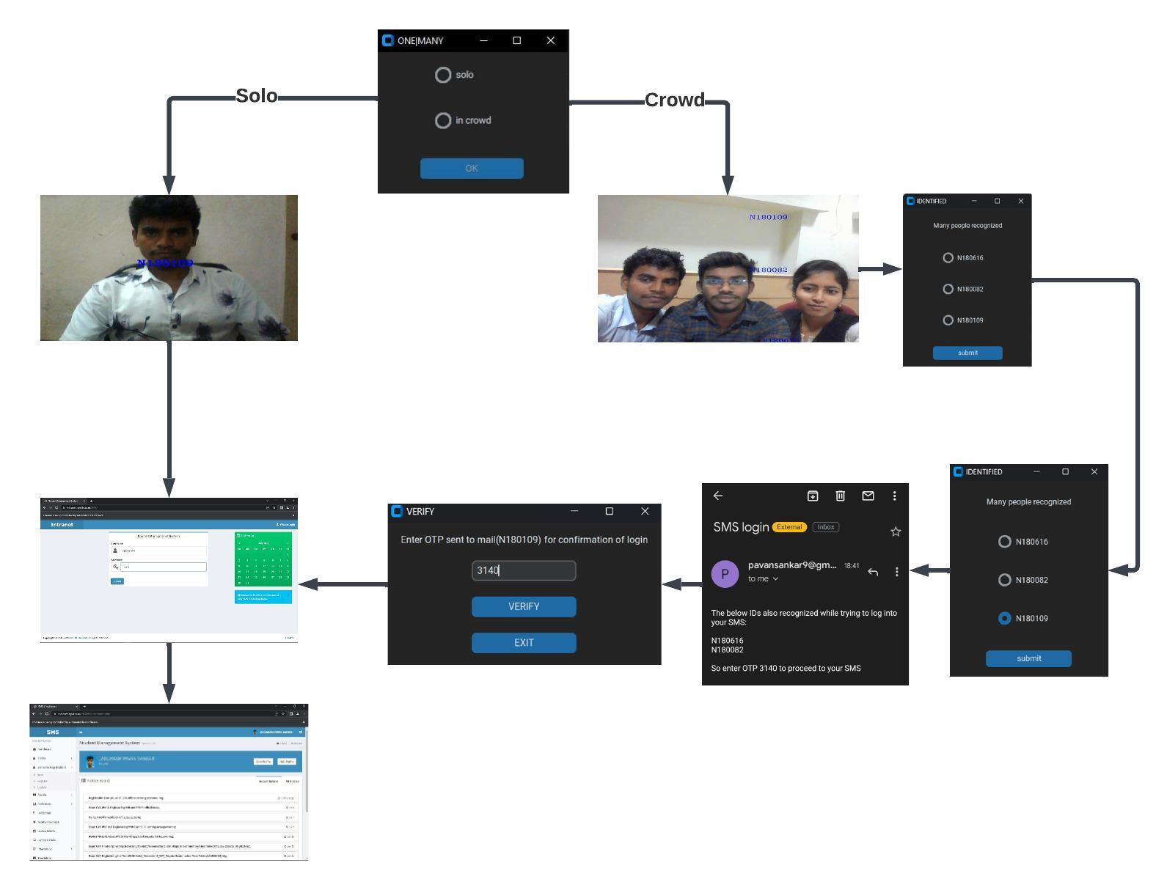
EXPERIMENTAL RESULTS

Slide 18
CONCLUSION
In conclusion, our project has successfully implemented a comprehensive student management system that leverages advanced technologies to enhance security and user experience. We have established a secure login process based on student facial features. The utilization of MongoDB as our database solution enables the storage of encrypted passwords, student details, ensuring privacy and data integrity. The incorporation of web scraping facilitates retrieval of student images and browser automation. The integration of email functionality enables automated notifications and updates. The custom GUI developed using customtkinter offers visually appealing interface for students. Collectively, these components contribute to a robust and user-friendly student management system that provides a seamless experience for students.

Slide 19
FUTURE SCOPE
As our future work, we would like to develop a web interface and deploy it in the cloud.
We further want to make it as an open source contribution.
We are going to perform spoof detection.

Slide 20
REFFERENCES
[1] Kumar, Bishnu Deo, Hilal Ahmad Mir, Mohd Kaif Ahmed, and Mohd Tabish Siddiqui. "Exam form automation using facial recognition." Materials Today: Proceedings 80 (2023): 2236-2240.

Slide 21
THANK YOU

