Slide 1
YOUTUBE AUDIO
AND
VIDEO DOWNLOADER
- J. PAVAN SANKAR (N180109)
Guided by Mrs. N. Swathi
Asst. professor, RGUKT - Nuzvid

Slide 2
ABSTRACT
The aim of this project is to develop a desktop application capable of downloading both YouTube videos and audios. Additionally, it can efficiently download entire YouTube playlists without requiring manual intervention for each individual video or audio download. While several online tools exist for downloading YouTube audio and video, they often lack the ability to download playlists seamlessly. Similarly, certain online playlist downloaders necessitate manual downloading of each video from the playlist. In response, I have created an application that combines the strengths of both functionalities. Upon receiving a provided link, the application initiates a verification process to determine whether the link corresponds to a playlist or a standalone video. It then presents distinct download options based on the media type. This approach streamlines the download process, enabling users to effortlessly save their desired content. Through this effort, I have successfully developed a comprehensive desktop application for downloading various media from YouTube.
Keywords: Youtube's audio and video download, streams, ffmpeg, transcode

Slide 3
INTRODUCTION
In today's world, YouTube has evolved into a ubiquitous source of entertainment, education, and knowledge for individuals across the globe. It offers the flexibility to enjoy a wide range of content whenever an internet connection is available. However, there is a growing need to download YouTube videos for future reference, especially in cases where internet access might not be readily available. While various online downloaders cater to this demand, they are not without their limitations. Regarding downloaders, platforms like y2mate[1], ymate[2] and some other excel at downloading individual YouTube audio and video content. However, they fall short when it comes to downloading playlists. YouTube 4K Downloader[3] shares some similarities with my project, offering the capability to download single YouTube videos and audio, as well as playlists. Nonetheless, this website imposes restrictions on the number of videos that can be downloaded from a playlist and necessitates manual interaction for each video download, resulting in a time-intensive process.

Slide 4
To bridge these gaps, I have developed the 'YouTube Audio and Video Downloader' application. This versatile tool efficiently downloads both audio and video content, as well as entire playlists. The application intelligently distinguishes between single videos and playlists based on the provided link. This functionality is made possible by leveraging the pytube module, which adeptly handles the downloading of videos and playlists from YouTube links. It offers access to available streams for a specific video, enabling users to select their preferred resolution for downloading. Additionally, the application supports audio downloads, albeit in a video container format. To address this, I implemented ffmpeg to seamlessly convert the downloaded audio into the widely compatible MP3 format. The user interface of the application is built using the tkinter and customtkinter libraries in Python, ensuring a seamless and engaging user experience. In conclusion, this application successfully addresses the challenge of downloading YouTube videos and audios, significantly streamlining the process of playlist downloads and enhancing overall user convenience.

Slide 5
EXISTING WORKS
YouTube 4K Downloader[3] can download audio, videos and also playlists
Limitations:
Only limited number of videos can be downloaded, but not the entire playlist
We need to manually click on each video to download it
Unwanted ads and pop-ups

Slide 6
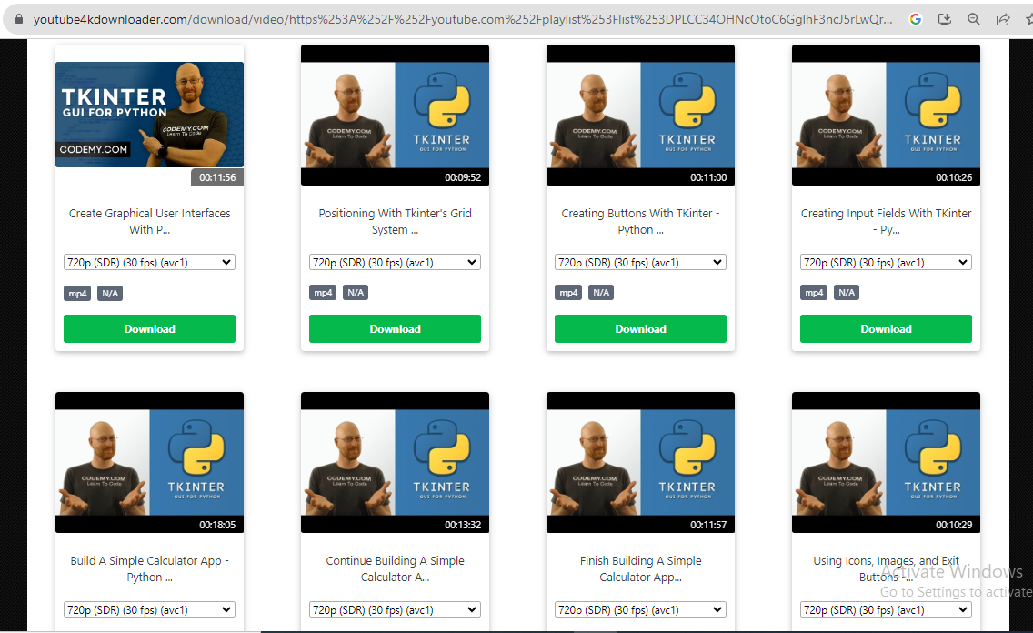
For a total of 225 videos it has given download option for 25 videos only

Slide 7
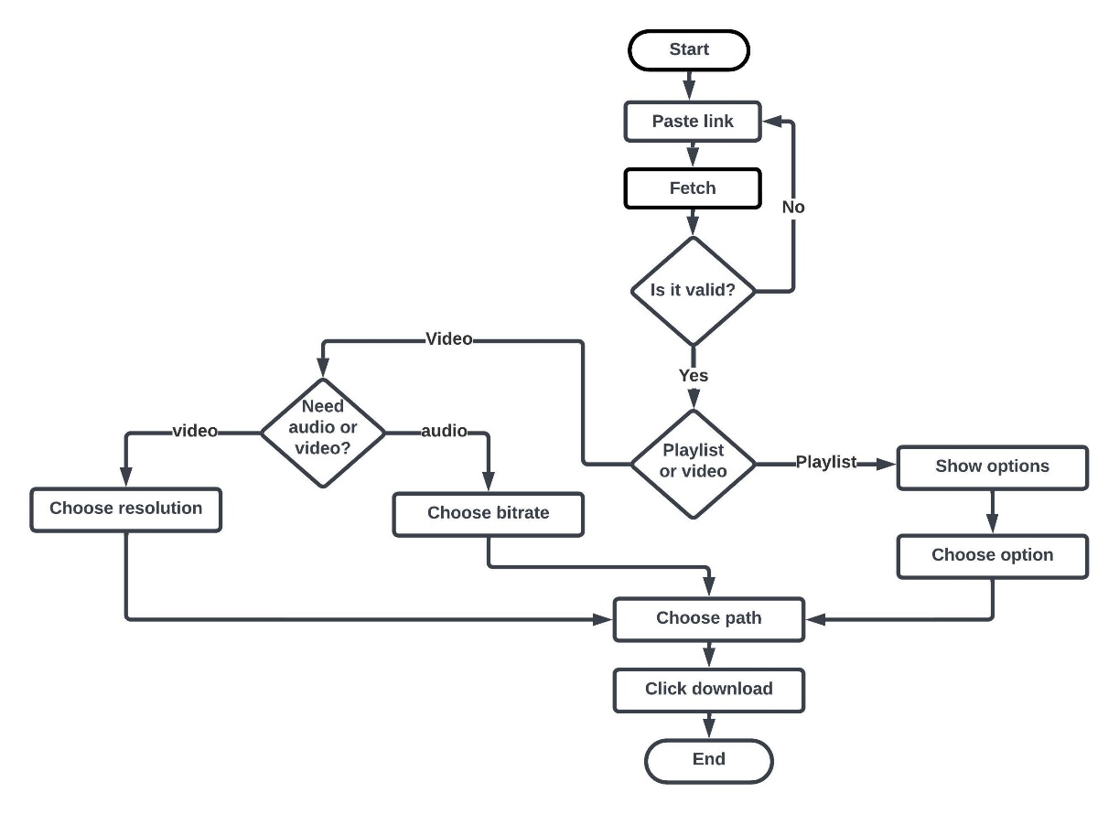
PROPOSED METHOD

Slide 8
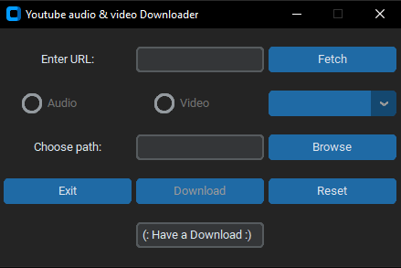
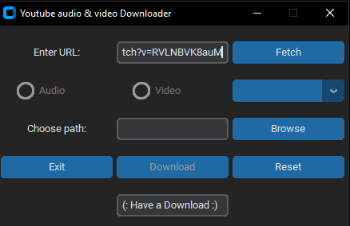
Start application: Starting the application will display a window like below
CustomTkinter:
customtkinter - to create custom GUI in python.
Enter URL : Enter URL of the video you want to download

Slide 9
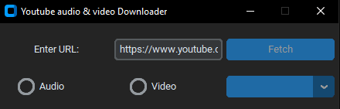
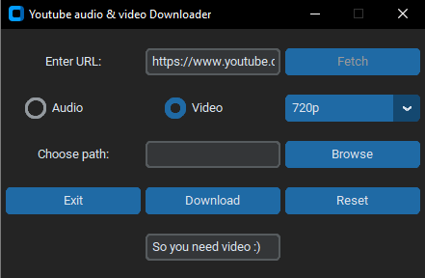
Giving YouTube video link:
Fetching data: Clicking on fetch will retrieve the various streams available for a video
pytube: A library provides convenient way to interact with YouTube videos
1.1 Choosing video: Selecting video and choosing the resolution

Slide 10
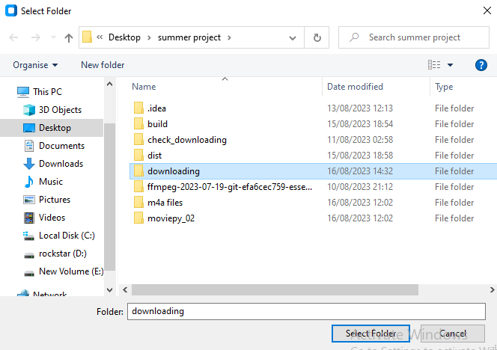
Choosing path: Clicked on browse to choose path

Slide 11
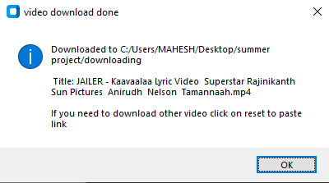
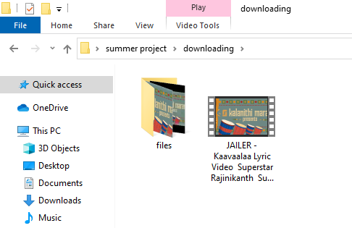
Downloading: Clicking on download will download the video in the given path
Tkinter: A built-in library, to create GUI in python
Downloaded to the given folder

Slide 12
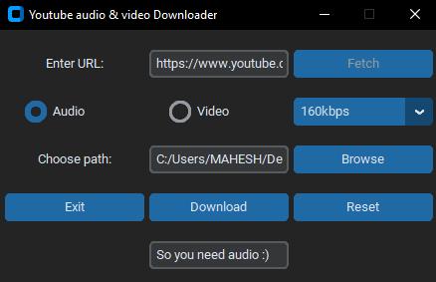
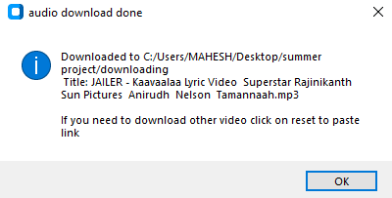
1.2 Choosing audio: Selecting audio and choosing the bitrate
FFmpeg:
It can handle multimedia data, including audio and video conversion
Downloading: clicking on download will download the audio in the given path

Slide 13
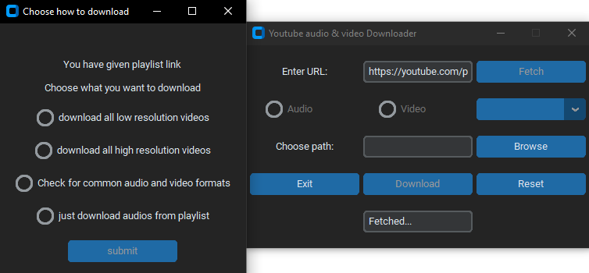
2. Giving playlist link:
Fetching playlist data: Options shown for the given playlist

Slide 14
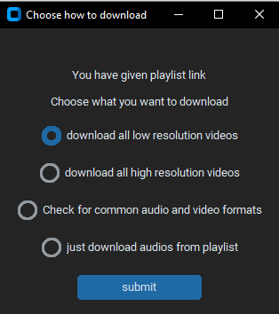
Choosing one option: Selecting one option among all

Slide 15
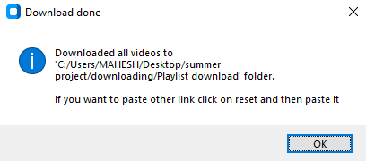
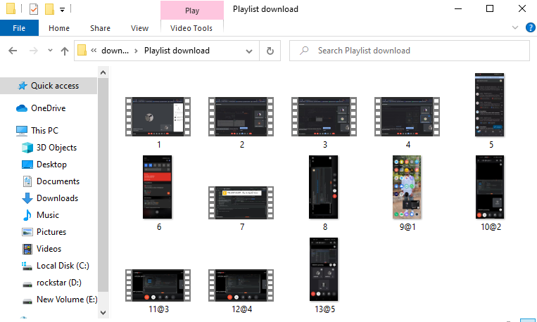
Downloading: Clicking on download will download the playlist in the given path
Downloaded playlist in the given path

Slide 16
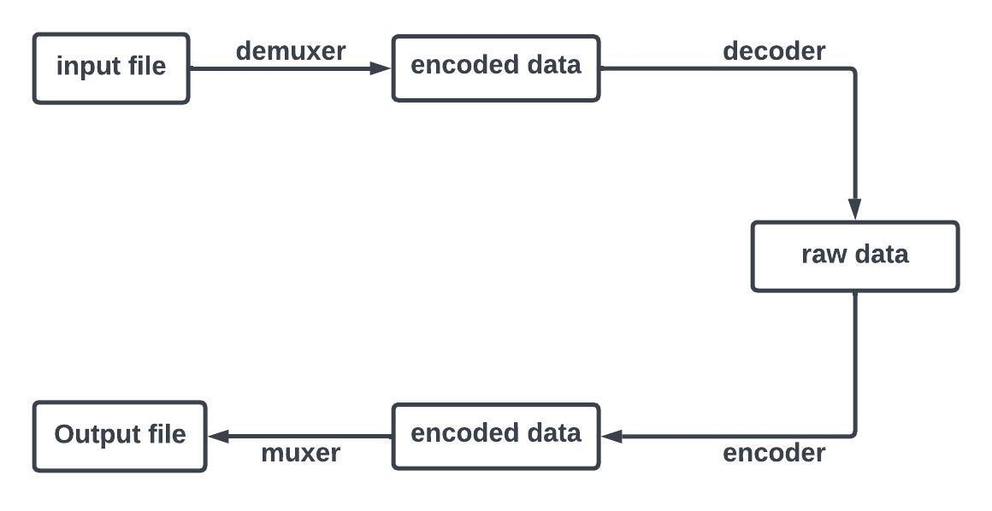
FFMPEG
ffmpeg is a powerful multimedia framework that supports a wide range of audio codecs and formats for conversion
TRANSCODING PROCESS IN FFMPEG

Slide 17
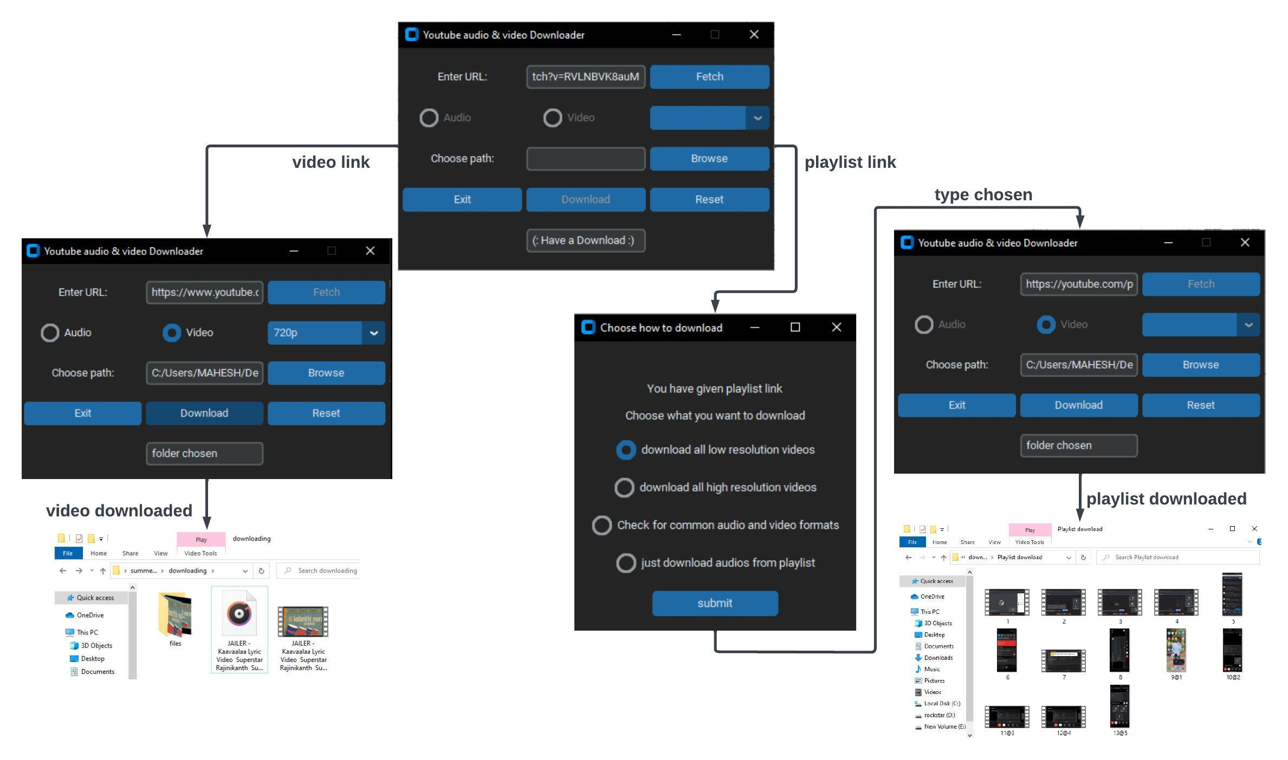
EXPERIMENTAL RESULTS

Slide 18
CONCLUSION
In conclusion, I have successfully implemented an application that harnesses the capabilities of various modules to facilitate the effortless download of YouTube audio, video, and playlists. This approach minimizes the need for extensive human interaction and eliminates the inconvenience of encountering unwanted ads often associated with online downloaders. By incorporating the pytube module, the application adeptly accesses diverse streams available for both video and audio content, allowing users to download according to their preferred resolutions and bitrates. Furthermore, the integration of the command-line tool ffmpeg simplifies the conversion process of downloaded audio container formats to the universally accepted MP3 format, ensuring compatibility with a wide range of systems. The user interface, meticulously crafted using customtkinter and tkinter, presents an appealing visual experience, enhancing accessibility for users, particularly students. In synergy, these components synergize to yield a robust and user-friendly YouTube audio and video downloader, offering a seamless and enjoyable user journey.

Slide 19
FUTURE SCOPE
I will develop a web interface for this project and I will deploy it in the cloud.
Inclusion of different audio formats for download
Making high resolution videos available to download

Slide 20
REFFERENCES
[1] https://www.y2mate.com/en807
[2] https://ymate.app/en69
[3] https://youtube4kdownloader.com/en84/convert-youtube-4k-video.html

Slide 21
THANK YOU

