Slide 1
FoodSpend Insights
What should I eat next, and why? Personalised nutrition analytics from 365 days of food history.
Synthetic dataset · 2025-10-27 to 2026-10-26 · decision support, not medical advice

Slide 2
The answer: a high-protein home lunch at ₹85
RECOMMENDED LUNCH · PROTEIN GOAL · ₹350 BUDGET
₹1,48,988
50.9 g
Home Paneer Bhurji with 2 Roti
spent on food in 365 days (synthetic)
logged protein per day vs 65.5 g target
26 g protein vs a 22.9 g lunch target (35% of 65.5 g/day)
520 kcal, within the 738 kcal lunch allowance
₹85 estimated cost, leaving ₹265 of the budget
Liked in explicit feedback; confidence High
Best delivery-only option: Idli Sambar (3 idli) + Boiled Eggs, ₹139, 24 g protein
210
4
meal combinations scored for this lunch
foods excluded by disliked / avoid feedback
Scores combine goal progress, explicit ratings and cost with published weights; all values recalculate when the budget, goal or food choices change.

Slide 3
Four linked synthetic datasets cover one year
A
B
C
D
Orders & consumption
Preferences & feedback
Health & goals
Nutrition & meal options
1223 orders, 1755 items. Purchases, home meals, consumption status and portion eaten
206 ratings (1–5) with liked / acceptable / disliked / avoid labels
79 measurements (weight, waist, BP, glucose); 3 goals with cited references
40 foods with per-serving or per-100 g nutrients; 80 priced meal options
Stable IDs link every table: orders → items → foods → nutrition; feedback → food (and order); measurements → person.
Generated by a seeded script (reproducible): weekday delivery lunches, home dinners, grocery runs, a 3-week travel gap.
Purchase frequency is driven by convenience, not by the hidden ratings, so buying and liking can diverge.
Clearly labelled synthetic; nutrients approximate IFCT 2017 / USDA values; targets cite ICMR-NIN 2020, DGA, WHO, IOM.

Slide 4
Architecture: one set of formulas from CSV to dashboard
Generate
Clean
MySQL
Django API
React
Seeded synthetic CSVs with planted quality issues
Validate, standardise, reject with reasons
Constrained schema, idempotent import
DRF views over foodspend_core formulas
Plotly dashboard and simulators
Why it holds together
foodspend_core (pure Python) holds every formula; the API and the Jupyter notebooks import the same functions.
48 SQL-vs-pandas checks and 35 backend tests compare database results with independent calculations.
The browser never sends prices or nutrients: scenarios send food IDs and servings, and the server recalculates.
Stack: React 18 + Vite + Bootstrap + Plotly · Django 6 + DRF · MySQL 8 · pandas, NumPy, Matplotlib, Jupyter.

Slide 5
Cleaning caught every planted problem without guessing
Table | Check / action | Result
orders | exact duplicate rows removed | rows removed: 2
order_items | exact duplicate rows removed | rows removed: 3
health_measurements | exact duplicate rows removed | rows removed: 1
food_nutrition | foods with unknown nutrient values (kept as NULL, not zero) | foods: F013: fiber_g, F016: fiber_g
orders | final_total recomputed from components | rows: 2; difference inr: 100
order_items | serving units standardised | rows: 30; variants: G, ML, gm, grams
order_items | blank food_id resolved by exact normalised-name match | resolved: 3; unresolved: 1
order_items | unknown food (orphan food_id) | rows rejected: 2
order_items | quantity must be > 0 | rows rejected: 2
orders | sum(item line totals) equals order items_subtotal (no double counting) | orders checked: 1223; mismatches: 0; orders without items: 1
food_feedback | rating missing or outside 1-5 | rows rejected: 2
health_measurements | physiologically implausible value or unknown indicator | rows rejected: 1
7
rows rejected and logged with the rule that rejected them
346 / 365
days with at least one record (travel gap in March)
Rules: a blank food ID is filled only by an exact normalised-name match; unknown nutrients stay NULL; purchases are never assumed eaten.

Slide 6
Delivery drives 71% of ₹1,48,988 annual food spending
₹12,425
average per month across 365 days
₹20,990
tax, delivery and platform charges (14.1%)
Spending = sum of order final totals (subtotal − discount + tax + fees) over 648 transactions; discounts saved ₹3,223. Home-meal ingredient estimates are excluded. March dips with the travel gap.

Slide 7
Logged protein and fibre sit below documented targets
Measure | Logged avg | Target | Status
protein | 50.9 | 65.5 g/day | Below target
fibre | 17.4 | 30 g/day | Below target
calories | 1,434.1 | 2,110 kcal/day | Within range
fat % of energy | 31.7% | ≤ 30% | Above target
carb % of energy | 54% | 45–65% | Within range
Based on 346 logged days (94.8% of the year); unlogged food is missing, so intake is likely underestimated.
Fibre is unknown for 2 dishes (57 meal items): reported as unknown, not zero.
Status labels are used only where a cited target exists; a value above a minimum is not scored as “better”.

Slide 8
Buying a food often does not mean liking it
0.44
rank correlation (Spearman) between rating and purchases across 37 rated foods
Example
Veg Hakka Noodles is #9 by purchase count (40 purchases) but has a mean rating of 2.8/5 and latest label 'disliked'.
206 explicit feedback records. Recommendations use ratings only; disliked or avoided foods are excluded, and purchase counts are shown beside ratings but never used as evidence of liking.

Slide 9
Health indicators: trends reported, causes not claimed
Indicator | First | Latest | Change | Readings | Reference | Latest status
BMI (derived) | 27.8 kg/m2 | 26.7 kg/m2 | −1.1 | 41 | 18.5–24.9 | Above target
Diastolic BP | 88 mmHg | 77 mmHg | −11.0 | 11 | ≤ 79 | Within range
Fasting glucose | 104 mg/dL | 97 mg/dL | −7.0 | 4 | 70–99 | Within range
Systolic BP | 127 mmHg | 124 mmHg | −3.0 | 11 | ≤ 119 | Above target
Waist | 97.1 cm | 92.1 cm | −5.0 | 12 | ≤ 89.9 | Above target
Weight | 82.2 kg | 78.9 kg | −3.3 | 41 | none | not assessed
How to read this
All values are simulated.
Weight weekly, waist and BP monthly, glucose quarterly; March has no readings.
Status compares the latest value with a cited range (WHO, ADA, ACC/AHA, IDF). It is not a diagnosis.
Changes co-occur with diet patterns but are not attributed to any food.

Slide 10
A transparent score ranks every feasible meal
1
Set the target
Daily goal × meal share (lunch 35%); recent 30-day intake for context
Score components
Goal = 0.7 × min(nutrient ÷ meal target, 1) + 0.3 × calorie fit
Calorie fit = 1 at 60–100% of the meal allowance, lower outside
Preference = (rating − 1) ÷ 4, with rating shrunk toward the person’s average: (n·mean + 2·avg) ÷ (n + 2)
Cost = 1 − cost ÷ budget
Ties: higher preference, then lower cost
No machine learning
2
Build candidates
Each main at allowed servings, alone or + one side / previously bought pantry food
3
Apply constraints
Cost ≤ budget · listed for the meal · latest label not disliked / avoid
4
Score
0.5 goal + 0.3 preference + 0.2 cost (user-adjustable)
5
Explain
Reasons, alternatives, trade-offs, confidence, ±15% serving range

Slide 11
Recommended lunch and four alternatives
Option | Meal | Cost | Protein (g) | kcal | Score
Recommended | Home Paneer Bhurji with 2 Roti | ₹85.00 | 26 | 520 | 0.887
Substitute the main dish | Home Dal, Rice and Sabzi Thali + Curd (Dahi) | ₹94.08 | 23.2 | 611.5 | 0.867
Increase the serving | Home Paneer Bhurji with 2 Roti x1.5 | ₹127.50 | 39 | 780 | 0.854
Add a previously purchased food | Home Paneer Bhurji with 2 Roti + Banana | ₹91.36 | 27.3 | 626.8 | 0.885
Lowest-cost option | Home Dal, Rice and Sabzi Thali | ₹75.00 | 18 | 520 | 0.795
Trade-offs
Delivery-only lunch (₹350 budget)
The larger serving adds protein but also calories and cost, and scores slightly lower.
Adding a pantry food adds little cost; the dal thali swap trades protein for a lower price.
Excluded by feedback: Veg Hakka Noodles (disliked), Green Salad (disliked), Chole Bhature (disliked), Fish Curry Meal (avoid).
Idli Sambar (3 idli) + Boiled Eggs: ₹139.09, 24 g protein, 485 kcal.
Substitute the main dish: Masala Dosa + Boiled Eggs (₹171, 22 g).
Increase the serving: Idli Sambar (3 idli) x2 + Banana (₹220, 23.3 g).

Slide 12
What-if: each change shifts protein and cost
Scenario | Cost change | kcal change | Within ₹350
Serving x2 | +₹267.75 | +720 | No
Add boiled eggs | +₹14.84 | +155 | Yes
Swap: chicken salad bowl | +₹42.00 | −310 | Yes
Swap: home thali + curd | −₹213.67 | −109 | Yes
Doubling the dish doubles protein but exceeds the budget.
Adding eggs from the pantry is the cheapest protein gain.
All values are recalculated server-side from reference data for every change.

Slide 13
A bigger budget does not buy a better delivery lunch here
Budget | Feasible combinations | Top-ranked option | Cost | Remaining | Used | Protein
₹150 | 5 | Idli Sambar (3 idli) + Boiled Eggs | ₹139.09 | ₹10.91 | 92.7% | 24 g
₹250 | 37 | Idli Sambar (3 idli) + Boiled Eggs | ₹139.09 | ₹110.91 | 55.6% | 24 g
₹350 | 108 | Idli Sambar (3 idli) + Boiled Eggs | ₹139.09 | ₹210.91 | 39.7% | 24 g
₹500 | 139 | Idli Sambar (3 idli) + Boiled Eggs | ₹139.09 | ₹360.91 | 27.8% | 24 g
₹150
Raising the budget adds options but the same lunch keeps winning: more spending is not treated as healthier.
Budget utilisation and remaining budget are shown for every option; zero budgets are handled without division errors.
Prices are the latest in the synthetic history, not current market prices.
already covers the top delivery option once pantry eggs are allowed

Slide 14
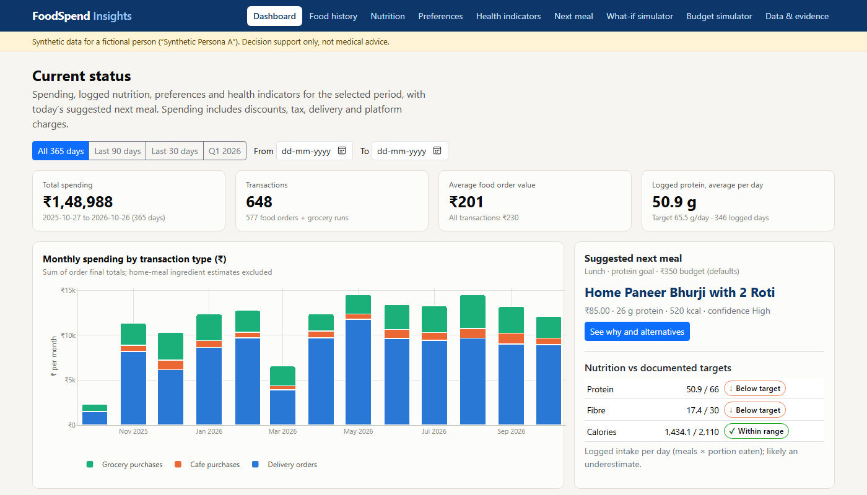
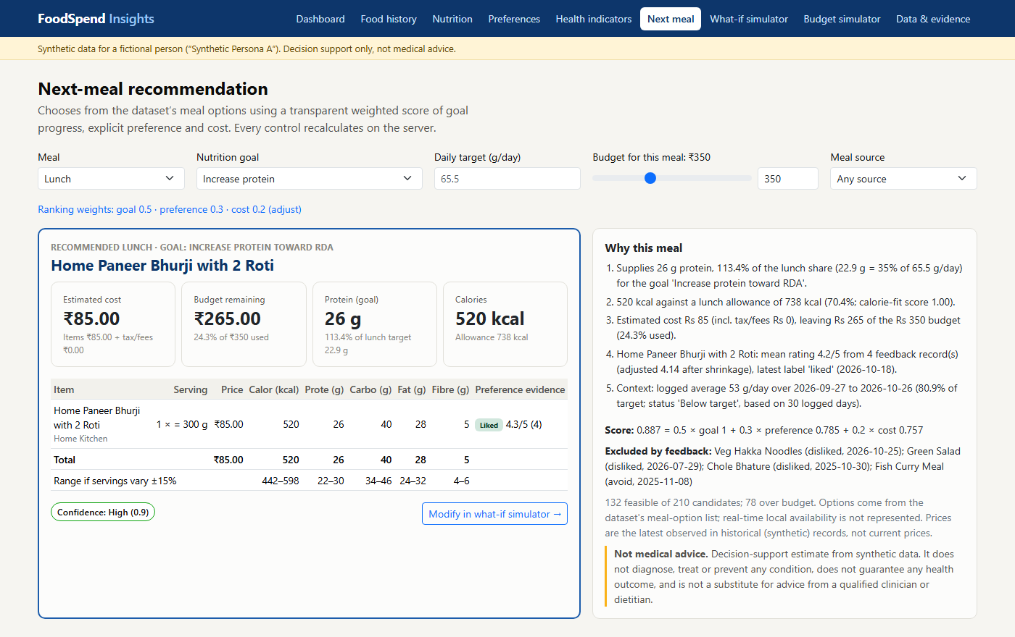
The dashboard answers the question interactively
Nine pages: dashboard, food history, nutrition, preferences, health, next meal, what-if, budget, data & evidence.
Every control (date range, goal, target, budget, source, weights, servings) triggers a server recalculation.
Charts carry titles, units and reference lines; status labels always pair an icon with text.

Slide 15
Key findings
Delivery dominates spending
Logged protein is below target
Delivery orders account for Rs 106,275 of Rs 148,988 (71%) across 431 orders. Tax, delivery and platform charges add Rs 20,990 (14.1% of spending); discounts saved Rs 3,223.
Average logged intake is 50.9 g/day vs a documented target of 65.5 (77.7%), over 346 logged days. Logging is incomplete, so true intake may be higher.
Logged fibre is below target
Frequent purchases are not the same as preferences
Average logged intake is 17.4 g/day vs a documented target of 30 (58.0%), over 346 logged days. Logging is incomplete, so true intake may be higher.
Veg Hakka Noodles is #9 by purchase count (40 purchases) but has a mean rating of 2.8/5 and latest label 'disliked'.
Well-rated options are under-used
Weight trend (association only)
Sprouts Chaat is rated 4.2/5 (4 ratings) yet was purchased only 3 times.
Recorded weight changed by -3.3 kg (82.2 -> 78.9 kg, 41 readings, 2025-11-02 to 2026-10-25). This is not attributed to any food choice; measurement gaps exist (e.g. March).

Slide 16
Limitations and what we would improve
Limitations
Next improvements
Synthetic data for one fictional person; nutrients are unverified estimates.
Intake covers logged meals only; grocery consumption is unknown.
Historical prices; no real-time availability or delivery times.
Meal shares, weights and ±15% uncertainty are assumptions.
Health trends are associations; nothing here is medical advice.
Load verified nutrients from IFCT / USDA FoodData Central by food code
Day-level planning: optimise all remaining meals against several goals
Log consumption of pantry stock to close the purchase-vs-eaten gap
Add authentication and per-user goals before sharing beyond localhost
Code-split the Plotly bundle for faster first load

