Slide 1
DEMO Different types of File Formats and Semi-structure Data Handling

Slide 2
Different File Formats in Snowflake
Format Type | Type of Data | Load | Unload | Binary Format Support | Readable
CSV | Structured | Yes | Yes | No | Yes
JSON | Semi-structured | Yes | Yes | No | Yes
PARQUET | Semi-structured | Yes | Yes | Yes | No
XML | Semi-structured | Yes | No | No | Yes
AVRO | Semi-structured | Yes | No | Yes | No
ORC | Semi-structured | Yes | No | Yes | No
**Snowflake Supports Geo-Spatial Data Formats: GeoJSON (like json readable format)

Slide 3
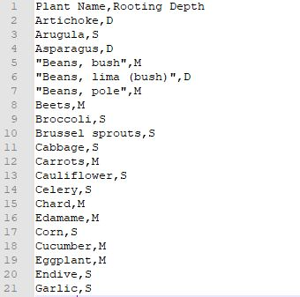
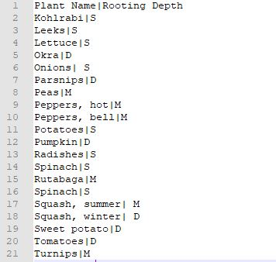
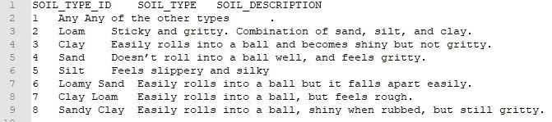
STRUCTURED FILES
Comma Delimiter
File Name *.txt/ *.csv/ *.tsv
Pipe/Vertical Bar Delimiter
v
v
type = ‘csv'
field_delimiter = ‘|'
skip_header = 1
field_optionally_enclosed_by=‘none’
type = ‘csv'
trim_space = true
field_delimiter = ‘,'
v
skip_header = 1
field_optionally_enclosed_by=‘\042’ (double quotes)
TAB Delimiter
type = ‘csv'
field_delimiter = '\t'
skip_header = 1

Slide 4
Syntax
CREATE [ OR REPLACE ] FILE FORMAT [ IF NOT EXISTS ] <name>
TYPE = { CSV | JSON | AVRO | ORC | PARQUET | XML }
[ formatTypeOptions ]
[ COMMENT = '<string_literal>' ]
[ formatTypeOptions ]
-- If TYPE = CSV
COMPRESSION = AUTO | GZIP | BZ2 | BROTLI | ZSTD | DEFLATE | RAW_DEFLATE | NONE
RECORD_DELIMITER = '<character>' | NONE
FIELD_DELIMITER = '<character>' | NONE
FILE_EXTENSION = '<string>'
SKIP_HEADER = <integer>
SKIP_BLANK_LINES = TRUE | FALSE
DATE_FORMAT = '<string>' | AUTO
TIME_FORMAT = '<string>' | AUTO
TIMESTAMP_FORMAT = '<string>' | AUTO
BINARY_FORMAT = HEX | BASE64 | UTF8
ESCAPE = '<character>' | NONE
ESCAPE_UNENCLOSED_FIELD = '<character>' | NONE
TRIM_SPACE = TRUE | FALSE
FIELD_OPTIONALLY_ENCLOSED_BY = '<character>' | NONE
NULL_IF = ( '<string>' [ , '<string>' ... ] )
ERROR_ON_COLUMN_COUNT_MISMATCH = TRUE | FALSE
REPLACE_INVALID_CHARACTERS = TRUE | FALSE
VALIDATE_UTF8 = TRUE | FALSE
EMPTY_FIELD_AS_NULL = TRUE | FALSE
SKIP_BYTE_ORDER_MARK = TRUE | FALSE
ENCODING = '<string>' | UTF8
-- If TYPE = JSON
COMPRESSION = AUTO | GZIP | BZ2 | BROTLI | ZSTD | DEFLATE | RAW_DEFLATE | NONE
DATE_FORMAT = '<string>' | AUTO
TIME_FORMAT = '<string>' | AUTO
TIMESTAMP_FORMAT = '<string>' | AUTO
BINARY_FORMAT = HEX | BASE64 | UTF8
TRIM_SPACE = TRUE | FALSE
NULL_IF = ( '<string>' [ , '<string>' ... ] )
FILE_EXTENSION = '<string>'
ENABLE_OCTAL = TRUE | FALSE
ALLOW_DUPLICATE = TRUE | FALSE
STRIP_OUTER_ARRAY = TRUE | FALSE
STRIP_NULL_VALUES = TRUE | FALSE
REPLACE_INVALID_CHARACTERS = TRUE | FALSE
IGNORE_UTF8_ERRORS = TRUE | FALSE
SKIP_BYTE_ORDER_MARK = TRUE | FALSE
Notes:
formatTypeOptions ::=
-- If TYPE = CSV
COMPRESSION = AUTO | GZIP | BZ2 | BROTLI | ZSTD | DEFLATE | RAW_DEFLATE | NONE
RECORD_DELIMITER = '<character>' | NONE
FIELD_DELIMITER = '<character>' | NONE
FILE_EXTENSION = '<string>'
SKIP_HEADER = <integer>
SKIP_BLANK_LINES = TRUE | FALSE
DATE_FORMAT = '<string>' | AUTO
TIME_FORMAT = '<string>' | AUTO
TIMESTAMP_FORMAT = '<string>' | AUTO
BINARY_FORMAT = HEX | BASE64 | UTF8
ESCAPE = '<character>' | NONE
ESCAPE_UNENCLOSED_FIELD = '<character>' | NONE
TRIM_SPACE = TRUE | FALSE
FIELD_OPTIONALLY_ENCLOSED_BY = '<character>' | NONE
NULL_IF = ( '<string>' [ , '<string>' ... ] )
ERROR_ON_COLUMN_COUNT_MISMATCH = TRUE | FALSE
REPLACE_INVALID_CHARACTERS = TRUE | FALSE
VALIDATE_UTF8 = TRUE | FALSE
EMPTY_FIELD_AS_NULL = TRUE | FALSE
SKIP_BYTE_ORDER_MARK = TRUE | FALSE
ENCODING = '<string>' | UTF8
-- If TYPE = JSON
COMPRESSION = AUTO | GZIP | BZ2 | BROTLI | ZSTD | DEFLATE | RAW_DEFLATE | NONE
DATE_FORMAT = '<string>' | AUTO
TIME_FORMAT = '<string>' | AUTO
TIMESTAMP_FORMAT = '<string>' | AUTO
BINARY_FORMAT = HEX | BASE64 | UTF8
TRIM_SPACE = TRUE | FALSE
NULL_IF = ( '<string>' [ , '<string>' ... ] )
FILE_EXTENSION = '<string>'
ENABLE_OCTAL = TRUE | FALSE
ALLOW_DUPLICATE = TRUE | FALSE
STRIP_OUTER_ARRAY = TRUE | FALSE
STRIP_NULL_VALUES = TRUE | FALSE
REPLACE_INVALID_CHARACTERS = TRUE | FALSE
IGNORE_UTF8_ERRORS = TRUE | FALSE
SKIP_BYTE_ORDER_MARK = TRUE | FALSE
-- If TYPE = AVRO
COMPRESSION = AUTO | GZIP | BZ2 | BROTLI | ZSTD | DEFLATE | RAW_DEFLATE | NONE
TRIM_SPACE = TRUE | FALSE
NULL_IF = ( '<string>' [ , '<string>' ... ] )
-- If TYPE = ORC
TRIM_SPACE = TRUE | FALSE
NULL_IF = ( '<string>' [ , '<string>' ... ] )
-- If TYPE = PARQUET
COMPRESSION = AUTO | LZO | SNAPPY | NONE
SNAPPY_COMPRESSION = TRUE | FALSE
BINARY_AS_TEXT = TRUE | FALSE
TRIM_SPACE = TRUE | FALSE
NULL_IF = ( '<string>' [ , '<string>' ... ] )
-- If TYPE = XML
COMPRESSION = AUTO | GZIP | BZ2 | BROTLI | ZSTD | DEFLATE | RAW_DEFLATE | NONE
IGNORE_UTF8_ERRORS = TRUE | FALSE
PRESERVE_SPACE = TRUE | FALSE
STRIP_OUTER_ELEMENT = TRUE | FALSE
DISABLE_SNOWFLAKE_DATA = TRUE | FALSE
DISABLE_AUTO_CONVERT = TRUE | FALSE
SKIP_BYTE_ORDER_MARK = TRUE | FALSE

Slide 5
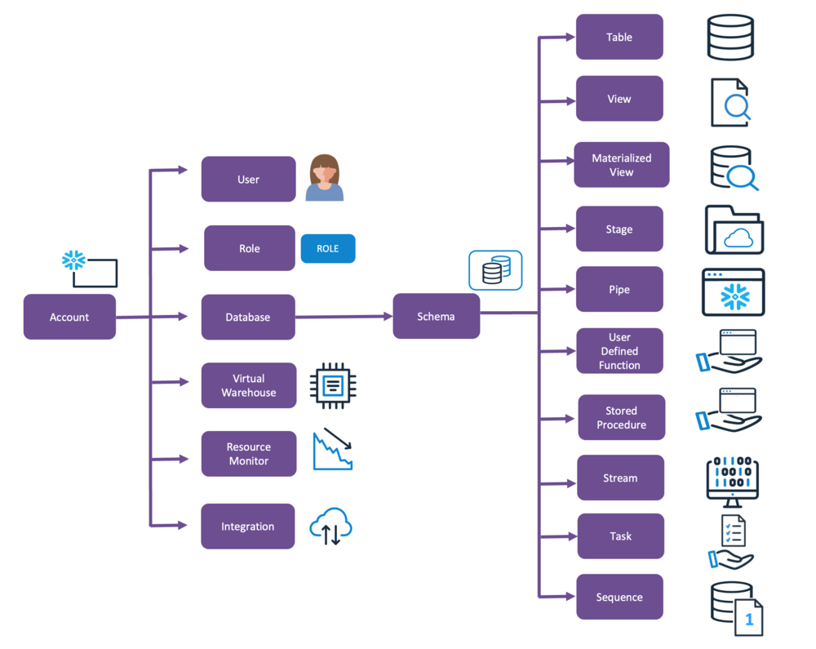
Snowflake Objects hierarchy
Multiple Tables
pavanb3
sysadmin
External Stage:
demo_lab_data_aws_s3_public
demo_lab
public
Organization
IJZPSAZ
ZX01546
compute_wh
Edition: Standard
Cloud: AWS
Region: Canada (Central)
File Format
Multiple File Formats

Slide 6
LAB

Slide 7
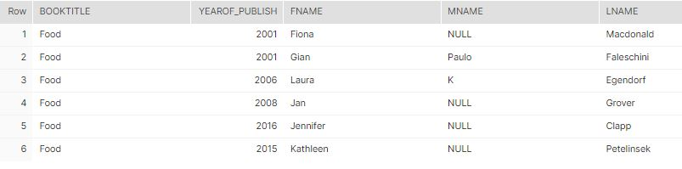
Relational representation
Semi-structure representation
{
"authors": [
{
"first_name": "Fiona",
"last_name": "Macdonald",
"middle_name": null
},
{
"first_name": "Gian",
"last_name": "Faleschini",
"middle_name": "Paulo"
}
],
"book_title": "Food",
"year_published": 2001
}

Slide 8
Semi Structure Data
Semi Structure Data - Nested JSON
Semi Structure Data -JSON
{
"authors": [
{
"first_name": "Fiona",
"last_name": "Macdonald",
"middle_name": null
},
{
"first_name": "Gian",
"last_name": "Faleschini",
"middle_name": "Paulo"
}
],
"book_title": "Food",
"year_published": 2001
}
{
"book_title": "Food",
"year_published": 2001
}
SRC variant
SRC variant
KEY
VALUE
SRC[‘book_title’]
“Food”
SRC[‘book_title’]::string
Food
SRC: year_published::number
2001
[
{
"first_name": "Fiona",
"last_name": "Macdonald",
"middle_name": null
},
{
"first_name": "Gian",
"last_name": "Faleschini",
"middle_name": "Paulo"
}
]
SRC:authors
Relational representation
Array as input
lateral flatten (input => SRC:authors)

Slide 9
References:
https://docs.snowflake.com/en/
https://plazagonzalo.medium.com/
https://rajivgupta780184.medium.com/

