Slide 1

FlyPilot: Giving a Drone the Escape Reflex of a Fruit Fly
Bio-Inspired Engineering EL | Phase I
Pavan Shenoy P (1RV25CS123) · Pranav Aggarwal (1RV25CS127) · Pratham G Bhat (1RV25CS131)
Notes:
[Title | about 15 s]
Good morning, everyone. We are Pavan, Pranav and Pratham, and our project for Bio-Inspired Engineering is called FlyPilot: giving a drone the escape reflex of a fruit fly.
TIP: Say the names clearly. Don't read the slide.

Slide 2
EL Phase-I
Presentation Outline
Introduction
Literature Review
Problem Definition
Objectives
Methodology
Proposed Outcomes
Timeline of the project
Conclusion
References
Notes:
[Outline | about 10 s]
I'll go through nine parts: the idea, what the research says, the problem, our objectives, how we will do it, what we expect, the timeline, and our conclusion.

Slide 3
Introduction
Overview of the topic: A fruit fly escapes a swatter within milliseconds using a tiny looming-detection circuit. Motion-sensing T4/T5 neurons feed LPLC2 and LC4 neurons, which converge on the giant fiber; its spike triggers the escape jump. FlyPilot rebuilds this circuit in software, wired from the FlyWire connectome, and uses it as the vision system of a simulated drone.
Importance of the topic: Small drones must spot incoming obstacles within milliseconds on very limited compute. CNN vision needs large labelled datasets, is computationally heavy, and often fails when lighting, texture or speed change. A circuit evolution refined for exactly this task may give earlier warning, fewer training examples and better robustness.
[Insert picture]
Fruit fly escaping a swatter / looming stimulus (add source credit)
Notes:
[Introduction | about 60 s]
Think about swatting a fly. It is gone before your hand arrives. It is not thinking about it. It has a tiny circuit in its brain built for one job: notice something growing quickly bigger in its vision, and jump.
Here is the chain. Motion-sensing neurons feed two kinds of neurons, called LPLC2 and LC4, that react to things growing bigger. Those connect to one big neuron called the giant fiber. When the giant fiber fires, the fly jumps.
Now think of a small drone. It also has to dodge things fast, but on a tiny computer. The usual solution, a CNN, needs thousands of labelled examples, is heavy to run, and often fails when lighting or backgrounds change.
Our idea is to copy the fly instead. And we can do it properly, because scientists have published the fly brain's complete wiring diagram, called FlyWire. So we copy the real connections, not a guess.
TIP: If you add the fly picture, point at it while you describe the swat.

Slide 4
Literature Review
Sl. No. | Year | Title | Author(s) | Summary
1 | 2014 | A spike-timing mechanism for action selection (Nature Neuroscience, 17, 962–970) | C. R. von Reyn et al. | Shows that the timing of giant-fiber spikes in Drosophila, set by how fast a looming object expands, selects between a fast short-mode takeoff and a slower long-mode takeoff. Defines the escape trigger we model.
2 | 2016 | Deep residual learning for image recognition (IEEE CVPR, pp. 770–778) | K. He, X. Zhang, S. Ren, J. Sun | Introduces residual connections that make very deep CNNs trainable. Our pretrained ResNet-18 comes from this family and serves as the secondary CNN baseline.
3 | 2017 | Ultra-selective looming detection from radial motion opponency (Nature, 551, 237–241) | N. C. Klapoetke et al. | Shows that LPLC2 neurons combine outward-motion signals from several directions to respond selectively to objects expanding toward the eye, and that they drive the escape pathway. Basis of our front-end and circuit design.
4 | 2024 | Neuronal wiring diagram of an adult brain (Nature, 634, 124–138) | S. Dorkenwald et al. | The FlyWire connectome: a synapse-level map of the adult fly brain, about 140,000 neurons and over 50 million synapses, with predicted neurotransmitters. Source of our circuit's real wiring.
5 | 2024 | Connectome-constrained networks predict neural activity across the fly visual system (Nature, 634, 1132–1140) | J. K. Lappalainen et al. | Builds a model of the fly visual system whose structure is fixed by the connectome and whose parameters are trained, and shows it predicts neural activity. Prior work we cite; its use as a front end is an optional variant.
Notes:
[Literature review: five papers | about 90 s]
These are the five papers we build on, in the order of the table.
Von Reyn and colleagues, 2014: they showed that the timing of the giant fiber's spike decides how the fly escapes. That is the trigger we model.
He and colleagues, 2016: they introduced ResNet, a standard image-recognition network. We use that family as one of our comparisons.
Klapoetke and colleagues, 2017: they showed that LPLC2 neurons respond specifically to things expanding towards the eye. That is our input.
Dorkenwald and colleagues, 2024: this is the FlyWire wiring diagram itself, about 140,000 neurons and over 50 million connections. This is where our wiring comes from.
Lappalainen and colleagues, 2024: they built a model of the fly's visual system from the same wiring. It is related prior work and we cite it.
So: two papers give the biology, one gives the wiring, one is related work, and one is the standard AI we compare against.
TIP: Don't read the table. Point to each row as you mention it.

Slide 5
Literature Review: Trends
Trends in literature: Whole-brain connectomes such as FlyWire let models be constrained by real wiring (Dorkenwald; Lappalainen). Looming detection and escape are characterised at neuron level (Klapoetke; von Reyn). Deep CNNs (He) remain the default for vision but depend on large labelled datasets.
Theoretical framework: Bio-inspired engineering: transfer a structure evolved for a task into an engineered system. The circuit is modelled as a leaky integrate-and-fire network; a shuffled-wiring control tests whether the wiring itself, not just the architecture, carries the advantage.
Relevance to our project: These studies give us the circuit (Klapoetke, von Reyn), the wiring data (Dorkenwald), a prior visual-system model (Lappalainen) and the baseline (He). We have not yet found a study testing a connectome-wired looming circuit against shuffled wiring and CNNs in closed-loop drone flight; the literature search is ongoing.
[Insert picture]
FlyWire figure of LPLC2 / LC4 → giant fiber circuit (add source credit)
Notes:
[Literature review: trends | about 40 s]
Three points from reading these. First, whole-brain wiring diagrams now let us build models from real wiring. Second, looming detection and the escape are understood neuron by neuron. Third, CNNs are still the default for vision, but they need a lot of data.
Our framework is bio-inspired engineering: take something evolution built for one task and test it in a machine. The scrambled-wiring control is how we check whether the exact wiring matters.
One honest note. We have not found a study that does exactly this combination, but our search is not finished, so we say 'we have not found', not 'it does not exist'.

Slide 6
Problem Definition
Clear statement of the problem: Small drones must detect and dodge sudden obstacles within milliseconds on limited compute, but CNN-based vision needs large labelled datasets, is heavy to run, and is brittle when conditions change.
Context of the problem: Fruit flies solve this with a tiny looming-detection circuit, now mapped synapse by synapse in the FlyWire connectome. It is not known whether that wiring, rebuilt in software, gives real engineering advantages over standard vision models.
Significance of addressing the problem: Without a controlled test, bio-inspiration stays a claim. A shuffled-wiring control and pre-registered comparisons show whether the real wiring matters, or only the general architecture does.
Notes:
[Problem definition | about 45 s]
The problem. Small drones need to see and dodge sudden obstacles in a fraction of a second, with very little computing power. The standard CNN approach needs a lot of data, is heavy, and breaks when conditions change.
The fly solves this with a tiny circuit, and we now have its wiring. What is not known is whether that wiring, rebuilt in software, actually gives an engineering advantage.
Without a controlled test, 'bio-inspired' is just a claim. Our scrambled-wiring control, and rules fixed in advance, turn it into a test.

Slide 7
Objectives
Main objective: Build and test a frozen, connectome-wired looming-escape circuit as the vision system of a simulated drone, compared against shuffled wiring and CNNs.
Specific objectives: (1) Extract the LPLC2/LC4 → giant-fiber subgraph from FlyWire and implement it as a spiking (LIF) network. (2) Compare real vs shuffled wiring vs from-scratch and pretrained CNNs on early warning, data efficiency and robustness. (3) Demonstrate a side-by-side drone race with fly-neuron activity shown before each dodge.
Expected contributions: A pre-registered, reproducible test of whether real wiring carries useful structure for collision avoidance, with open code. Either outcome is informative.
Notes:
[Objectives | about 45 s]
Our main objective: build a fixed circuit from the real wiring, and test it as the vision of a simulated drone, against scrambled wiring and CNNs.
Three specific steps. One: pull the looming circuit out of FlyWire and run it as a spiking network. Two: compare it with scrambled wiring and two CNNs on early warning, data efficiency and robustness. Three: show a side-by-side drone race, with the fly neurons firing before each dodge.
What we hope to contribute is a reproducible test of whether real wiring carries useful structure, with open code. Either answer is useful.

Slide 8
Methodology
Design: Quantitative, simulation-based experiment. A fixed Reichardt-style motion front end feeds a leaky integrate-and-fire circuit wired from FlyWire (weights = synapse count × one global scale). Left and right giant fibers decide when and which way to dodge.
Data collection: Scripted episodes in gym-pybullet-drones (approaching, passing and receding objects, exact time-to-collision) with separate calibration, training, validation and test seeds.
Data analysis: Time-to-collision at trigger at ≤5% false alarms; CNN training sweep from 10 to 1000 episodes; five robustness shifts at three severities; 20+ shuffled-wiring seeds.
Tools: Python, PyTorch, PyBullet, FlyWire data; RTX 3050 laptop and Colab A100.
[Insert picture]
gym-pybullet-drones screenshot (drone + incoming object)
Notes:
[Methodology | about 60 s]
Our method is a simulation experiment. A fixed motion detector, with nothing learned, turns camera frames into signals. Those drive a spiking circuit wired from FlyWire, where each connection's strength is its synapse count times one single number.
There are two giant fibers, left and right. Whichever fires first tells us the threat is on that side, and the drone dodges the other way.
We generate test scenes in the drone simulator: objects that approach, pass by, or move away, with the exact time to collision known. We keep separate sets of scenes for calibration, training and testing.
We measure how much warning each model gives, at the same small false-alarm rate. We train the CNN on 10 up to 1,000 examples, test five kinds of change like noise and blur, and run twenty or more scrambled versions.
Tools: Python, PyTorch, PyBullet, on a laptop GPU and Colab.
TIP: If you add the simulator screenshot, point to the drone and the incoming object.

Slide 9
Methodology
Camera frame
30 fps, left | right halves
Reichardt front end
fixed, no learning
LIF circuit
LPLC2 / LC4 → giant fiber (FlyWire wiring)
First giant fiber to fire
= trigger; side = dodge direction
Same fixed sidestep in gym-pybullet-drones
↑ Fly pipeline (real wiring, or shuffled wiring ×20+ seeds) ↓ CNN baselines
6-frame window
sliding every frame
From-scratch CNN | frozen ResNet-18 + temporal head
Output threshold at ≤5% false alarms
trigger + left/right
Evaluation
TTC at trigger (≤5% false alarms) · data efficiency (10–1000 episodes) · robustness (5 shifts × 3 severities) · real vs shuffled wiring
Notes:
[Methodology: the flowchart | about 75 s]
Here is the whole system. The top row is the fly pipeline. The camera frame, 30 frames a second, is split into a left half and a right half. The fixed motion detector turns frames into movement signals. The spiking circuit, wired from FlyWire, receives them. The first giant fiber to fire is the trigger, and which side it is on tells us which way to dodge.
The bottom row is the CNN. It looks at the last six frames and outputs 'dodge or not' and 'left or right'. We set every model's trigger so it gives false alarms at most 5% of the time, so the comparison is fair.
Both rows end in the same fixed sidestep, so the only difference is the decision. At the bottom is what we measure. The fly row is run with real wiring and with twenty or more scrambled versions.
TIP: Walk left to right with your hand or pointer. This is the slide people look at longest.

Slide 10
Progress So Far
Setup: Python 3.12 environment, simulator tested with a headless camera frame, automated tests passing.
Real data: FlyWire snapshot 783 downloaded and checked against the published checksums.
Circuit found: 210 LPLC2 and 104 LC4 neurons, plus one giant fiber on each side.
Subgraph built: 293 of those neurons connect directly to the giant fibers through 1,885 synapses, all on the same side.
Honest limit: LPLC2 and LC4 supply about 20% of each giant fiber's input. Our circuit models the looming pathway, not the whole giant fiber.
Notes:
[Progress so far | about 60 s]
We have already done the first technical steps. The software environment is set up, and the drone simulator runs and can produce camera frames.
We downloaded the real FlyWire wiring data and checked it against published checksums. In that data we found the neurons we need: 210 LPLC2 neurons, 104 LC4 neurons, and two giant fibers, one on each side.
We extracted the circuit. 293 of those neurons connect directly to the giant fibers, through 1,885 synapses. Every one of those connections stays on the same side as its giant fiber, which supports our left-right dodge rule.
We also learned a limit. These neurons supply only about a fifth of the giant fiber's input, so our circuit models the looming pathway, not the whole giant fiber.
The next step is to run this circuit on a simulated looming object.
TIP: State plainly that there are no performance results yet.

Slide 11
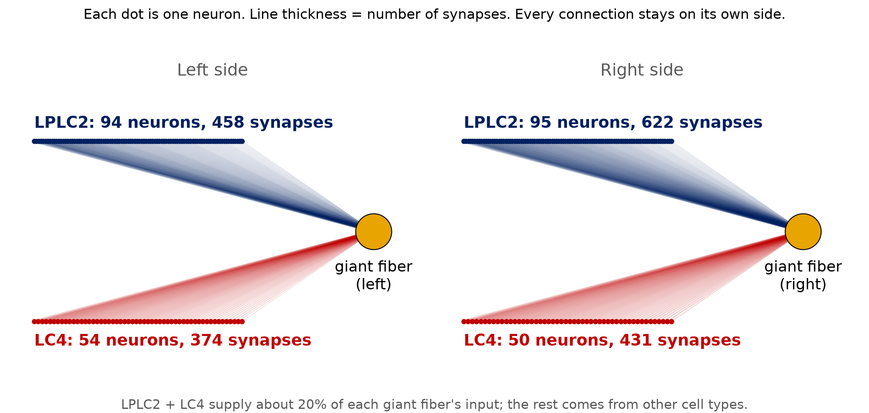
The Real Circuit (FlyWire)
Notes:
[The real circuit | about 30 s]
This is the real wiring we pulled from FlyWire. Each dot is one neuron. The navy ones are LPLC2 neurons, the red ones are LC4 neurons, and the yellow circle is the giant fiber, the neuron that triggers the escape. Thicker lines mean more synapses.
On the left side, 94 LPLC2 and 54 LC4 neurons connect to the left giant fiber. On the right side, 95 and 50 connect to the right one. Nothing crosses sides, which is why the left and right giant fibers can tell us which way to dodge.
This is the actual data, not a diagram we drew by hand.
TIP: Say it is the wiring only. No neuron has been simulated yet.

Slide 12
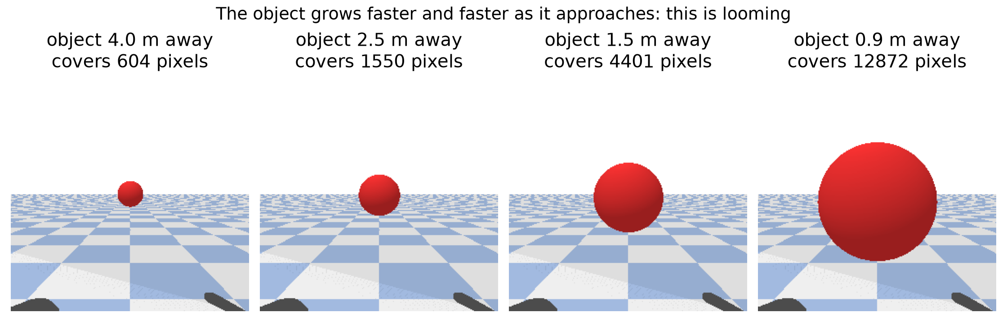
What the Drone Sees
Notes:
[What the drone sees | about 30 s]
This comes from our drone simulator, running on a laptop. The drone's camera looks forward and an object comes towards it. Watch how the object grows. At four metres it covers about 600 pixels, at two and a half metres about 1,550, at one and a half about 4,400, and at under a metre about 12,900.
It does not grow steadily. It grows faster and faster. That accelerating growth is exactly what looming neurons are built to detect, and it is the input our fly circuit will receive.
TIP: Say 'simulator'. No circuit has seen these frames yet.

Slide 13
Proposed Outcomes
Expected results (hypothesis): The real circuit triggers earlier than shuffled wiring and matches or beats a from-scratch CNN on early warning, data efficiency and robustness, especially with little training data. Scope: one task, in simulation.
Potential impact: Evidence on whether evolved wiring, not just architecture, carries useful structure; a low-compute, data-light collision-avoidance idea for small drones.
Future directions: Real-camera flight, other fly circuits, neuromorphic implementation, flyvis as a front end.
Pre-registered: each comparison is fixed in advance, so a loss is a finding, not a failure.
[Insert picture]
Example results plot (TTC vs training episodes) or race screenshot
Notes:
[Proposed outcomes | about 45 s]
What do we expect? Our hypothesis is that the real circuit triggers earlier than scrambled wiring, and matches or beats a CNN trained from scratch on early warning, data efficiency and robustness, especially when training data is small. This is one task, in simulation, and nothing more.
If it works, it is evidence that evolved wiring carries useful structure, and a light, data-efficient idea for small drones. Next steps could be real cameras, other fly circuits, or neuromorphic hardware.
We fix every comparison in advance, so a loss is a finding, not a failure.
TIP: Say 'hypothesis', not 'result'.

Slide 14
Timeline of the project
Project Timeline Overview
Phase I: idea and setup (complete)
  Pitch, environment and tests, FlyWire data pulled, circuit subgraph extracted, draft pre-registered config.
Early November
  LIF circuit and front end on a synthetic looming dot, with shuffle control (Phase II artifact).
Mid November
  Episode generator, cached episodes, evaluation values locked in the report.
Late November
  CNN baselines and sweeps running; closed-loop drone built in parallel.
Early December
  Finish sweeps, plots and race dashboard.
Mid December
  Report, rehearsal and a buffer week.
Notes:
[Timeline | about 30 s]
Our timeline. This pitch completes the idea and setup phase. Early November: run the circuit on a synthetic looming object, with the scrambled control. Mid November: build the test scenes and fix the evaluation values. Late November: train the CNNs and run the experiments, with the drone loop in parallel. Early December: finish the experiments, plots and demo. Mid December: report, rehearsal, and a spare week.

Slide 15
Conclusion
Summary of key points: FlyPilot rebuilds the fruit fly's looming-escape circuit from the FlyWire connectome and tests it as a drone's vision system against shuffled wiring and CNNs on early warning, data efficiency and robustness.
Final thoughts: Whether evolved wiring gives small machines faster, more data-efficient and more robust collision avoidance is a testable question, and the shuffled control isolates the answer.
Next steps: Get the LIF circuit firing on a synthetic looming dot, then build the drone simulation and baselines.
Notes:
[Conclusion | about 30 s]
To sum up. FlyPilot rebuilds the fruit fly's escape circuit from its real wiring, and tests it as a drone's vision against scrambled wiring and CNNs.
Whether evolved wiring gives small machines faster, more data-efficient, more robust collision avoidance is a testable question, and the scrambled control isolates the answer.
Next, we run the circuit on a looming object and build the drone simulation.

Slide 16
References
Dorkenwald, S., et al. (2024). Neuronal wiring diagram of an adult brain. Nature, 634, 124–138.
He, K., Zhang, X., Ren, S., & Sun, J. (2016). Deep residual learning for image recognition. Proceedings of the IEEE Conference on Computer Vision and Pattern Recognition (CVPR), 770–778.
Klapoetke, N. C., et al. (2017). Ultra-selective looming detection from radial motion opponency. Nature, 551, 237–241.
Lappalainen, J. K., et al. (2024). Connectome-constrained networks predict neural activity across the fly visual system. Nature, 634, 1132–1140.
von Reyn, C. R., et al. (2014). A spike-timing mechanism for action selection. Nature Neuroscience, 17, 962–970.
Notes:
[References | about 5 s]
These are our references. I won't read them out, and I'm happy to discuss any of them.

Slide 17
Expected Outcome by the end of First Year
Our target outputs by the end of the first year:
Conference publication: Paper in IEEE format covering the circuit, the comparisons and the results, whichever way they fall.
Open-source release: Code, pre-registered configuration and cached episodes so the experiment can be reproduced.
Research proposal: Extend to real-camera flight, other fly circuits, or a neuromorphic implementation.
Notes:
[Expected outcome by the end of the first year | about 20 s]
By the end of the year we aim for a conference-style paper in IEEE format, an open-source release so others can reproduce the work, and a proposal to extend it to real cameras or other fly circuits.

Slide 18

Notes:
[Thank you | about 10 s]
Thank you. We are happy to take questions.

