Slide 1
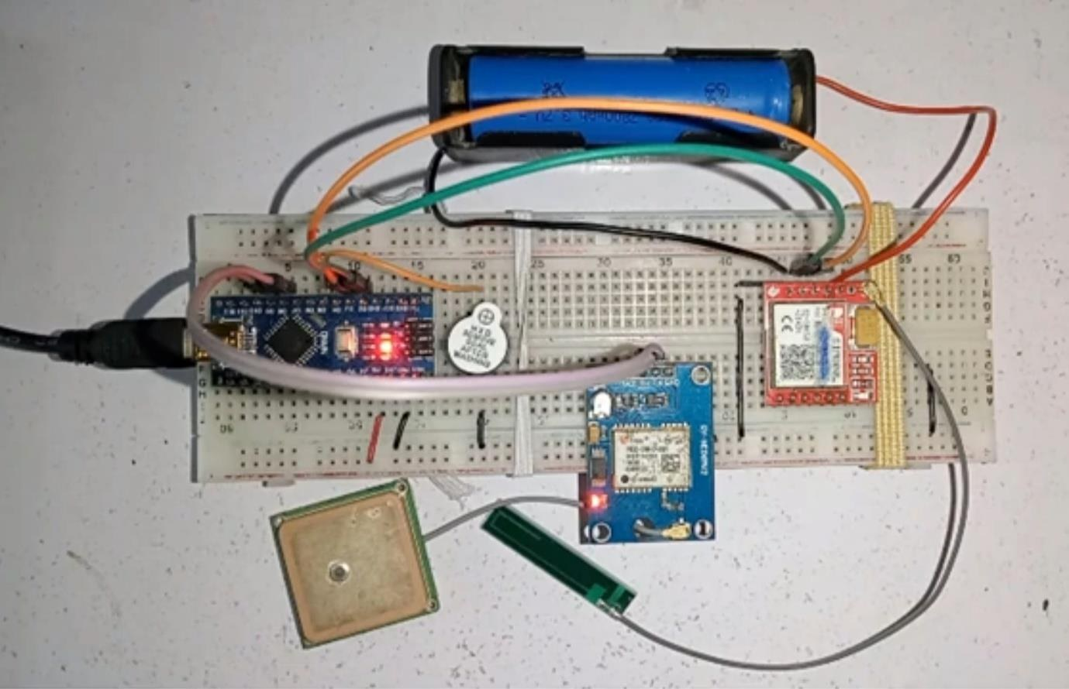
SMART GPS GEOFENCING SYSTEM
Real-time Entry / Exit SMS Alerts using Arduino Nano, NEO-6M GPS & SIM800L GSM/GPRS
EMBEDDED SYSTEMS
REAL-TIME TRACKING
SMS ALERTS
HAVERSINE GEOFENCE
Pavan Shetty H S
Dept. of Electronics & Communication • AIT, Chikkamagaluru • Embedded Systems Mini Project

Slide 2


INTRODUCTION
What is a Smart GPS Geofencing System?
A geofence is a virtual boundary drawn around a real location. This project pairs live GPS positioning with that boundary so that the moment a tracked device enters or exits it, an SMS alert is sent automatically — with no smartphone app, server, or internet connection required on the tracked side.
tracked
device
Local computation
Distance to the geofence boundary is computed on-device using the Haversine formula — no cloud round-trip.
Geofence
centre
SMS-only alerting
Works anywhere with 2G GSM coverage, even with zero mobile data or Wi-Fi.
Anti-spam logic
Exactly one SMS per genuine entry/exit event, not one per loop cycle.
Live GPS Fix → Haversine Distance → Inside / Outside → SMS
02

Slide 3




MOTIVATION
Problem Statement
Lack of real-time monitoring
Conventional tracking methods are often slow to detect route deviations, unauthorized access, or unsafe movement.
Security & safety gaps
Monitoring sensitive areas or vulnerable individuals (children, elderly) reliably and continuously is difficult with manual methods.
Costly, app-dependent alternatives
Biometric attendance hardware and app-based LBS platforms require recurring connectivity, servers, and cost that don't scale to low-budget or rural deployments.
No offline-capable alerting
Most geofencing solutions assume a smartphone app with internet access — unavailable in low-connectivity areas where only 2G GSM may reach.
03

Slide 4


BACKGROUND
Literature Survey
Geofencing Application using IRNSS/NavIC
Geofencing-Based Attendance System
Human Safety Using GPS and Geofencing
R. Prasadh — CONIT 2022
R. Shinde — ICETET-SIP 2022
K. S. Yamuna — ICSES 2024
Builds a child-safety geofencing app on India's NavIC satellite system, alerting parents when a child leaves a defined zone.
Replaces costly biometric attendance hardware with a phone-based geofence around the workplace for automatic check-in/out.
Combines GPS tracking with safe-zone geofences to auto-notify emergency contacts when an at-risk user leaves a safe area.
This project differs by removing the app/cloud dependency entirely — alerts are delivered by SMS directly from the embedded device.
04

Slide 5




GOALS
Objectives
Real-Time GPS Tracking
Automated Alerts
Accurate Boundary Detection
Continuously acquire accurate live position from the NEO-6M module.
Trigger an SMS the instant a geofence boundary is crossed.
Use the Haversine formula for true great-circle distance, not flat approximation.
Spam-Free Notifications
Robust Error Handling
Local Indication
Send exactly one SMS per transition via state-change detection.
Gracefully handle GPS signal loss and GSM send failures.
Give immediate visual/audible feedback via LEDs and a buzzer.
05

Slide 6




BILL OF MATERIALS
Hardware Components
Arduino Nano
NEO-6M GPS
SIM800L GSM/GPRS
18650 Li-ion Battery
ATmega328P microcontroller
GY-NEO6MV2 breakout module
AT-command SMS alert engine
3.7V, 2200mAh
TP4056 Module
Boost + Buck Regulators
Buzzer + LEDs
Breadboard + Wiring
Charging + battery protection
5V rail (logic) + 4V/2A rail (GSM)
Local audible/visual indication
Prototyping platform
Full Bill of Materials with approximate costs: hardware/BOM.md
06

Slide 7
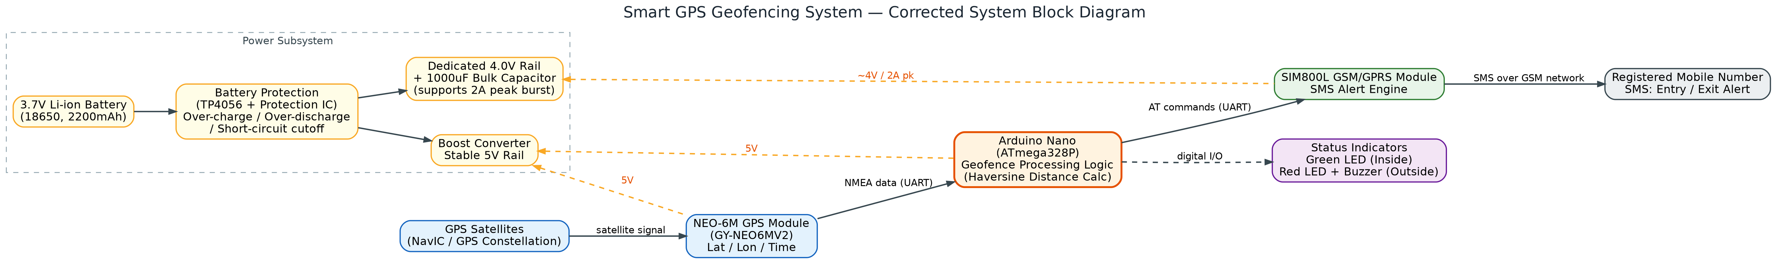
SYSTEM DESIGN
System Block Diagram
Signal Path
Power Subsystem
Processing
GPS → Arduino → GSM → SMS
Dual regulated rails: 5V logic / ~4V GSM
On-device Haversine geofence logic
07

Slide 8
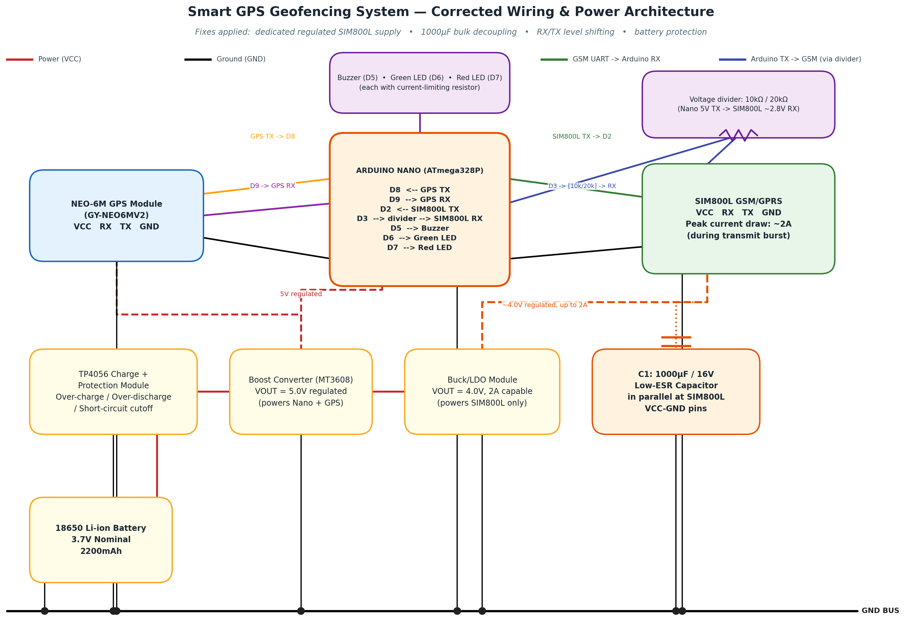
HARDWARE CORRECTION
Corrected Wiring & Power Architecture
CRITICAL FIXES APPLIED
Dedicated ~4.0V / 2A-capable rail for SIM800L — not shared with Arduino's 5V logic supply
1000µF low-ESR capacitor placed directly across SIM800L VCC–GND to absorb current bursts
10kΩ/20kΩ voltage divider levels the Arduino's 5V TX down to SIM800L-safe logic
TP4056 module adds over-charge / over-discharge / short-circuit battery protection
SIM800L correctly documented as GSM/GPRS — not "Bluetooth" as mis-stated in the original report
08

Slide 9



FIRMWARE LOGIC
Working Principle
1
2
3
4
5
6
Read GPS
Parse Fix
Haversine Calc
Compare Radius
State Change?
Send SMS
Stream NMEA data
from NEO-6M
TinyGPS++ extracts
lat / lon / validity
Great-circle distance
to geofence centre
distance ≤ radius ?
INSIDE / OUTSIDE
Compare with last
alerted state
One alert per
genuine crossing
Anti-spam logic: the firmware tracks the state for which an SMS was last sent (lastAlertedAs) and only fires a new SMS when the current state genuinely differs from it — preventing thousands of redundant messages while the device sits on either side of the boundary.
09

Slide 10
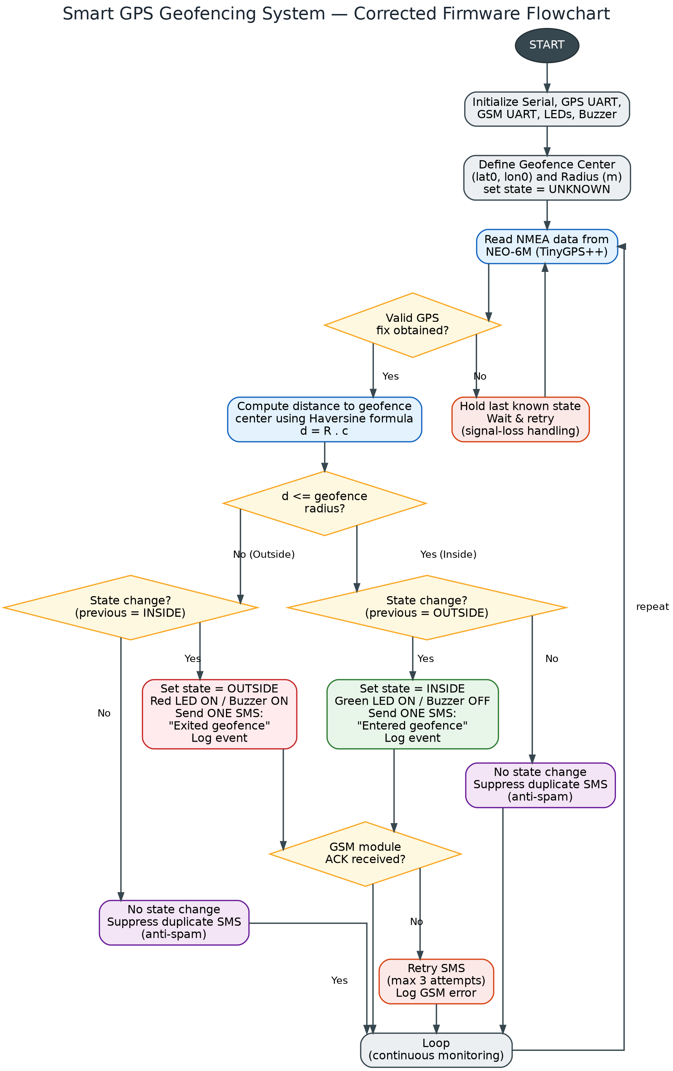
FIRMWARE LOGIC
Corrected Firmware Flowchart
Key corrections vs. the original report:
GPS signal-loss handling
Holds last known state and retries instead of guessing on a lost fix.
Haversine-based decision
Real distance math replaces an undefined comparison in the original flow.
Anti-spam state machine
SMS fires only on a genuine boundary transition.
GSM ACK + retry
Bounded retries with logged failures instead of a silent, unchecked send.
10

Slide 11
IMPLEMENTATION
Code Highlights
Haversine Distance Calculation
Anti-Spam State Transition
double haversineDistanceMeters(
double lat1, double lon1,
double lat2, double lon2) {
const double R = 6371000.0;
double dLat = radians(lat2 - lat1);
double dLon = radians(lon2 - lon1);
double a = sin(dLat/2)*sin(dLat/2) +
cos(radians(lat1))*cos(radians(lat2))*
sin(dLon/2)*sin(dLon/2);
double c = 2*atan2(sqrt(a), sqrt(1-a));
return R * c;
}
if (currentState == lastAlertedAs) {
// No change -> suppress duplicate SMS
return;
}
// Genuine transition -> send ONE SMS
bool sent = sendSMSWithRetry(
ALERT_PHONE_NUMBER, message,
SMS_MAX_RETRIES);
if (sent) {
lastAlertedAs = currentState;
}
Full sketch: software/Smart_GPS_Geofencing.ino
TinyGPS++: Parses raw NMEA sentences into latitude / longitude / fix validity
SoftwareSerial: Two virtual UARTs (GPS + GSM) since Nano has only one hardware UART
11

Slide 12
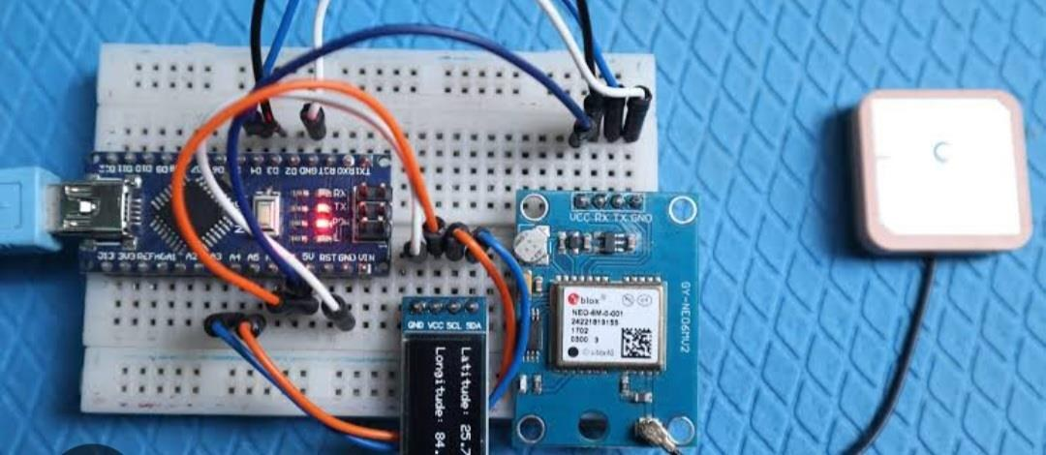
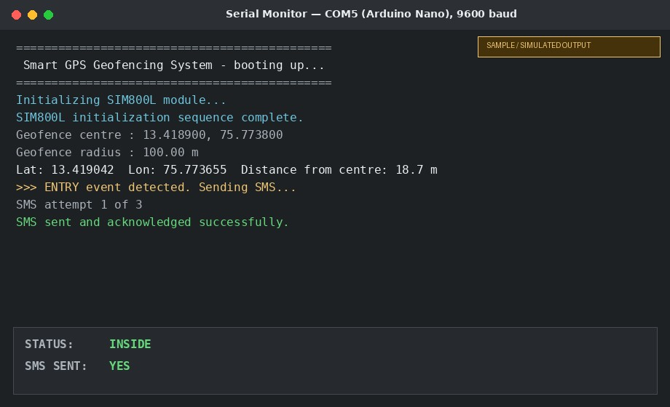
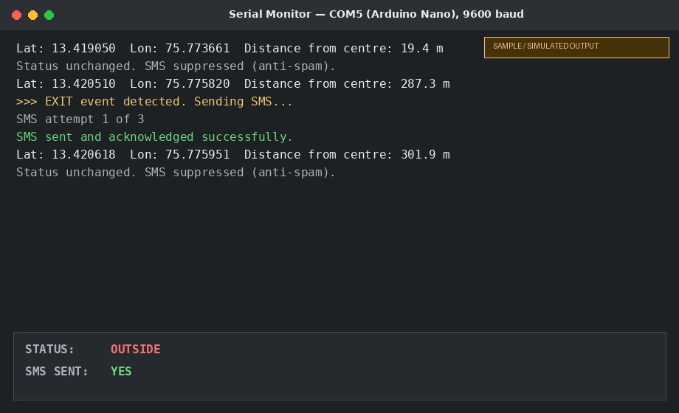
TESTING & RESULTS
Hardware Build & Sample Output
Completed hardware build
GPS satellite acquisition test
Sample output — inside geofence*
Sample output — outside geofence*
* Serial Monitor outputs are illustrative mock-ups of the expected log format — see results/output_analysis.md
12

Slide 13

WHY IT WORKS
Advantages
Internet-Free Alerting
Spam-Free SMS
Needs only 2G GSM signal — no Wi-Fi, mobile data, or app required on the tracked side.
One alert per genuine crossing keeps SIM balance and the recipient's inbox under control.
Zero Server Latency
Low-Cost & Portable
Geofence math runs entirely on-device — no round-trip to a backend.
Breadboard-friendly, battery-powered build at roughly ₹1,300–₹2,000 in parts.
Protected Power Design
Dedicated SIM800L rail, bulk capacitor, and battery protection prevent brown-outs.
13

Slide 14







WHERE IT FITS
Applications & Future Enhancements
APPLICATIONS
FUTURE ENHANCEMENTS
Home Automation
Workplace Attendance
Multiple simultaneous geofences
Delivery Notifications
Parental Controls
Cloud logging / dashboard via GPRS
Fleet & Asset Management
Elderly / Personal Safety
Hysteresis band to reduce boundary jitter
Solar-assisted charging circuit
Migrate to ESP32 for native Wi-Fi / BLE
14

Slide 15

REFERENCES
[1] R. Prasadh, “Geofencing Application using IRNSS/NavIC,” CONIT 2022.
[2] R. Shinde, “Geofencing-Based Attendance System for Mobile Applications,” ICETET-SIP 2022.
[3] K. S. Yamuna, “Human Safety Using GPS and Geofencing,” ICSES 2024.
THANK YOU
Questions & Discussion
Pavan Shetty H S
Dept. of Electronics & Communication • AIT, Chikkamagaluru
Smart GPS Geofencing System — Embedded Systems Mini Project

