Slide 1
Customer Support Chat bot with ML
PIP2001 Capstone Project
Review-2
Batch Number: CAI-G05
Under the Supervision of,
Dr.Swati Sharma
Associate Professor - Selection Grade
School of Computer Science & Engineering
Presidency University
Roll Number | Student Name
20211CAI0065 20211CAI0147 20211CAI0175 20211CAI0076 20211CAI0064 | SIRI H G PAVAN S REDDY MOULYA H M E BHAVANI S SANJANA
Name of the Program: Bachelor of Technology
Name of the HoD: Dr. Zafar Ali Khan N
Name of the Program Project Coordinator: Dr. Afroz Pasha
Name of the School Project Coordinators: Dr. Sampath A K / Dr. Abdul Khadar A / Mr. Md Ziaur Rahman

Slide 2
Introduction
A very advanced solution for automating customer care is a Customer Support Chatbot with Machine Learning that can analyse client complaints or queries and actively learn from encounters.
This chatbot can evaluate consumer questions, look up possible answers in its database, and offer prompt support.
It easily moves the case to human support personnel when a novel or complicated problem emerges.
When the staff fixes the problem, the chatbot gains knowledge from the exchange, adds the updated solution to the database, and gets ready to answer similar questions in the future.
In addition to increasing response speed and accuracy, this technology guarantees ongoing learning and development, which gradually makes customer support more knowledgeable and flexible.

Slide 3
Literature Review
Improved intelligence: Chatbots are getting smarter, thanks to machine learning and NLP.
Better customer service: Chatbots can help customers quickly and efficiently.
Happy customers: Satisfied customers are more likely to stay loyal.
Personalized service: Chatbots can tailor their responses to each customer.
Deep learning: This technology helps chatbots understand language better.
Easy to use: Chatbots can be easily set up and managed.
Continuous learning: Chatbots get better over time by learning from interactions.

Slide 4
Literature Survey Contd..
KATRAGADDA, V. (2023): This paper likely provides an overview of chatbot automation in customer support, covering topics such as benefits, challenges, and best practices.
Patel, N., & Trivedi, S. (2020): This paper focuses on the use of predictive modeling, machine learning, NLP, and AI chatbots to enhance customer loyalty.
Nuruzzaman, M., & Hussain, O. K. (2018): This paper surveys the implementation of chatbots using deep neural networks in the customer service industry.
Nguyen, T. (2019): This paper explores the potential effects of chatbot technology on customer support, such as improved efficiency and reduced costs.
Abouelyazid, M. (2022): This paper delves into NLP techniques for automated customer support in e-commerce, specifically focusing on intent recognition and response generation.

Slide 5
Literature Survey Contd..
Iyambo, H. N., & Iyawa, G. (2023): This paper discusses the development of a customer support chatbot using machine learning techniques to enhance customer experience.
Suta, P., Lan, X., Wu, B., Mongkolnam, P., & Chan, J. H. (2020): This paper provides an overview of machine learning applications in chatbots, including topics such as natural language understanding, dialogue management, and knowledge representation.
Kumar, R., & Ali, M. M. (2020): This paper likely discusses the role of chatbots in customer support, potentially covering topics such as benefits, challenges, and case studies.
Kumar, N. K., Maheswari, K., Abinaya, A., Ramya, J., Ande, P. K., & Ramaian, C. P. (2024): This paper focuses on recent advancements in chatbot technology for enhanced customer support in online retail.
D'silva, G. M., Thakare, S., More, S., & Kuriakose, J. (2017): This paper describes a real-world smart chatbot for customer care implemented using a SaaS architecture.

Slide 6
Literature Survey Contd..
Numerous significant themes and potential avenues for future research can be discerned from the literature review:
A rise in chatbot sophistication can be seen in their increased ability to comprehend natural language, provide responses that seem human, and handle intricate client enquiries.
Integration with additional technologies: In order to deliver a more thorough customer experience, chatbots are being more and more integrated with additional technologies, including analytics software and CRM systems.
Ethical considerations: As chatbots proliferate, it's critical to take into account ethical concerns like privacy, bias, and transparency.
Progress in natural language processing (NLP) and machine learning: Chatbot performance will be enhanced by ongoing NLP and machine learning research and development.

Slide 7
Existing method Drawback
1. Rule-Based and Template-Based Chatbots: Limited to predefined responses, they struggle with complex or varied queries and lack learning capabilities, requiring manual updates.
2. Retrieval-Based Chatbots: Inaccurate when faced with ambiguous queries and incapable of learning from interactions without manual intervention.
3. Generative Chatbots: Inconsistent response quality, high dependency on large datasets, and difficulty in identifying when to hand off to human support.
4. Limited Hand-Off Capabilities: Inefficient in escalating issues and lacking feedback mechanisms to learn from human-agent interactions.

Slide 8
Proposed Method
Regardless of complexity or language, the suggested customer care chatbot employs Natural Language Processing (NLP) and Machine Learning (ML) to reliably interpret customer complaints or inquiries.
When pertinent answers are found, it searches a dynamic database and provides them instantly.
The chatbot ensures smooth handoffs by elevating questions to human support workers if they can't be answered by current knowledge.
The chatbot picks up knowledge from the resolution process during the staff-customer interaction and incorporates the updated solution into its database.
The chatbot can now respond to similar queries on its own in the future thanks to this ongoing learning process.
It lowers the need for manual updates and raises client satisfaction levels overall by getting better with every contact.
The chatbot also guarantees flexibility to meet changing client needs, optimizes response times, and offers round-the-clock assistance.

Slide 9
Objectives
Using ML to automate query resolution with accurate results
The chatbot system uses Natural Language Processing (NLP) and Machine Learning (ML) models, such as refined BERT, to accurately evaluate client complaints and inquiries, guaranteeing accurate intent classification and reducing misunderstandings.
It looks up the best answers on its own using an organized TSV-based knowledge store, and it can handle a variety of questions thanks to fallback mechanisms like Scikit-learn classifiers.
The chatbot utilizes generative AI models to produce pertinent responses dynamically in situations where established solutions are not accessible, ensuring smooth interactions.
The system reduces the need for human interaction by automating query resolution, which greatly increases response time, precision, and client satisfaction.
In order to facilitate the chatbot's ongoing adaptation and improvement, commonly asked inquiries and answered queries are also categorized and saved for quicker future retrieval.
By combining automation, structured information management, and generative capabilities, the entire customer service process is streamlined, and the workload for human agents is decreased while consistent, real-time help is guaranteed.

Slide 10
Objectives
2. Regular enhancement through scaling and feedback
By learning from unanswered questions, the self-improving mechanism built into the chatbot system increases its scalability and versatility.
To guarantee prompt resolutions for clients, the chatbot forwards questions it is unable to answer to a human assistance representative.
After resolving the issue, the chatbot records the exchange, adds the updated solution to the knowledge base, and gains the ability to handle related questions on its own in the future.
The system can continuously adapt to user needs and inquiry trends thanks to this feedback loop. To make sure the knowledge base is complete and current, newly recorded solutions are verified and added to it after interaction logs are examined to find knowledge gaps.
The accuracy and contextual comprehension of the chatbot are further improved via periodic modifications, such as upgrading the BERT model with labelled data and improving the Generative AI components.
Over time, the chatbot's automation of this learning process lessens its dependency on human agents, leading to cost savings, better query resolution, and an improved customer experience.

Slide 11





Methodology/Modules
1. Project Planning
2. Design
3. Development
4. Training and Testing
5. Deployment

Slide 12
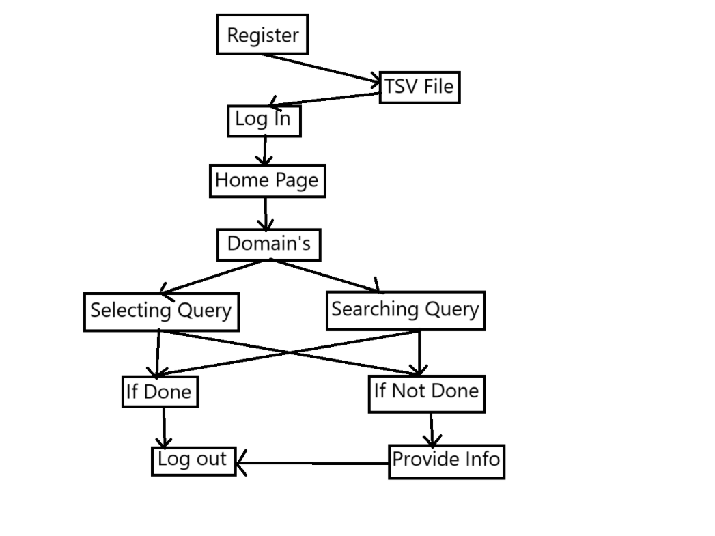
Architecture

Slide 13
Software components
Natural Language Processing (NLP): Figures out what the customer wants and how they feel about it.
Knowledge Base: A database that stores answers to common questions, troubleshooting guides, and product information. It can be simple (like a TSV file) or complex (like a full-featured database). It can also be connected to a system that tracks specific problems.
Search Engine: Searches the knowledge base for answers that match the question the customer asked.
Dialogue Management: Keeps the conversation going by asking follow-up questions, suggesting options, or sending the customer to a human if needed.
Learning Engine: Watches how the chatbot performs and improves its skills over time.

Slide 14
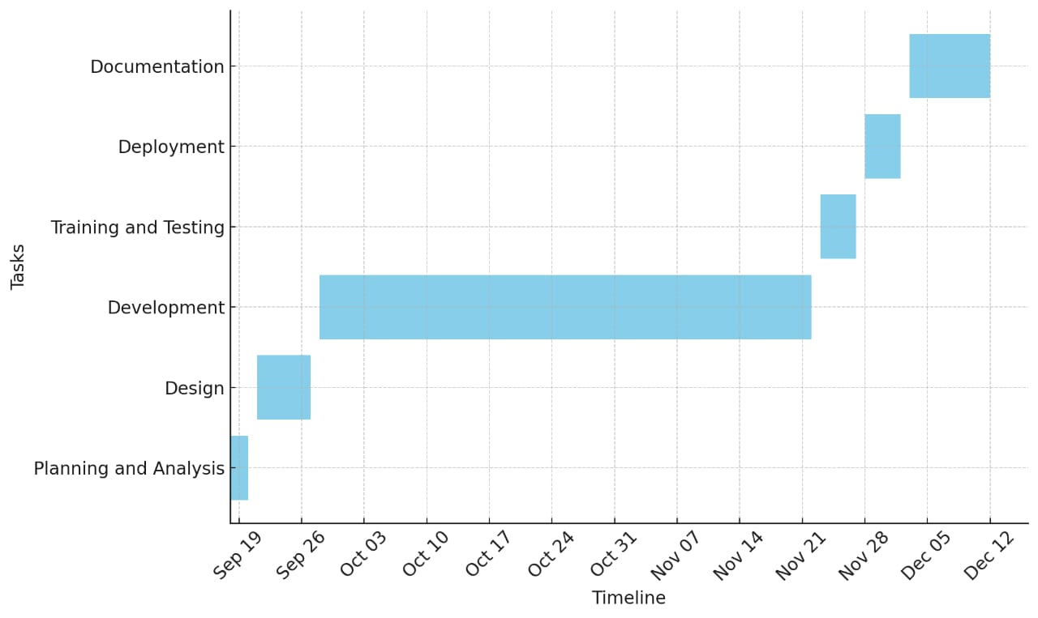
Timeline of Project

Slide 15
Implementation Details
The machine learning-based customer support chatbot requires the cooperation of several intricate parts. Preprocessing, including text normalization and tokenization, is done on client questions before they are put into a revised BERT model to ascertain purpose and context.
The BERT model, trained on domain-specific labelled data, may efficiently match to a structured TSV-based knowledge base by separating searches into intents with confidence ratings.
This knowledge base saves predefined query-response pairings and metadata to offer timely responses to frequently asked questions.
Using conversational data, a generative AI model ensures contextual relevance by dynamically generating responses to unknown questions.
Fallback classifiers for Scikit-learn provide additional accuracy in classification when purpose predictions are made with low confidence.

Slide 16
Implementation Details
The responses are recorded for the knowledge base, and unanswered queries are sent to staff members for resolution to increase flexibility.
Continuous learning ensures that the chatbot responds to user needs via model revision, knowledge base expansion, and interaction log analysis.
A feedback system, advanced machine learning algorithms, and scalable data management are all combined in this well-executed solution to provide a creative and adaptable customer support solution.
By combining BERT, generative AI, and organized fallback mechanisms, the chatbot improves its accuracy, scalability, and capacity to handle a wide range of customer inquiries.

Slide 17
Expected Outcomes
Automatically Responding to Inquiries with Superior Accuracy
Modern Natural Language Processing (NLP) and Machine Learning (ML) technologies are used to enable the chatbot to automatically and precisely answer questions.
It accurately interprets user intent by utilizing enhanced BERT models, ensuring that customer inquiries and complaints are evaluated with the minimum possible misunderstandings.
By independently collecting responses from a structured knowledge repository based on TSV, the chatbot delivers reliable replies rapidly.
While fallback methods, like Scikit-learn classifiers, enable generative AI models to handle a range of issues with flexibility, these models also consistently produce accurate answers for circumstances that lack known solutions.
This automation significantly increases reaction time, accuracy, and client satisfaction by reducing the need for human intervention.
Commonly requested questions and their responses are also grouped and stored for later retrieval to guarantee the chatbot is always adapting and providing dependable, real-time assistance.
Optimizing customer support processes and reducing the strain for human agents is achieved through the integration of automated query resolution, structured information management, and continuously evolving generating capabilities.

Slide 18
Expected Outcomes
2. Scalability and Continuous Improvement through Feedback Loops
The chatbot's self-improving mechanism, which learns from unaddressed queries, ensures scalability and adaptability.
A human agent is notified when a query comes up that it cannot respond to. After the interaction, the chatbot records it, adds the updated answer to the knowledge base, and gains the ability to respond to similar queries automatically in the future.
This feedback loop may allow the system to adjust as user needs and query patterns shift. Newly recorded solutions are verified and uploaded to the knowledge base to maintain it up to date and complete, and interaction logs are analysed to identify any knowledge gaps.
Regular upgrades further enhance the chatbot's contextual understanding and accuracy. Among these upgrades are enhancements to the Generative AI elements and an upgrade to the BERT model employing data with labels.
As a result of this learning cycle automation, fewer human agents are eventually required, which reduces expenses, improves query processing, and raises customer satisfaction.

Slide 19
Conclusion
To sum up, a customer care chatbot that possesses sophisticated abilities to comprehend inquiries, explore databases, and gain insight from human exchanges offers a revolutionary method of customer support.
It guarantees effective issue resolution while reducing client annoyance by skillfully managing ordinary enquiries and elevating complicated problems to support workers.
By continuously learning from interactions in real-time, the chatbot can answer similar questions on its own in the future, building a knowledge base that becomes better and better.
Furthermore, by handling several queries at once, the system improves scalability, lowers operating costs, and provides 24/7 customer service.
This technology streamlines internal operations and enhances the customer experience while freeing up human agents to work on more difficult jobs.
In the end, this kind of chatbot yields long-term advantages including increased output, more effective resource management, and steady company expansion.

Slide 20
Github Link
https://github.com/pavansreddy27/Customer-Support-Chat-bot-with-ML

Slide 21
References
KATRAGADDA, V. (2023). Automating Customer Support
Patel, N., & Trivedi, S. (2020). Leveraging predictive modeling, machine learning personalization, NLP customer support, and AI chatbots to increase customer loyalty.
Nuruzzaman, M., & Hussain, O. K. (2018, October). A survey on chatbot implementation in customer service industry through deep neural networks.
Nguyen, T. (2019). Potential effects of chatbot technology on customer support:
Abouelyazid, M. (2022). Natural Language Processing for Automated Customer Support in E-Commerce: Advanced Techniques for Intent Recognition and Response Generation.
D'silva, G. M., Thakare, S., More, S., & Kuriakose, J. (2017, February). Real world smart chatbot for customer care using a software as a service (SaaS) architecture.
Iyambo, H. N., & Iyawa, G. (2023). Customer Support Chatbot to Enhance Customer Support Experience Using Machine Learning Techniques.
Suta, P., Lan, X., Wu, B., Mongkolnam, P., & Chan, J. H. (2020). An overview of machine learning in chatbots. International Journal of Mechanical Engineering and Robotics Research, 9(4), 502-510.[8]
Kumar, R., & Ali, M. M. (2020).
Kumar, N. K., Maheswari, K., Abinaya, A., Ramya, J., Ande, P. K., & Ramaian, C. P. (2024, April). Advancements in Chatbot Technology for Enhanced Customer Support in Online Retail.

Slide 22
Thank You

