Slide 1
Exploratory Data Analysis (EDA) of heart disease
By
Pavan Kumar Kancherla (787000799)
Sai Kiran Dangeti(321329442)

Slide 2
Contents
Introduction
Objective
Dataset Description
Design Overview
Process Description
Code Description
Results
Conclusion

Slide 3
Introduction
A human can be afflicted with a number of ailments, one of which being heart disease. It is a well-known condition that can affect patients of any age group. Other factors may play a role in determining whether or not a patient is at risk for heart disease. So, the goal of this proposal is to compile a list of the least and most common causes that can lead to heart disease in humans.

Slide 4
Objective
As previously said, heart disease is one of the most frequent diseases that people can suffer from, and it can be caused by a variety of conditions and habits. We will offer an exploratory data analysis in this suggested effort in order to generate an overview of cardiac disease and its causes.

Slide 5
Dataset Description
The heart disease dataset included in this proposal was obtained from Kaggle’s repository, however, it really belongs to the Machine Learning Repository. The collection contains 303 instances, and 14 attributes are utilized. This data set consists of Age, Sex, Chest pain experienced by each individual using different formats, Diagnosis of Heart Disease where it gives the value which defines the individual is suffering from Heart disease are not and many more Characteristics.

Slide 6
Design Overview
The heart disease dataset that has been proposed for this study contains a diverse feature set, therefore there is a wealth of information that may be utilized to define exploratory data analysis. We may require various library packages for this suggested task in order to conduct a comprehensive data analysis in the R application framework. As soon immediately we read the dataset, we will begin charting the data and blending it with its connected characteristics in our planned effort.

Slide 7
Process Description
We intend to complete the planned task on time. To begin, gather data and get familiar with the various r library packages for exploratory data analysis. Then we'll get down to business by looking for linked characteristics and plotting them for visualization. Finally, once we've plotted all of the associated data, we'll be able to determine which factors are the most and least likely to cause heart disease, and therefore we'll be able to accomplish the goal of this Project.

Slide 8
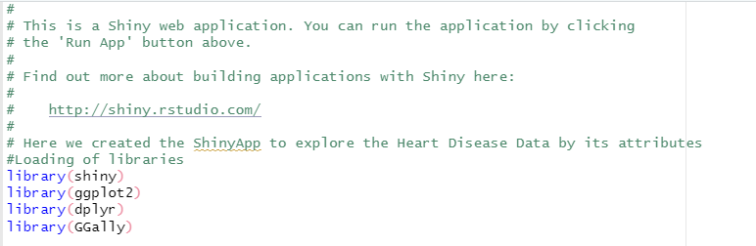
Code Description
R packages are a collection of R functions, complied code and sample data. They are stored under a directory called "library" in the R environment. By default, R installs a set of packages during installation. More packages are added later, when they are needed for some specific purpose like dplyr, Ggally.

Slide 9
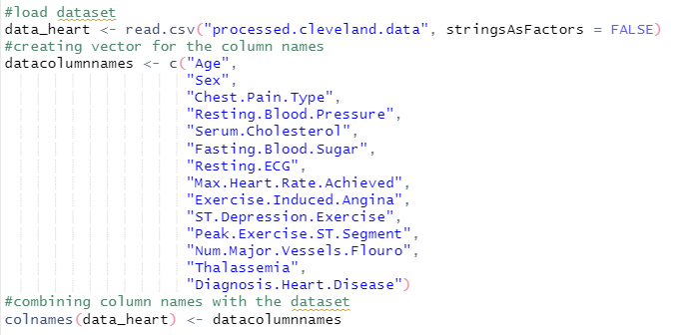
To read data from file and defining column names.
The argument 'stringsAsFactors' is an argument to the 'data. frame()' function in R. It is a logical that indicates whether strings in a data frame should be treated as factor variables or as just plain strings

Slide 10
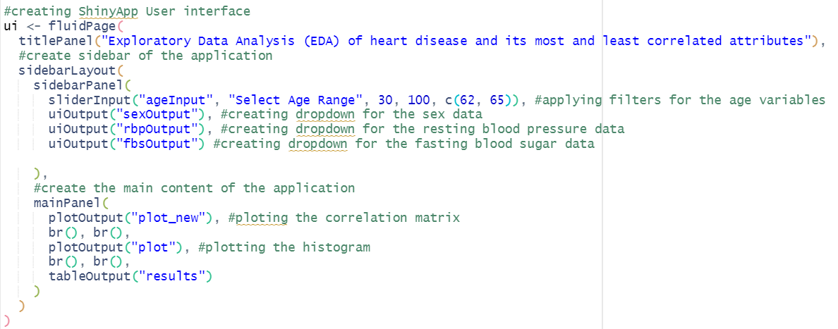

Slide 11
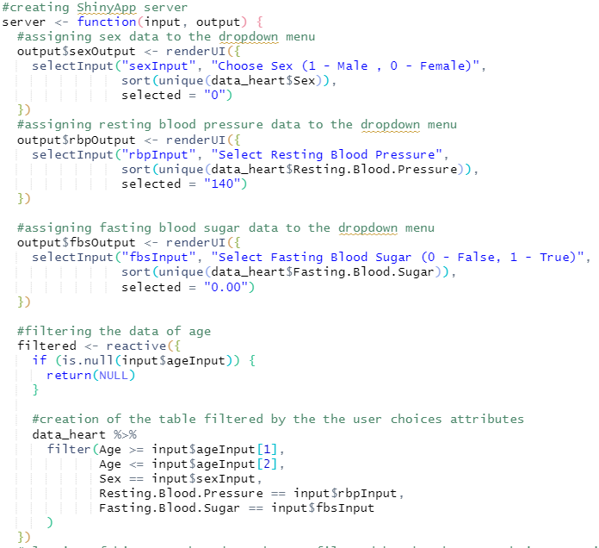
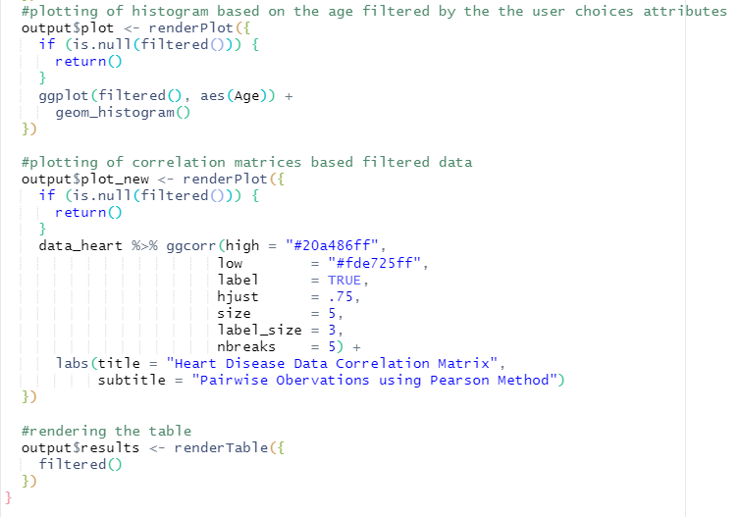

Slide 12
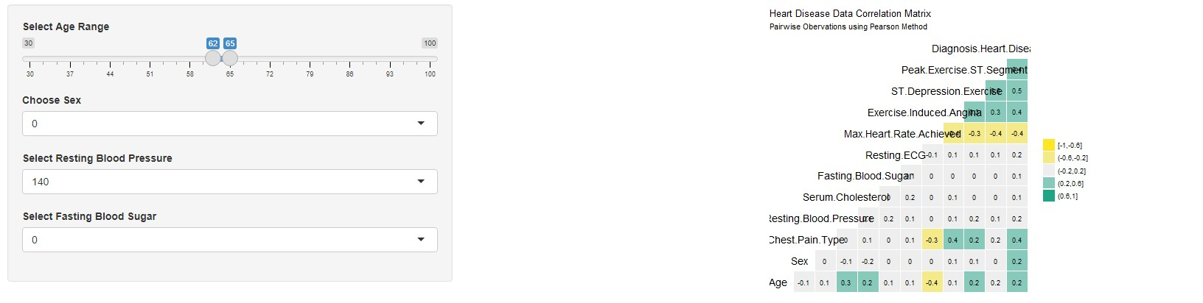
Results
Designed view from the shiny app where it shows the options to select categories and right side shows the correlation matrix for all the parameters.

Slide 13
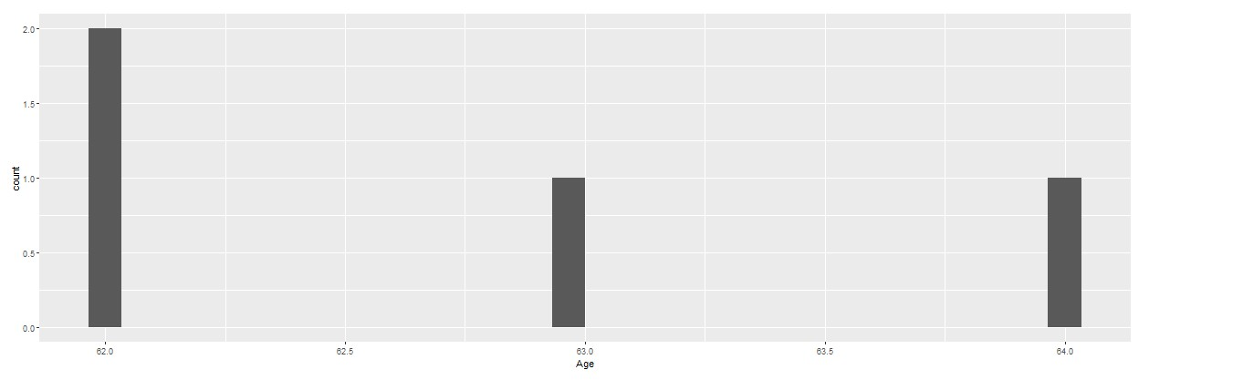
A Graph between the selected age group to the number of people at that particular age.

Slide 14
Finally the data table to show the information about data given above and to also to now the characteristics of each individual parameter. The last column Diagnosis of Heart Diseases defines that individual is suffering from the Heart Disease are not and the values 0,1,2,3,4 refers that 0 means absence whereas 1,2,3,4 means present and defines the stages.

Slide 15
Conclusion
Shiny is an R tool for creating web applications directly from R. CSS themes, HTML widgets, and JavaScript activities may be used to customize your Shiny applications.
We have successfully created our desired ShinyApp using the R Studio and that is successfully running in local servers. The filter information is running smoothly and the table and the histogram plot is also working fine. From the entire work we can conclude that, we have successfully analyzed the data and also able to visualize the filtered information and correlational matrices that are available in the proposed heart disease dataset.

Slide 16
Thank You

