Slide 1



DSCI 6004: NATURAL LANGUAGE PROCESSING
AUTOMATED RESUME SCREENING FOR HIRING TEAMS USING RETRIEVAL-AUGMENTED GENERATION (RAG)
Team members:
Pavan kumar Sunkara
Veda prakash Chiliveru

Slide 2
Project topic and domain
Topic: Automated Resume Screening using Retrieval-Augmented Generation(RAG)
Domain: Human Resources, Recruitment Automation
Corpus: Resume databases, job descriptions

Slide 3
Project objectives
Implement a RAG (Retrieval-Augmented Generation) system for automated resume screening.
Evaluate open-source LLMs to generate feedback on candidate fit.
Assess performance using retrieval accuracy, generation quality, and response time.

Slide 4
What Problem Are We Solving?
Manual resume screening is time-consuming and subjective.
HR teams struggle to identify top candidates quickly.
We provide a scalable, AI-powered screening system to improve decision-making.

Slide 5
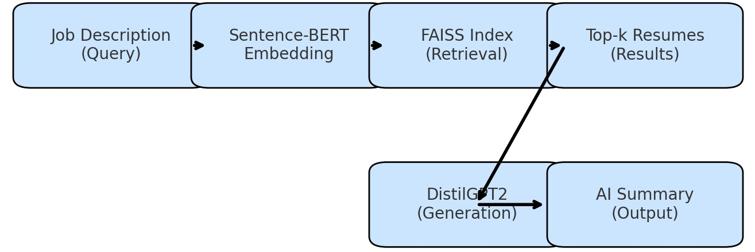
APPROACH
LLMs: Mistral-7B, Llama-3, Phi-3
Knowledge Base: Resume databases, job descriptions, skill taxonomies
System Features(using FAISS and sentence-BERT):
Keyword-based Retrieval: Matches resumes with job descriptions
Skill Gap Analysis: Highlights missing qualifications
AI-generated Resume Summary: Shortlists candidates with AI insights
Candidate Ranking System: Scores candidates based on relevance
System Architecture: Retrieval pipeline, embedding-based search, response generation

Slide 6
System Architecture
Input: Job Description + Resume Dataset (CSV)
Embedding: Convert resumes to vectors
Retrieval: Use FAISS to find top 5 matches
Analysis: Compare skills and summarize
Generation: LLM writes AI feedback
Output: Display results + export Excel

Slide 7
DELIVERABLES
Resume & Job Description Embedding System(stores vectors in FAISS vector index for fast retrieval)
RAG-Based Resume Matching(dense semantic search)
AI-Generated Resume Summary
Skill Gap Analysis Module
Candidate Ranking System
Model Benchmarking(Mistral-7B, LLaMA-3, Phi-3)

Slide 8

Evaluation methodology
Retrieval Metrics: Cosine similarity, Top-K ranking
Generation Quality: Coherence, relevance, overage
User feedback, Output- ranked list with AI-generated candidate summary

Slide 9
Gradio Demo (Live)
Colab link: https://colab.research.google.com/drive/1J033wYhopjbXH_2PpiWV-YoiEcP2wg1t?usp=sharing
Upload Resume Dataset
01
Enter Job Description
02
View Matching Results
03
Match %
Matching/Missing Skills
AI Assessment
Export Excel Report
04

Slide 10
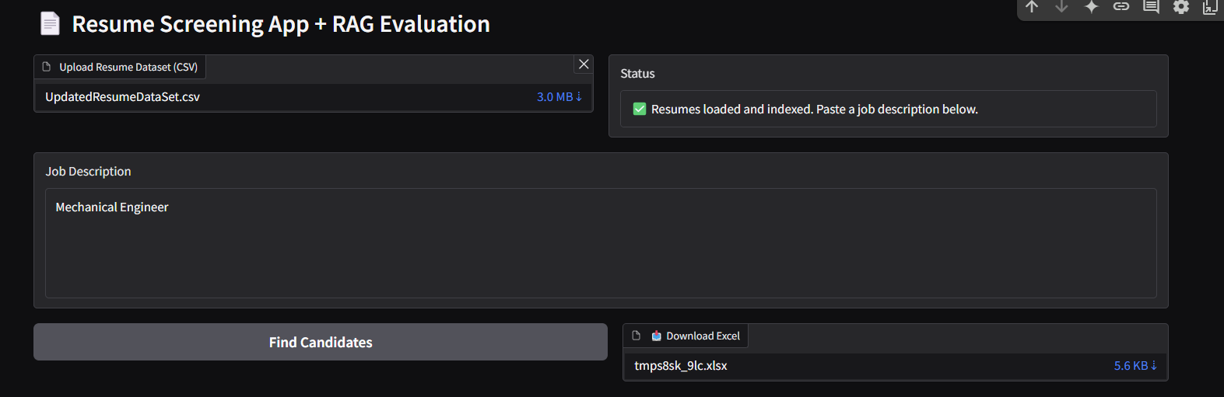
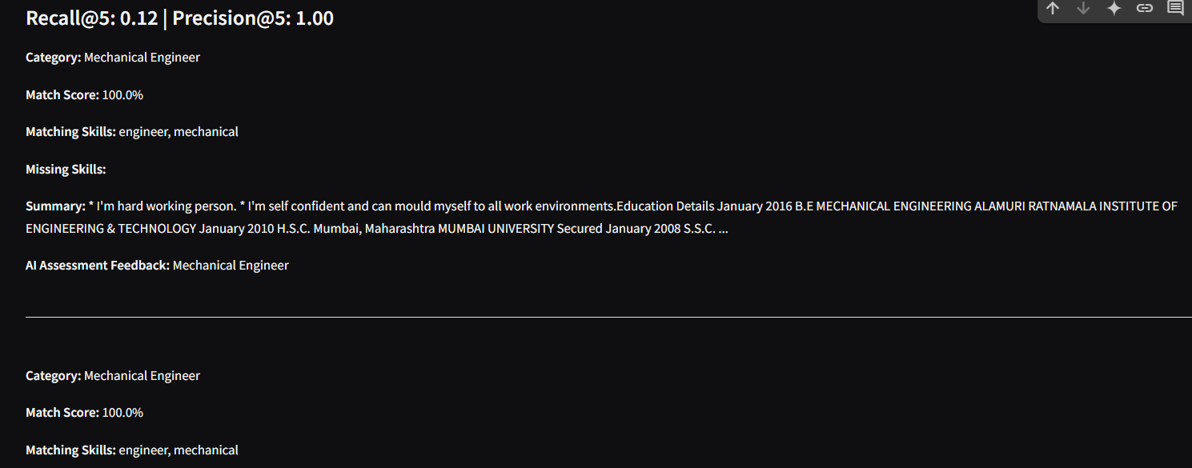
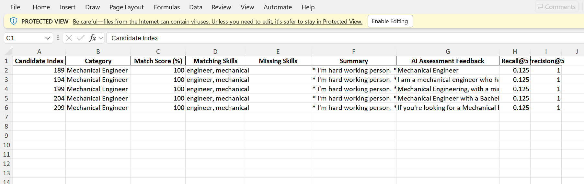
Evaluation Example
Recall@5: 0.12
Precision@5: 1.00
"Candidate-3 has strong mechanical engineering background and project exposure, suitable for entry-level roles."

Slide 11
Key Takeaways
End-to-end working RAG pipeline
Combines retrieval, skill comparison, and LLM generation
Fully interactive via Gradio in Colab
Time-saving, scalable solution for HR teams

Slide 12
Questions?
Contact info:
Pavan Kumar Sunkara,
Veda Prakash Chiliveru
Mail ID:
psunk3@unh.Newhaven.edu, vchil7@unh.newhaven.edu
Github repository:
https://github.com/pavansunkara958/Automated-Resume-Screening-using-RAG

Slide 13

THANK YOU

