Slide 1
E-COMMERCE OLIST STORE ANALYSIS
PRESENTED BY: GROUP 2
AMIT PATHAK
Madhuri Mohan Kadam Megha Ravindra Chopade Mohd Farhan
Priti Pradeep khedekar Pavan Kumar T
Shubhangi Balasaheb Gunjal

Slide 2
OUR AGENDA
Introduction
Project Overview
KPI’S
Excel Dashboard
Power BI Dashboard
Tableau Dashboard
Problem Faced
Conclusion

Slide 3
INTRODUTION
This project provides an in-depth analysis of Olist store data, leveraging tools like Excel, MySQL, Power-BI and Tableau. Olist is a comprehensive e-commerce platform designed to connect small and medium-sized businesses with a broader customer base through its marketplace. By offering a centralized system for sellers to manage their products, inventory, and customer interactions, Olist simplifies the complexities of online retail.
Objectives: Seamless Integration : Enabling business to list their products on multiple marketplace simultaneously. Enhanced Logistics : Offering end-to-end solution for shipping and delivery to improve customer satisfaction. Data-Driven Insights : Leveraging customer and sales data to optimize performance, marketing strategies and inventory management.

Slide 4
PROJECT OVERVIEW
Overview : This project aims to analyze the performance of Olist, an e-commerce platform that facilitates businesses in reaching wider audiences and optimizing their operations. Key Focus Areas :
1.Sales Performance:
Analyze total sales and profit trends.
Identify top-performing product categories and customer segments.
2. Customer Insights:
Evaluate unique customer behavior and preferences.
Highlight repeat customers and their contribution to revenue.
3.Operational Efficiency:
Assess delivery timelines and shipping methods.
Understand the impact of logistics on customer satisfaction.
4.Payment Trends:
Review payment types and their popularity among customers.

Slide 5
Key Insights
According to the data, Olist E-commerce has about 99,440 orders. With about 89,940 orders being delivered, the company has a 90% delivery success rate.
Their average product rating is 4.09 stars, with product categories going as high as 4.67 stars and as low as 2.5 stars. 1 Star reviews are on third place in the review score distribution ranking which likely indicates that there could be problems with product quality in some product categories
It helps in understanding the spending patterns of customers in sao paulo city .it also helps Olist in identifying high value customers and creating targeted marketing campaigns.
The analysis of payment statistics based on weekday vs. weekend provides an understanding of the buying behavior of customers. and can also help Olist to improve their weekend sales and plan promotions accordingly.

Slide 6
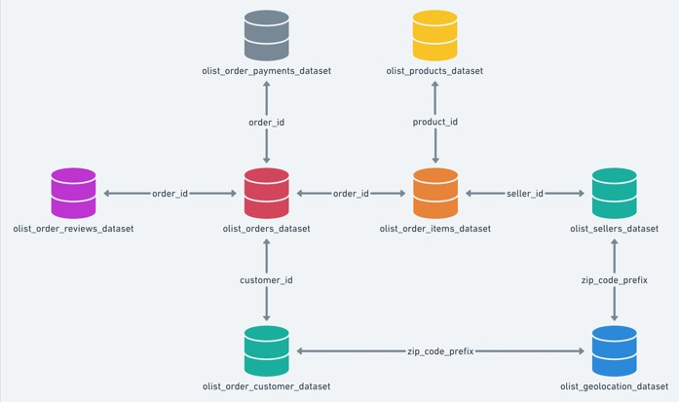
DATA MODELING

Slide 7
KPI LIST:
Weekday Vs Weekend (Order_Purchase_Timestamp) Payment Statistics.
Number of Orders with review score 5 and payment type as credit card.
Average number of days taken for (Order_Delivered_Customer_Date) for Pet Shop.
Average price and payment values from customers of Sao Paulo City.
Relationship between shipping days (Order_Delivered_Customer_Date - Order_Purchase_Timestamp) Vs review scores.

Slide 8
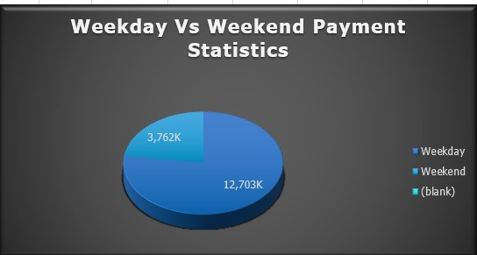
1.Weekday Vs Weekend (Order_Purchase_Timestamp) Payment Statistics:
Weekdays vs. Weekends: Analysis reveals that weekdays see higher order volumes, with a peak on Monday and a gradual decline towards midweek. This trend indicates that customers are more active during weekdays, suggesting an opportunity for targeted promotions.

Slide 9
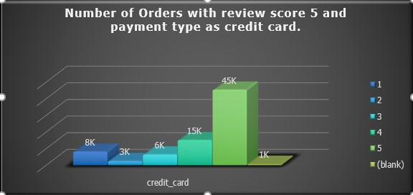
2.Number of Orders with review score 5 and payment type as credit card:
Dominance of Credit Cards: Credit cards are the preferred payment method, especially for 5-star reviews, followed by boleto. This highlights the importance of secure and convenient payment options in driving customer satisfaction.

Slide 10
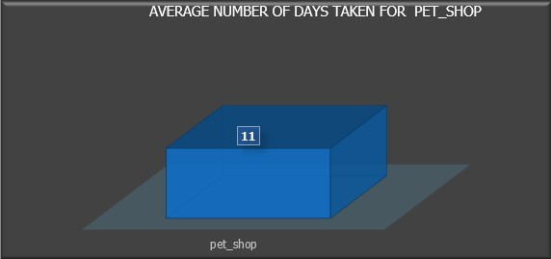
3.Average number of days taken for Order_Delivered_Customer_Date for Pet_Shop:
Category Variations: Office furniture has the longest delivery time, while arts and craftsmanship have the shortest. On average, deliveries take 12 days, with pet shop products averaging 11 days. Streamlining delivery processes for categories with longer times could enhance overall efficiency

Slide 11
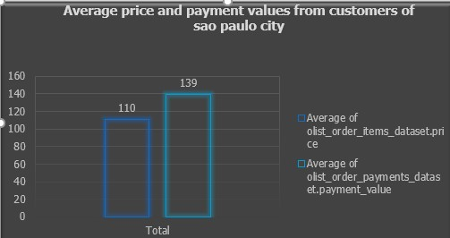
4.Average price and payment values from customers of Sao Paulo City:
City-wise Trends: Sao Paulo and Rio de Janeiro record the highest order counts. In Sao Paulo, the average payment surpasses the average price, likely due to high order density. Tailored marketing strategies for these regions could further boost sales.

Slide 12
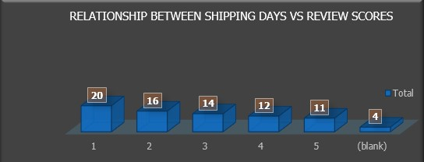
5.Relationship between shipping days (Order_Delivered_Customer_Date - Order_Purchase_Timestamp) Vs review scores:
Negative Correlation: A clear negative correlation exists between shipping duration and review scores. Faster shipping times are associated with higher review scores, emphasizing the need for efficient logistics.

Slide 13
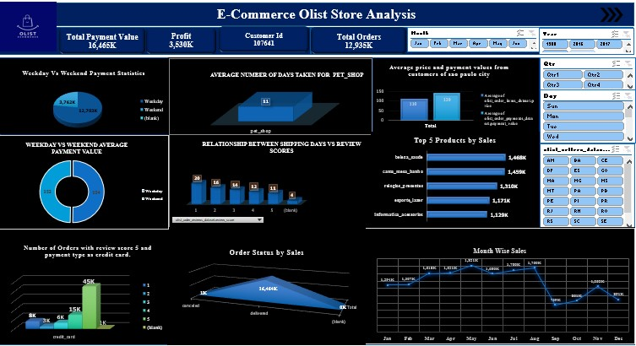
EXCEL DASHBOARD

Slide 14
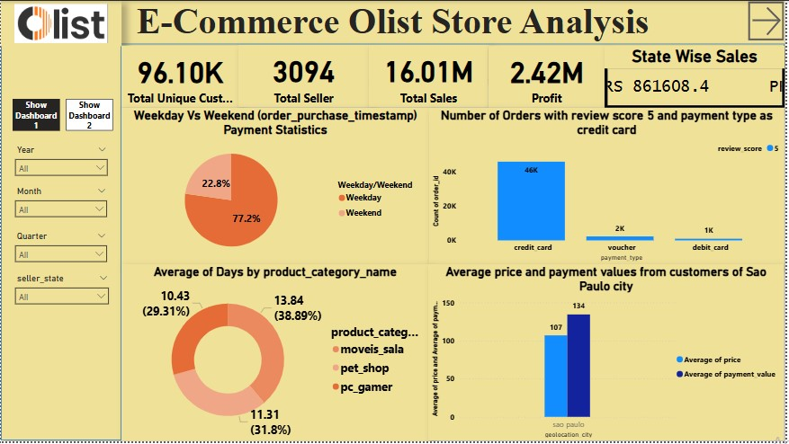
POWER BI Dashboard

Slide 15
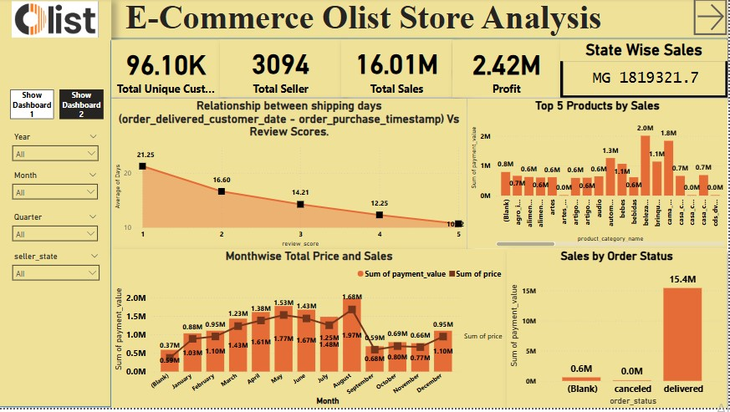

Slide 16
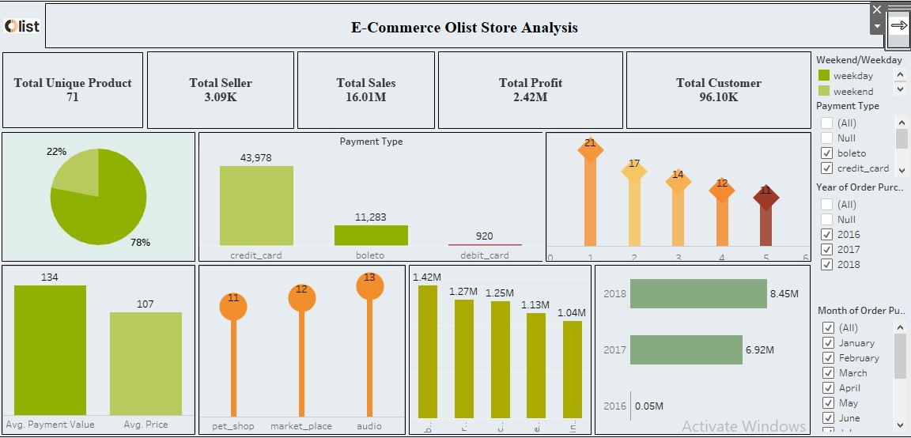
Tableau dashboard

Slide 17
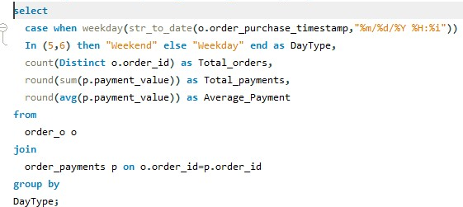

SQL
KPI 1: Weekday Vs Weekend (Order_Purchase_Timestamp) Payment Statistics.
Output

Slide 18
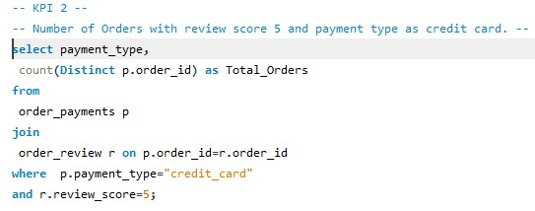

KPI 2: Number of Orders with review score 5 and payment type as credit card.
Output

Slide 19
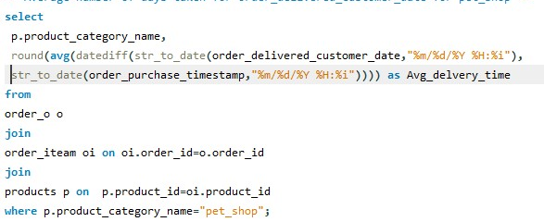

KPI 3:Average number of days taken for Order_Delivered_Customer_Date for Pet_Shop.
Output

Slide 20
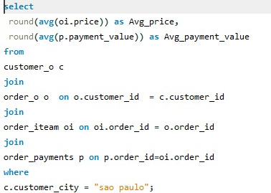

KPI 4 :Average price and payment values from customers of Sao Paulo City.
Output

Slide 21
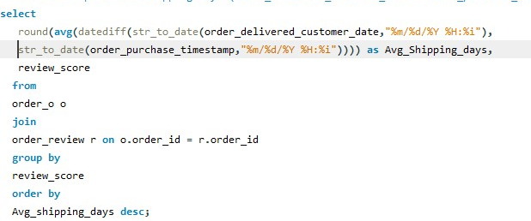
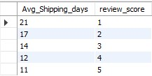
KPI 5 : Relationship between shipping days (Order_Delivered_Customer_Date - Order_Purchase_Timestamp) Vs review scores.
Output

Slide 22
Problem faced
EXCEL:
Making the Slicers work, Cleaning the data and merged.
Connecting the slicers to all the visuals.
POWERBI:
DAX calculations.
TABLEAU:
Making funnel chart.
SQL:
Importing the data and changing the data types Of columns correctly.
A few times, I had to import because the source file didn’t have an underscore in column names.

Slide 23
Conclusion
Popular Product Categories: Focus marketing efforts on top-selling categories and maintain sufficient inventory.
Customer Segmentation: Tailor campaigns based on demographics, purchasing patterns, and preferred payment methods.
Delivery Impact: Improve logistics to reduce delivery times, enhancing customer satisfaction.
Customer Retention: Implement loyalty programs and personalized offers to convert one-time buyers into repeat customers.
Logistics Investment: Invest in fulfillment infrastructure to improve delivery efficiency and reduce costs

Slide 24
Thank you

