Slide 1
Can the crowds’ wisdom predict the cricket match outcome better than historical data ?
A comparative study of machine learning algorithms
Name : S.P.P.M. Sudasinghe
Index : s14510
Supervisor : Dr. Sameera Viswakula
Co-Supervisor : Dr. G. P. Lakraj

Slide 2
Overview
01
03
Significance
Background
02
Objectives
04
Approach

Slide 3
Background
Cricket match outcome prediction is a challenging task due to the complexity of the game
Some of the information can not be provided by historical data
e.g., injuries, match-banned players
Several researchers have used social media as a meaningful source of information for sports match outcome prediction

Slide 4

Objectives
To predict the winner of T20 international matches, using both historical and micro-posts posted on Twitter before the match starts.
To build a model for classifying pre-match tweets as positive or negative using sentiment analysis techniques with less effort.
To study whether Twitter-derived features can provide useful information to predict cricket match outcomes.
To check whether there is any profit we can gain from pre-match betting by applying the proposed model.

Slide 5
Significance of the study
01
Most of the predictive models for cricket were built using historical and instantaneous features.
03
Less number of studies checked whether they could gain a profit from pre-match betting by applying their models.
02
A limited number of studies have been done on cricket match outcome prediction, and most of the models were built for ODI matches & T20 Premier leagues.
04
For sentiment analysis, most of the studies have used supervised learning techniques.

Slide 6
Approach
01
02
03
A model based on historical and other statistics about the cricket teams
A model solely based on Twitter features
A model based on both historical & Twitter features

Slide 7
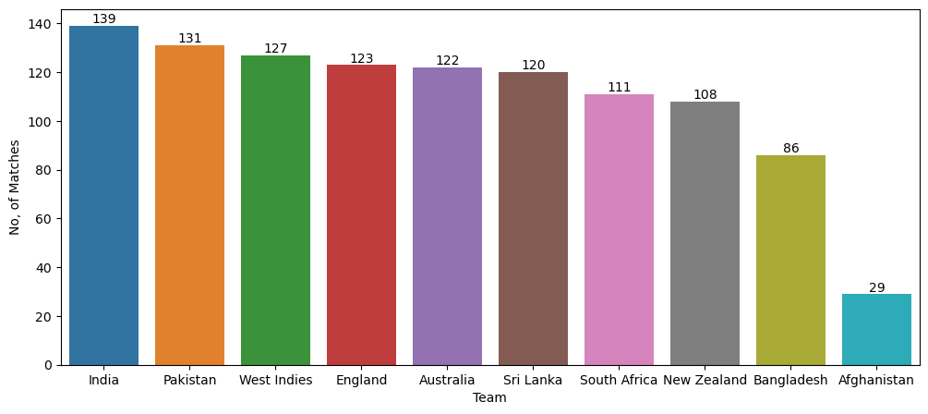
01/01/2011 – 15/10/2022
Top 10 Teams
548 Matches
01/01/2011 – 15/10/2022
Top 9 Teams
519 Matches
Number of matches played by each team
01/01/2011 – 15/10/2022

Slide 8
01
A model based on historical and other statistics about the cricket teams

Slide 9
Historical Dataset
NAME | DESCRIPTION | TYPE
ID | Match ID | Numerical
Date | Match playing date | Categorical
Venue | Match playing ground | Categorical
T1_Mat | Total number of matches played by Team 1 | Numerical
T1_RunsScored | Total number of runs scored by Team 1 | Numerical
T1_4s | Total number of 4s earned by Team 1 | Numerical
T1_6s | Total number of 6s earned by Team1 | Numerical
T1_RunsConceded | Total number of runs conceded by Team 1 | Numerical
T1_WktsTaken | Total number of wickets taken by Team1 | Numerical
T1_W/L | Team 1 Win / Loss ratio | Numerical
T1_WktsLost | Total number of wickets lost by Team 1 | Numerical
T2_Mat | Total number of matches played by Team 2 | Numerical
T2_RunsScored | Total number of runs scored by Team 1 | Numerical
T2_4s | Total number of 4s scored by Team 2 | Numerical
T2_6s | Total number of 6s scored by Team 2 | Numerical
T2_RunsConceded | Total number of runs conceded by Team 2 | Numerical
T2_WktsTaken | Total number of wickets taken by Team 2 | Numerical
T2_W/L | Team 2 Win / Loss ratio | Numerical
T2_WktsLost | Total number of wickets lost by Team 2 | Numerical
Winner | Team 1 or Team 2 | Categorical

Slide 10
Feature Engineering
Average Runs Scored in a match
Average number of boundaries earned in a match
Average Rune conceded in a match
Average wickets taken in a match
Average Wickets lost in a match
Categorize the venues continent-wise

Slide 11
Dataset after Feature Engineering
NAME | DESCRIPTION | TYPE
Venue | Match playing continent | Categorical
T1_Mat | Total number of matches played by Team 1 | Numerical
T1_Avg_Runs_Scored | Average runs scored by Team 1 | Numerical
T1_Avg_Bound | Average number of boundaries earned by Team 1 | Numerical
T1_Avg_Runs_Con | Average runs conceded by Team 1 | Numerical
T1_Avg_Wkts_Taken | Average number of wickets taken by Team1 | Numerical
T1_Avg_Wkts_Lost | Average number of wickets lost by Team 1 | Numerical
T1_W/L | Team 1 Win / Loss ratio | Numerical
T2_Mat | Total number of matches played by Team 2 | Numerical
T2_Avg_Runs_Scored | Average runs scored by Team 2 | Numerical
T2_Avg_Bound | Average number of boundaries earned by Team 2 | Numerical
T2_Avg_Runs_Con | Average runs conceded by Team 2 | Numerical
T2_Avg_Wkts_Taken | Average number of wickets taken by Team 2 | Numerical
T2_Avg_Wkts_Lost | Average number of wickets lost by Team 2 | Numerical
T2_W/L | Team 2 Win / Loss ratio | Numerical
Winner | Team 1 or Team 2 | Categorical
519 observations, 16 variables

Slide 12
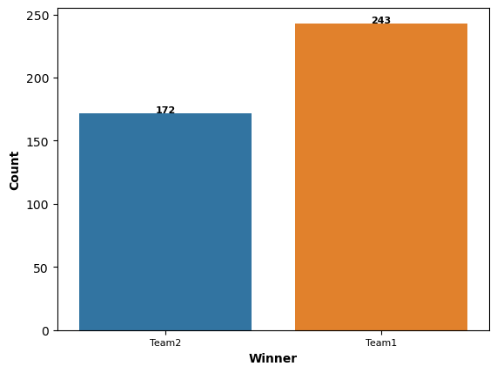
Descriptive Analysis - Important Results
The dataset is imbalanced

Slide 13
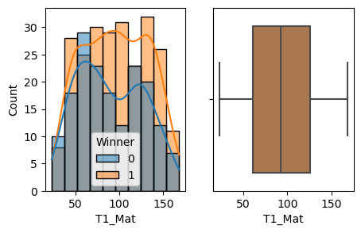
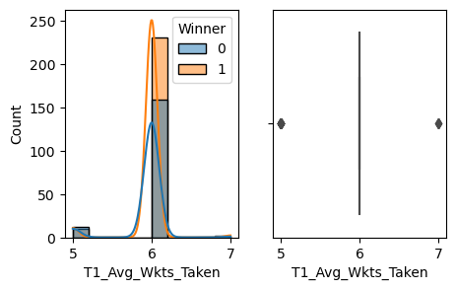
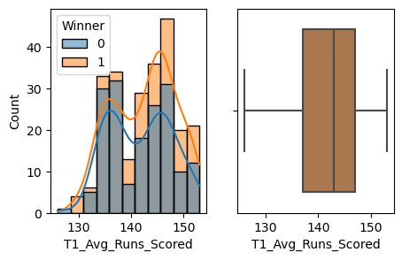
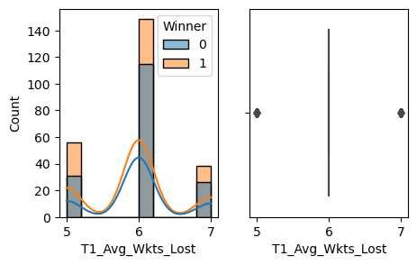
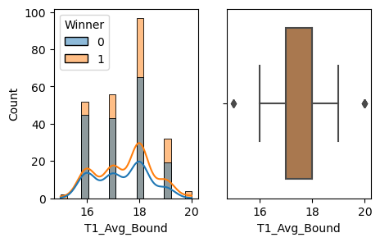
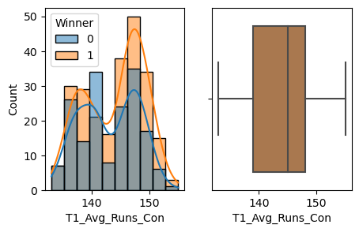
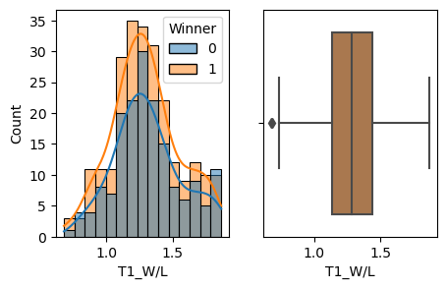

Slide 14
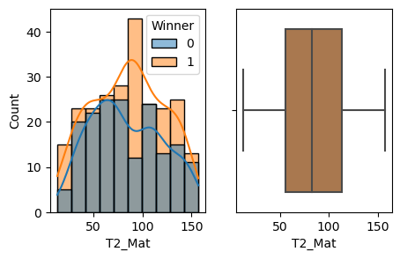
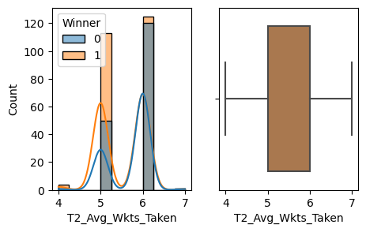
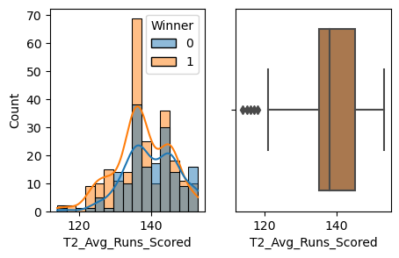
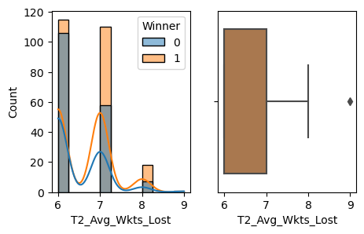
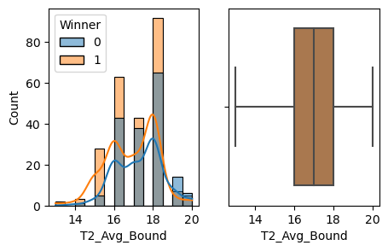
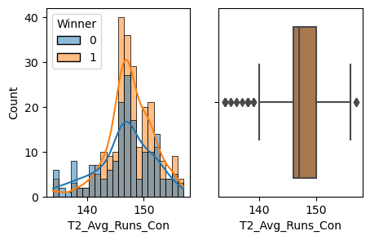
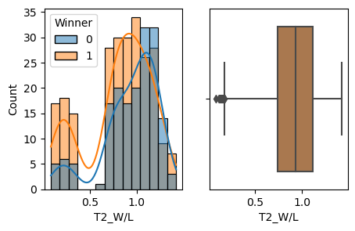

Slide 15
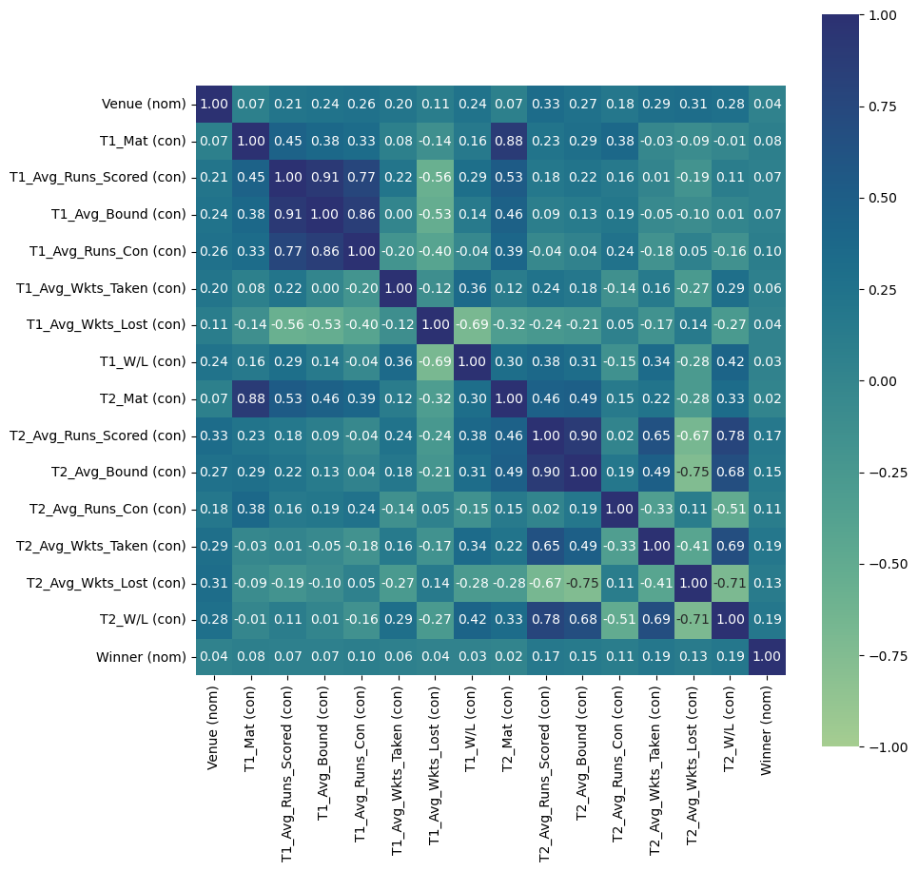
Correlation – Association Plot
Multicollinearity exists

Slide 16
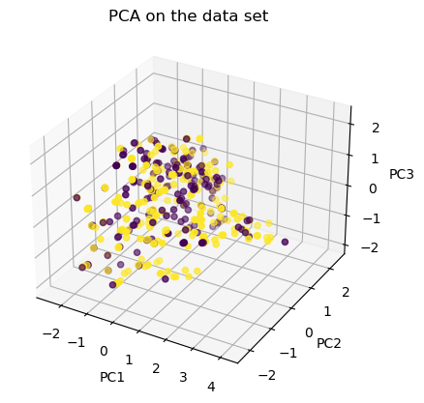
FAMD – Factor Analysis of Mixed Data
A principal component method dedicated to analyze a data set containing both quantitative and qualitative variables

Slide 17
Historical Model Results
Train set
Test set
Model | F1 Score | Precision | Recall | Accuracy | F1 Score | Precision | Recall | Accuracy
Logistic Regression | 62.7% | 62.4% | 63.0% | 62.6% | 63.8% | 60.7% | 67.3% | 59.6%
Naïve Bayes | 61.6% | 61.8% | 61.3% | 61.7% | 61.4% | 59.3% | 63.6% | 57.7%
SVM | 63.2% | 60.8% | 65.8% | 61.7% | 62.2% | 57.8% | 67.3% | 56.7%

Slide 18
02
A model based on Twitter data

Slide 19
Twitter Dataset
519 observations, 7 variables
NAME | DESCRIPTION | TYPE
T1_Twitter_Volume | Volume of pre-match tweets for Team 1 | Numerical
T1_Fans_Sentiment | Aggregated fans’ sentiment for Team 1 | Numerical
T1_Winner_Prediction | Number of mentions of Team 1 as the winner | Numerical
T2_Twitter_Volume | Volume of pre-match tweets for Team 2 | Numerical
T2_Fans_Sentiment | Aggregated fans’ sentiment for Team 2 | Numerical
T2_Winner_Prediction | Number of mentions of Team 2 as the winner | Numerical
Winner | Team 1 or Team 2 | Categorical
$\text{T}\text{1_}\text{Twitter}\text{_}\text{Volume}$ = $\frac{Count of pre match tweets of T1 for the match}{Total Number of pre match tweets for the match}$
T1_Fans_Sentiment = $\frac{Count of positive tweets of T1 for the match}{Total Number of pre match tweets for the match}$
T1_Winner_Prediction =$Count of tweets contain$‘T1 win’ or ‘T1 will win’

Slide 20
Tweets that occurred between 24 hours and 1 hour before the start of the game wanted to be considered.
Extracted the starting time of each past match using the schedule reports given by Cricbuzz and noted the relevant timestamps utilizing that time.
Converted those GMT timestamps into epoch time using https://www.epochconverter.com/
Manually created a list of hashtags & user handles associated with each team.
Using these inputs Tweets were collected for each team under each match with the help of Snscrape.

Slide 21
List of Hashtags & User Handles
Team | Hashtags | Handles
India | #TeamIndia #MenInBlue #BCCI #IndianCricket #IndianCricketTeam #cricketmerijaan #bharatarmy | @BCCI @thebharatarmy
England | #ECB #englandcricket #cricketengland #englandteam #EnglandCricketTeam | @englandcricket @TheBarmyArmy
Pakistan | #BackTheBoysInGreen #TheGreenArmy #packistancricket #packistancricketteam #TheRealPCB #PakCricket #cricketpakistan #PCB | @TheRealPCB
South Africa | #ProteaFire #Proteas #PureProtea #southafricacricket #CricketSouthAfrica #rsacricket #sacricket #SouthAfricanCricket #CSA | @ProteasMenCSA
New Zealand | #BACKTHEBLACKCAPS #CricketNation #blackcaps #NZC #newzealandcricket #nzcricket | @BLACKCAPS
Australia | #australiancricket #CricketAustralia #australiacricket #CricketAus #cricketcomau | @CricketAus @cricketcomau
West Indies | #MenInMaroon #WiAllin #WestIndies #Windies #windiescricket #westindiescricket | @windiescricket
Sri Lanka | #RoaringForGlory #ApeKollo #TeamSriLanka #SriLankanCricketTeam #SriLankanTeam #SrilankaCricket #GemmakThamai #OfficialSLC | @OfficialSLC
Bangladesh | #RiseOfTheTigers #BCB #BCBtigers #BangladeshCricket #bangladeshcricketteam #bdcricket #bdtigers #bdcricket_team | @BCBtigers

Slide 22
For tweets with more than one hashtag, we elected to label it with the first club hashtag.
We reason that if a tweet mentions two or more clubs, the tweeter may have intended more emphasis towards the first club mentioned.
-Robert P.Schumaker et.al
#SLvIND --------> Sri Lanka
#INDvSL --------> India

Slide 23
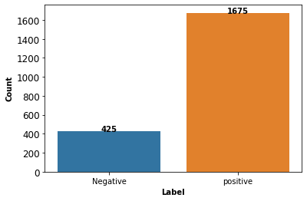
Sentiment Analysis
To Create Fans Sentiment Score Variable
60,000+
Tweets
3,000
Labeled Tweets
-Train set ( 2100 )
-Validation set (450)
-Test set (450)

Slide 24
Sentiment Analysis Results
Train set
Validation set
Test set
Model | F1 Score | Precision | Recall | Accuracy | F1 Score | Precision | Recall | Accuracy | F1 Score | Precision | Recall | Accuracy
VADER |  |  |  |  |  |  |  |  | 93.1% | 90.8% | 95.7% | 88.4%
LSTM | 90.6% | 92.1% | 89.1% | 85.2% | 89.6% | 91.7% | 87.6% | 84.0% | 87.3% | 91.4% | 83.5% | 80.0%
RoBERTa | 97.4% | 95.8% | 99.1% | 95.9% | 95.3% | 93.3% | 97.5% | 92.4% | 95.3% | 93.9% | 96.7% | 92.2%
Class Label | F1 Score | Precision | Recall
Negative | 76.8% | 82.9% | 71.6%
Positive | 95.3% | 93.9% | 96.7%

Slide 25
A model based on both historical &
Twitter features
03
Combine both approaches to understand whether Twitter can provide any additional information on top of the information that is already available through historical statistics

Slide 26
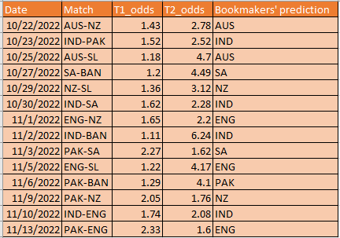
Check the effectiveness of the Methodology
To better understand the effectiveness of the methodology, the predicted results will be compared with the bookmakers’ predictions and checked whether can we gain an extra profit using the proposed model
Betting odds & Bookmakers’ predictions
for the T20 World Cup 2022

Slide 27
Timeline
 | SEP | OCT | NOV | DEC | JAN | FEB
Proposal Presentation
Literature Review
Data Collection
Data Preprocessing
Model Building & Evaluation
Thesis Writing

Slide 28
Thank
You!

