Slide 1
Can the crowds’ wisdom predict the cricket match outcome better than historical data ?
A comparative study of machine learning algorithms
Name : S.P.P.M. Sudasinghe
Index : s14510
Supervisor : Dr. Sameera Viswakula
Co-Supervisor : Dr. G. P. Lakraj

Slide 2

Page
02
Overview
Background Introduction to the problem Motivation
Significance Literature review Data collection
Methodology Techniques Timeline
References

Slide 3
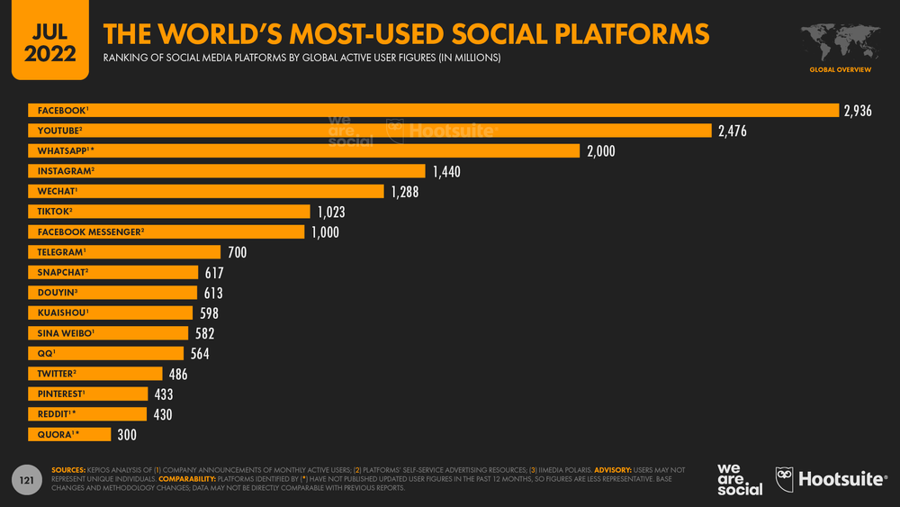
Page
03
Background
Twitter is one of the most popular social media for opinion and information sharing, with over 400 million active users.
Source: https://datareportal.com/social-media-users?rq=twitter

Slide 4
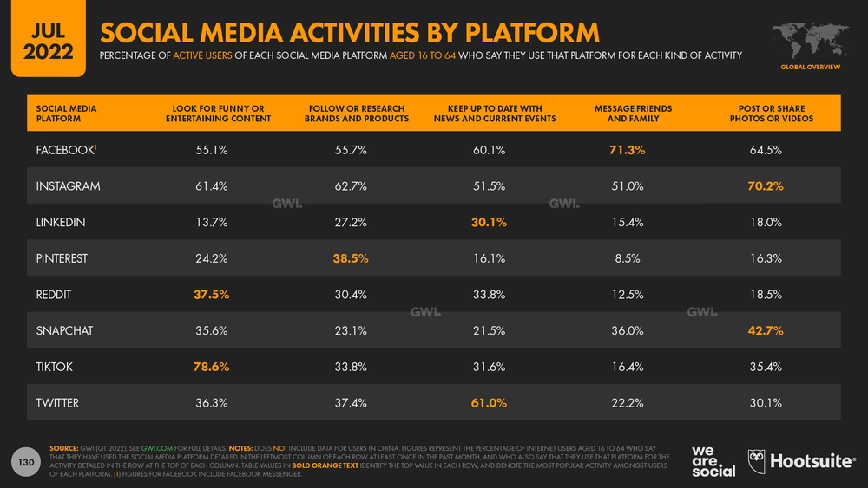
Page
04
Source: https://datareportal.com/social-media-users?rq=twitter

Slide 5
Page
05
There is a correlation between the moods of the public expressed on Twitter and the way the stock market performs.
- Bollen et al. (2011)
The sentiment of Twitter data has shown to be an effective feature for future predictions in real-world events.
“You can predict the results of major-league football games with Twitter. Better, in many cases, than you could with traditional means.”
- Researchers at Carnegie Mellon University (2013)
Twitter can be considered a valid indicator of political opinion.
- Tumasjan et.al. (2010)

Slide 6
Page
06
The latest ICC men's T20 World Cup (Oct-Nov, 2021) delivered a record viewership globally, garnering a television reach of 167 million.
Top 5 Trending Popular Sports in the World 2022
Worldwide Estimated Fans in Billions
“We are pleased with these outstanding global viewership numbers, that demonstrate the power of T20I cricket to attract a huge audience across the globe on linear and digital platforms.”
- ICC CEO Geoff Allardice
Source: https://fallinsports.com/top-10-about-sports-and-games/top-10-trending-popular-sports-in-the-world-2022/

Slide 7
Page
07
Men’s T20I Team Rankings
Position | Team
1 | India
2 | England
3 | South Africa
4 | Pakistan
5 | New Zealand
6 | Australia
7 | West Indies
8 | Sri Lanka
9 | Bangladesh
10 | Afghanistan
Last updated - 14 Sep 2022

Slide 8
Page
08
Introduction to the problem
Cricket match outcome predictions can be challenging due to the complexity of the game.
Every Cricket match leaves behind a huge set of data.
Some of the information can not be provided by historical data.
e.g., injuries, sentiment towards the teams, and match-banned players
The key problem that needs to be solved is predicting the outcome of a match before the game starts using both historical & Twitter data.

Slide 9
Page
09
Objectives
To predict the winner of T20 international matches, using both historical and microposts posted on Twitter before the match starts.
To classify pre-match tweets as positive or negative using sentiment analysis techniques.
To study whether Twitter-derived features can provide useful information to predict cricket match outcomes.
To check whether there is any profit we gained while betting on a team before a match.

Slide 10
Page
10
Motivation
Cricket needs a better predictive model with good accuracy.
There is a lot of interest among people to earn extra income through pre-match betting.
Predicting match results before starting the game can help teams to make changes in their strategies during and before the game.
Companies like to know about the sentiments of the people towards teams. It will help them to get an idea of which team they should invest in/ sponsor.

Slide 11
Page
11
Significance of the study
01
Most of the predictive models for cricket were built using historical and instantaneous features.
03
Less number of studies checked whether they could gain a profit from pre-match betting by applying their models.
02
A limited number of studies have been done on cricket match outcome prediction, and most of the models were built for ODI matches & T20 Premier leagues.
04
Not much attention has been paid to the hybrid approach to find the sentiment of tweets.

Slide 12
Page
12
Literature Review
Using Twitter to predict football outcomes. Kampakis et al.(2014) | Data mined from Twitter can indeed be a useful source for predicting games in the Premier League.
Beating the bookmakers: leveraging statistics and Twitter microposts for predicting soccer results. Godin et al.(2014) | A combination of statistical and Twitter-based knowledge can beat expert and bookmaker predictions with absolute improvements of 8% and 1%, respectively.
Predicting the cricket match outcome using crowd opinions on social networks: A comparative study of machine learning methods. Ul Mustafa et al. (2017) | The results beat bookmakers' predictions, realizing a profit of 67%.
Predicting the cricket match outcome using ANFIS classifier for viewers opinions on twitter data. Anbazhagu et al.(2021) | They got up to 75% right expectations.

Slide 13









Page
13
Data Collection
Historical &
other statistical data
Tweets
ESPNcricinfo statsguru
Snscrape
Betting Odds
Betting tips &
Experts’ predictions
Odds Portal
Cricbuzz
CricTracker
Crictips & etc.
Notes:
The data will consist of more than 500 games played by the top ten teams collected from 2010 to this year's T20 world cup finals.
Historical data will be scraped using ESPNcricinfo stats guru.
When considering the Twitter dataset, tweets posted 24 hours before the game starts will be retrieved through a Python library called snscrape using a created list of hashtags and handles, which are strongly associated with each team.
Also, during the next t20 world cup season, bookmaker odds will be taken from OddsPortal, and booking tips and experts' predictions will be extracted from websites like cricbuzz, crictips, and crictracker.

Slide 14
Page
14
Methodology
Historical data
Data pre-processing
Apply classifiers
Evaluation
+
Tweets pre-processing
Create features for each match
-Tweets volume
-Sentiment score
-Average predicted score & etc.
Apply classifiers
Evaluation
Historical data
+
Tweets
Tweets
Best model selection
Apply classifiers
Evaluation
To check the effectiveness of this methodology, these results will be compared with the bookmaker and experts' predictions.

Slide 15
Page
15
Techniques
01
Classification Algorithms
02
NLP Techniques
Logistic Regression
Naïve Bayes
Support Vector Machine
Random Forest
Ensemble Learning
Word Tokenization
Stemming
Lemmatization
POS Tagger
NER
BoW
TF-IDF
NLTK

Slide 16
Page
16
Calculate sentiment score
03
Sentiment analysis approaches
Lexicon-based
Statistical
Hybrid
Vader
TextBlob
SentiWordNet
Machine Learning algorithms
Leverage both techniques

Slide 17
Page
17
Timeline
 | SEP | OCT | NOV | DEC | JAN | FEB
Proposal Presentation
Literature Review
Data Collection
Data Preprocessing
Model Building & Evaluation
Thesis Writing
Thesis Submission

Slide 18
Page
18
References
Kampakis, S., & Adamides, A. (2014). Using Twitter to predict football outcomes. arXiv preprint arXiv:1411.1243.
Mustafa, R. U., Nawaz, M. S., Lali, M. I. U., Zia, T., & Mehmood, W. (2017). Predicting the cricket match outcome using crowd opinions on social networks: A comparative study of machine learning methods. Malaysian Journal of Computer Science, 30(1), 63-76.
Godin, F., Zuallaert, J., Vandersmissen, B., De Neve, W., & Van de Walle, R. (2014, June). Beating the bookmakers: leveraging statistics and Twitter microposts for predicting soccer results. In KDD Workshop on large-scale sports analytics (pp. 2-14). New York, NY, USA: ACM.
Anbazhagu, U. V., & Anandan, R. (2021). Predicting the cricket match outcome using anfis classifier for viewers opinions on twitter data. In Data Management, Analytics and Innovation (pp. 171-182). Springer, Singapore.
Bollen, J., Mao, H., & Zeng, X. (2011). Twitter mood predicts the stock market. Journal of computational science, 2(1), 1-8.
Tumasjan, A., Sprenger, T., Sandner, P., & Welpe, I. (2010, May). Predicting elections with twitter: What 140 characters reveal about political sentiment. In Proceedings of the International AAAI Conference on Web and Social Media (Vol. 4, No. 1, pp. 178-185).

Slide 19
Thank
You!

