Slide 1


Slide 2
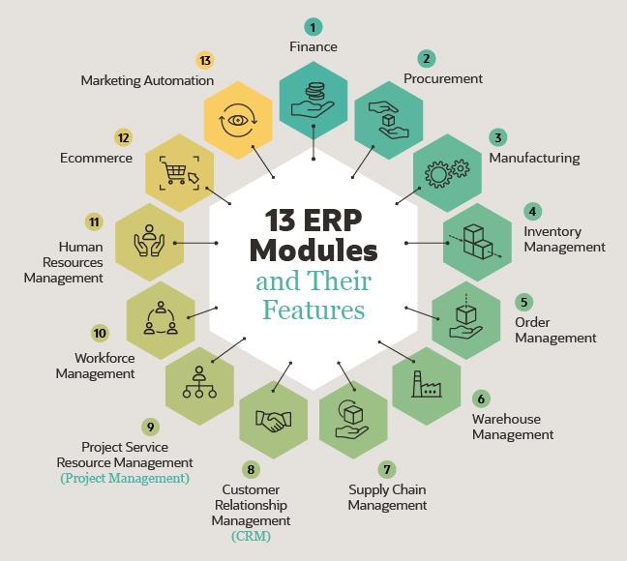
MODULES
Finance
Procurement
Manufacturing
Projects
Planning
Customer Relationship Management(CRM)
Service

Slide 3
LN TECHINICAL TOPICS
APPLICATION ARCHITECTURE
SOFTWARE ARCHITECTURE
SOFTWARE COMPONENTS
DOMAINS
TABLES
SESSIONS
QUESTIONS/MESSAGES
LABLES
FORMS
MENUS
REPORTS
PROGRAMM SCRIPTS

Slide 4
APPLICATION ARCHITECTURE
It is a 3 tier architecture
UI(User interface)
VM(Virtual Machine)
DB(Data Base)
UI
VM
DB

Slide 5
SOFTWARE ARCHITECTURE
Package combination
Package by package Combination
Package VRC(Version release customer)

Slide 6
Package :It is defined as 2 letters word (PP)
Classification of group based upon functionality we have different package .
tp,td,ti,tf,tc,tc,wh,ci,bp etc.
TP-Project
td-distribution
tf-finance
tc-common
wh-warehouse
ts-service
cp-planning
Module: it is defined as 3 letter (MMM)
package is linked with module.
PPMMM
module sub -functionality of a package
tf - acp(accounts payable)
gld(gender ledger)
cmg(cash management)
td - sls(sales)
pur(purchase)

Slide 7
1)Package combination:- A package combination is a collection of various Infor LN packages. Every package combination has a unique VRC. The package combination links users to a specific version of the Infor LN software. A package combination can be linked to one or more users and to one or more companies. However, a package combination can contain only one version of a package, which is identified by a package VRC. 2)Package by package combination:- package is linked package combination. 3)Package VRC:- B61 a base VRC b61u a standard/update version b61/ind 10 localization b61c 10 customized

Slide 8
1)Domain:- -Domain Commonly defines the data type. -Domain is linked with Packages. -Basic Nomenclature for Domain. PP means Package. dddd means domain name.
SOFTWARE COMPONENTS
PP dddd

Slide 9
1.Combination of rows and columns. 2.Rows are known as records. 3.columns are known as fields. 4.Table fields are linked to domains 5.Table is linked to Packages and a Module.
2) Tables:-

Slide 10
3) Sessions:-
Mainly sessions are the combination of packages ,modules, tables
It has the 6 types of sessions
(maintain session) tdpur4100m000
(Update session) tdpur4200m000
(print session) tdpur4400m000
(display session) tdpur4500m000
(mmt)satellite session tdpur4600m00

Slide 11
4) Questions:- Questions and messages are used to show a message to the user. We will get those information by creating of these two: 1)Message 2)Questions

Slide 12
1)Messages
Types of Massages
Warning
Information
Critical

Slide 13
2)Questions
Types of Questions:
Warning
Information
Critical

Slide 14
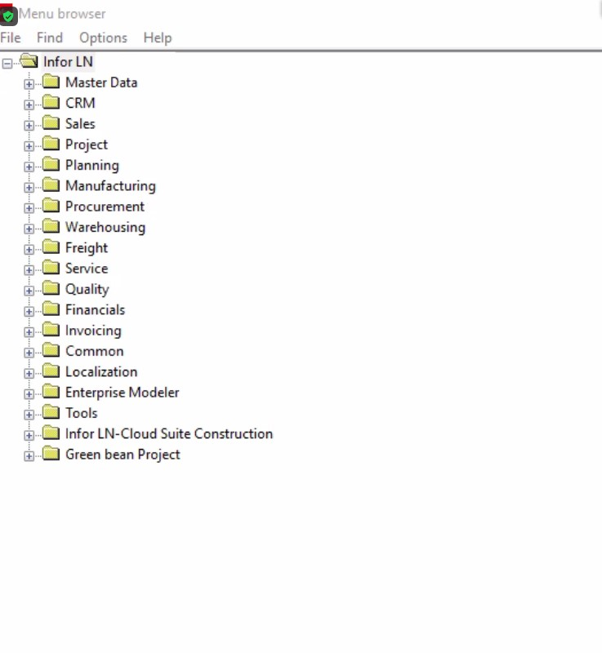
5) Menus:-

Slide 15
SCRIPTS
3GL
4GL (event sessions)
DAL
DAL2
DLL
UE(User Exits)

Slide 16


