Slide 1


AWS

Slide 2





Application
Database
OS
Hardware
Datacenter

Slide 3

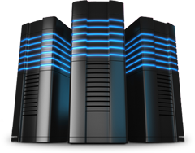
On-premise Infrastructure
Year 1:
1000 users
Year 2:
2000 users
Year 3:
5000 users

Slide 4
Business Requirements
#1: High Availability
#3: Elasticity
#2: Fault Tolerant
#4: Scalability

Slide 5
Datacenter Infrastructure Management
Dedicated space
High bandwidth
Redundant power supply
Support Availability
Capacity planning
Higher Maintenance effort
Time consuming
Leadership Experience

Slide 6
What is Cloud Service ?
A cloud service is any service made available to users on demand via the Internet from a cloud computing provider's servers
What is Cloud Computing ?
cloud computing is the delivery of computing services-servers, storage, databases, networking, software, analytics and more-over the Internet

Slide 7
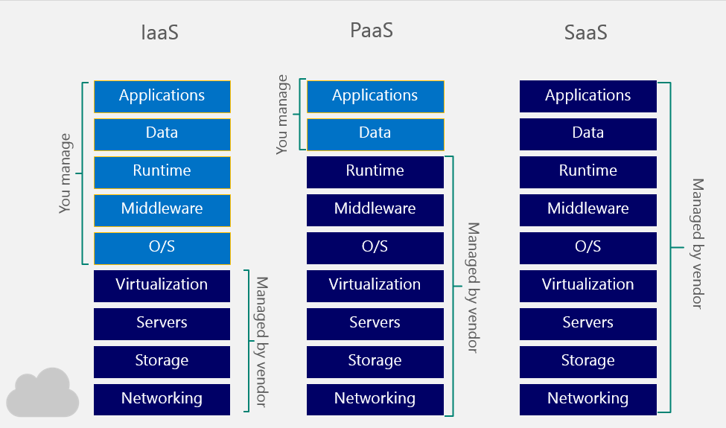
Cloud Service Models
(Host)
(Build)
(Consume)
Admins
Developers
End Users

Slide 8
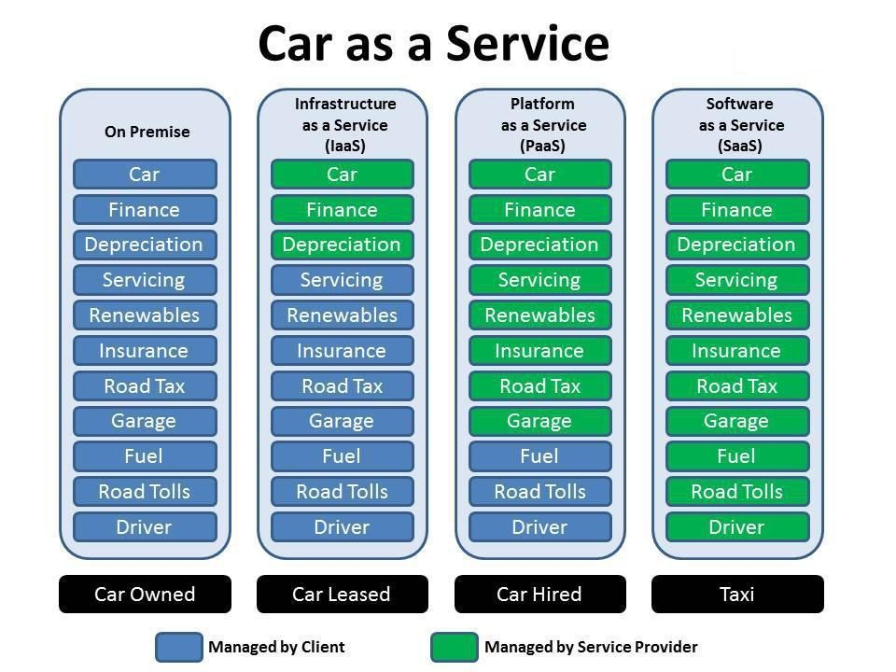

Slide 9

Amazon Web Services is a subsidiary of Amazon.com that provides on-demand cloud computing platforms
Cost-Effectiveness – Pay as you Go
Elasticity and Agility
Flexibility and Openness
Security
Reliable & High Performance

Slide 10



AWS Setup
AMI
AMI
AMI
Instance
Instance
Instance
Availability
Zone
Availability
Zone #1
Availability
Zone #2
Availability
Zone #2
Availability
Zone #2
Availability
Zone #2
Region # 1
Region # 2
Region # 3

Slide 11
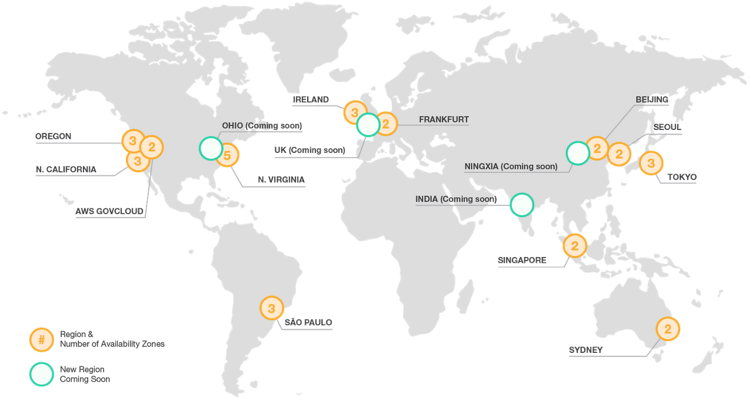
AWS Regions

Slide 12
AWS “Free Tier”
AWS Free Tier refers to the limited free usage of AWS services
AWS offers the Free Tier as means for a user to learn, experiment and get hands-on experience with AWS services
Almost all AWS services offer some kind of Free Tier usage
Free Tier is available for 12 months for an AWS account
Some services extend past 12 months
Free Tier is only available for new accounts

Slide 13
Free Tier "Featured Services"
EC2
EBS
S3
RDS
DynamoDB
SNS
Lambda
https://aws.amazon.com/free

Slide 14
Create an AWS account
URL: https://aws.amazon.com
1) Click on "Create a New AWS Account"
2) Enter your email address
3) Make sure "I am a new user" is selected
4) Complete the "Login Credentials" form
5) Select "Company" or "Personal" Account
6) Complete the rest of the "Contact Information" form
7) Complete the "Payment Information" form
You will need a validate credit/debit card
8) Complete "Identity Verification" form & follow instructions to input the verification PIN number
9) Select a "Support Plan"
Select "Basic" for no fee/free tier use
10) Sign in to the AWS Console with your newly created credentials

Slide 15
Navigate the AWS Console
AWS services
Documentation
Support
Region Selection
Account settings

Slide 16
VPC Virtual Private Cloud
VPC is a private sub-section of AWS that you control, in which you place AWS resources
You have full control over who has access to the AWS resources that you place inside our VPC
VPC lets you provision a logically isolated section of the AWS cloud where you launch AWS resources in a virtual network
In the VPC we can control our virtual networking environment, IP address, creation of subnets, route tables & gateways
When we create an AWS account, a default "VPC" is created for you

Slide 17



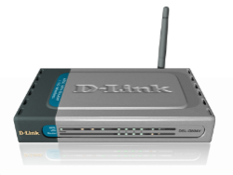



Modem/DSL
Router/Switch
Firewall

Slide 18





Internet Gateway
R.T
Network Access Control List (NACL)
Security Group
EC2 Instance
Availability Zone #1
Availability Zone #2

Slide 19
Internet Gateway
Internet gateway is a horizontally scaled, redundant & highly available component of VPC that allows communication between instances in your VPC & the internet
Our Default VPC already has an IGW attached
Only 1 IGW can be attached to a VPC at any time
an IGW cannot be detached from a VPC while there are active resources in the VPC
Without VPC the resources can talk to each other but not to the internet

Slide 20
Route table
RT contains a set of rules, called routes that are used to determine where the network traffic is directed
The Default VPC already has a main route table
Unlike an IGW, you can have multiple active route tables in a VPC
You cannot delete a route table if it has "dependencies"

Slide 21
Internet Gateway
R.T
Network Access Control List (NACL)
Security Group
EC2 Instance
Subnet 1
Subnet 2
Availability Zone #1
Availability Zone #2

Slide 22
NACL - Network Access Control Lists
NACL is an optional layer of security for your VPC that acts as a firewall for controlling traffic in & out of one or more subnets
Your default VPC already has a NACL in place & associated with the default subnets

Slide 23
Routing Table
Inbound
Rules
Outbound
Rules
For the default NACL All traffic is allowed (both inbound/outbound)
EC2 Instance
EC2 Instance
Subnet 1
Subnet 2

Slide 24
Routing Table
Rules are evaluated based on “rule #” from lowest to highest
The first rule evaluated that applies to the traffic type gets immediately applied & executed regardless of the rules that come after that
When you create a new NACL All traffic is denied by default
EC2 Instance
EC2 Instance
Subnet 1
Subnet 2

Slide 25
Subnet (subnetwork)
Subnet is a sub-section of network, generally includes all the computers in a specific location
Compare with our home network analogy, if ISP being a network then our home network can be considered a subnet of our ISP's network
When we create a VPC, it spans on all of the Availability Zones in the region
You can add one or more subnets in each Availability Zone
Each subnet must reside entirely within one Availability zone
The default VPC already has a subnet created by default
Subnets Must be associated with a route table
A PUBLIC subnet has a route to the internet
A PRIVATE subnet doesn't have a route to the internet

Slide 26
Subnet (subnetwork)
Subnet is a sub-section of network, generally includes all the computers in a specific location
Compare with our home network analogy, if ISP being a network then our home network can be considered a subnet of our ISP's network
When we create a VPC, it spans on all of the Availability Zones in the region
You can add one or more subnets in each Availability Zone
Each subnet must reside entirely within one Availability zone
The default VPC already has a subnet created by default
Subnets Must be associated with a route table
A PUBLIC subnet has a route to the internet
A PRIVATE subnet doesn't have a route to the internet

Slide 27



Internet Gateway
R.T
Network Access Control List (NACL)
Security Group
EC2 Instance
Subnet 1 (public)
Subnet 2 (public)
Subnet 3 (private)
Subnet 4 (private)
Availability Zone #1
Availability Zone #2

Slide 28
Internet Gateway
R.T with
IGW
R.T without
IGW
Network Access Control List (NACL)
EC2 Instance
Subnet 3 (private)
Subnet 1 (public)

Slide 29
Availability Zone
Availability Zone are distinct locations that are engineered to be isolated from failures in other AZ
By launching instances in separate Availability zones, we can protect our application from the failure of a single location
High Availability:
Creating the architecture in such a way that your system is always available
HA ensure that we can always access our data in the cloud
Fault Tolerant:
The ability of our system to withstand failures in one/more of its components & still remain available
FT ensure that if one of our web server failed, the backup server immediately took over
If something in our system fails, it can repair itself

Slide 30
EC2 Basics
Elastic Compute Cloud is your computer in the cloud
EC2 provides scalable computing capacity in the AWS cloud
Use EC2 to launch as many or as few virtual servers as you need, configure security, networking & manage storage.
EC2 enables you to scale up or down to handle changes in requirements

Slide 31
Conceptually understanding EC2
Basic Computer components:
Operating System
CPU
Hard Drive
Network Card
Firewall
RAM
EC2 Instance components:
AMI's
Instance type
EBS(local storage)
IP Addressing
Security Groups
RAM

Slide 32
EC2 Instance Purchasing Options
On-Demand:
Most expensive purchasing option
Most flexible purchasing option
You are charged only when instance is Running(billed by hour)
You can provision/terminate an instance anytime
Reserved:
Allows us to purchase an instance for a set time period (1/3 yrs)
Significant price discount
Once you buy a reserved instance, we are responsible for the entire price - regardless of how often we use it
Spot:
Amazon sells the unused instances, for short amount of time at lower price
We can Bid on an instance type & only use when the spot price is equal to or below your bid price
Charged by hour
Spot price fluctuate based on supply & demand in market

Slide 33
How are we charged for using EC2 ?
1) Purchasing Options:
  on-Demand
  Reserved
  Spot
2) Instance Type:
  General Purpose
  Compute Optimized
  GPU Optimized
  Memory optimized
  Storage Optimizes
3) EBS Optimized (Option for higher IOPS performance)
4) AMI Type (price varies on distribution/software packages)
  Linux
  Windows
5) Data Transfer (in/out of the instance)
6) Regions

Slide 34
AMI - Amazon Machine Image
A preconfigured package required to launch an EC2 Instance; includes an Operating system, software packages & other settings
AMI provides the information required to launch an instance, which is a virtual server in the cloud
We can launch as many instances from the AMI as you need

Slide 35
Step1: Selecting an AMI
When you launch an EC2 Instance, the first thing you do is select an AMI
AMIs come in 2 main categories:
1) Community AMIs:
- Free to use
- Generally it contains only the OS
2) AWS Marketplace AMIs:
- pay to use
- generally comes packaged with additional licensed software
3) My AMIs:
- AMIs that you can create yourself

Slide 36
Step2: Instance Type?
Instance type is the CPU (compute power) of your instance
When you launch an instance, the instance type determines the hardware of the host
Each instance type offers different compute, memory & storage capabilities
Select an instance type based on the requirement of the software that you plan to run on your instance
Instance Type Components:
Family: Categorizing instance types based on what they are optimized for
Type: subcategory for each family type
vCPUs: number of virtual CPUs the instance type uses
Memory: Amount of RAM the instance type uses
Instance Storage(GB): local instance storage volume(hard drive)
EBS-Optimized Available: Indicates if EBS-optimization is an option for the instance type
Network Performance: Rating based on its data transfer rate(bandwidth)

Slide 37

EBS – Elastic Block Store?
Storage
EBS is a storage volume for an EC2 instance(this of it as Hard Drive)
EBS volumes are highly available & reliable storage volumes that can be attached to any running instance that is in the same Availability Zone
EBS persist independently from the life of the instance
IOPS (Input/Output operations per sec):
IOPS is the amount of data that can be written/retrieved from EBS per sec
The operations are measured in KiB. 1 kibibyte = 1024 bytes
Larger the EBS volume size, more IOPS the volume has
More IOPS means better the volume performance (faster read/write)

Slide 38



Every EC2 instance must have a “root” volume, which maybe or may not be EBS
By default, EBS root volumes are set to be deleted when instance is terminated. However we can choose to keep it
You can add more additional EBS volumes to the instance
Any additional volume attached to the instance at any time, is not deleted when the instance is terminated
EC2 instance
Root Volume
Root Volume
Additional Volume
EC2 instance

Slide 39
This means that you can swap EBS volumes between different EC2 Instances by “detaching” it from one & “attaching” it to another
Root Volume
Additional Volume
EC2 instance #1
swap
Root Volume
Additional Volume
EC2 instance #2

Slide 40

Snapshot
A snapshot is an image of an EBS volume that can be stored as a backup
Also can be used to create a duplicate EBS volume
You cannot attach or detached a snapshot to an EC2 instance
To restore a snapshot, we need to create a new EBS volume using the snapshot as the template
EBS Volume
(original)
Snapshot of EBS Volume
Duplicate of EBS Volume

Slide 41

Security Groups ?
Firewall is a network security system designed to prevent unauthorized access to/from a private network
Security groups acts as a virtual firewall that controls the traffic for one or more instances
We add rules to each SG that allow/deny traffic from its associated instances
Best practice is to allow only traffic that is required
Firewall
Security
Security Groups

Slide 42
IP Addressing ?
Similar to having home street address to send mail
IP address is the instances address on the network
Private IP:
By default every EC2 instance will be provided with a private IP address
Private IP addresses allow instances to communicate as long as they are located in the same VPC
Public IP:
EC2 instances can be launched with/without public IP address
Public IP address is required for the instance to communicate with the network

Slide 43
Launching an EC2 Instance:
Select an AMI
Select an Instance Type
Configure Instance Details:
use this to run a bash script that install Apache
  #!/bin/bash
  yum update -y
  yum install -y httpd
  service httpd start
Add Storage
Add a Tag ( give the instance a name )
Configure/Assign a Security Group
  Create a new security group
  Add new rule for http
Review & Launch
Create a new Key pair & Download it
Note : Free Tier EC2 instances can be launched in N. Virginia and Oregon only.

Slide 44
Connecting to an EC2 Instance(Linux/SSH)
Select the instance
Under "Actions", choose "connect"
Follow these in order
  Open a terminal to access the cmd line
  Navigate into the dir that contains the Key pair we downloaded
  Run the chmod on Key pair
  Run commands

Slide 45
IAM
Identity & Access Management is where you manage your AWS users & their access to AWS accounts & services
The user created when you created the AWS account is called the "root" user
By default, the root user has FULL administrative rights & Access to every part of the account
Any new users you create in the AWS account by default wont have any access to any AWS services
Permissions must be given for all the users
The common use of IAM is to manage:
  users
  groups
  Access policies
  Roles

Slide 46
IAM Initial Configuration:
When a new AWS root account is create, it is best practice to complete the tasks listed in IAM under "Security Status":
  Delete your root access keys
  Activate MFA on your root account
  Create individual IAM users
  User groups to assign permissions
  Apply an IAM password policy
Create Individual IAM Users:
AWS best practice is to NEVER use your root account for day-to-day use
Create an IAM user & attach the "Administrator Access" policy to it
Use this user account as your daily driver

Slide 47
User groups to assign permissions:
It is convenient & efficient to set up groups & assign permissions to the group rather than managing each user
Apply an IAM password policy:
A password policy dictates the format & expiration rules that must be followed when a user creates/modifies their password

Slide 48



Users & Policies
user1
S3 Bucket

Slide 49


user2
user1
IAM S3
Full Access Policy
S3 Bucket

Slide 50
user2
user1
IAM S3
Full Access Policy
S3 Bucket

Slide 51
Groups & Policies
user2
user1
group
S3 Bucket

Slide 52
user2
user1
group
IAM S3
Full Access Policy
S3 Bucket

Slide 53
user2
user1
group
IAM S3
Full Access Policy
S3 Bucket

Slide 54
Roles
user2
user1
group
IAM S3
Full Access Policy
EC2
S3 Bucket

Slide 55

user2
user1
group
IAM S3
Full Access Policy
IAM Role
EC2
S3 Bucket

Slide 56
ELB Elastic Load Balancer
A load balancer is a device that distributes network or application traffic across a number of servers
ELB distributes incoming application traffic across multiple EC2 instances in multiple Availability Zones
This increases the fault tolerance of our applications
ELB detects unhealthy instances & routes traffic only to healthy instances
ELB Pricing:
Free Tier use is not available for ELB
Charged per hour or partial hour the load balancer is running
Charged for each GB of data transferred through the load balancer
Detailed Classic ELB pricing info:
https://aws.amazon.com/elasticloadbalancing/classic/pricing

Slide 57





Customers
Internet Gateway
ELB
Network Access Control List (NACL)
Security Group
Web server #1
Web server #2
Availability Zone #1
Availability Zone #2

Slide 58


Internet Gateway
ELB
R.T
Network Access Control List (NACL)
Security Group
Web server #1
Web server #2
Availability Zone #1
Availability Zone #2

Slide 59
Creating a Classic ELB
In EC2 navigate to ELB
Create an ELB -> Select Classic Load Balancer
Basic Configuration (Give ELB a name)
  If the ELB is used for serving web traffic to EC2 Instances, then protocol is set to HTTP & port set to 80
  If you want to add support for HTTPS, then set port to 443
Assign Security Groups:
  Ensure the SG you assign to ELB has the appropriate rules which allows traffic based on the protocols selected in the previous step
Configure Health Checks:
  Select a ping protocol & port for the ELB to use to conduct health checks on the attached EC2 instances
Add EC2 instances: (For this example we will not add the Instance)
Add tags:
Review & Create

Slide 60
Auto Scaling?
The process of adding(scaling up) or removing)scaling down) EC2 instances based on traffic demand for your application
Auto scaling helps to ensure that we have the correct number of EC2 instances available to handle the load for our application
You can specify the minimum number of instances in each Auto scaling group & Auto scaling ensure that the group never below the size
If we specify the scaling policies, then auto scaling can launch or terminate instances as demand on our application increase/decreases

Slide 61
Customers
Internet Gateway
ELB
Network Access Control List (NACL)
Auto Scaling
Group
Security Group
Web server #1
Web server #2
Availability Zone #1
Availability Zone #2

Slide 62
ELB
Max capacity
of 3 users
Max capacity
of 3 users
Webserver #1
Webserver #2

Slide 63


ELB
Max capacity
of 3 users
Max capacity
of 3 users
Webserver #1
Webserver #2

Slide 64
ELB
Max capacity
of 3 users
Max capacity
of 3 users
Max capacity
of 3 users
Webserver #1
Webserver #2
Webserver #3

Slide 65
Launch Configuration:
The EC2 template needs to be specified so that when Auto scaling needs to add an additional server to our Auto scaling group
Auto Scaling Group:
All the rules & settings that govern when an EC2 server is automatically added or removed
How are we charged for using ELB?
Auto scaling is Free to use
You will be charged for the resources that Auto Scaling provisions

Slide 66
Creating a Launch Configuration:
Select an AMI
Select an Instance type
Create Launch Configuration:
  Give Launch name
  Make sure that a public IP address will be assigned
Select/Add storage type
Configure Security Group
Review & Create

Slide 67
Creating an Auto Scaling Group:
  Give group name
  Select number of instances with which group should start
  Select VPC & subnets in which you want Auto scaling to create the instances
  Open Advanced Details:
  Check the box to include Load balancing
  Select the ELB you want to use
  Configure the health checks
Configure Scaling policies:
  Select "use scaling policies to adjust the capacity of this group"
  Choose the number of instances you want to scale between, min & max number of instances
  Create new Alarm for Increase Group Size & Decrease Group Size
  Provide the metric thresholds that govern when Auto scaling adds or removes instances
  CPU utilization is the most commonly user metric
Configure Notifications
Review & create

