Slide 1

Cost Optimization in AWS
Explore cost optimization strategies for AWS.

Slide 2
What is cost optimization?
Cost optimization is a continual process of refinement and improvement over the span of a workload’s lifecycle. To reduce the expenditure on unwanted usage on resources that we are investing.
1
Reduce Overspending
Maximize resource utilization.
2
Minimize Idle Resources
Stop unnecessary services and instances.
3
Optimize Resource Configuration
Use the right instance types and sizes.
4
Maximize Savings
Utilize discounts and pricing models.

Slide 3
Cost Type | Examples of Services | Details
Upfront Costs | EC2 Reserved Instances, RDS Reserved Instances, AWS Savings Plans, Direct Connect | Pay in advance for a term (1-3 years) for discounts.
Compute Costs | EC2, Lambda, EKS | Ongoing charges based on usage, instance size, or requests.
Storage Costs | S3, EBS, EFS, FSx | Charges based on storage used, data transfer, and IOPS.
Data Transfer Costs | Data Transfer Out, Inter-AZ Transfer, Direct Connect | Charges for data moving out of AWS or between regions/AZs.
Database Costs | RDS, DynamoDB, Aurora, Redshift | Based on database usage, storage, and instance type.
Monitoring & Logging Costs | CloudWatch, CloudTrail | Costs for metrics, logs, and events.
Other Service Costs | API Gateway, Route 53, Secrets Manager | Based on requests, data transfer, or services used.

Slide 4


Key AWS Cost Optimization Strategies
Discover proven methods for controlling AWS costs.
Reserved Instances
Commit to instance usage for discounts.
Savings Plans
Pay a discounted hourly rate for compute.
Spot Instances
Bid on unused EC2 instances for lower costs.
Autoscaling
Scale resources dynamically based on demand.

Slide 5
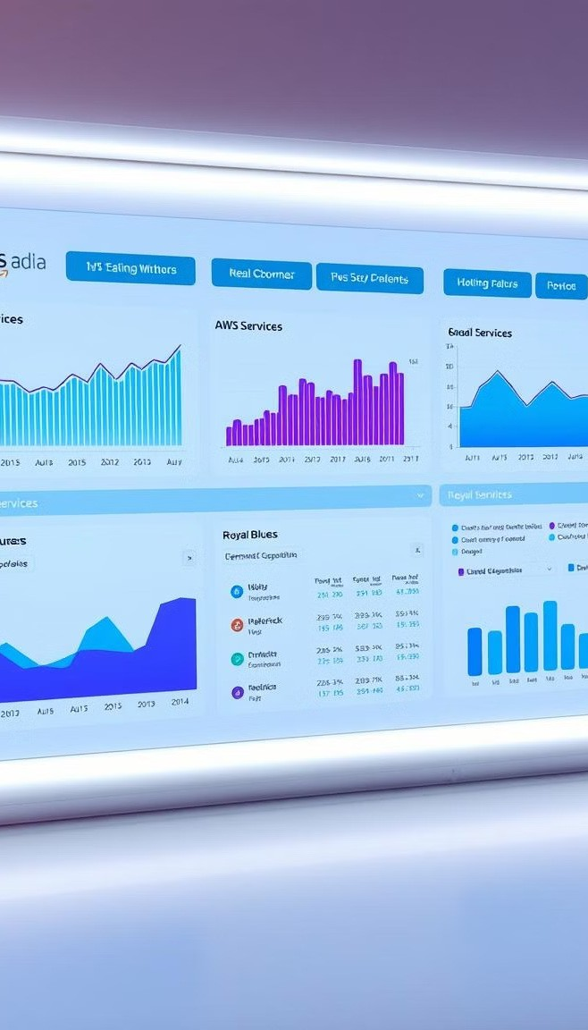



Monitoring and Analyzing AWS Spending
Gain insights into your AWS costs and identify areas for improvement.
Cost Explorer
Visualize spending trends and identify cost outliers.
Budgets and Alerts
Set spending limits and receive alerts for potential overspending.
Cost and Usage Reports
Download detailed reports for comprehensive analysis.

Slide 6

Applying Cost Optimization Techniques
to Your Environment
Implement these strategies to manage your AWS spend effectively.
Start with a Baseline
Analyze your current AWS spend and identify areas for improvement.
Develop a Cost Optimization Plan
Define goals, strategies, and a timeline for implementation.
Continuous Monitoring and Analysis
Regularly monitor your costs and adjust your strategies accordingly.

Slide 7
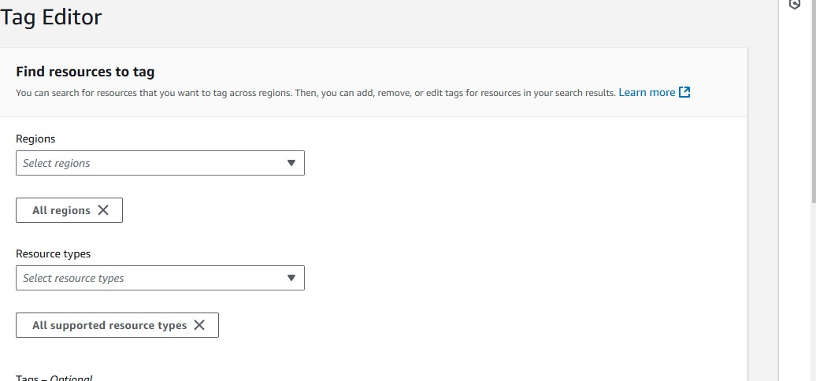
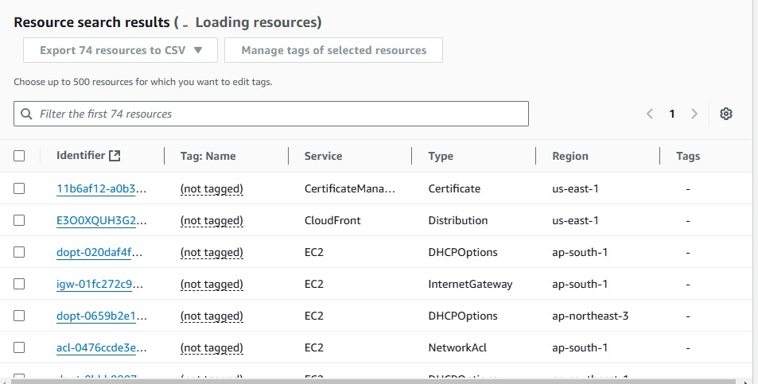
Manually optimizing the cost’s
Tag editor is useful for to
Check all the resources
running in aws service and
useful to check the regions
1
Select the resources that running in the aws
2

Slide 8
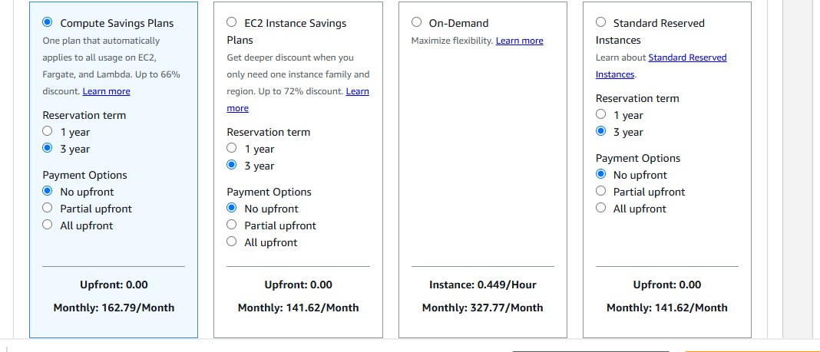
Payment options in AWS
All Upfront: Pay the full cost of the plan upfront.
Partial Upfront: Pay part of the plan's cost upfront, with the remaining balance paid monthly.
No Upfront: Spread the cost across the term with monthly payments

Slide 9
Service | Pricing Model | Cost Example (USD)
Amazon EC2 (Compute) | On-demand / Reserved | - t3.micro: $0.0104 per hour (on-demand)
 |  | - 1-Year Reserved (All Upfront): $50/year
 |  | - 1-Year Reserved (No Upfront): $0.0066/hour
Amazon S3 (Storage) | Per GB Stored | - $0.023 per GB for standard storage (S3)
 |  | - $0.004 per GB for Glacier storage (archival)
Amazon RDS (Relational DB) | On-demand / Reserved | - Reserved (1-year All Upfront): ~$150/year
Amazon Elastic Load Balancer (ELB) | Per Hour + Data Processed | - $0.025 per hour (Classic ELB)
Amazon VPC (Networking) | Per Hour | - $0.01 per hour (for each VPN connection)
Amazon EBS (Block Storage) | Storage + I/O Requests | - $0.10 per GB for General Purpose SSD (gp3)
Pricing chart

Slide 10

What is serverless??..
In AWS, serverless refers to a cloud computing model where AWS manages the infrastructure, allowing developers to focus on writing code and building applications without worrying about provisioning, scaling, or maintaining servers. In a serverless environment, you only pay for the computing resources you actually use, and AWS automatically handles scaling, availability, and fault tolerance.
Popular Serverless services in AWS
1. Lambda
2. API Gate way
3. Dynamo DB
4. Amazon s3
5. Event Bridge
6. Aws Fargate
7. SNS

Slide 11

Lambda
AWS Lambda is a serverless compute service provided by Amazon Web Services (AWS) that allows you to run your code without provisioning or managing servers. Instead of managing infrastructure, you just upload your code to AWS Lambda, and it runs in response to specific events (like HTTP requests, file uploads, or database changes).
Quotation:- Run code without thinking about servers
Supported languages : -
Node js
.Net
Python
Ruby
Amazon linux
Java

Slide 12
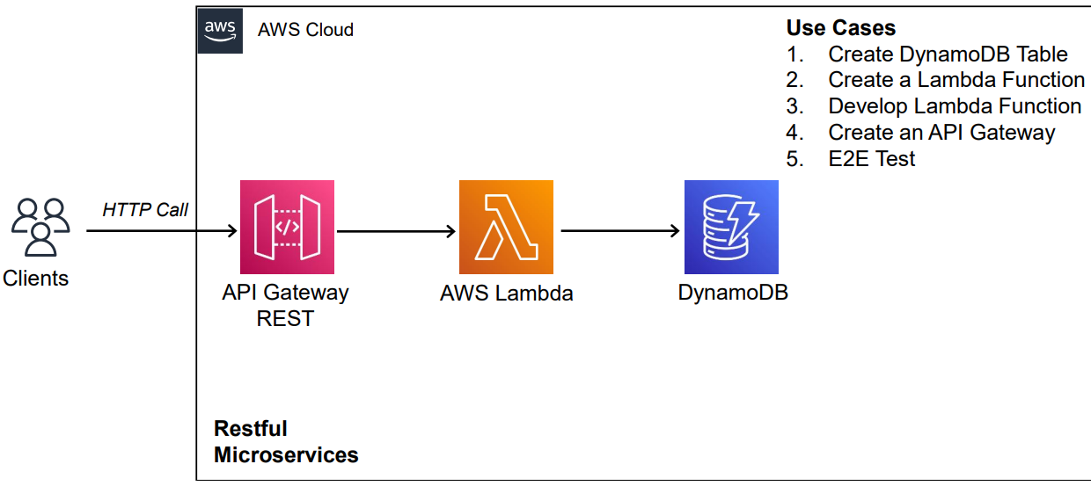

Slide 13
API Gate way
Fully managed service for developers to easily create, publish, maintain, monitor, and secure API’s such
as REST, HTTP, and websocket at any scale.
The four main methods to create HTTP methods
1. GET :- Retrieve the representation of the resource at specified url.
2. PUT :- Update a resource at a specified url.
3. CREATE :- create a new resource.
4. DELETE :- delete a specified url.

