Slide 1

Go, change the world
RV College of
Engineering
Design Thinking
Department of CSE
Phase II

Slide 2

Go, change the world
RV College of
Engineering
Team Details
Team Members
Nachiket G Kallapur
Vishal M
Dave Shivangi Devendra
Pavankumar V Badiger
Mentors
Prof. Pavithra H and Prof. Prafulla S B

Slide 3
Go, change the world
RV College of
Engineering
Team Members Responsibility
Nachiket brainstormed on areas which focused mainly on maintaining soil fertility and improve it. This included crop rotation, multi-cropping, organic farming. Vishal brainstormed on the areas which focused on monitoring plant growth. This mainly focused on crop disease management.
Pavankumar focused on climatic aspects of a plant growth. He also worked on data analytics. Shivangi brainstormed on automating present manpower in the farm to reduce manpower and labor cost.

Slide 4
Go, change the world
RV College of
Engineering
Theme and Title
Theme: “Improving the Quality of Life of a farmer and increase his farm yield using Computer Science principles“
Subtheme: The world is drastically changing with the advent of AI and smart devices. Agriculture, the backbone for Indian economy has went through an era of deprived security leading to subtle farming. With the increasing effects on nature as a result of industrialization, global warming and population explosion, it is our responsibility to integrate technology in addressing these scenarios. As engineering students and technology optimists, we came up with integrating machine learning with agricultural IOT with an intention of improving resource utilization , cost optimization and recommender system for maximum yield prediction. We feel the incidence of AI in almost all the domains is evident by the next 25 years, so we aspire to come up with an approach to address the same in an eco-friendly and robust way with an intention of improving precision agriculture.
Title: “Machine Learning in agricultural IoT”

Slide 5
Go, change the world
RV College of
Engineering
How Might We
How might we convey the importance of retaining or improving the soil fertility to the farmer?
How might we convey the importance of crop monitoring to the farmer?
How might we leverage traditional techniques with modern scientific methods ?
How might we educate farmers in adopting technology for agriculture?
How might we overcome the problem of making technology cost effective?
How might we make the irrigation system self sustained and efficient with respect to resource consumption?
How might we increase the reach of technology in a diversified country like India?
How might we make the farmers understand the product chain in the market?

Slide 6
How Might We contd.
RV College of
Engineering
Go, change the world
How might we make farmers to approach experts to improve their yield?
How might we inform the farmers about the benefits they get from government on practicing smart methods?
How might we convince the farmers that they are the major factor of workforce contributing to the economy very less than what they can?
How might we increase the Producer’s share in Consumer’s Rupee?
How might we expose farmers to real time pricing of their products and make them able to react to sudden changes in market as well as climate?
How might we convince the farmers that agriculture is not art but science?
How might we integrate cultivation in a way without harming cultivation?

Slide 7
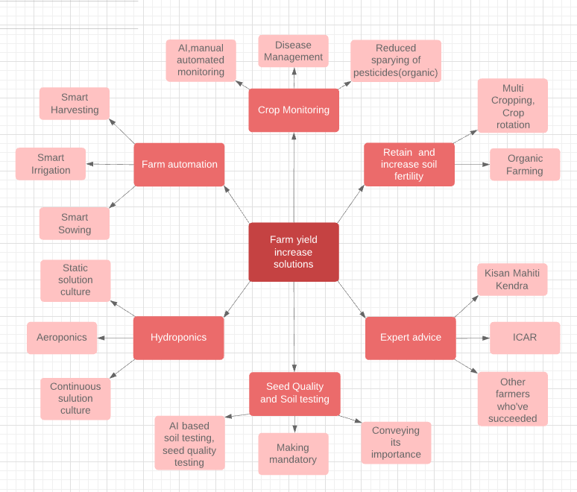
Go, change the world
RV College of
Engineering
Mind Map

Slide 8
RV College of
Engineering
Why this challenge?
Go, change the world
Multi-cropping factor prediction has a major role in retaining the soil fertility and increasing the yield within the land area present. Due to population explosion, it s turning out to be difficult to increase farm land. Due to this flaw in the society retaining the present agricultural land would be wise step.
This concept of multi-cropping and crop rotation is not followed due to the fact that it reduces the farm yield by a small factor. But soil fertility is degraded gradually. Soil fertility being a natural intent of plant’s growth, retaining is of the highest importance.
Once the fertility is degraded, farm would become unfit for cropping.
The former part deals with planning before sowing. Along with this crop growth monitoring is also important. So, second focus of our focus was on Crop monitoring to detect disease.

Slide 9
RV College of
Engineering
Data Analytics
Go, change the world
Consider a black soil region where crops like wheat(monocot), grams(dicot) can be grown. A man has 10 hectare land where he can grow either of them or both of them in some proportion(say x:y). Let us assume that if the soil fertility is 100% there is an yield of 4 tons of wheat per hectare. Growing only wheat reduces the fertility of soil by 10% every year.
Next slide shows the analysis of farmers revenue for growth of wheat.

Slide 10
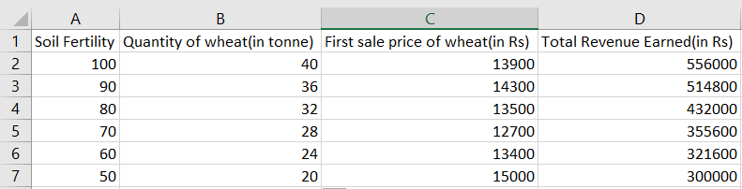
RV College of
Engineering
Data Analytics
Go, change the world

Slide 11
RV College of
Engineering
Data Analytics
Go, change the world
Another farmer of same region grows 3:2 proportion of wheat and Bengal gram. Bengal gram is a dicot, deep rooted crop which fixes atmospheric nitrogen in to soil. This would maintain nitrogen content in the soil. Now, say the remaining nutrients contributing to fertility reduce by 3% a year.(100% soil fertility would yield 2 ton of Bengal gram per hectare)
Next slide shows the revenue analysis of this farmer.

Slide 12
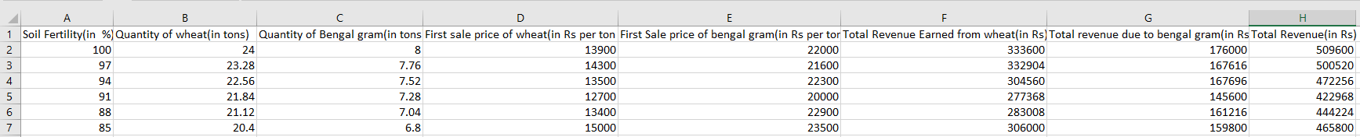
RV College of
Engineering
Data Analytics
Go, change the world

Slide 13
Go, change the world
RV College of
Engineering
Prototyping Tools and Technologies
To prototype our model, we will need the following:
Sensors which would be useful in agricultural IOT like Temperature and humidity sensor, water level sensors, irrigation monitoring sensor etc which are needed for creating datasets.
Microcontroller with ESP8266 module like NODE MCU for creating a Local host as it is cost effective compared to Raspberry PI.
A cloud platform to analyze the real time data and make smart prediction for real time monitoring and resource utilization.
A machine learning model constraint to n(yet to be decided) parameters to create our probabilistic model.
A server coupled with a scalable database as we need to have zonal data partitioned and provide zone specific recommendation for the farmer.

Slide 14
RV College of
Engineering
Methodology (in brief)
Go, change the world
Methodology mainly consists of setting up of IoT nodes in the farm in distributed manner. Collecting various data like humidity, temperature, soil pH etc. This data would be supplemented by these data from past 5 years. The demand and supply are also included. These are used to train AI model.
During the sowing season we borrow the multi-cropping factor for n crops. from the .
The performance of the electronic nodes is also supported by the model.

Slide 15
Go, change the world
RV College of
Engineering
Expected Outcome
Improvement in farmers’ standard of life and increase in farm yield.
Improvement in Producer’s share in Consumer’s Rupee
Increase in contribution of agriculture to Indian economy
India would become self sustained in agriculture and horticulture products
Reduction in number of farmer suicides

Slide 16
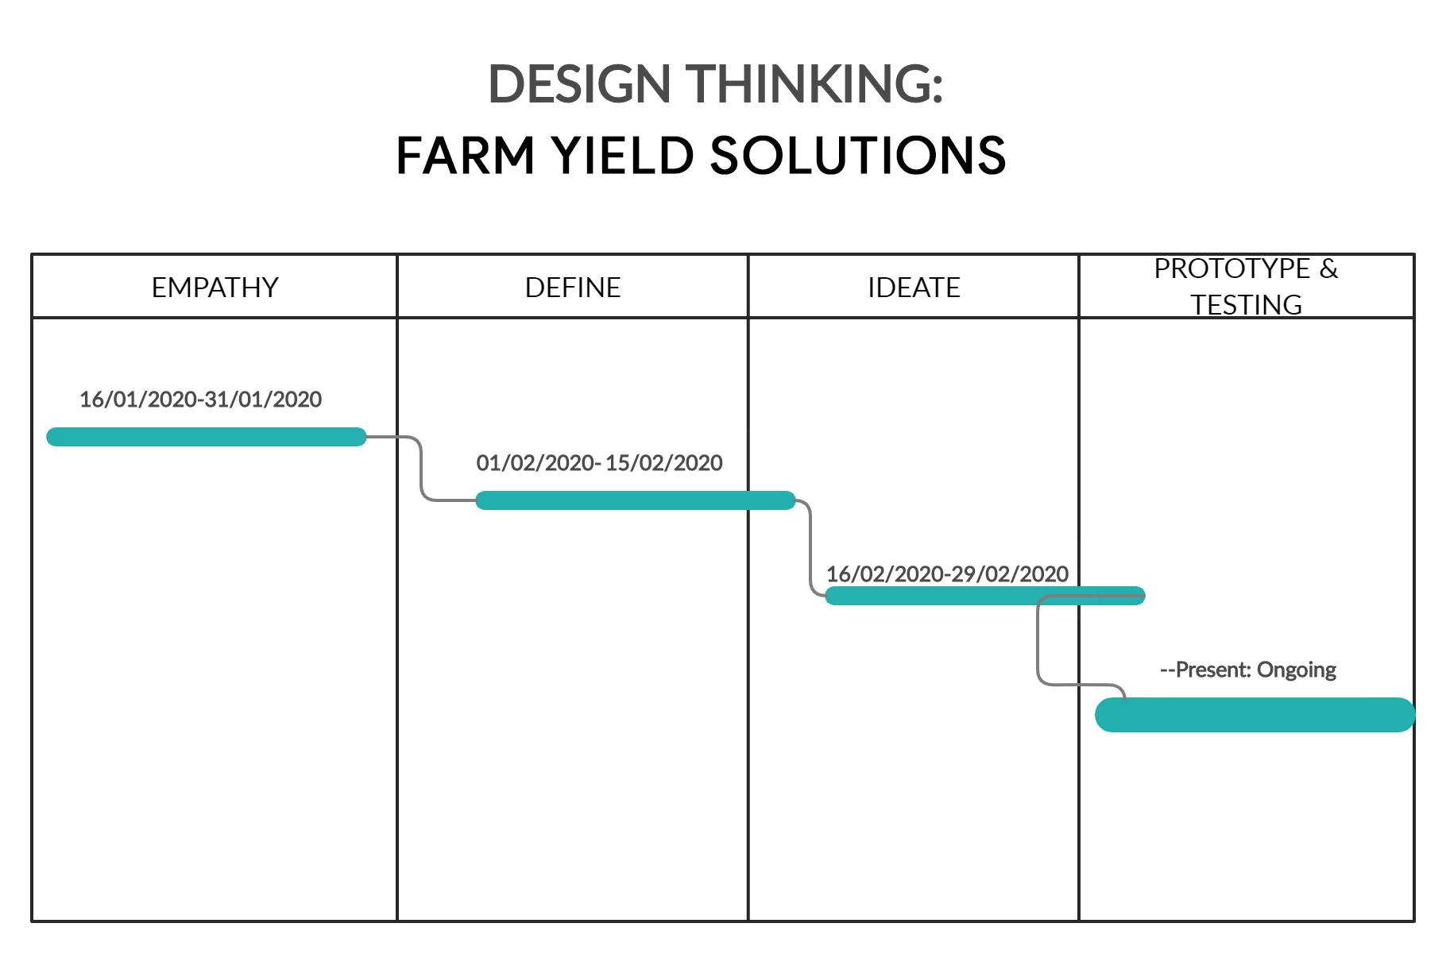
Go, change the world
RV College of
Engineering
Gantt Chart
Forming groups based on common interest.
Exploring a common domain with proper reasoning
Analyzing the contribution of the domain to economy
Extending Empathy
Formulating our subtheme
Defining constraints
Exploring various challenges
Deep-rooting on a specific challenge
Analyzing technical constraints and mapping them with abstract ones

Slide 17
Go, change the world
RV College of
Engineering
References
U.B Sangolkar, Producer’s share in consumer rupee in marketing of fresh banana, International Journal of Commerce and Business Management
Sujeet More, Jimmy Singla , Machine Learning Techniques with IoT in Agriculture, International Journal of Advanced Trends in Computer Science and Engineering.
Mohan Sridharan , Prasanna Gowda, Application of statistical machine learning algorithms in precision agriculture, 7th Asian-Australasian Conference on Precision Agriculture.
Jérôme Treboux , Dominique Genoud, High Precision Agriculture: An Application Of Improved Machine-Learning Algorithms, 2019 6th Swiss Conference on Data Science (SDS)

