Slide 1

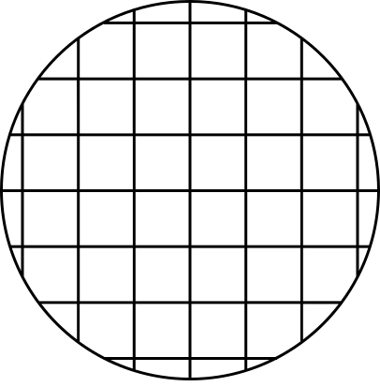


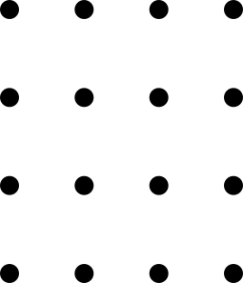
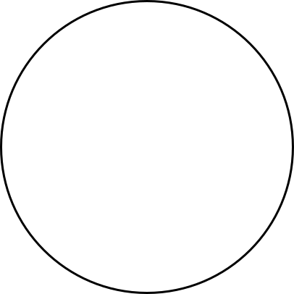
SCIENCESOCIETY_21790
CHOOSING AN OPTIMAL MACHINE LEARNING CLASSIFIER FOR FACIAL RECOGNITION
Authors:
B Pavan Vishnu Sai
Pallikonda Raj Sudarshan
C Gunal
Prof. Rohit Kumar Gupta

Slide 2
Introduction
Flow Chart
Methodology
Implementation
Accuracy
Results
Observation
Conclusion
Table Of Content

Slide 3
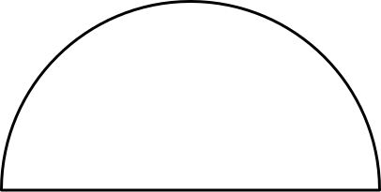
Introduction
Facial recognition is always a top priority in image processing and machine learning. Biometrics, information security, law enforcement, and access control might all benefit from it on one level.
To increase system security and dependability, traditional access control techniques such as keys, PINs, or ID cards are being phased out in favor of facial recognition.
On the other hand, as machine learning has advanced in recent years, new algorithms and computing resources may be developed to cut run time, increase identification accuracy, and examine additional application situations.

Slide 4
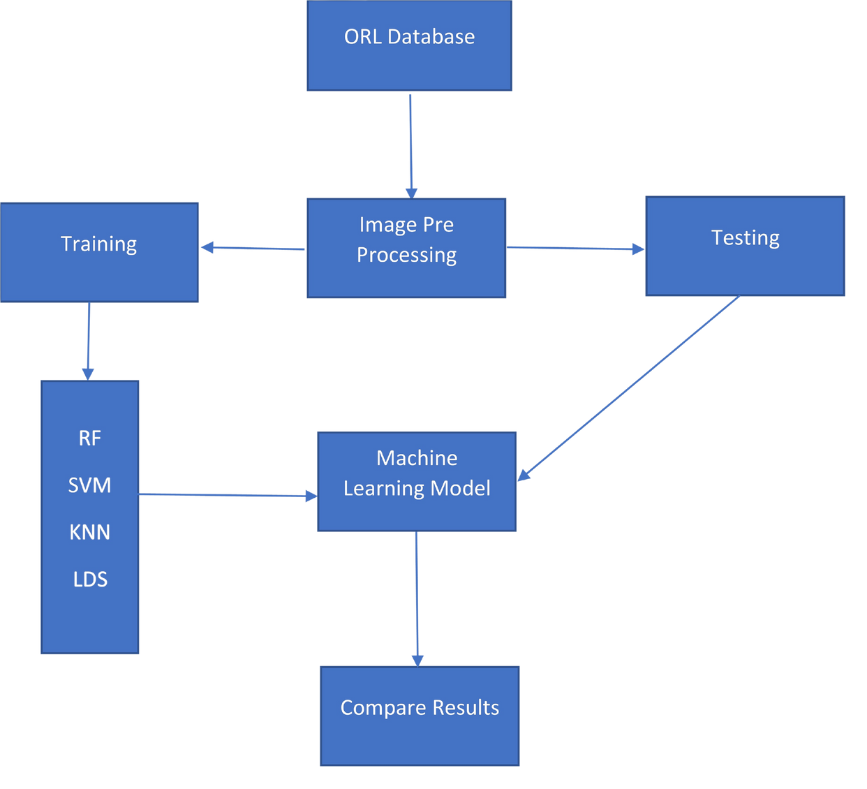
Flow Chart
Methodology of Face Recognition :

Slide 5
Methodology
The ORL faces databases are 40x10, with 40 people and 10 photographs for each. The size of the training and testing data has an impact on detection accuracy.
First, we will import all the libraries cv2, os, NumPy, and matplotlib. pyplot , train_test_split, accuracy_score
Before going to the next process, we must put our images in order. Then we will reshape the dimensions to 80x 80. Then we will assign the dataset to the list. “X_train = list()”
This list is converted to numpy array “X_train1 = np.array(X_train)”
Now the shape will be in 3 dimensional: (287,80,80)
Then we will reshape it to 2 dimensional: (287,80*80) = (287, 6400)
Again, in testing we will assign it to a list and convert it to a NumPy array, here we will make the data reshape (123,80,80). which is in 3D we will reshape to 2D (123,6400).
Performance should be better with more training data and less testing data. In practice, however, the size of training data will always be smaller than that of testing data.

Slide 6
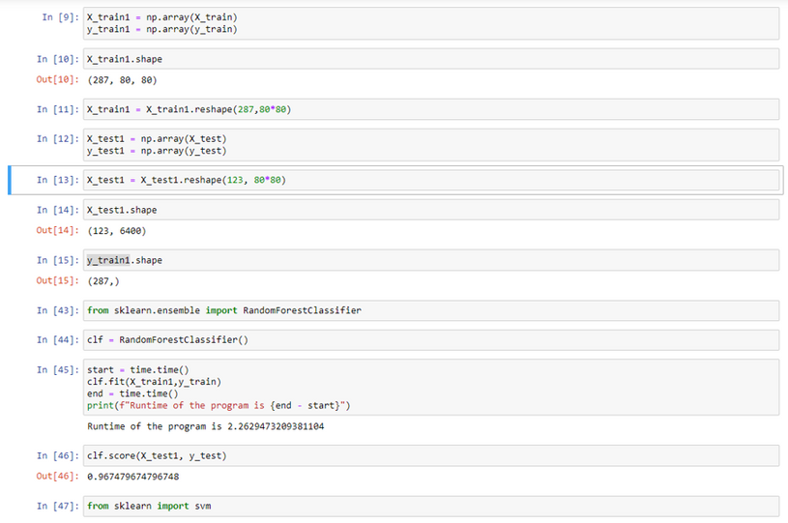
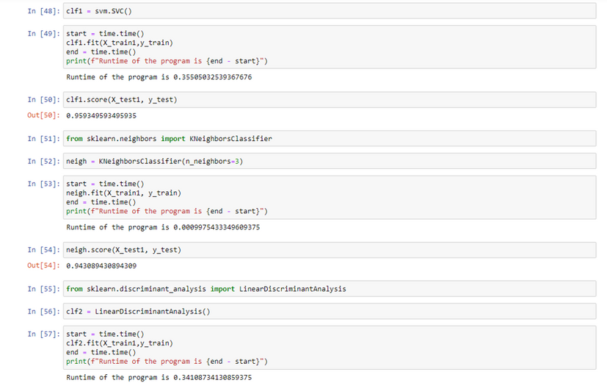
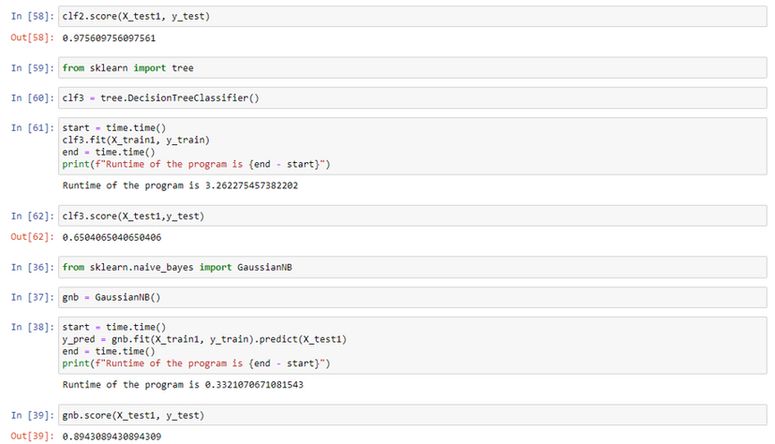
Implementation

Slide 7
Accuracy
Following through the six classifiers, we been through the comparison of:
65%
89%
94%
95%
96%
97%
Decision Tree
GAussianNaiveBayes
KNeighborsClassifier
Support Vector Machine
Random Forest Classifier
LinearDiscriminantAnalysis

Slide 8
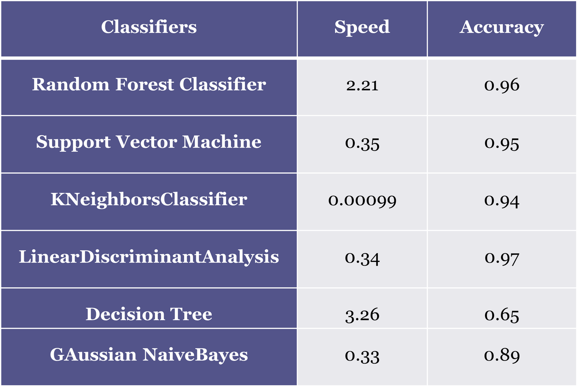
Results

Slide 9
Observation
From the table, we can see that the Decision tree speed is 3.26 which takes more time compared to every classifier also the accuracy is 0.65 which is least accuracy as we can see in the table so we can ignore and GAussianNaiveBayes speed is 0.33 which takes the least time, but the accuracy is 0.89 which is less. If we compare RF from the table, we can see speed is 2.21 which takes a large amount of time, and the accuracy is 0.96 which is good. SVM speed is 0.35 and the accuracy is 0.95 which is good. KNN takes the least time and accuracy is also good. If we compare the LDA speed is 0.34 and the accuracy is 0.97 which is a very less time and very good accuracy
Best to least of classifiers after results :
•LDA
•RF
•SVM
•KNN
•Gaussian Naviebayes
•Decision Tree

Slide 10
Conclusion
This research compares two facial recognition methods. Using the ORL database and six different types of machine learning classifiers, we were able to achieve reliable accuracy in facial recognition at high running speed. LDA is a top-notch reliable system where there is high accuracy and at decently low running speed. In this LDA classifier we get desirable accuracy in facial recognition system at significantly low running speed. On the other hand, we have Random Forest Classifier which also has a high accuracy but at a cost of high running speed which is not feasible. Also 3rd place we can take SVM and KNN. Other machine learning classifications could be used in future studies, and some of them could be combined to create a more complicated system. But these classifiers should operate at low running speed and sustain high recognition accuracy for larger datasets.

Slide 11
End
Thank you

