Slide 1

Seasonal Agriculture Performance
Jangili Pavan Kalyan
CMR Technical Campus
AICTE STU ID:STU672e2d046d44e1731079428

Slide 2

PROBLEM STATEMENT:
Agricultural activities are influenced by seasonal variations in environmental conditions, farming practices, resource availability and market conditions. As a result, agricultural performance may differ from one season to another.
However, raw agricultural data does not clearly explain how agricultural performance changes across seasons or what patterns can be observed in different seasonal conditions.
The problem is to analyze the given agricultural dataset and investigate seasonal differences in agricultural performance by identifying meaningful patterns, trends, relationships and variations within the available data.

Slide 3
Project Description:
.
Developed a Seasonal Agriculture Performance Analysis project using Python to analyze agricultural data across different seasons, regions, and farming conditions. Performed data cleaning, preprocessing, and exploratory data analysis using Pandas and NumPy.
Created visualizations such as pie charts, bar charts, line charts using Matplotlib and pandas to identify seasonal trends, variations, relationships, and outliers.
Derived data-driven insights to understand agricultural performance and support better seasonal planning.

Slide 4

WHO ARE THE END USERS?
End Users:
Farmers
agricultural officers
researchers
government agriculture departments
agricultural consultants
agribusiness organizations

Slide 5

Technology Used:
Programming Language:
Python
Libraries:
Pandas
Numpy
Matplotlib

Slide 6
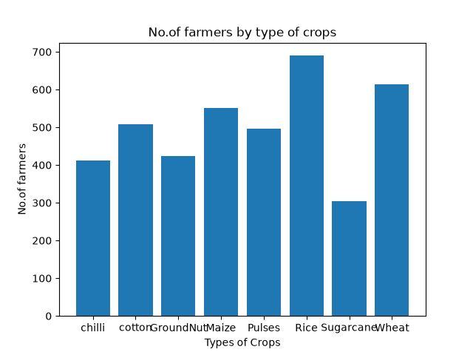
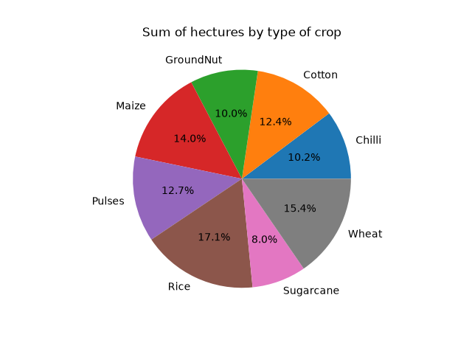
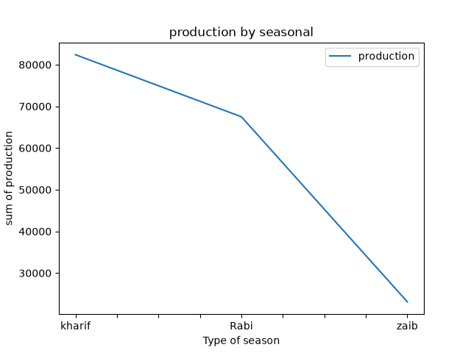
RESULTS:
States,values using pandas:
states values
0 AP 19527.06
1 Gujarat 23586.01
2 Karnataka 23341.30
3 Madhya Pradesh 18667.08
4 Maharastra 22519.83
5 Punjab 25280.82
6 Tamilnadu 19807.58
7 Telangana 20255.16

Slide 7
RESULTS: STATES,VALUES USING PANDAS:
import numpy as np
import pandas as pd
data={
"states":["AP","Gujarat","Karnataka","Madhya Pradesh","Maharastra","punjab","Tamilnadu","Telangana"],
"values":[19527.06,23586.01,23341.3,18667.08,22519.83,25280.82,19807.58,20255.16],
}
df=pd.DataFrame(data)
print(df)

Slide 8
RESULTS: BAR CHART:
import matplotlib.pyplot as plt
x=["chilli","cotton","GroundNut","Maize","Pulses","Rice","Sugarcane","Wheat"]
y=[412,508,424,551,496,690,305,614]
plt.bar(x,y)
plt.title("No.of farmers by type of crops")
plt.xlabel("Types of Crops")
plt.ylabel("No.of farmers")
plt.show()

Slide 9
RESULTS:
PIE CHART:
import matplotlib.pyplot as plt
x=["Chilli","Cotton","GroundNut","Maize","Pulses","Rice","Sugarcane","Wheat"]
y=[3232.34,3916.1,3167.57,4428.05,4002.37,5410.91,2535.26,4860.46]
plt.pie(y,labels=x,autopct="%1.1f%%")
plt.title("Sum of hectures by type of crop")
plt.show()

Slide 10
RESULTS: Line chart:
import pandas as pd
import matplotlib.pyplot as plt
data={
"season":["kharif","Rabi","zaib"],
"production":[82387.61,67498.88,23098.35],
}
df=pd.DataFrame(data)
df.plot(x="season",y="production",kind="line")
plt.title("production by seasonal")
plt.xlabel("Type of season")
plt.ylabel("sum of production")
plt.show()

Slide 11
Future scope:
Machine Learning Integration: Develop models to predict crop yield based on seasonal and environmental factors.
Weather Data Integration: Include real-time rainfall, temperature, and humidity data for improved analysis.
Interactive Dashboard: Develop an interactive dashboard using Power BI or Streamlit for easier monitoring.
Crop Recommendation: Recommend suitable crops based on seasonal and environmental conditions.
Regional Expansion: Extend the analysis to more regions, crops, and farming conditions.
Resource Optimization: Analyze fertilizer, water, and other resource usage to support efficient agricultural planning.
Advanced Prediction: Use historical data to forecast future seasonal agricultural performance.

Slide 12
GitHub Link:
https://github.com/AswiniKumar55/-Seasonal-Agriculture-Performance-Analysis-.git

Slide 13
VOIS Course completion certificate - Course name- Data Visualization

Slide 14
Thank you
The End
.
.

