Slide 1

Budgetwise:
A Financial Driven Personal Budget Management

Slide 2

Presented by
- SAI VENKAT KARNATI
- KANIMUTHU MURUGESAN

Slide 3
Problem Statement:
Managing personal finances can be challenging, particularly for individuals who lack financial literacy or struggle with impulse spending. For example, a young professional might find it difficult to stick to a budget, save for future goals, and avoid accumulating debt. Traditional budgeting tools often require manual input and offer limited insights, leaving users feeling overwhelmed and unsure of how to improve their financial situation. Without clear visibility into their spending habits and financial health, users may struggle to make informed decisions about their money.

Slide 4

Budgetwise: A Flexible Expense Tracking Solution
Budgetwise is a comprehensive expense tracking application that empowers users to seamlessly manage their finances. From intuitive account management to intelligent expense categorization, Budgetwise provides an organized and insightful platform to take control of your spending.

Slide 5
Introducing Budgetwise
User-Friendly Design
Secure User Database
Budgetwise features a clean and intuitive interface, making it easy for users to navigate and track their expenses.
Built on Spring Security, Budgetwise ensures the safety and privacy of user data, providing a reliable and trustworthy platform.

Slide 6
Unique Feature Of Application
Initial Expense Setup: User enters fixed expense details (amount, due date) for the first time.
Automatic Due Date Update: After payment, the due date is automatically updated to the same date next month.
Real-Time Dashboard Reflection: Updated due date and details are immediately visible on the dashboard.
Account Selection for Payment: User is prompted to choose which account to use for processing the payment.
This makes expense management simpler, with automatic updates and flexible payment options.

Slide 7
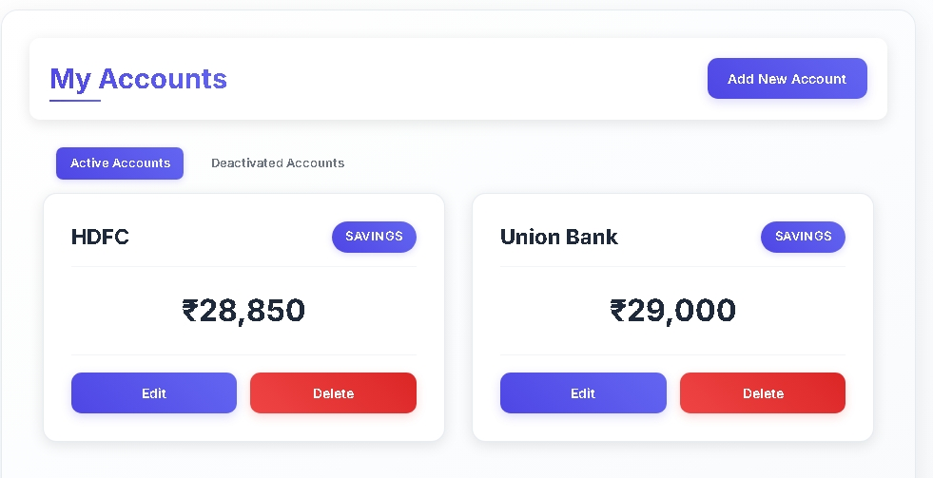
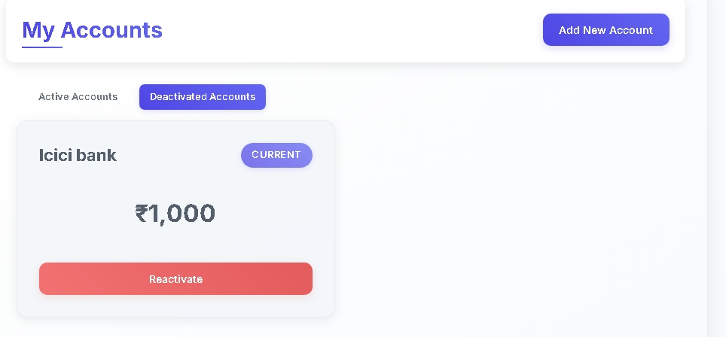
Accounts Microservices
Adding New Accounts
Deactivating and Reactivating Accounts
Users can seamlessly add new accounts to Budgetwise, enabling them to track expenses across multiple financial institutions.
Budgetwise allows users to temporarily deactivate accounts and reactivate them when needed, providing flexibility in managing their financial landscape.

Slide 8

Fixed Expenses and Bill Payments
Managing Fixed Expenses
Streamlined Bill Payments
Budgetwise enables users to set up and track recurring fixed expenses, ensuring timely payments and better financial planning.
With Budgetwise, users can easily process bill payments, reducing the risk of missed or late payments.

Slide 9
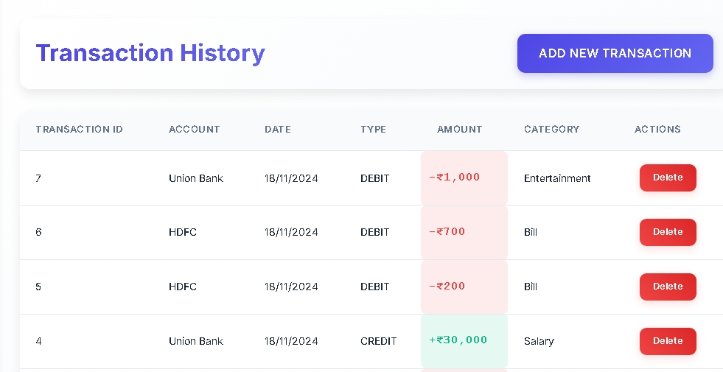
CATEGORY AND TRANSACTION SECTION
Managing Variable Expenses
Transaction History
In Category section the user can view the amount they spent for the different category based on the specific month.
With this section the user can note his transaction history and able to gets the acknowledgement of recent transaction they commit

Slide 10
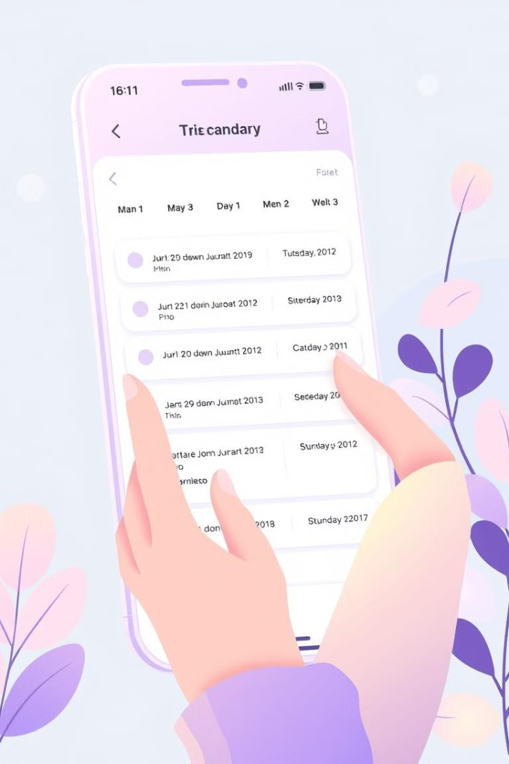
Updating Due Dates
1
Identify Fixed Expense
Users can easily locate and select the fixed expense they need to update.
2
Adjust Due Date
Budgetwise allows users to conveniently change the due date of the fixed expense, ensuring timely payments.
3
Schedule Update
The updated due date is automatically reflected in the user's account, streamlining their financial management.

Slide 11



Enhancing the User Experience
Intelligent Alerts
Budgetwise provides timely notifications to help users stay on top of their expenses and upcoming payments.
Comprehensive Reporting
Budgetwise offers detailed reports and visualizations to help users gain deeper insights into their spending patterns.

Slide 12
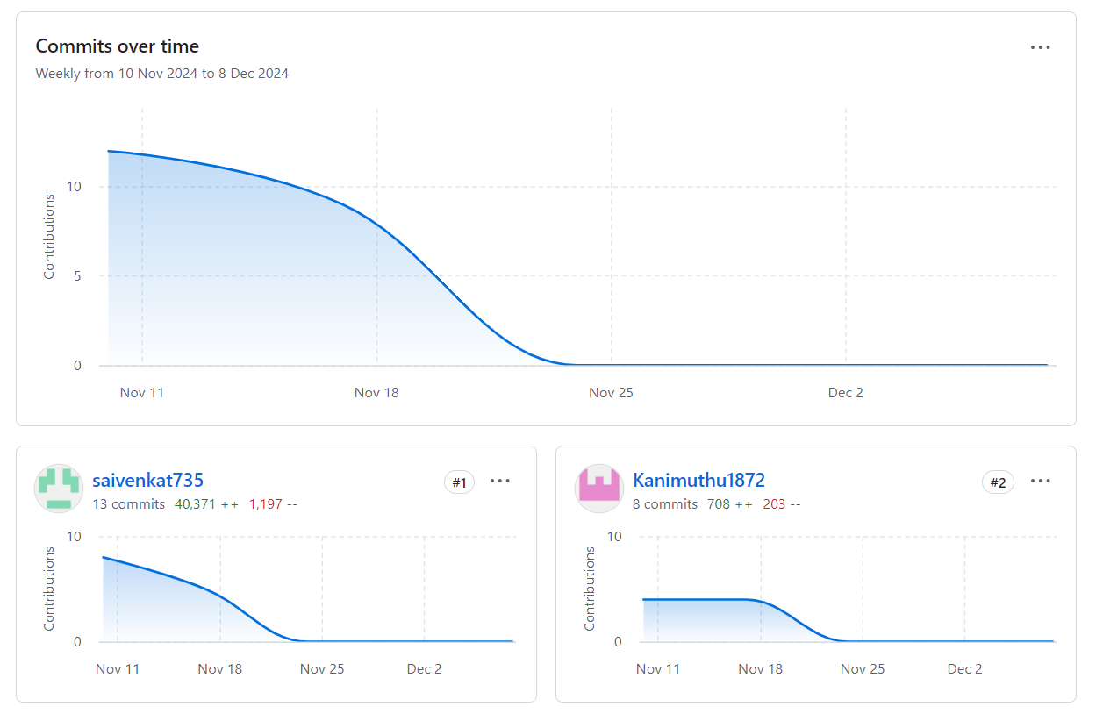
PROJECT MANAGEMENT
(Github Collaboration)

Slide 13
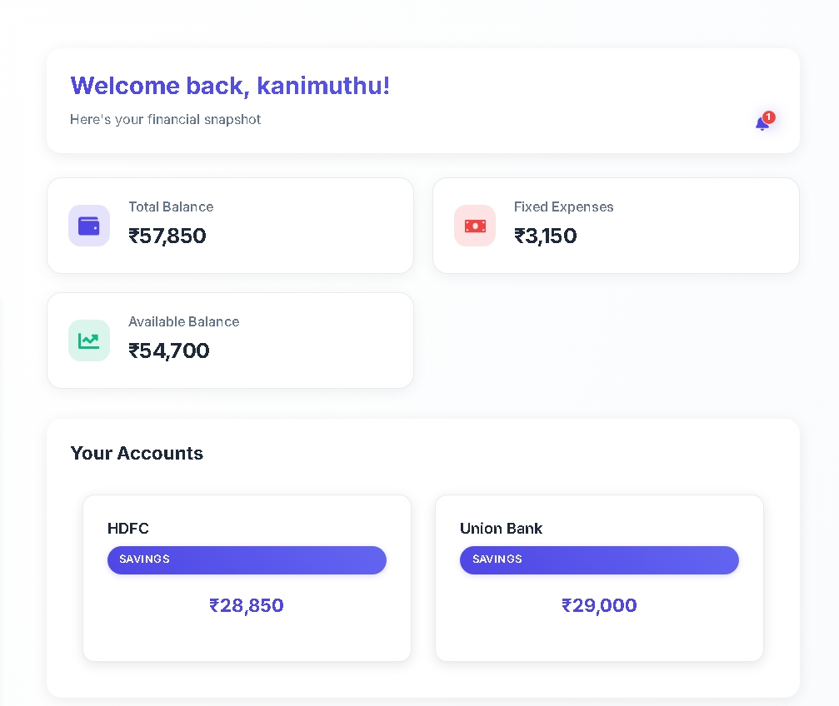
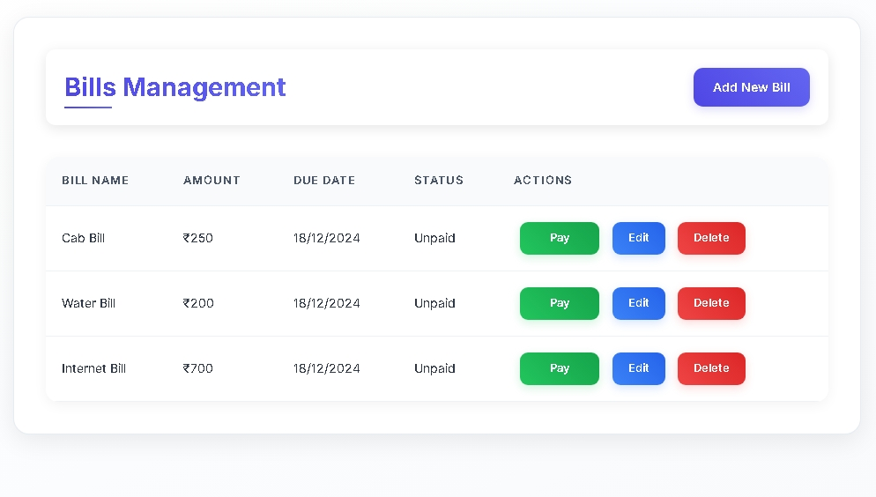
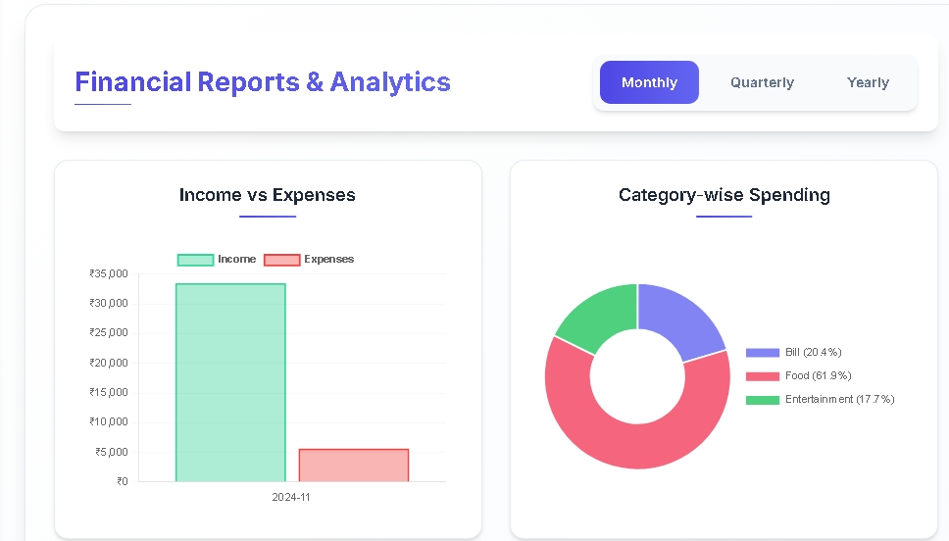
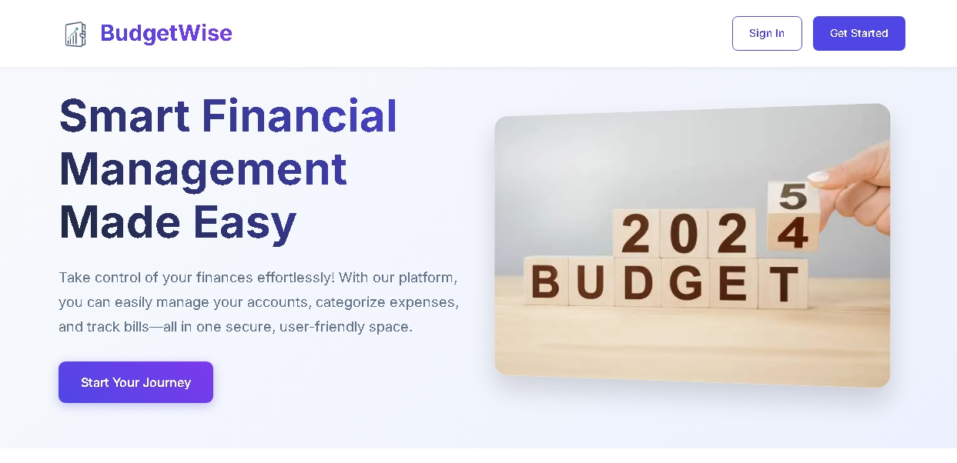
SCREENSHOTS
KM

Slide 14



Next Steps for Budgetwise
Expansion
1
Introduce new features and functionalities to further enhance the Budgetwise experience.
Integration
2
Seamlessly integrate Budgetwise with popular financial services and platforms.
Personalization
3
Offer customizable settings and preferences to cater to individual user needs.

Slide 15

Conclusion
Empowering Users
Continuous Improvement
Budgetwise empowers users to take control of their finances, providing a comprehensive and user-friendly expense tracking solution.
The Budgetwise team is committed to continuously improving the application, introducing new features and enhancements to better serve its users.

