Slide 1
Customized e commerce business model
Group Project – Team IKWT

Slide 2
About us!!
Venkat : I graduated from MIT Manipal with a major in Information Technology in 2021, and I have gained 2.5 years of work experience as a Data Analyst at Merkle Inc.
Pavan : I graduated in Mechanical Engineering from NIT Durgapur in 2020 and I have 2.3 years of work experience as a Systems Engineer at Infosys.
Karthik : I graduated with a degree in Electronics and Communication Engineering, securing the second rank in the department from SRM University in 2022. Following my graduation, I worked as a software engineer at Amdocs for one year.
Rupa : I am a Data-Enthusiast graduated from RISE Engineering college in Computer Science in 2023.
Dinesh : I graduated from KLU with a degree in Electronics and communication Engineering in 2021, and I got 2 years of work experience as a Project Engineer at Wipro.

Slide 3
CUST-IT!!!
One Stop Destination for Customized Clothing and Apparels.
We sell the Clothes, Apparels, and other gifts in a customized fashion desired by the users. Here customers will have the authority to choose their style, color, size, fabric type, text ,any graphic elements to be printed on it (here they can choose the graphics from a wide range of styles we have and can upload the one they adore).
While our business model may not have the same level of scalability as giants like Walmart and Amazon in the initial stages, we are placing a strong emphasis on providing excellent customer support. Our primary objective is to create a base of satisfied and happy customers through our unique approach.

Slide 4
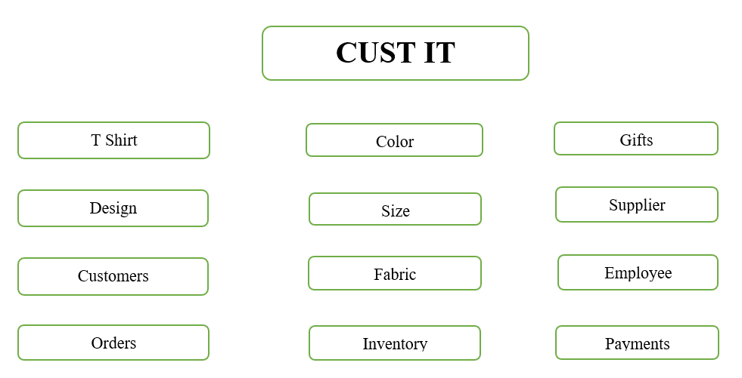
Model Overview

Slide 5
Business Rules
Each customer, employee, gift, T-shirt, supplier, inventory, fabric type, order must have their corresponding unique ID.
Each order must be associated with a valid customer, employee, apparel, and gift.
Each T-shirt must be associated with a valid size, color, design, fabric type, and inventory item.
Customer names((first and last names), Gift, Color, Fabric names cannot be empty.
Each payment must have a unique payment ID and payment method names cannot be empty.
Employee names (first and last) cannot be empty and the hire date of an employee must be provided.
Customer mobile and email must be provided.

Slide 6
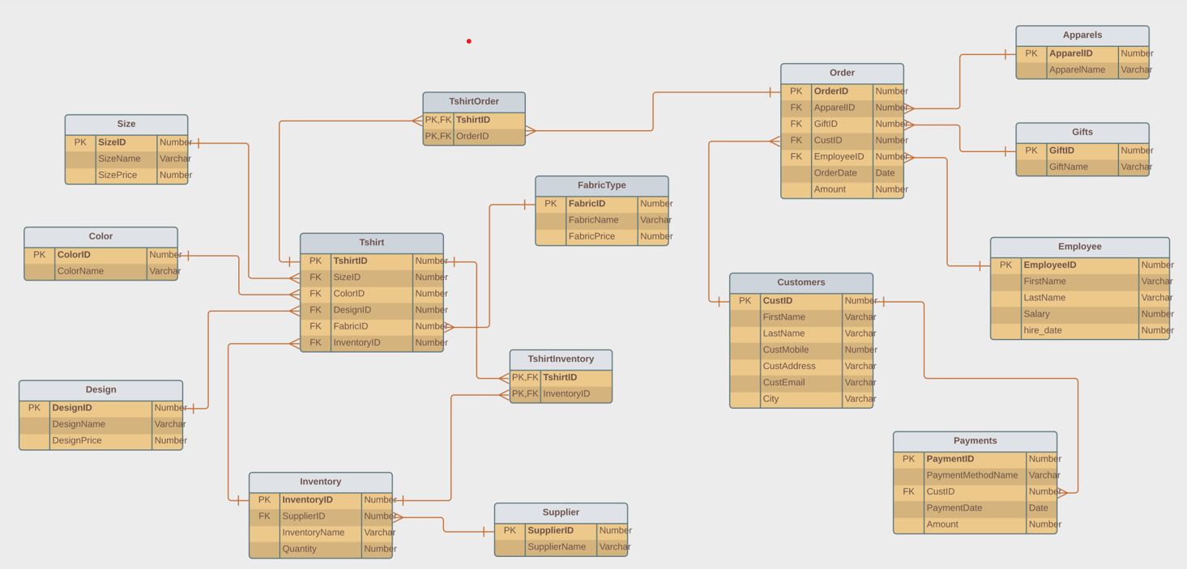
CustIT - ERD

Slide 7
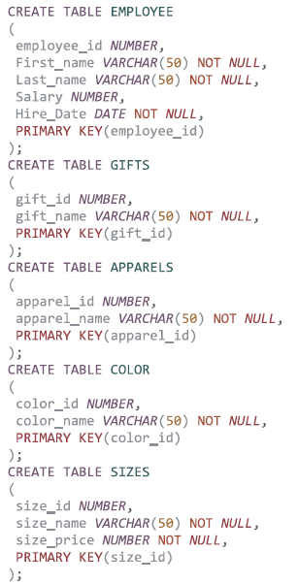
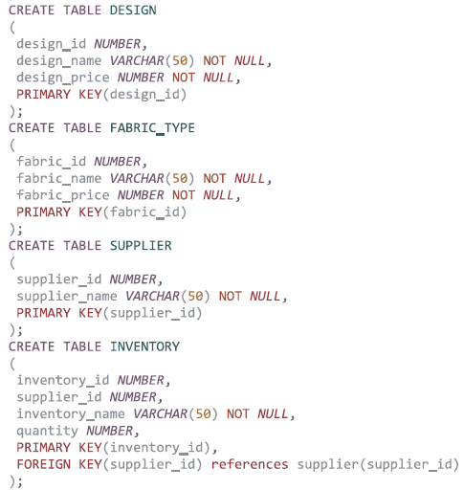
Preview of Table Creation

Slide 8
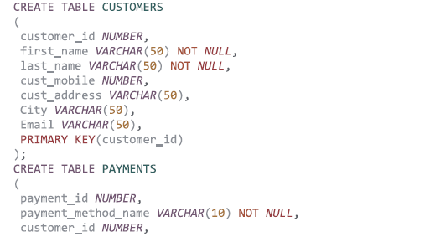
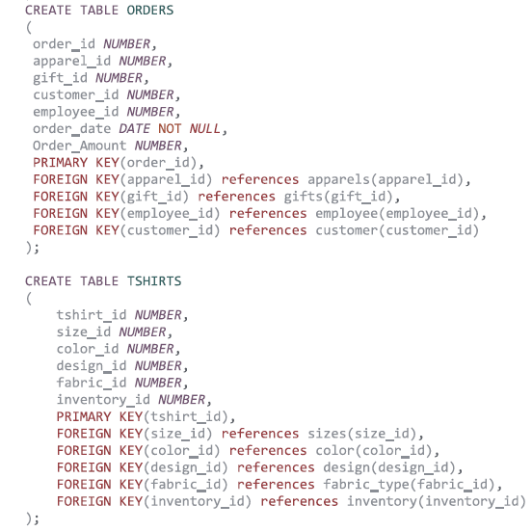

Preview of Table Creation

Slide 9

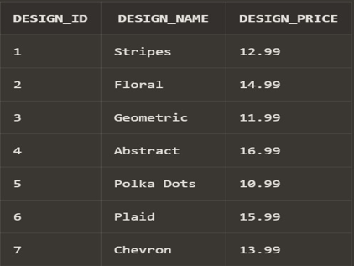
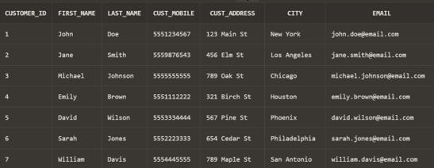
Preview of a Table

Slide 10
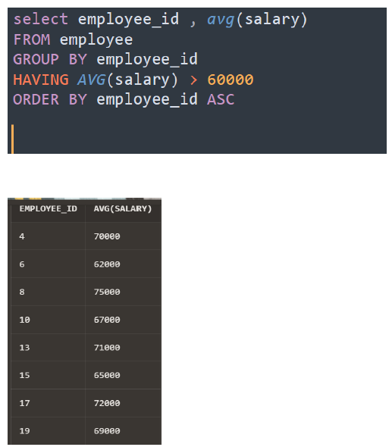
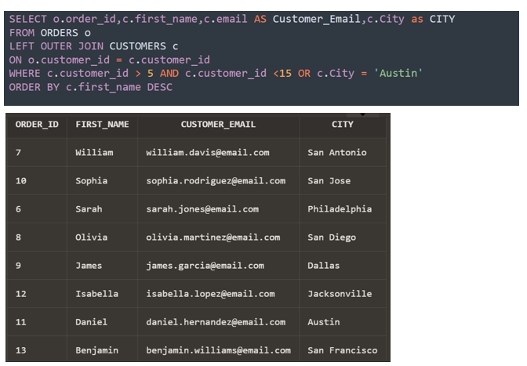
Sample Queries

Slide 11
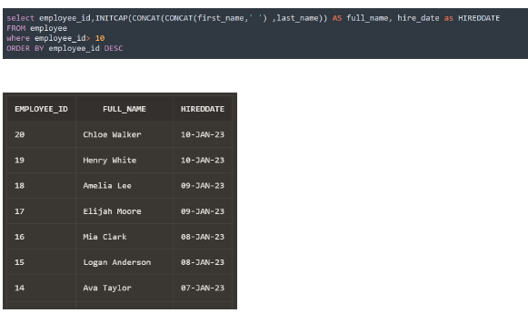
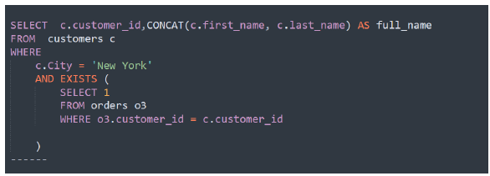
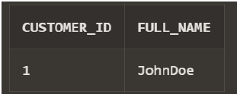
Sample Queries

Slide 12
Data Visualizations

Slide 13
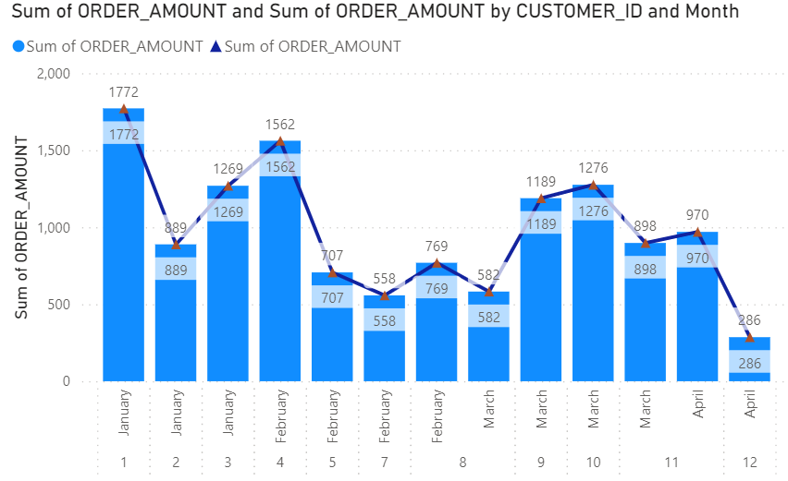
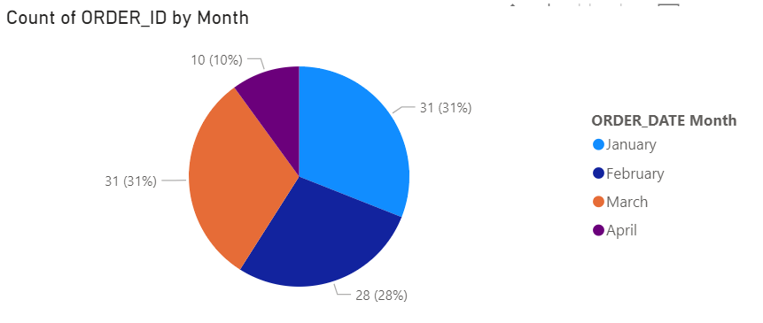
Sum of Order Amount (MONTH-WISE)
Total Percentage of Orders(MONTH-WISE)

Slide 14
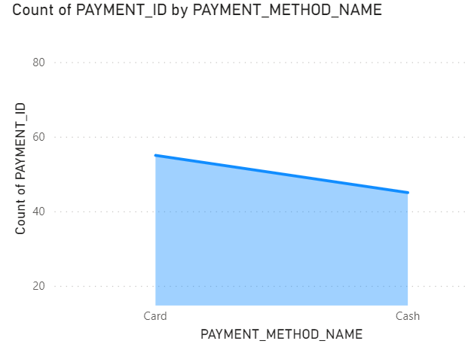
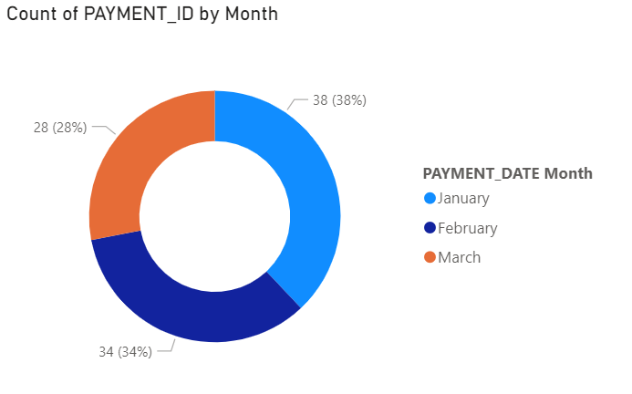
Sum of Payments Done (METHOD-WISE)
Total Percentage of Payments-Made (MONTH-WISE)

Slide 15
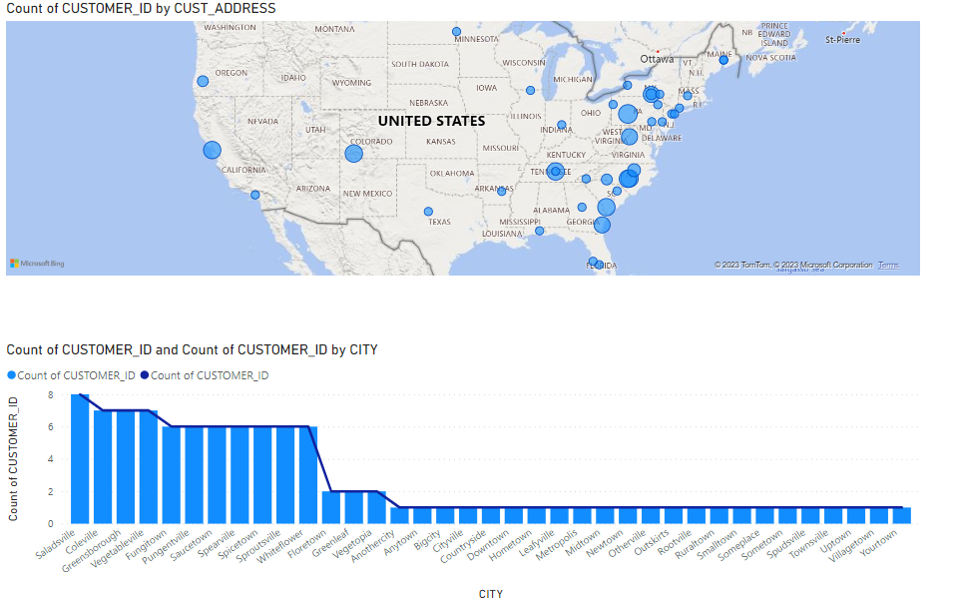
Total No of Customers (CITY & ADDRESS-WISE)

Slide 16
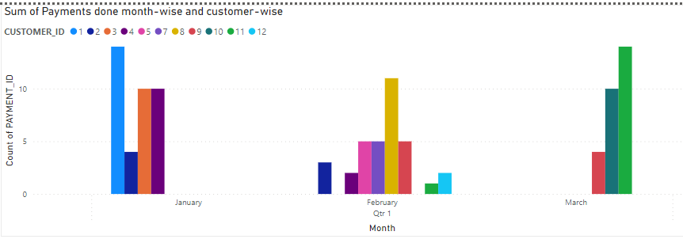
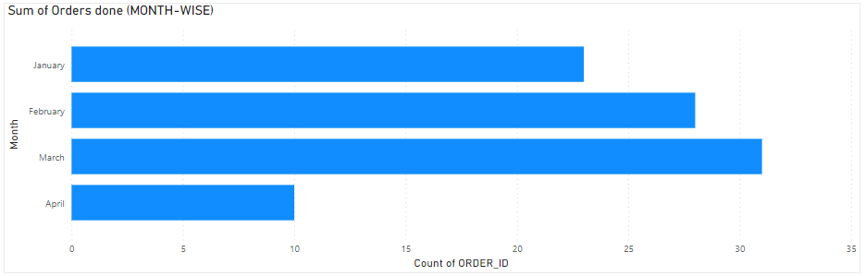
Total Payments-Done (MONTH-WISE & CUSTOMER-WISE)
Total Orders Made (MONTH-WISE)

Slide 17
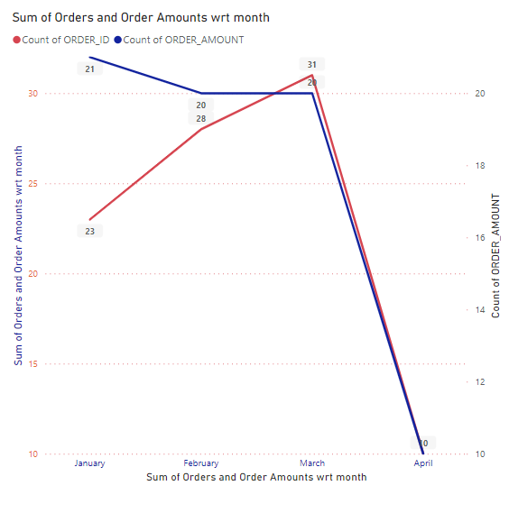
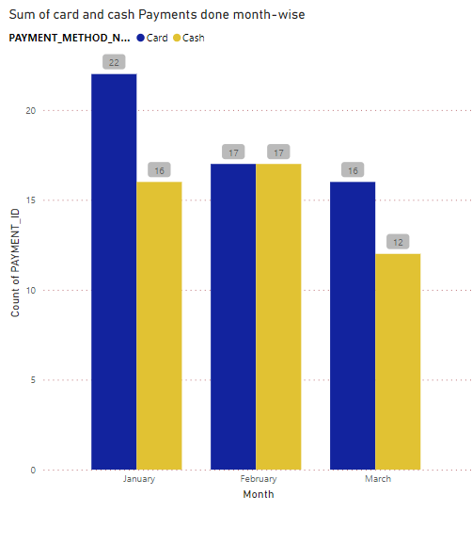
Sum of Orders & Order Amount (MONTH-WISE)
Sum of Card & Cash Payments Made (MONTH-WISE)

Slide 18
Thank You..!!

