Slide 1
Bootstrap 4
Artem Pavliuk

Slide 2
Agenda
What is Bootstrap ?
Grid
Components
Artem Pavliuk

Slide 3
What is Bootstrap ?
Bootstrap is the most popular CSS Framework for developing responsive and mobile-first websites.
Artem Pavliuk

Slide 4
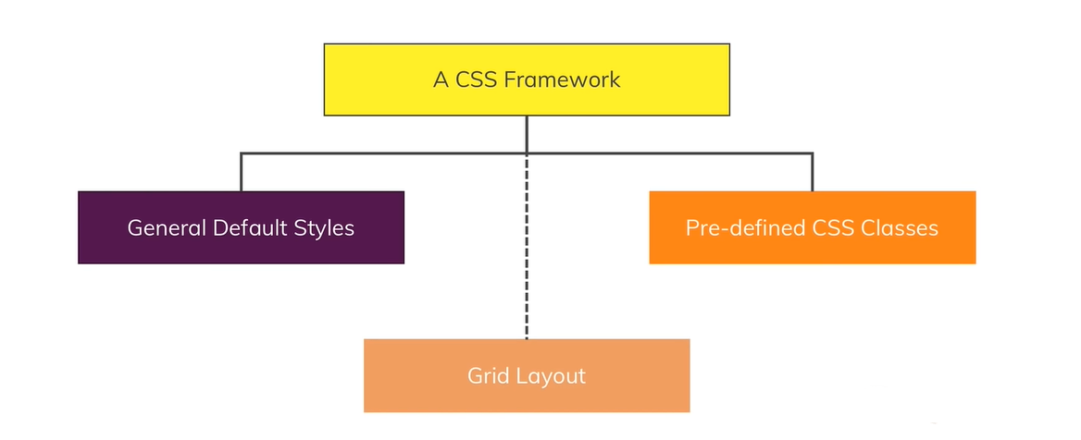
Artem Pavliuk

Slide 5
Quick start
https://getbootstrap.com/docs/4.3/getting-started/
CDN
Download
Package manager
Artem Pavliuk

Slide 6
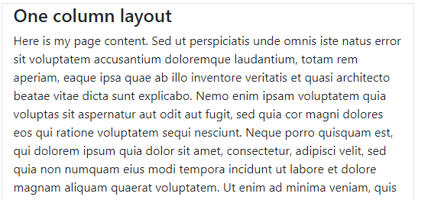
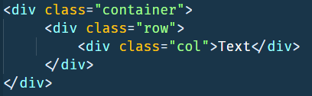
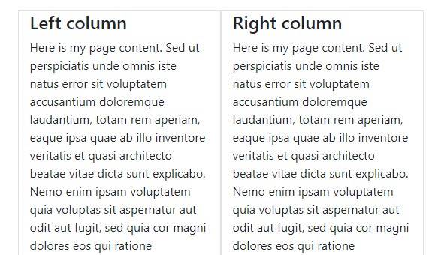
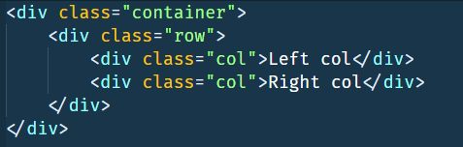
Grid concept
Artem Pavliuk

Slide 7
Best practices
columns are strictly inside the row at the first level of nesting
rows are needed only for placement of columns
rows must be located inside the container
Artem Pavliuk

Slide 8
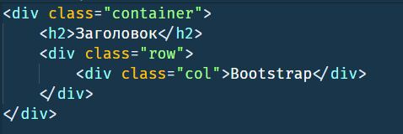
Container
Use .container for a responsive pixel width
.container-fluid for width: 100% across all viewport and device sizes.
Don’t forget about container
Artem Pavliuk

Slide 9

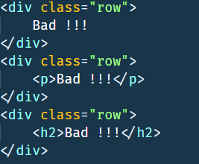
Rows
.row = display:flex
Don’t put content directly in a row
Artem Pavliuk

Slide 10

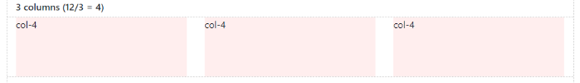

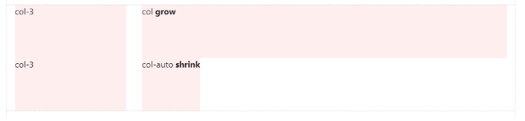
Cols
Artem Pavliuk

Slide 11
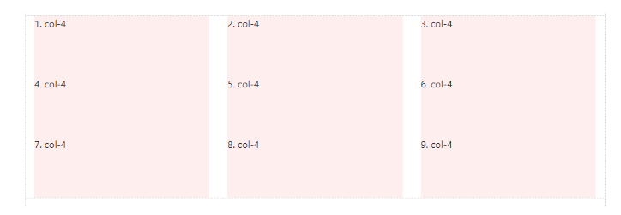
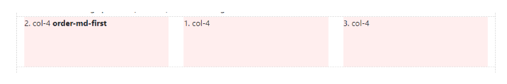
Cols order
Artem Pavliuk

Slide 12
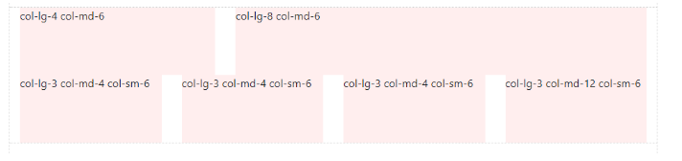
Responsive design
(xs) — extra small — width < 576px;
sm — small — width ≥ 576px;
md — medium — width ≥ 768px;
lg — large — width ≥ 992px;
xl — extra large — width ≥ 1200px.
Artem Pavliuk

Slide 13
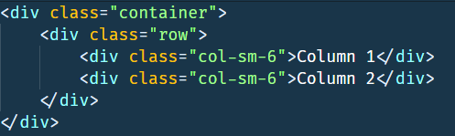
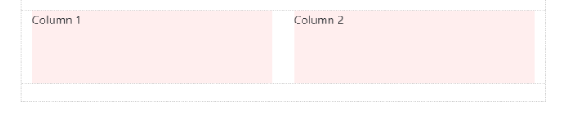
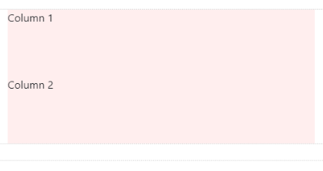
Responsive design
>768px
<768px
Artem Pavliuk

Slide 14
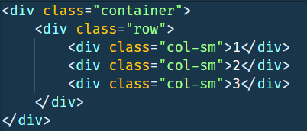
Mobile first
Big breakpoints override smaller ones.
xs(default) > sm > md > lg > xl
Artem Pavliuk

Slide 15
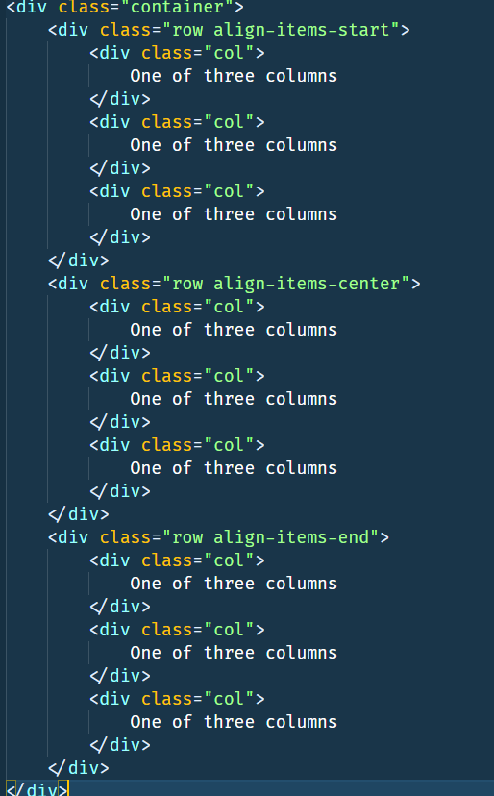
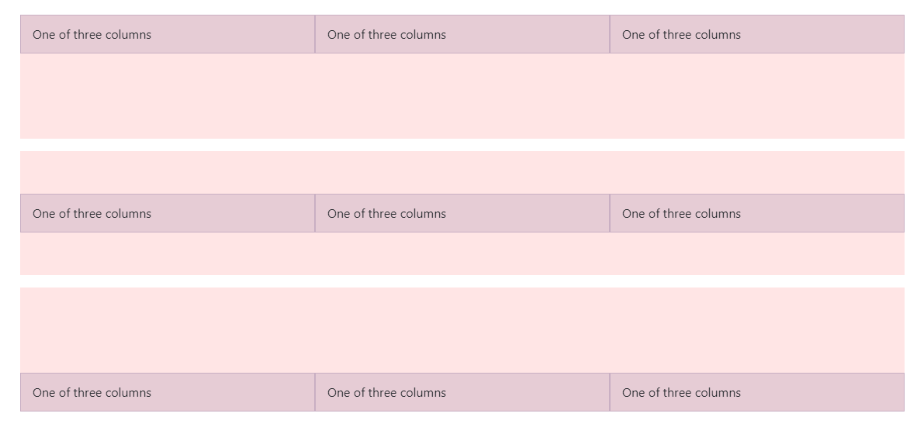
Vertical alignment
align-items-start
align-items-center
align-items-end
Artem Pavliuk

Slide 16
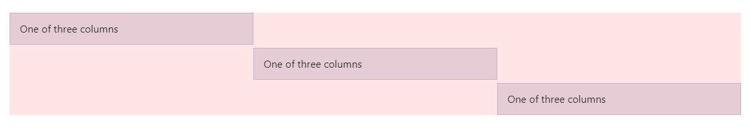
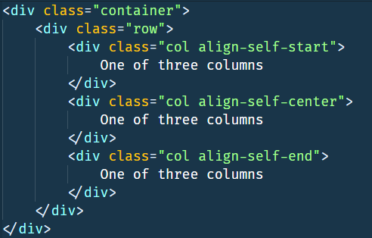
Vertical alignment
Artem Pavliuk

Slide 17
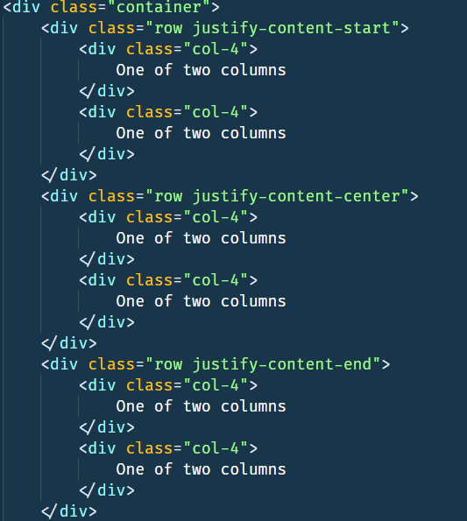
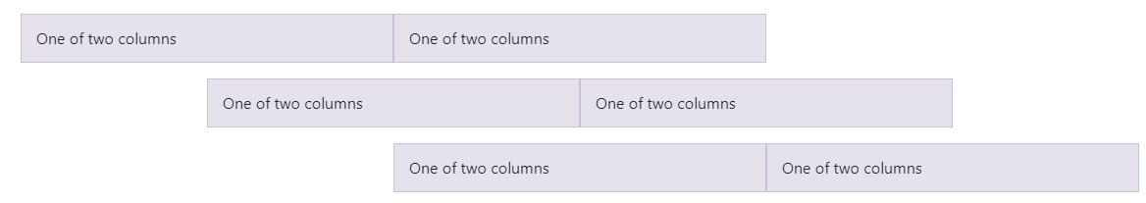
Horizontal alignment
justify-content-start
justify-content-center
justify-content-end
Artem Pavliuk

Slide 18
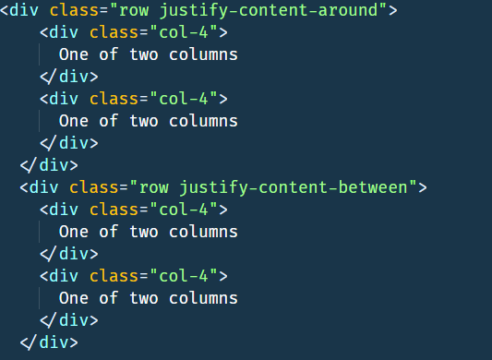
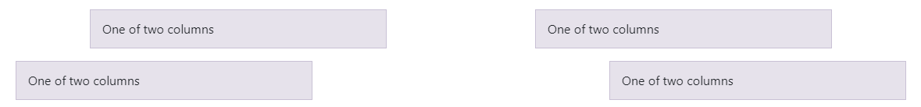
Horizontal alignment
Artem Pavliuk

Slide 19
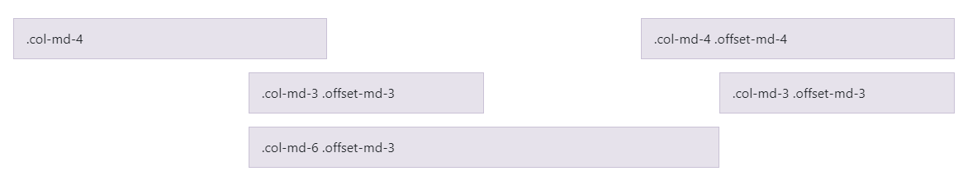
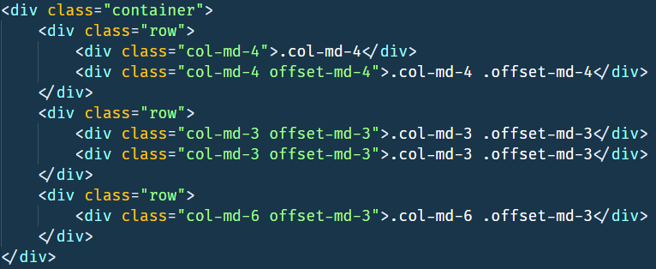
Offset classes
Artem Pavliuk

Slide 20
Components
Artem Pavliuk

Slide 21
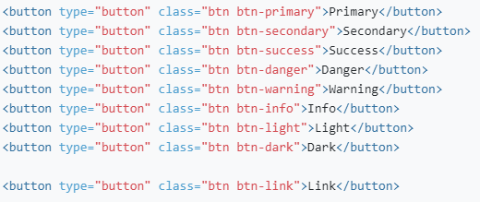
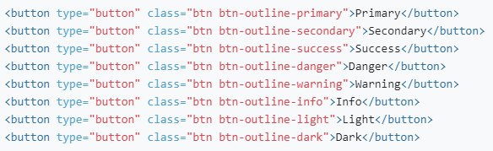
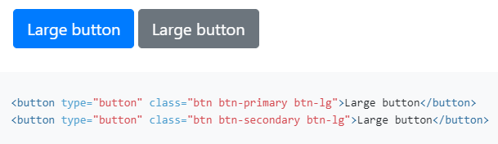
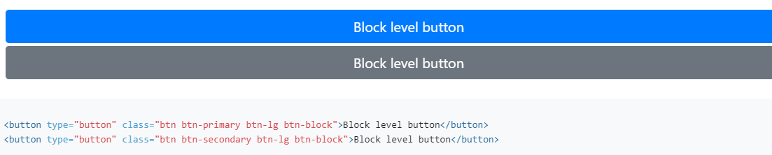
Button
Artem Pavliuk

Slide 22
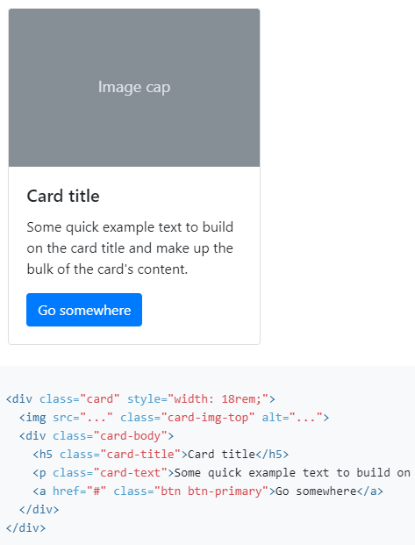
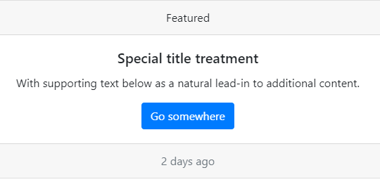
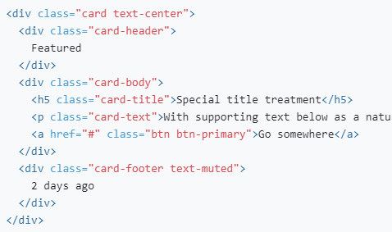
Card
Artem Pavliuk

Slide 23
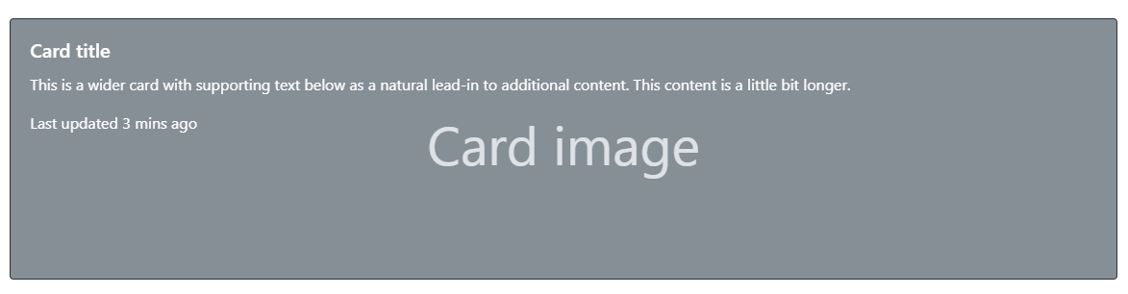
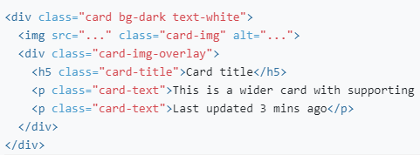
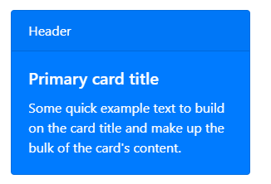
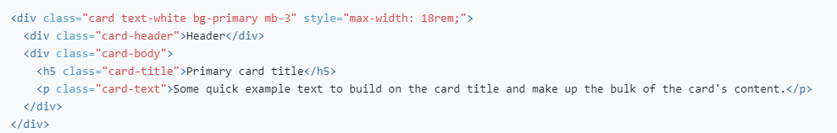
Card
Artem Pavliuk

Slide 24
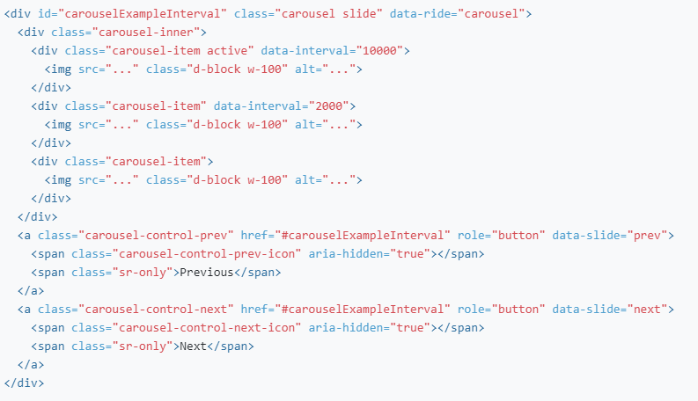

Carousel
Artem Pavliuk

Slide 25
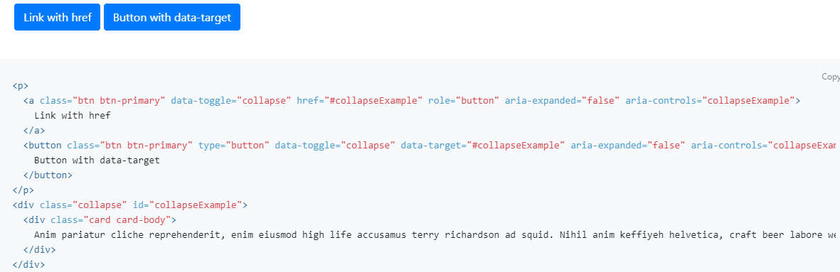
Collapse
Artem Pavliuk

Slide 26
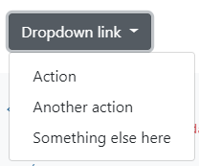
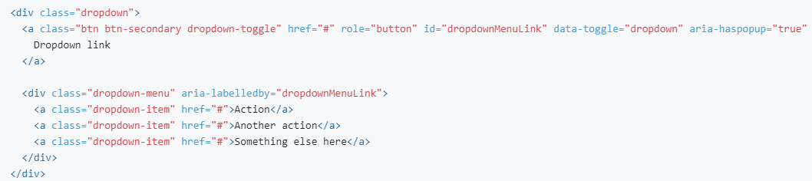
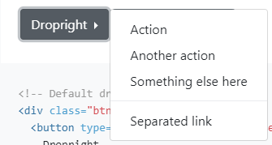
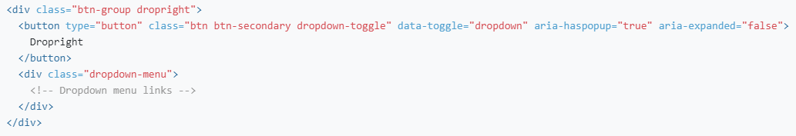
Dropdown
Artem Pavliuk

Slide 27
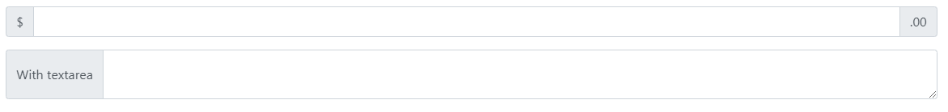
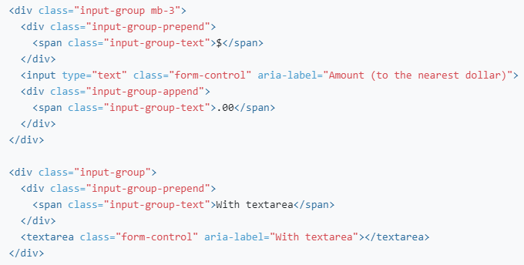
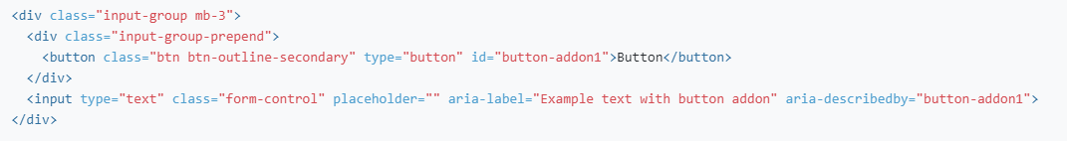
Input
Artem Pavliuk

Slide 28
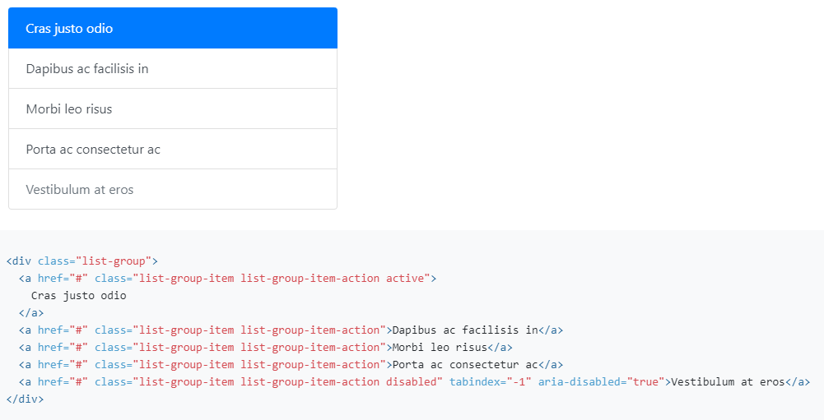

List
Artem Pavliuk

Slide 29

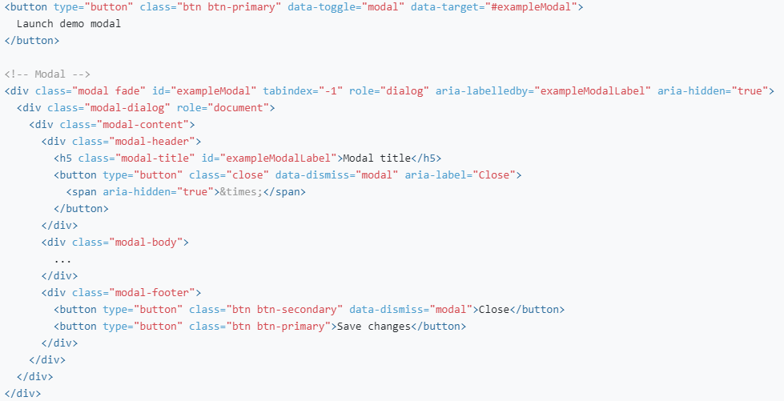
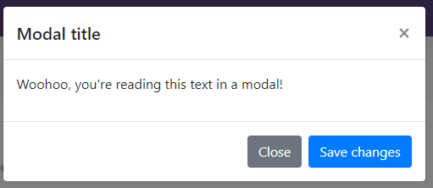
Modal
Artem Pavliuk

Slide 30
Resource
https://getbootstrap.com/
https://www.w3schools.com/bootstrap4/bootstrap_get_started.asp
https://html5css.ru/bootstrap4/default.php
Artem Pavliuk

Slide 31
Thank you
Artem Pavliuk

