Slide 1
Data Structures and Algorithms (CS F211) – T1
Prof.N.L.Bhanu Murthy

Slide 2
Show how to implement a first-in, first-out queue with a priority queue. Show how to implement a stack with a priority queue.

Slide 3
Give an O(n log k)-time algorithm to merge k sorted lists into one sorted list, where n is the total number of elements in all the input lists.

Slide 4
Give a Θ(n)-time non-recursive procedure that reverses a singly linked list of n elements. The procedure should use no more than constant storage beyond that needed for the list itself.

Slide 5
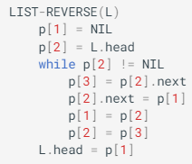
Give a Θ(n)-time non-recursive procedure that reverses a singly linked list of n elements. The procedure should use no more than constant storage beyond that needed for the list itself.

Slide 6
You wish to store a set of n numbers in either a max-heap or a sorted array. For each application below, state which data structure is better, or if it does not matter. Explain your answers.
(a) Want to find the maximum element quickly.
(c) Want to be able to form the structure quickly (after adding or deleting an element)
(d) Want to find the minimum element quickly.

Slide 7
You wish to store a set of n numbers in either a max-heap or a sorted array. For each application below, state which data structure is better, or if it does not matter. Explain your answers.
(a) Want to find the maximum element quickly.
(c) Want to be able to form the structure quickly (after adding or deleting an element)
(d) Want to find the minimum element quickly.
Sol:
(a): it doesn’t matter. As top element in max heap and first element in sorted array will give the max element and both of these operation can be performed in O(1) complexity.
(c): max-heap. By adding or deleting an element the properties of max heap gets disturbed and thereafter a max heap can be constructed with in O(log n) complexity. An insertion or deletion into a sorted array may take O(n) complexity to retain its structure.
(d): sorted array. The last element of sorted array gives minimum element and complexity is O(1). Finding minimum element is max heap is big task can’t be accomplished in constant time.

Slide 8
What are the minimum and maximum number of elements in a heap of height h?
Sol:
The minimum number of elements is 2^{h} and the maximum number of elements is 2^{h+1} − 1.

Slide 9

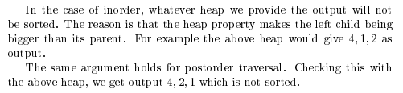
Consider a binary heap. Print the keys as encountered in a preorder travel. Is the output sorted? Justify your answer. Attempt the same question for inorder and postorder travel.

Slide 10
Suppose that instead of doubling the size of an array-based stack when it becomes full, you increase the array size by the following sequence k, 2k, 3k, 4k, . . . for some positive constant k.
(i) If you have an empty stack that uses an array whose initial size is k, and you perform n pushes (assume that n > k), how many resize operations will be performed?

Slide 11
What is the total cost complexity of executing n push operations? Explain your reasoning.
(ii) What is the total cost complexity of executing n push operations? Explain your reasoning.

Slide 12
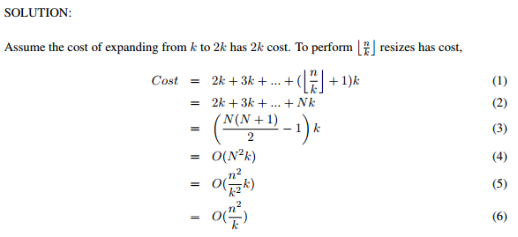
What is the total cost complexity of executing n push operations? Explain your reasoning.
Sol: Floor(n/k) resizes are required.
(ii) What is the total cost complexity of executing n push operations? Explain your reasoning.

Slide 13
Suppose there are n elements in a queue. Reverse all n elements in the queue. (You may use another standard data structure).

Slide 14
Which data structure is optimal in getting curly brackets (like {, }) checked correctly in IDE/Complier?

Slide 15
What data structure is to be used to represent a polynomial?

Slide 16
Thank You!!

