Slide 1
Data Structures and Algorithms (CS F211) – T1
Prof.N.L.Bhanu Murthy

Slide 2
Consider a binary heap. Print the keys as encountered in a preorder travel. Is the output sorted? Justify your answer. Attempt the same question for inorder and postorder travel.

Slide 3

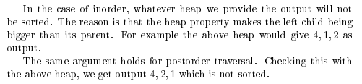
Consider a binary heap. Print the keys as encountered in a preorder travel. Is the output sorted? Justify your answer. Attempt the same question for inorder and postorder travel.

Slide 4
Let H be a heap storing 30 unique integer keys. List all the levels of the heap H that can have the 7th smallest key. Assume that smaller keys have higher priorities.

Slide 5
Let H be a heap storing 30 unique integer keys. List all the levels of the heap H that can have the 7th smallest key. Assume that smaller keys have higher priorities.
Solution: This is min heap. Since at level (height) 0 there is 1 entry, level 1 there are 2 entries, level 2
there are 4 entries, level 3 there are 8 entries, level 4 there are the rest, that is 15 entries, the height of this heap is 4. The 7th smallest key can be anywhere except level 0. Therefore it can be at levels 1, 2, 3, 4

Slide 6
Suppose we have a heap H and we would like to insert elements having distinct values v1 and v2. Let H12 be the heap you get if you insert v1 and then v2 into H, and H21 be the heap you get if you insert v2 and then v1 into H. Give an example of H, v1 and v2 such that H12 is not same as H21.

Slide 7
Suppose we have a heap H and we would like to insert elements having distinct values v1 and v2. Let H12 be the heap you get if you insert v1 and then v2 into H, and H21 be the heap you get if you insert v2 and then v1 into H. Give an example of H, v1 and v2 such that H12 is not same as H21.
Solution:
A heap constructed by inserting 15, and then 10. Take v1=5, v2=20.

Slide 8
Suppose we use a hash function h to hash n distinct keys into an array T of length m.
Assuming simple uniform hashing, what is the expected number of collisions?
More precisely, what is the expected cardinality of {{k, l} : k ≠ l and h(k) = h(l)}?

Slide 9
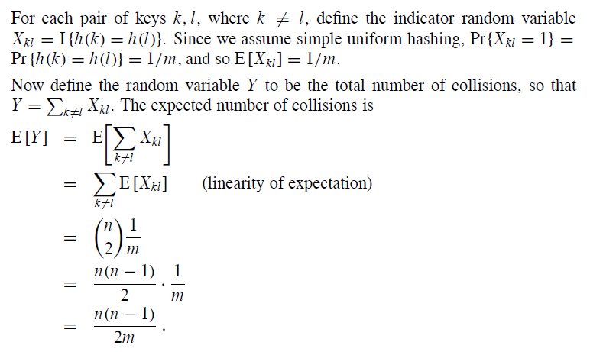
Suppose we use a hash function h to hash n distinct keys into an array T of length m.
Assuming simple uniform hashing, what is the expected number of collisions?
More precisely, what is the expected cardinality of {{k, l} : k ≠ l and h(k) = h(l)}?

Slide 10
Consider an array A[1 ….n] constructed by the following process: we start with n distinct elements, sort them, and then rotate the array k steps to the right. For example, we might start with the sorted array [1, 4, 5, 9, 10], and rotate it right by k = 3 steps to get [5, 9, 10, 1, 4]. Give an O(log n) time algorithm that finds and returns the position of a given element in array A, or returns none if x is not in A. Your algorithm is given array A[1 … n] but does not know k.

Slide 11
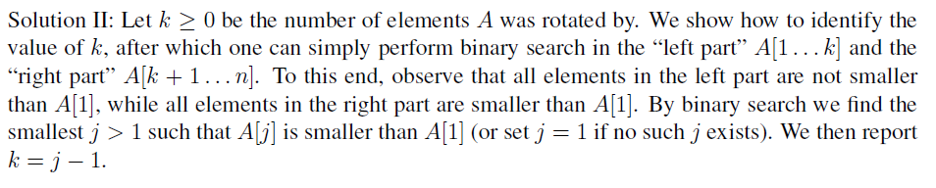
Consider an array A[1 ….n] constructed by the following process: we start with n distinct elements, sort them, and then rotate the array k steps to the right. For example, we might start with the sorted array [1, 4, 5, 9, 10], and rotate it right by k = 3 steps to get [5, 9, 10, 1, 4]. Give an O(log n) time algorithm that finds and returns the position of a given element in array A, or returns none if x is not in A. Your algorithm is given array A[1 … n] but does not know k.

Slide 12
An unsuccessful search takes expected time Θ(1+α).
Any key not already in the table is equally likely to hash to any of the m slots.
To search unsuccessfully for any key k, need to search to the end of the list T[h(k)], whose expected length is α.
Adding the time to compute the hash function, the total time required is Θ(1+α).

Slide 13
A successful search takes expected time Θ(1+α).
Proof:
The probability that a list is searched is proportional to the number of elements it contains.
Assume that the element being searched for is equally likely to be any of the n elements in the table.
The number of elements examined during a successful search for an element x is 1 more than the number of elements that appear before x in x’s list.
  These are the elements inserted after x was inserted.
Goal:
  Find the average, over the n elements x in the table, of how many elements were inserted into x’s list after x was inserted.

Slide 14
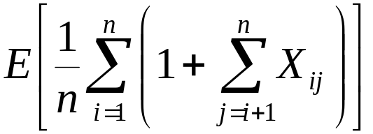
Proof (contd):
Let x_{i} be the i^{th} element inserted into the table, and let k_{i} = key[x_{i}].
Define indicator random variables X_{ij} = I{h(k_{i}) = h(k_{j})}, for all i, j.
Simple uniform hashing ⇒ Pr{h(k_{i}) = h(k_{j})} = 1/m
⇒ E[X_{ij}] = 1/m.
Expected number of elements examined in a successful search is:

Slide 15
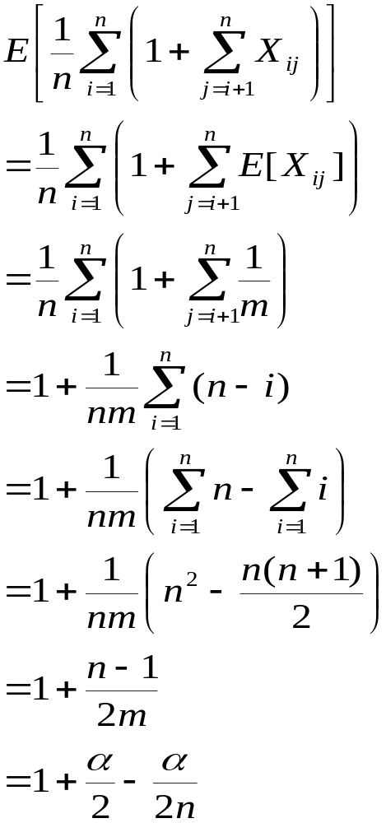
(linearity of expectation)
Expected total time for a successful search = Time to compute hash function + Time to search
= O(2+α/2 – α/2n) = O(1+ α).

Slide 16
Suppose we have a hash table with N buckets, currently containing n entries. Suppose that instead of a linked list, each bucket is implemented as a binary search tree. Give the worst and best case time complexity of adding an entry to this hash table.
Solution: Best case happens when we insert into an empty bucket, and this is O(1) time. Worst case is when we insert in a bucket that has all n entries. Worst case insertion into a BST is O(n) so worst case is O(n).

Slide 17
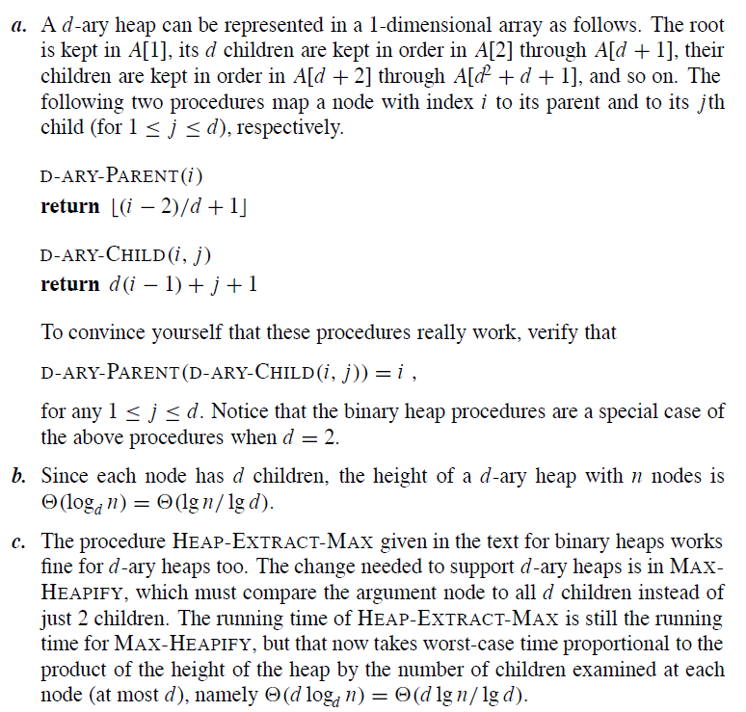
A d-ary heap is like a binary heap, but (with one possible exception) non-leaf nodes have d children instead of 2 children.
(i). How would you represent a d-ary heap in an array?
(ii). What is the height of a d-ary heap of n elements in terms of n and d?
(iii). Give an efficient implementation of EXTRACT-MAX in a d-ary max-heap. Analyze its running time in terms of d and n.

Slide 18
Thank You!!

