Slide 1
Data Structures and Algorithms (CS F211) – T1
Prof.N.L.Bhanu Murthy

Slide 2
Suppose we use a hash function h to hash n distinct keys into an array T of length m.
Assuming simple uniform hashing, what is the expected number of collisions?
More precisely, what is the expected cardinality of {{k, l} : k ≠ l and h(k) = h(l)}?

Slide 3
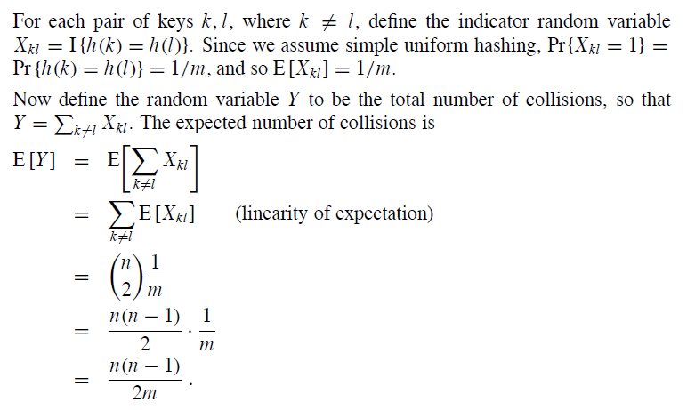
Suppose we use a hash function h to hash n distinct keys into an array T of length m.
Assuming simple uniform hashing, what is the expected number of collisions?
More precisely, what is the expected cardinality of {{k, l} : k ≠ l and h(k) = h(l)}?

Slide 4
Consider an array A[1 ….n] constructed by the following process: we start with n distinct elements, sort them, and then rotate the array k steps to the right. For example, we might start with the sorted array [1, 4, 5, 9, 10], and rotate it right by k = 3 steps to get [5, 9, 10, 1, 4]. Give an O(log n) time algorithm that finds and returns the position of a given element in array A, or returns none if x is not in A. Your algorithm is given array A[1 … n] but does not know k.

Slide 5
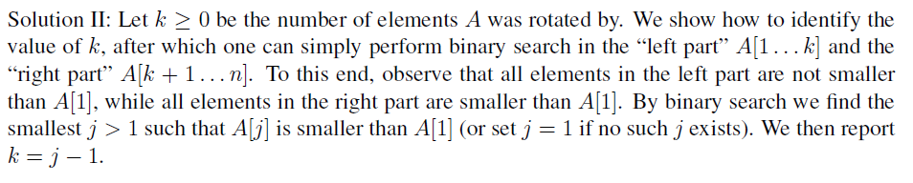
Consider an array A[1 ….n] constructed by the following process: we start with n distinct elements, sort them, and then rotate the array k steps to the right. For example, we might start with the sorted array [1, 4, 5, 9, 10], and rotate it right by k = 3 steps to get [5, 9, 10, 1, 4]. Give an O(log n) time algorithm that finds and returns the position of a given element in array A, or returns none if x is not in A. Your algorithm is given array A[1 … n] but does not know k.

Slide 6
Problem 1
Show that an n-element heap has height lg n
Problem 2
Where in a max-heap might the smallest element reside, assuming that all elements are distinct?

Slide 7

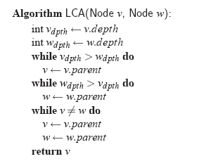

Slide 8
Consider a binary heap containing n numbers (the root stores the greatest number). You are given a positive integer k < n and a number x. You have to determine whether the kth largest element of the heap is greater than x or not. Your algorithm must take O(k) time. You may use O(k) extra storage.

Slide 9
Consider a binary heap containing n numbers (the root stores the greatest number). You are given a positive integer k < n and a number x. You have to determine whether the kth largest element of the heap is greater than x or not. Your algorithm must take O(k) time. You may use O(k) extra storage.
Solution: I think you are trying to find the kth largest element in the heap in O(k) time in order to solve this problem. But actually, you need not find the kth largest element in the heap to solve this problem. You will be able to solve the problem if you are able to find whether the number of elements in the heap which are greater than x are more/less/equal to k . Now exploit the definition of the heap, to do this task inO(k) time. Note that you have extra O(k) storage space to use.

Slide 10

Suppose we have a hash table with 2n slots with collisions resolved by chaining, and suppose that n/8 keys are inserted into the table. Assume each key is equally likely to be hashed into each slot (simple uniform hashing). What is the expected number of keys for each slot? Justify your answer.

Slide 11
Design an algorithm that takes fewer than 2n - 3 comparisons to find the two smallest elements(first and second smallest elements) in an array of length n?
Any algorithm that takes greater than or equal to 2n -3 comparisons will not be considered for evaluation.

Slide 12
Consider the modified binary search algorithm so that it splits the input not into two sets of almost-equal sizes, but into three sets of sizes approximately one-third. Write down the recurrence for this ternary search algorithm and the asymptotic complexity of this algorithm.

Slide 13

Consider the modified binary search algorithm so that it splits the input not into two sets of almost-equal sizes, but into three sets of sizes approximately one-third. Write down the recurrence for this ternary search algorithm and the asymptotic complexity of this algorithm.
For ternary search we make two comparisons on elements which partition the list into three sections with roughly n=3 elements and recurse on the appropriate partition.

Slide 14
Consider another variation of the binary search algorithm so that it splits the input not only into two sets of almost equal sizes, but into two sets of sizes approximately one-third and two-thirds. Write down the recurrence for this search algorithm and the asymptotic complexity of this algorithm.

Slide 15
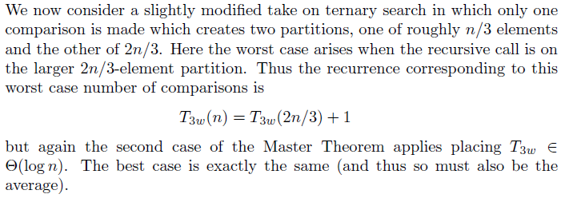
Consider another variation of the binary search algorithm so that it splits the input not only into two sets of almost equal sizes, but into two sets of sizes approximately one-third and two-thirds. Write down the recurrence for this search algorithm and the asymptotic complexity of this algorithm.

Slide 16
There are 25 horses which runs at different speed, and you have to find out the top three horses, in one race you can race not more than 5 horses, find the no. of races required minimum.
The answer is 7.
First 5 races: divide 25 horses into 5 groups and that gives you 5 winners
now race 5 of them that will tell u which two are the bottom most group.
Reject them
Now consider first 3 groups
the horse that came 3rd ; his group can only bid for 3rd place so we take him for next level.
the horse that came 2nd; his group can bid for 2& 3rd spots we take 2 from this group.
the horse that came first ; his group can bid for 1,2,3rd place; but we have already got our first; so we need only to take 2 from this group
so that leave us with 5 horses; Race them u get ur top 3

Slide 17
There are 25 horses which runs at different speed, and you have to find out the top three horses, in one race you can race not more than 5 horses, find the no. of races required minimum.

Slide 18
There are 25 horses which runs at different speed, and you have to find out the top three horses, in one race you can race not more than 5 horses, find the no. of races required minimum.
The answer is 7.
First 5 races: divide 25 horses into 5 groups and that gives you 5 winners
now race 5 of them that will tell u which two are the bottom most group.
Reject them
Now consider first 3 groups
the horse that came 3rd ; his group can only bid for 3rd place so we take him for next level.
the horse that came 2nd; his group can bid for 2& 3rd spots we take 2 from this group.
the horse that came first ; his group can bid for 1,2,3rd place; but we have already got our first; so we need only to take 2 from this group
so that leave us with 5 horses; Race them u get ur top 3

Slide 19
Assume you have an array A[1..n] of n elements. A majority element of A is any element occurring in more than n/2 positions (so if n = 6 or n = 7, any majority element will occur in at least 4 positions). Assume that elements cannot be ordered or sorted, but can be compared for equality. (You might think of the elements as chips, and there is a tester that can be used to determine whether or not two chips are identical.) Design an efficient divide and conquer algorithm to find a majority element in A (or determine that no majority element exists). Aim for an algorithm that does O(n log n) equality comparisons between the elements.

Slide 20

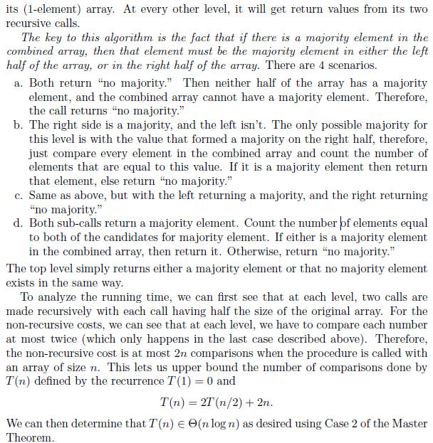

Slide 21
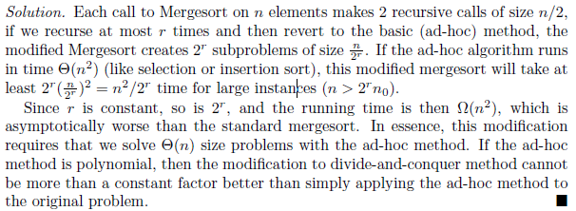
Consider the following variation on Mergesort for large values of n. Instead of recursing until n is sufficiently small, recur at most a constant r times, and then use insertion sort to solve the 2^{r} resulting subproblems. What is the (asymptotic) running time of this variation as a function of n?

Slide 22
A program, Prog1, written by one of the programmer in an IT organization uses an implementation of the sequence ADT ( data structure like an array, linked list) as its main component. It performs atRank, insertAtRank and remove operations in some unspecified order. It is known that Prog1 performs n2 atRank operations, 2n insertAtRank operations, and n remove operations. Which implementation of the sequence ADT should the programmer use in the interest of efficiency: the array-based one or the one that uses a doubly-linked list? Support your answer with the help of asymptotic notation and analysis.

Slide 23
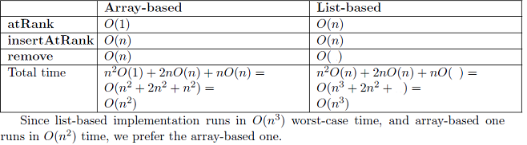
A program, Prog1, written by one of the programmer in an IT organization uses an implementation of the sequence ADT ( data structure like an array, linked list) as its main component. It performs atRank, insertAtRank and remove operations in some unspecified order. It is known that Prog1 performs n2 atRank operations, 2n insertAtRank operations, and n remove operations. Which implementation of the sequence ADT should the programmer use in the interest of efficiency: the array-based one or the one that uses a doubly-linked list? Support your answer with the help of asymptotic notation and analysis.

Slide 24
Suppose that we are given a sequence of n values x1, x2, ..., xn and seek to quickly answer repeated queries of the form: given i and j, find the smallest value in xi, . . . , xj . Design a data structure that uses O(n²) space and answers queries in O(1) time.

Slide 25
Suppose that we are given a sequence of n values x1, x2, ..., xn and seek to quickly answer repeated queries of the form: given i and j, find the smallest value in xi, . . . , xj . Design a data structure that uses O(n²) space and answers queries in O(1) time.
Sol: Use a n-by-n matrix directly. The 𝑖×𝑗 cell denotes the smallest value in 𝑥𝑖,…,𝑥𝑗

Slide 26
Thank You!!

