Slide 1
Data Structures and Algorithms (CS F211) – T12
Prof.N.L.Bhanu Murthy

Slide 2

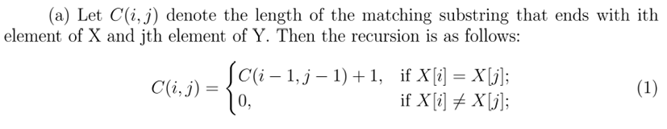
Problem 1
The longest common substring (not subsequence) of two strings X and Y is
the longest string that appears as a run of consecutive letters in both strings. For example, the longest common substring of photograph and tomography is ograph.
Solution

Slide 3
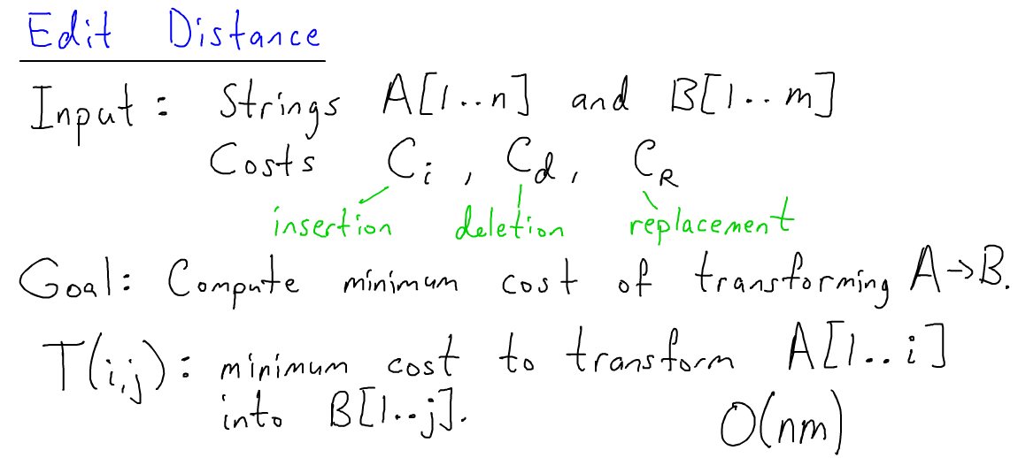
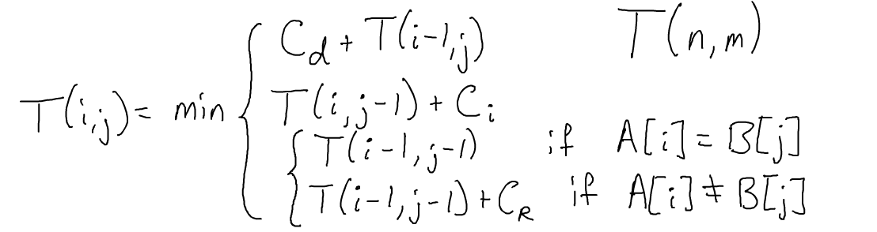
Problem 2
Edit Distance - Given two text strings A of length n and B of length m, you want to transform A into B with a minimum number of operations of the following types: delete a character from A, insert a character into A, or change some character in A into a new character. The minimal number of such operations required to transform A into B is called the edit distance between A and B.
Solution

Slide 4
Problem 3
A palindrome is a nonempty string over some alphabet that reads the same forward and backward.
Examples of palindromes are civic, racecar, and aibohphobia.
Give an efficient algorithm to find the longest palindrome that is a subsequence of a given input string.
For example, given the input character, your algorithm should return carac. What is the running time of your algorithm?

Slide 5

Solution
For an input strings=s1, s2, . . . sn, let f(i,j) be the length of the longest palindrome subsequence on the substring s_{i}, s_{i+1}. . . s_{j}. It follows that we have the recurrence
The base cases correspond to the empty string and a single character. If the string is at least length 2, then we check if the first and last characters are equal. If this is true, we take both characters to be part of the palindrome and recurse on the inner substring. Otherwise, we take the maximum of the two subproblems that ignore the first and last character. The length of the longest palindromic subsequence of s is f(1, n).
By using dynamic programming, the running time and space complexity of this algorithm are both O(n²)

Slide 6




Problem 5
If the postage is n, what is the minimum number of stamps to cover the postage?

Slide 7

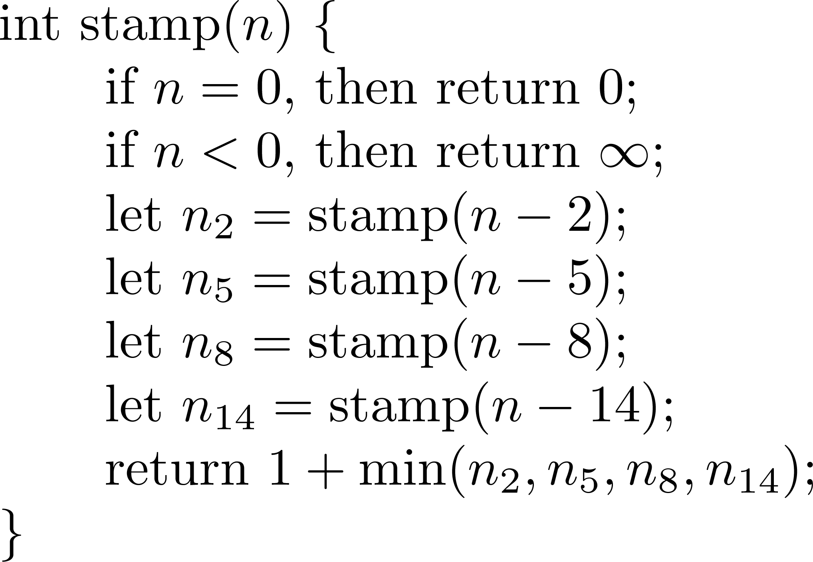

Slide 8

The DP-algorithm takes only O(n) time and space!

Slide 9
Illustration
0 | 1 | 2 | 3 | 4 | 5 | 6 | 7 | 8 | 9 | 0 | 1 | 2 | 3 | 4 | 5 | 6 | 7 | 8 | 9 | 0 | 1 | 2 | 3 | 4
0 | * | 1 | * | 2 | 1 | 3 | 2 | 1 | 3 | 2 | 4 | 3 | 2 | 1 | 3 | 2 | 4 | 3 | 2 | 4 | 3 | 2 | 4 | 3

Slide 10
Problem 6
The binomial coefficients are the most important class of counting numbers, where nCk counts the number of ways to choose k things out of n possibilities. First, nCk = n!/((n−k)!k!), so in principle you can compute them straight from factorials. However, this method has a serious drawback. Intermediate calculations can easily cause arithmetic overflow, even when the final coefficient fits comfortably within an integer. Devise an algorithm to compute nCk (for larger values of n,k) without actually computing n!, k! and (n-k)!

Slide 11
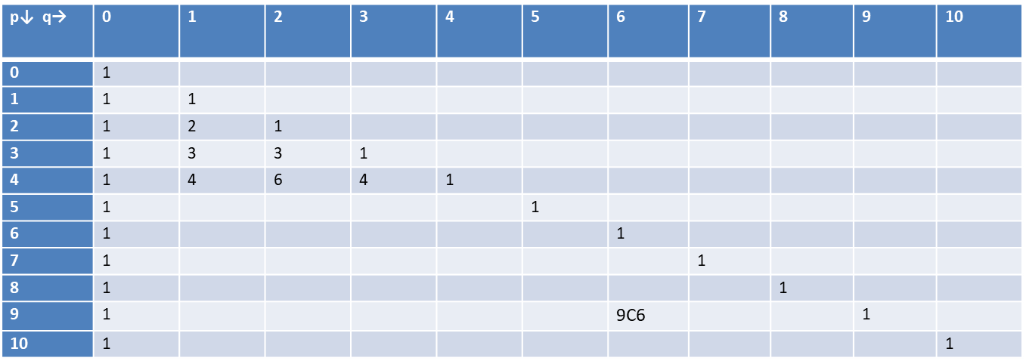
Problem 6
nCk represents the number of k-element subsets of {1, 2, .. , n}.
Number of k-element subsets (each subset not having ‘n’) = (n-1)C(k)
Number of k-element subsets (each subset having ‘n’) = (n-1)C(k-1)
Hence nCk = (n-1)C(k) + (n-1)C(k-1)

Slide 12
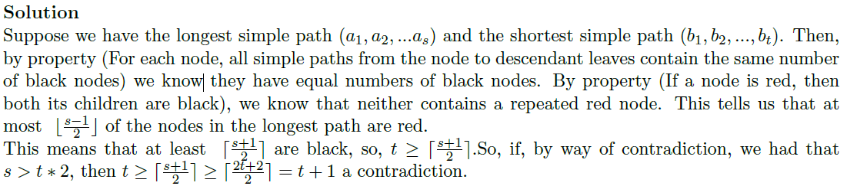
Problem 6
Show that the longest simple path from a node x in a red-black tree to a descendant leaf has length at most twice that of the shortest simple path from node x to a descendant leaf.

Slide 13
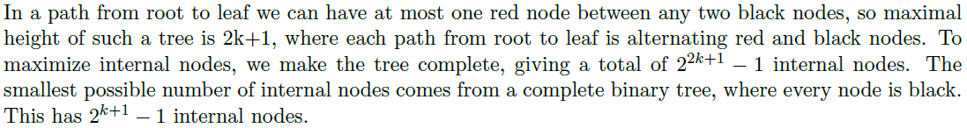
Problem 7
What is the largest possible number of internal nodes in a red-black tree with black height k? What is the smallest possible number?

Slide 14
Problem 6
Describe a red-black tree on n keys that realizes the largest possible ratio of red internal nodes to black internal nodes. What is this ratio? What tree has the smallest possible ratio, and what is the ratio?

Slide 15
Problem 7
Show the red-black trees that result after successively inserting the keys 41, 38, 31, 12, 19, 8 into an initially empty red-black tree.

Slide 16
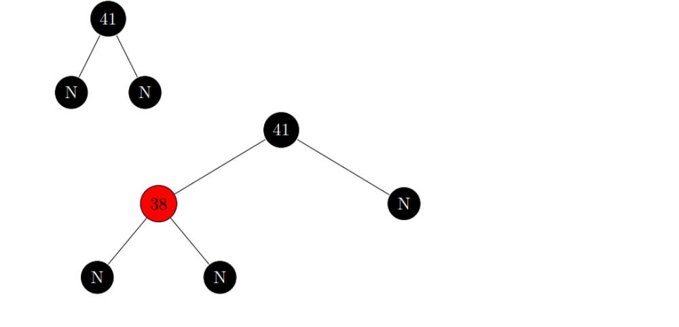

Slide 17
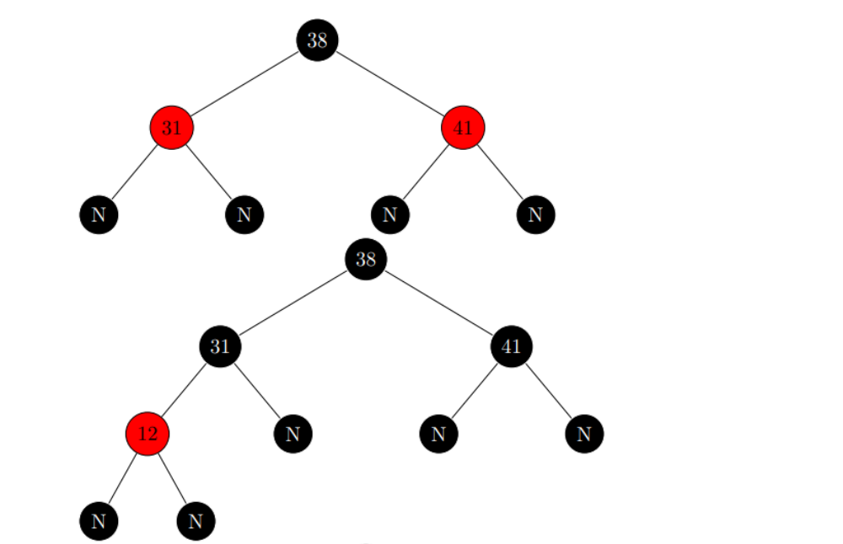

Slide 18
