Slide 1
Presents:
Doctor Lin Berto
Alison Angel 03 House Wife

Slide 2



Slide 4



Slide 5



Slide 6



Slide 7



Slide 8


Slide 9



Slide 10



Slide 11


Slide 12



Slide 13



Slide 14
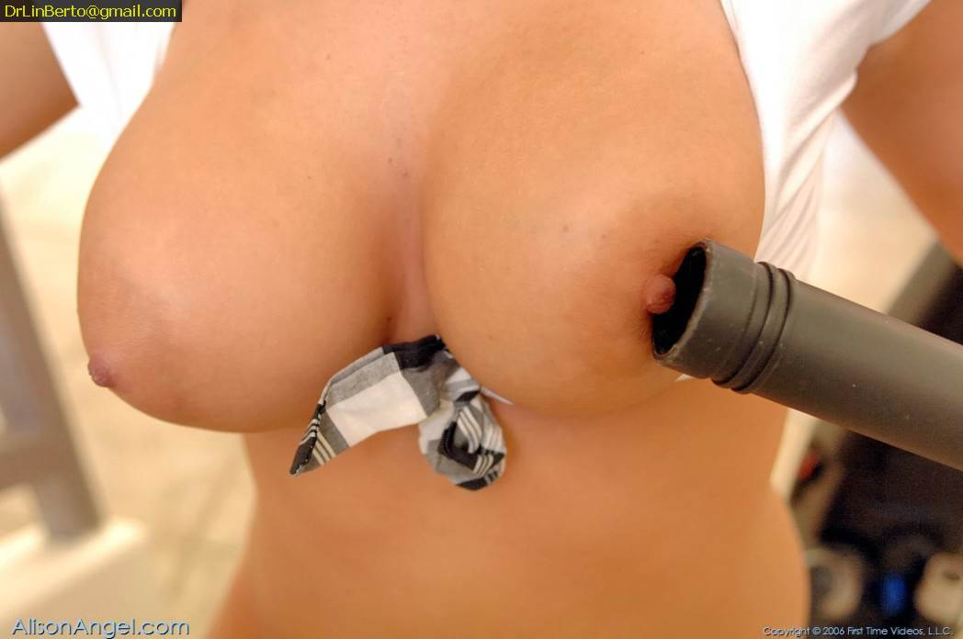

Slide 15


Slide 16



Slide 17


Slide 18


Slide 19



Slide 20



Slide 21



Slide 22


Slide 23


Slide 24


Slide 25


Slide 26


Slide 27
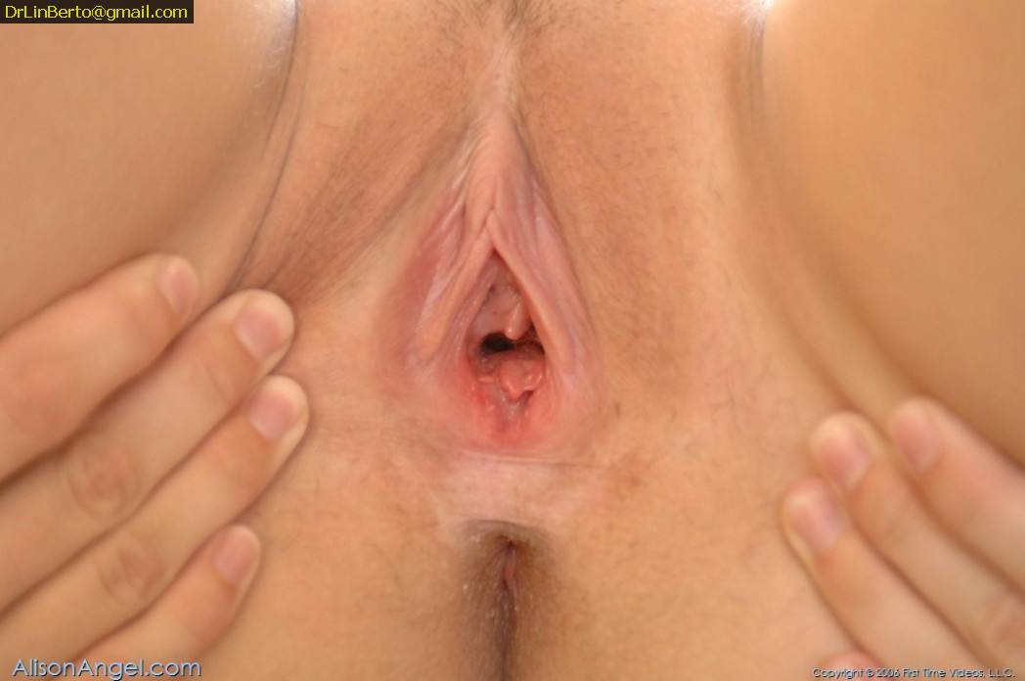

Slide 28



Slide 29


Slide 30



Slide 31
Made by
Dr Lin Berto
DrlinBerto@gmail.com

