Slide 1
NOODLES CRYPTO ANALYTICS
A social-engagement analytics pipeline for cryptocurrencies
Python ETL → MySQL Star Schema → Power BI Dashboards
Pavendhar Tamilarasu
MVP Studio Internship · Data & BI Track

Slide 2
EXECUTIVE SUMMARY
What this project is
WHAT
WHY
HOW
RESULT
An automated pipeline that measures how much social-media attention each cryptocurrency gets on Twitter and Reddit.
Manually cross-referencing scattered JSON exports is slow and error-prone — this turns raw exports into a queryable warehouse and live dashboards.
Python + pandas for ETL, a MySQL star schema for storage, Power BI + DAX for interactive reporting.
2,682 engagement records across 33 active currencies, 4 SQL views, 19 DAX measures, 2 published Power BI reports, 100% data-quality score.
2

Slide 3
THE PROBLEM
Scattered engagement data,
no easy way to compare currencies
Challenge
Currency, Twitter, and Reddit data arrive as three separate JSON exports with no shared structure.
Need
A reliable, repeatable way to join them, calculate real engagement scores, and rank currencies by buzz.
Users
Analysts and stakeholders who want a dashboard, not raw JSON files.
Success metric
A trustworthy warehouse (verified referential integrity) feeding dashboards that load in under 3 seconds.
3

Slide 4
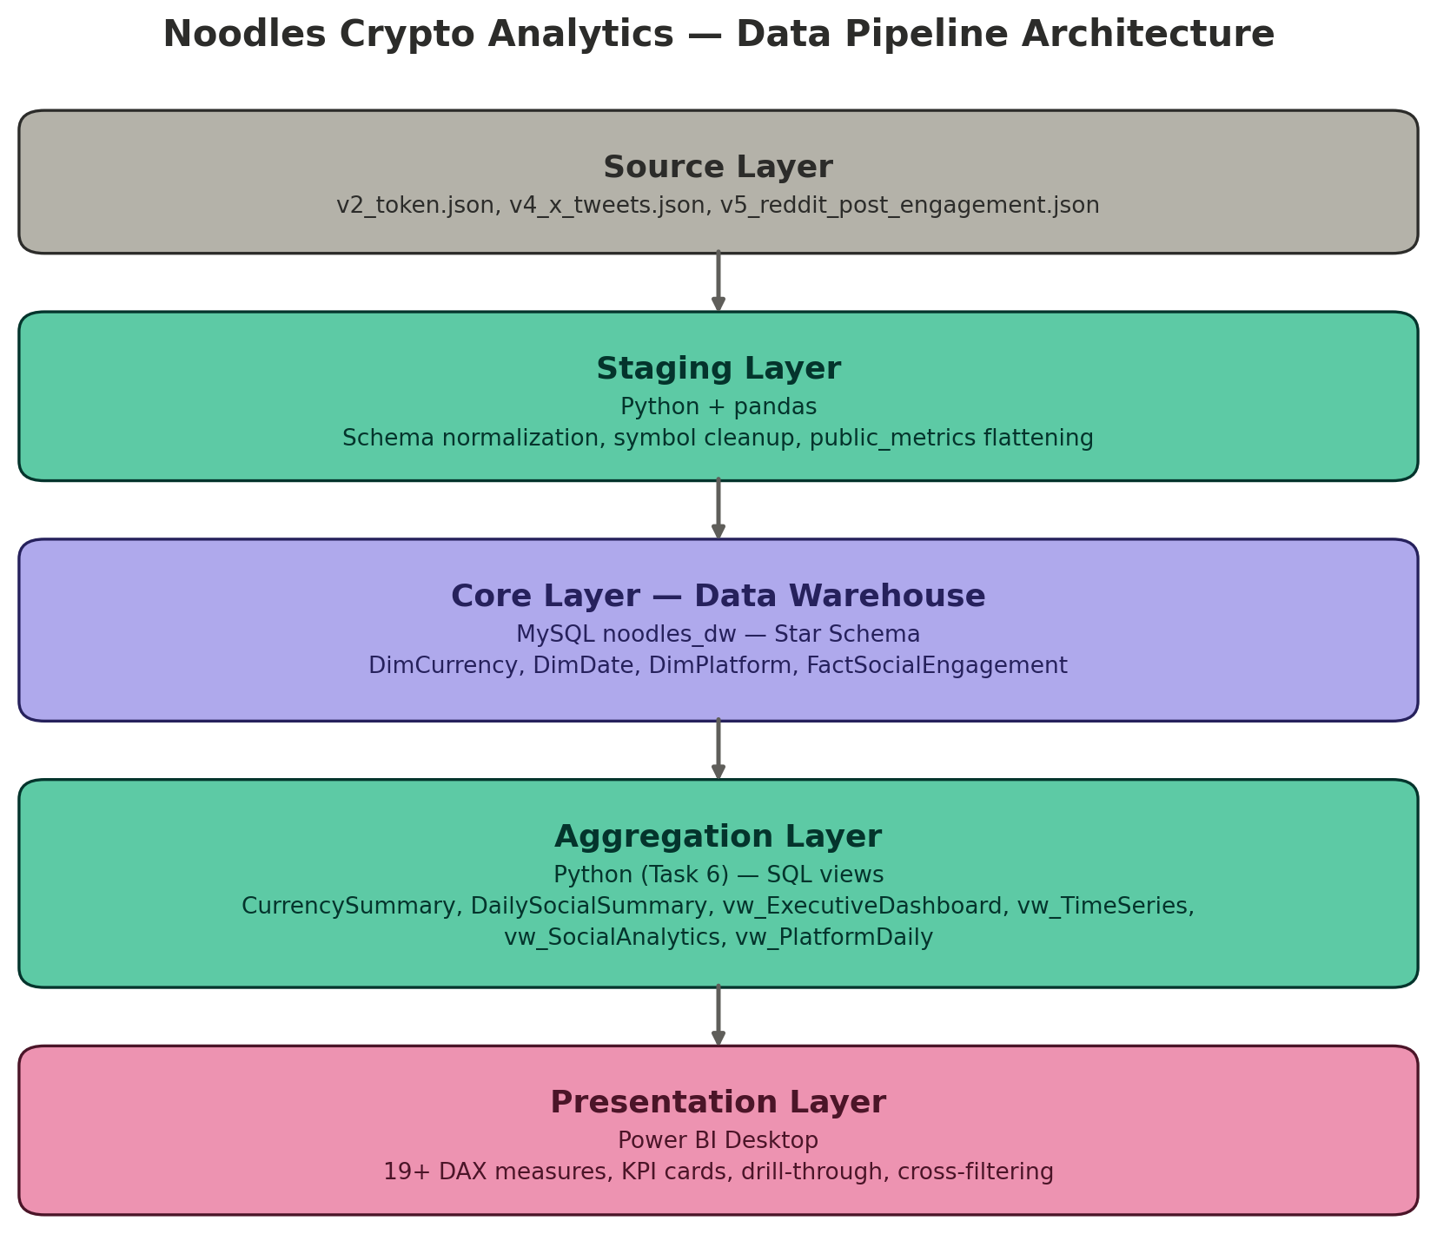
TECHNICAL ARCHITECTURE
Five layers, source to dashboard
Source
3 JSON files: currencies, tweets, Reddit posts
Staging
pandas — schema normalization, symbol cleanup
Core
MySQL star schema — 3 dims + 1 fact
Aggregation
SQL views built in Python, sized for BI
Presentation
Power BI Desktop, ODBC connection, DAX
4

Slide 5
DATA MODEL
Star schema
One fact table at the centre, three dimensions describing it. Grain: one row per social media post.
FactSocialEngagement
2,682 rows
Likes · Retweets · Comments
Impressions · EngagementScore
DimCurrency
DimDate
DimPlatform
78 rows
Symbol, Name, Supply
1,300+ rows
Year, Quarter, Month, Day
2 rows
Twitter, Reddit
5

Slide 6
PYTHON ETL PIPELINE
Extract, clean, load — in code
def normalize_symbol(x):
if not isinstance(x, str):
return None
x = x.upper().strip()
x = re.sub(r"^[#$]", "", x)
x = re.sub(r"(USDT|USD|BTC|ETH)$", "", x)
return x if len(x) >= 2 else None
df_twitter["NormalizedSymbol"] = (
df_twitter["tokenSymbol"]
.apply(normalize_symbol)
)
fact = df_twitter.merge(
dim_currency,
left_on="NormalizedSymbol",
right_on="TokenSymbol",
how="inner"
)
Symbol matching
Regex-normalized tokenSymbol so tweets join cleanly to DimCurrency
Error handling
to_safe_text() guards against list/dict/NaN values before MySQL insert
Quality checks
Orphan-FK, null-metric, and duplicate-PostId scans before load
Runtime
Full pipeline completes in under a minute on this dataset
6

Slide 7
DATA QUALITY & VALIDATION
Verified, not assumed
No orphaned foreign keys — every FactSocialEngagement row points to a real currency, date, and platform
100.0%
No null Likes or EngagementScore values
Data quality score
No duplicate PostId values within the same platform
2,682 / 2,682 records passed
every check, zero rejects
Twitter's public_metrics correctly normalized — total_likes = 7,284, avg score = 18.89 (not zero)
vw_PlatformDaily verified to span multiple distinct days per platform before being used for trend charts
7

Slide 8
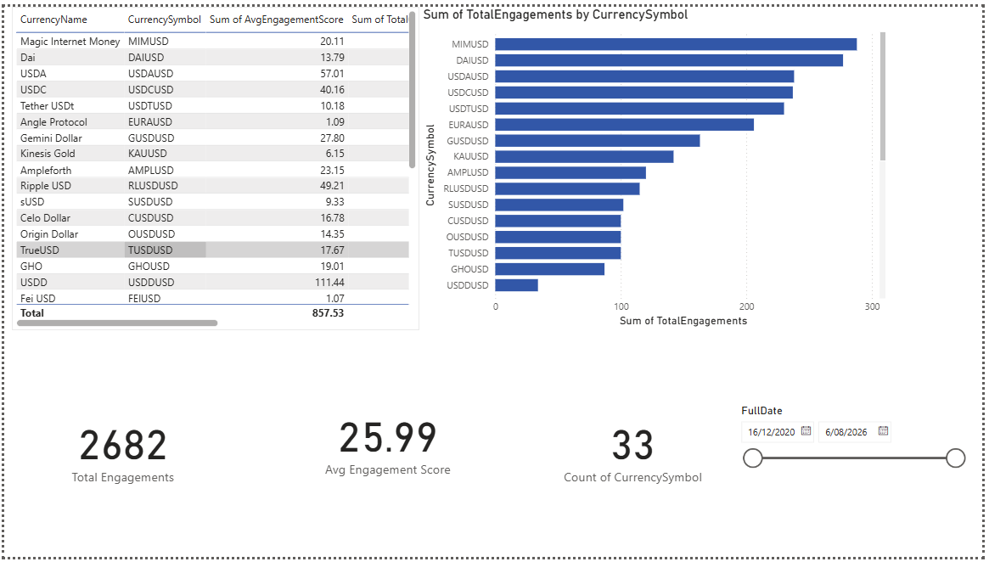
POWER BI — TOP PERFORMERS REPORT
Executive Dashboard page
2,682
total engagements
33
active currencies
25.99
avg engagement score
MIMUSD
top-ranked currency (288)
Sorted, Top-10 filtered bar chart, and KPI cards built from a dedicated DAX measure library.
8

Slide 9
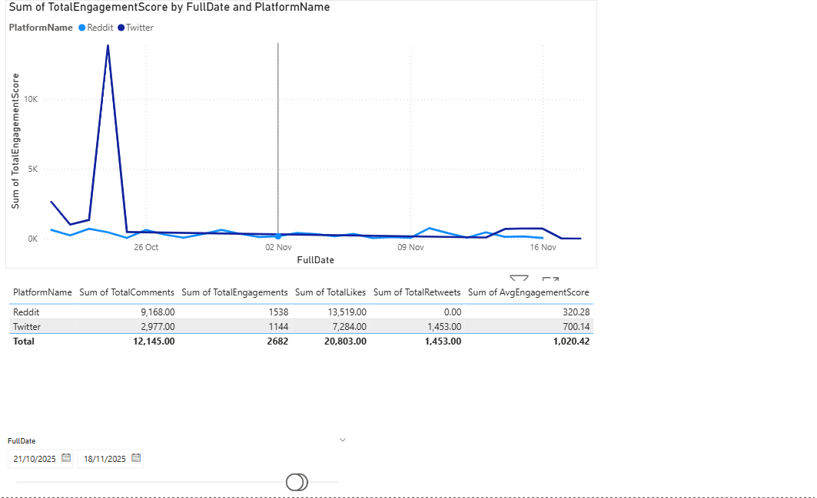
POWER BI — PLATFORM PERFORMANCE
Twitter vs Reddit, over real time
Platform comparison
Reddit
1,538 posts · 13,519 likes
avg score 320.28
Twitter
1,144 posts · 7,284 likes
avg score 700.14
Takeaway: Reddit wins on volume; Twitter posts earn more engagement per post.
Fixed the classic bug: built on vw_PlatformDaily[FullDate], not the LastEngagement load-timestamp column — so the trend line shows real dates, not a single flat point.
9

Slide 10
KEY INSIGHTS
What the data actually shows
Reddit drives volume, Twitter drives quality
Reddit logged 1,538 posts vs Twitter's 1,144 — but Twitter's average engagement score (700.14) is more than double Reddit's (320.28).
Engagement is heavily concentrated
Magic Internet Money (MIMUSD) alone accounts for 288 of 2,682 total engagements — about 1 in 9 — despite 33 currencies being active.
Only 42% of tracked currencies have any social presence
33 of the 78 currencies loaded from Task 5 show zero engagement — most crypto tokens in this dataset get no social attention at all.
Sample windows differ by platform, and that matters for analysis
Reddit data spans 2020–2025 (617 distinct days); Twitter only spans Oct–Nov 2025 (11 days) — any fair platform comparison needs a matched date range.
10

Slide 11
TECHNICAL HIGHLIGHTS
By the numbers
2,682
4
19
fact rows loaded
(1,144 Twitter + 1,538 Reddit)
SQL views built for Power BI
(vw_ExecutiveDashboard, vw_TimeSeries,
vw_SocialAnalytics, vw_PlatformDaily)
DAX measures
KPI, time-intelligence, ranking, tooltip
6
2
100%
model relationships
across 3 dimensions + 4 views
Power BI reports
7 pages, drill-through, slicers
data quality score
zero orphaned or duplicate records
11

Slide 12
Thank you
Questions welcome.
PROJECT
Noodles Crypto Analytics — MVP Studio Internship
DELIVERABLES
05_data_warehouse_design.ipynb, 06_powerbi_prep.ipynb, 2 Power BI reports, full docs/ suite
AUTHOR
Pavendhar Tamilarasu

