Slide 1
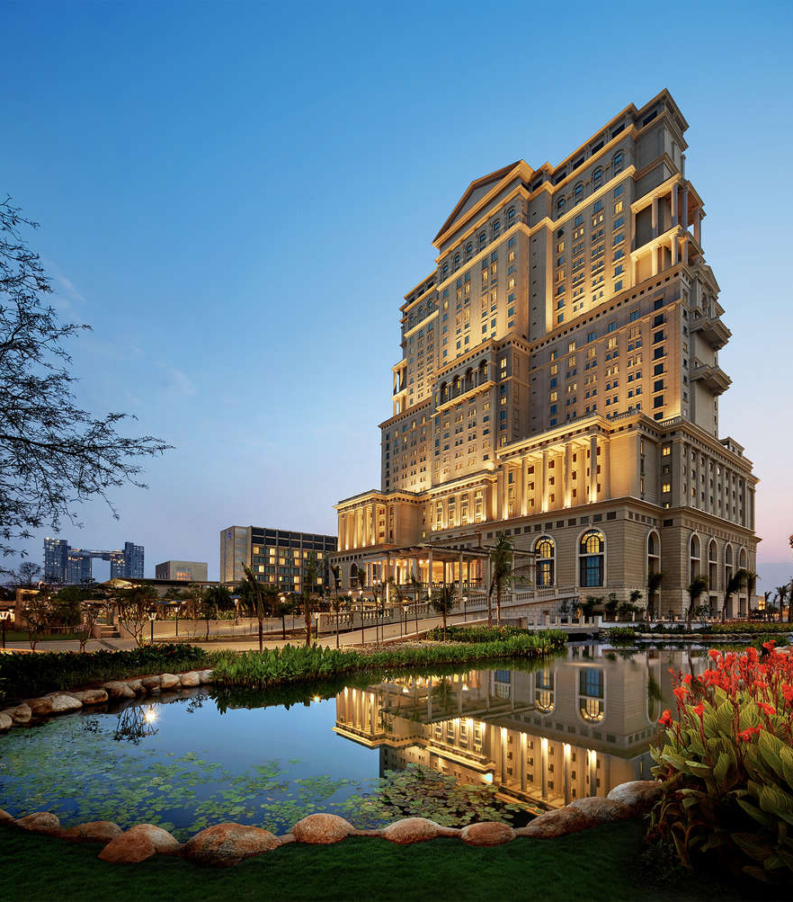

ITC Hotels Revenue Optimization

Slide 2

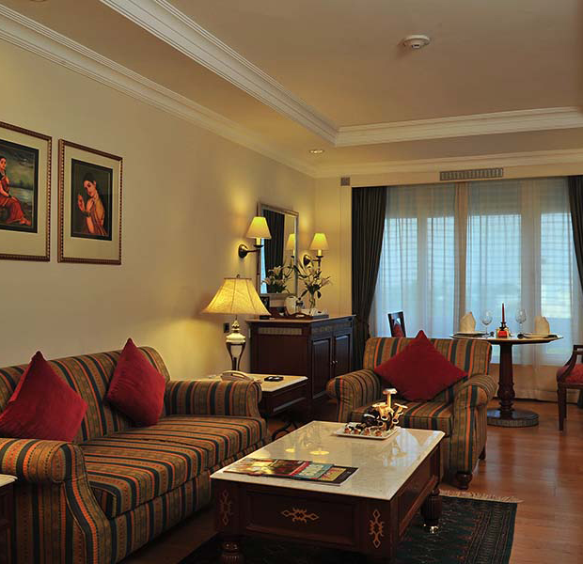
About ITC Hotels
Established in 1975, ITC Hotels has grown into one of India’s leading hospitality chains, with 140+ hotels across 90+ destinations. Blending India’s rich tradition of hospitality with world-class services, the group offers distinctive experiences through six brands – ITC Hotels and Mementos (Luxury), Storii (Boutique Premium), Welcomhotel (Upper Upscale), Fortune (Midscale), and WelcomHeritage (Heritage Leisure). A pioneer in Green Hoteliering, ITC Hotels is the first in India to receive the 2024 US Green Building Council Leadership Award for Organisational Excellence, with all owned ITC Hotels and Welcomhotels LEED Platinum certified. The portfolio also includes globally acclaimed culinary brands like Bukhara, Dum Pukht, Avartana, and Ottimo. Committed to talent development, ITC Hotels has also established the ITC Hospitality Management Institute and WGSHA, nurturing hospitality leaders worldwide.

Slide 3

Aim of The Project
ITC Hotels is a luxury hotel chain that operates multiple properties with diverse room categories and varying occupancy rates. The company wants to gain deeper insights into its overall financial performance, customer booking behavior, occupancy trends, and room category performance to optimize revenue generation, minimize cancellations, and enhance customer satisfaction. The goal of this project is to create an interactive, multi-page Power BI dashboard to provide stakeholders with real-time insights for decision-making.

Slide 4
Problem Statements
ITC Hotels, a premier luxury hotel chain, operates multiple properties with varied room
categories and fluctuating occupancy rates. The analysis aims to provide a comprehensive
performance review of ITC Hotels across revenue, occupancy, room category insights,
and cancellations. The key problem areas to address are:
Revenue Performance
Understanding total and segmented revenue across hotels and room categories.
Measuring growth trends (cumulative, MoM, WoW).
Evaluating pricing efficiency through ADR and RevPAR.
Occupancy & Capacity
Tracking occupancy rates by hotel and room type.
Identifying seasonal/periodic fluctuations.
Linking occupancy with revenue and RevPAR performance.
Room Category & Booking Behavior
Assessing revenue contribution by room category.
Analyzing booking patterns (lead time, check-in, ALOS).
Monitoring room revenue trends and growth trajectory.
Cancellations & Lost Revenue
Measuring cancellation rates and associated revenue loss.
Studying cancellation trends over time.
Detecting patterns linked to cancellations (room type, seasonality).

Slide 5
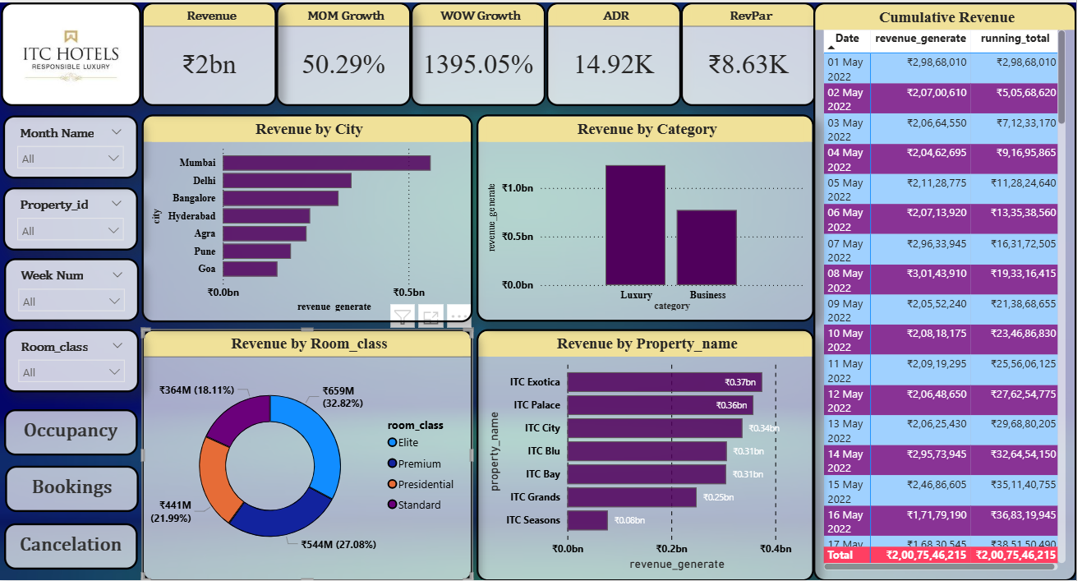
Page 1: Financial Overview & Revenue Performance

Slide 6

🔑Key Insights
Revenue Growth: ₹2Bn generated; strong momentum with 50.29% MoM and 1395% WoW growth.
Pricing Metrics: High ADR (₹14.92K) and solid RevPAR (₹8.63K) indicate strong premium positioning.
Geographic Trends: Revenue concentrated in Mumbai & Delhi (~₹0.5Bn each); Goa & Pune underperforming.
Category Performance: Luxury rooms dominate (>₹1Bn), while Business lags significantly.
Room Classes: Elite class leads (33%), followed by Premium (27%) and Presidential (22%); Standard lowest (18%).
Revenue Trend: Steady cumulative growth with peak daily revenue of ₹3.01Cr on 8 May 2022.
📌Recommendations
Optimize Underperformers: Launch targeted campaigns for ITC Seasons & Grands; boost Standard/Premium demand.
Diversify City Revenue: Strengthen presence in Bangalore, Hyderabad, and Goa with tailored offers.
Business Segment Push: Expand MICE partnerships and corporate tie-ups to uplift Business category.
Sustain Growth: Replicate drivers of recent WoW spike (promotions/events) and monitor repeat vs. new guests.

Slide 7
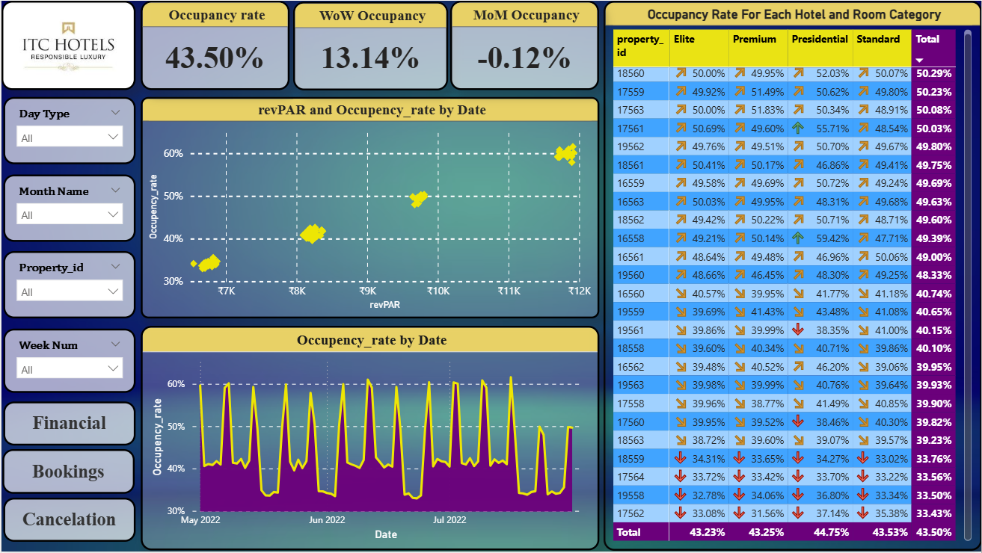
Page 2: Occupancy & Capacity Analysis

Slide 8

🔑 Key Insights
Overall Occupancy: 43.5% (below optimal benchmarks for premium hotels).
Growth Trends:
WoW growth: +13.14% (positive short-term momentum).
MoM change: –0.12% (flat, indicating stagnation in longer-term growth).
Room Category Trends:
Presidential rooms show relatively stronger occupancy (~44.8%).
Elite & Premium hover around ~43%, while Standard is lowest (~43.5%).
Property-Level Performance:
Top-performing properties achieve ~50% occupancy.
Bottom performers (e.g., IDs 17562, 19558) record as low as ~33%.
Seasonal/Weekly Fluctuations:
Occupancy exhibits sharp peaks on weekends, dropping mid-week.
📌 Recommendations
Boost Underperforming Properties: Launch targeted offers and promotions for low-occupancy hotels (<35%).
Leverage Weekday Gaps: Introduce weekday corporate packages and loyalty discounts to smooth mid-week slumps.
Optimize Room Mix: Presidential rooms perform better — replicate success drivers (bundles, upselling) across other categories.
Dynamic Pricing: Adjust pricing strategies in line with occupancy dips to improve base demand without eroding ADR.

Slide 9
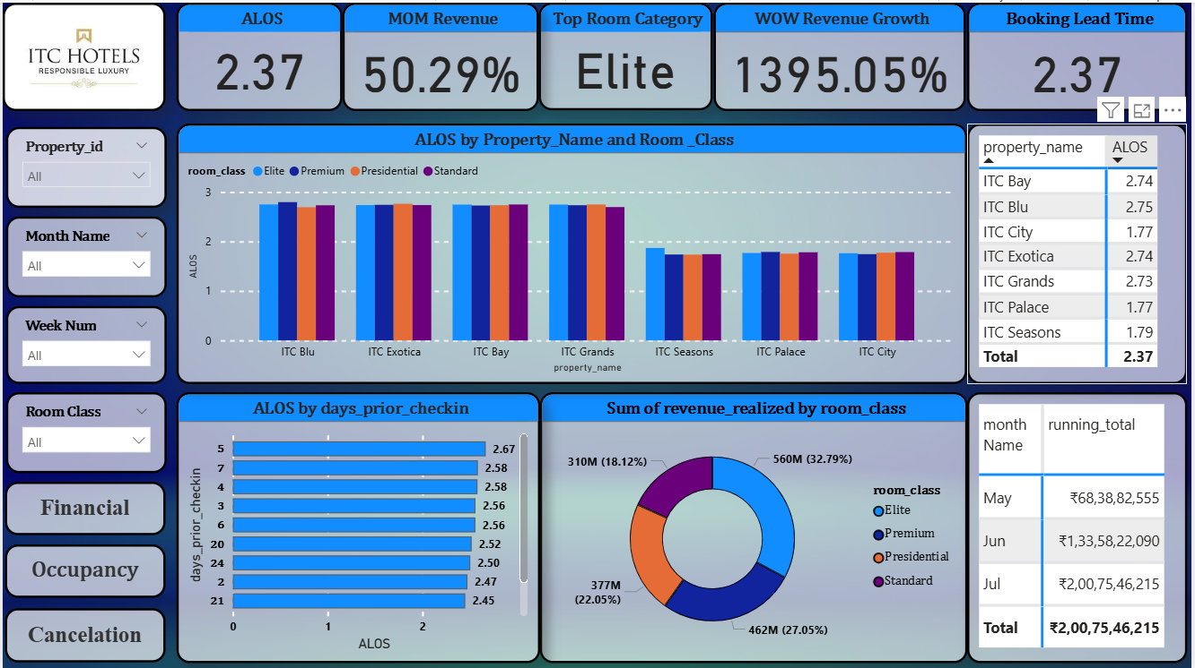
Page 3: Room Category Performance & Booking Insights

Slide 10
🔑 Key Insights
ALOS (Average Length of Stay): Overall at 2.37 days, with highest in ITC Blu (2.75) and lowest in ITC City (1.77) and ITC Palace (1.77).
Booking Lead Time: Matches ALOS at 2.37 days, indicating short planning horizons.
Revenue by Room Class:
Elite class dominates (33%, ₹560M).
Premium (27%, ₹462M) and Presidential (22%, ₹377M) remain strong contributors.
Standard generates the lowest share (18%, ₹310M).
Property-Level ALOS: Mid-range properties (Blu, Exotica, Bay, Grands) sustain higher ALOS (~2.7), while Palace & City struggle with shorter stays (<2 days).
Monthly Revenue Trend:
May: ₹683.8M
June: ₹1.33Bn (almost doubled MoM).
July: ₹2.0Bn cumulative total → sustained growth momentum.
WOW Revenue Growth: Exceptional spike at 1395%, signaling a sharp surge in demand.
📌 Recommendations
Increase Stay Duration: Develop multi-day packages and bundled experiences for properties with low ALOS (City & Palace).
Lead Time Optimization: Encourage early bookings via discounts for reservations made >7 days prior, reducing last-minute volatility.
Boost Standard Segment: Reposition Standard rooms with value-added services to increase share beyond 18%.
Sustain Elite Room Success: Continue upselling strategies and premium offerings, as Elite

Slide 11
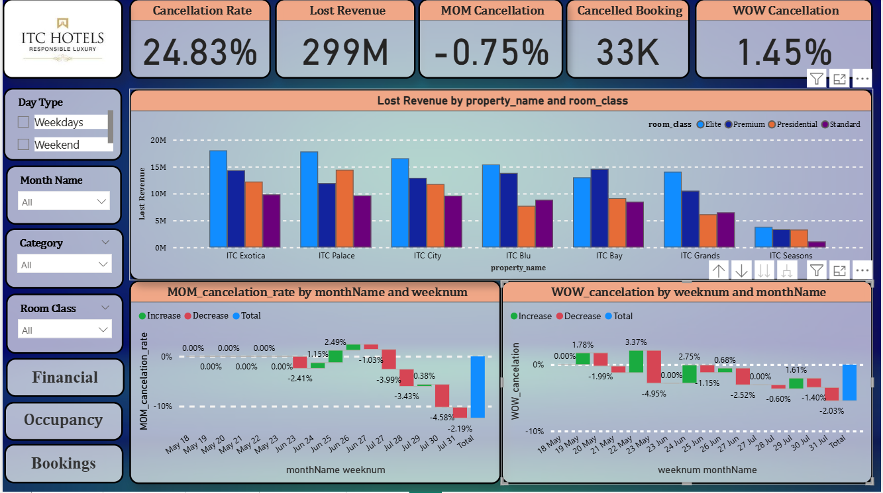
Page 4: Cancellations & Lost Revenue Analysis

Slide 12
🔑 Key Insights
Cancellation Rate: High at 24.8%, resulting in 33K cancelled bookings.
Lost Revenue: ₹299M attributed to cancellations — a significant leakage.
Trend Analysis:
MoM Cancellation: Slight improvement (–0.75%) but still high overall.
WoW Cancellation: Volatile, with alternating increases and decreases, net +1.45%.
Property-Level Impact:
Highest loss at ITC Exotica, Palace, and City (>₹15M each).
Lowest loss at ITC Seasons (<₹5M).
Room Category Impact:
Elite and Premium categories experience the highest lost revenue, reflecting their stronger demand base.
Booking Behavior: Weekends show sharper fluctuations in cancellation rates compared to weekdays.
📌 Recommendations
Strengthen Cancellation Policies: Introduce stricter terms or flexible but fee-based cancellation options for high-demand dates.
Advance Commitment Discounts: Encourage early, non-refundable bookings with price incentives to reduce last-minute drop-offs.
Property-Specific Focus: Target high-loss properties (Exotica, Palace, City) with tailored retention programs (loyalty perks, flexible rescheduling).
Room Category Strategy: Protect Elite/Premium revenue by offering rebooking credits instead of outright cancellations.

Slide 13
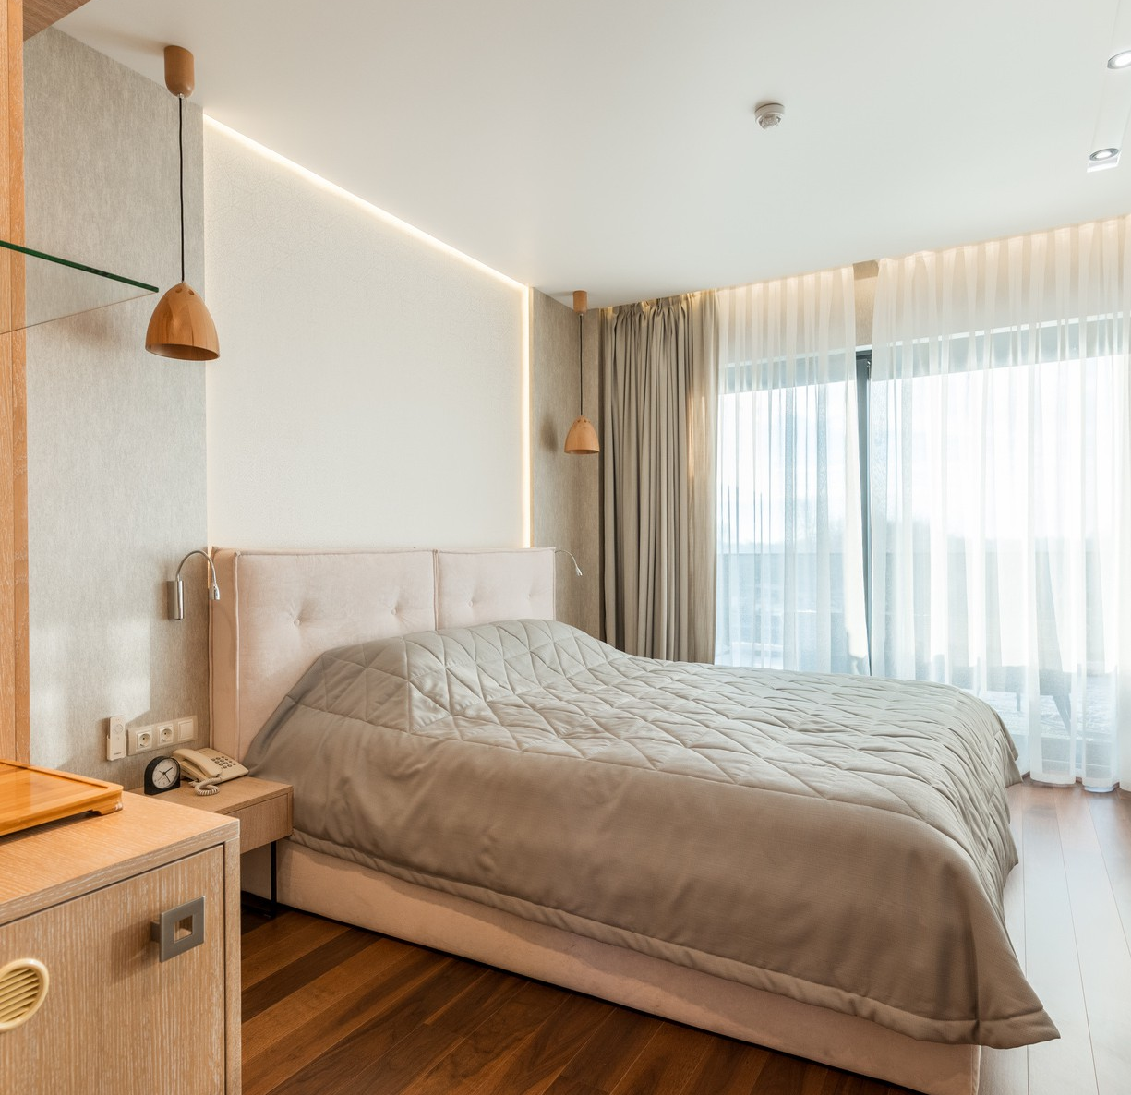
Overall Recommendations
Strenghten Revenue Drivers: Focus on high-performing cities (Mumbai, Delhi) and Luxury/Elite rooms to sustain growth.
Improve Occupancy: Current occupancy (43.5%) is below benchmark → replicate successful property strategies and introduce dynamic pricing.
Enhance Guest Retention: Increase ALOS through bundled offers (dining, spa, transport) and loyalty programs.
Reduce Cancellations: High rate (24.8%) causes revenue loss → adopt prepaid discounts, flexible cancellation policies, and weekend-specific offers.
Data-Driven Decisions: Continuously monitor KPIs (Revenue, ADR, RevPAR, Occupancy) using dashboards for proactive actions.
Focus on Low-Performers: Prioritize improvement in ITC Seasons and other low-occupancy properties with targeted campaigns..

Slide 14
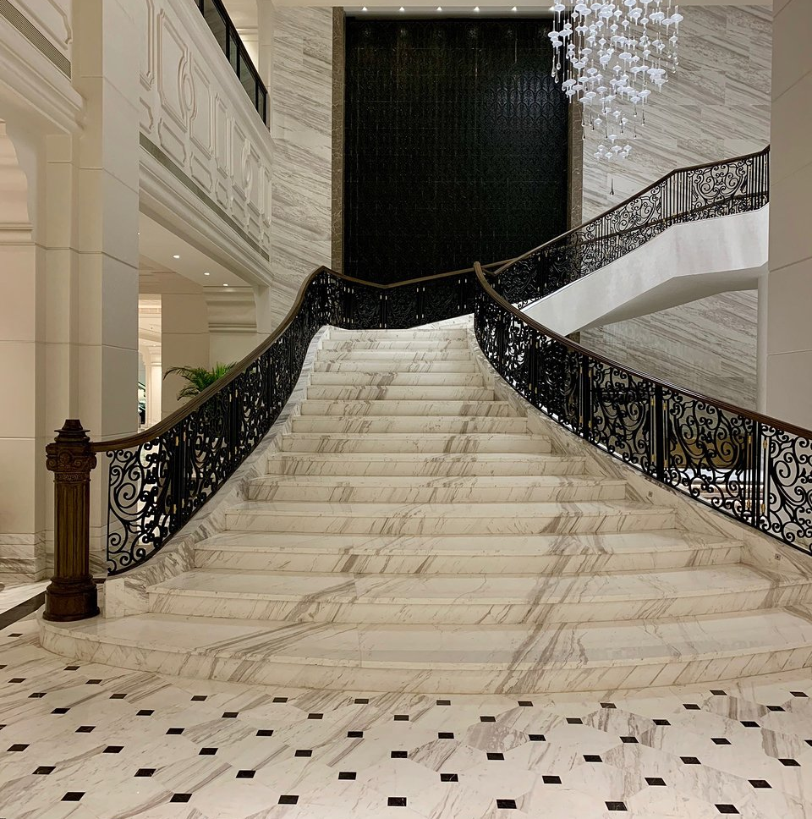
Thank You
F O R Y O U R A T T E N T I O N

Slide 15




Connect With Me.
pavelghosh177@gmail.com
www.linkedin.com/in/ghosh-pavel
https://github.com/pavel-iso

